Slide 1
Lecture 1: R Basics

Slide 2
Outline
    Why R, and R Paradigm
    References, Tutorials and links
    R Overview
    R Interface
    R Workspace
    Help
    R Packages
    Input/Output
    Reusing Results

Slide 3
Why R?
    It's free!
    It runs on a variety of platforms including Windows, Unix and MacOS.
    It provides an unparalleled platform for programming new statistical methods in an easy and straightforward manner.
    It contains advanced statistical routines not yet available in other packages.
    It has state-of-the-art graphics capabilities.

Slide 4
How to download?
  Google it using R or CRAN
  (Comprehensive R Archive Network)
  http://www.r-project.org

Slide 5
Tutorials
  Each of the following tutorials are in PDF format.
  P. Kuhnert & B. Venables, An Introduction to R: Software for Statistical Modeling & Computing
  J.H. Maindonald, Using R for Data Analysis and Graphics
  B. Muenchen, R for SAS and SPSS Users
  W.J. Owen, The R Guide
  D. Rossiter, Introduction to the R Project for Statistical Computing for Use at the ITC
  W.N. Venebles & D. M. Smith, An Introduction to R

Slide 6
Web links
  Paul Geissler's excellent R tutorial
  Dave Robert's Excellent Labs on Ecological Analysis
  Excellent Tutorials by David Rossitier
  Excellent tutorial an nearly every aspect of R (c/o Rob Kabacoff) MOST of these notes follow this web page format
  Introduction to R by Vincent Zoonekynd
  R Cookbook
  Data Manipulation Reference

Slide 7
Web links
  R time series tutorial
  R Concepts and Data Types presentation by Deepayan Sarkar
  Interpreting Output From lm()
  The R Wiki
  An Introduction to R
  Import / Export Manual
  R Reference Cards

Slide 8
Web links
  KickStart
  Hints on plotting data in R
  Regression and ANOVA
  Appendices to Fox Book on Regression
  JGR a Java-based GUI for R [Mac|Windows|Linux]
  A Handbook of Statistical Analyses Using R(Brian S. Everitt and Torsten Hothorn)

Slide 9
R Overview
R is a comprehensive statistical and graphical programming language and is a dialect of the S language:
      1988 - S2: RA Becker, JM Chambers, A Wilks
      1992 - S3: JM Chambers, TJ Hastie
      1998 - S4: JM Chambers
R: initially written by Ross Ihaka and Robert Gentleman at Dep. of Statistics of U of Auckland, New Zealand during 1990s.
Since 1997: international “R-core” team of 15 people with access to common CVS archive.

Slide 10
R Overview
    You can enter commands one at a time at the command prompt (>) or run a set of commands from a source file.
    There is a wide variety of data types, including vectors (numerical, character, logical), matrices, dataframes, and lists.
    To quit R, use
    >q()

Slide 11
R Overview
    Most functionality is provided through built-in and user-created functions and all data objects are kept in memory during an interactive session.
    Basic functions are available by default. Other functions are contained in packages that can be attached to a current session as needed

Slide 12
R Overview
    A key skill to using R effectively is learning how to use the built-in help system. Other sections describe the working environment, inputting programs and outputting results, installing new functionality through packages and etc.
    A fundamental design feature of R is that the output from most functions can be used as input to other functions. This is described in reusing results.

Slide 13
R Interface
Start the R system, the main window (RGui) with a sub window (R Console) will appear
In the `Console' window the cursor is waiting for you to type in some R commands.

Slide 14
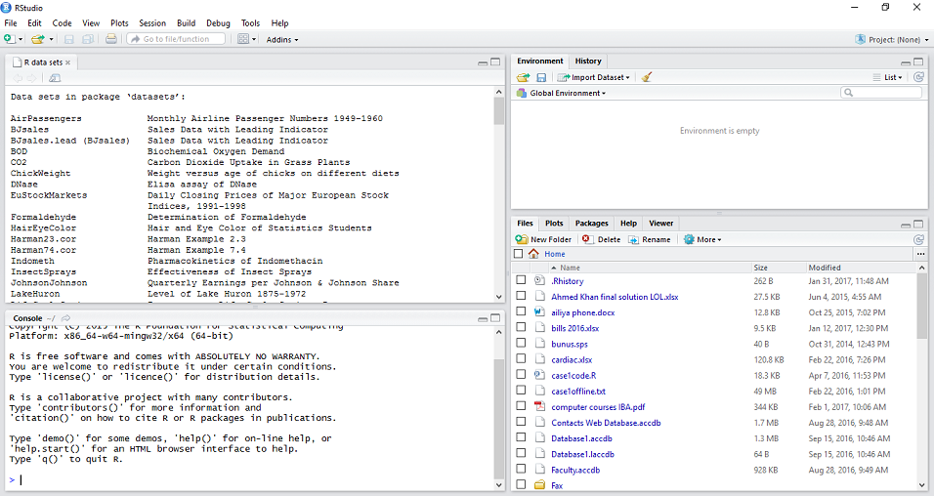
First R-Studio Session

Slide 15
R Introduction
Results of calculations can be stored in objects using the assignment operators:
  An arrow (<-) formed by a smaller than character and a hyphen without a space!
  The equal character (=).

Slide 16
R Introduction
These objects can then be used in other calculations. To print the object just enter the name of the object. There are some restrictions when giving an object a name:
  Object names cannot contain `strange' symbols like !, +, -, #.
  A dot (.) and an underscore ( ) are allowed, also a name starting with a dot.
  Object names can contain a number but cannot start with a number.
  R is case sensitive, X and x are two different objects, as well as temp and temP.

Slide 17
An example
    > # An example
    > x <- c(1:10)
    > x[(x>8) | (x<5)]
    > # yields 1 2 3 4 9 10
    > # How it works
    > x <- c(1:10)
    > X
    >1 2 3 4 5 6 7 8 9 10
    > x > 8
    > F F F F F F F F T T
    > x < 5
    > T T T T F F F F F F
    > x > 8 | x < 5
    > T T T T F F F F T T
    > x[c(T,T,T,T,F,F,F,F,T,T)]
    > 1 2 3 4 9 10

Slide 18
R Introduction
    To list the objects that you have in your current R session use the function ls or the function objects.
        > ls()
        [1] "x" "y"
    So to run the function ls we need to enter the name followed by an opening ( and and aclosing ). Entering only ls will just print the object, you will see the underlying R code of the the function ls. Most functions in R accept certain arguments. For example, one of the arguments of the function ls is pattern. To list all objects starting with the letter x:
        > x2 = 9
        > y2 = 10
        > ls(pattern="x")
        [1] "x" "x2"

Slide 19
R Introduction
    If you assign a value to an object that already exists then the contents of the object will be overwritten with the new value (without a warning!). Use the function rm to remove one or more objects from your session.
        > rm(x, x2)
    Lets create two small vectors with data and a scatterplot.
        z2 <- c(1,2,3,4,5,6)
        z3 <- c(6,8,3,5,7,1)
        plot(z2,z3)
        title("My first scatterplot")

Slide 20
R Warning !
    R is a case sensitive language.
    FOO, Foo, and foo are three different objects

Slide 21
R Introduction
    > x = sin(9)/75
    > y = log(x) + x^2
    > x
    [1] 0.005494913
    > y
    [1] -5.203902
    > m <- matrix(c(1,2,4,1), ncol=2)
    > m
    > [,1] [,2]
    [1,] 1 4
    [2,] 2 1
    > solve(m)
    [,1] [,2]
    [1,] -0.1428571 0.5714286
    [2,] 0.2857143 -0.1428571

Slide 22
R Workspace
  Objects that you create during an R session are hold in memory, the collection of objects that you currently have is called the workspace. This workspace is not saved on disk unless you tell R to do so. This means that your objects are lost when you close R and not save the objects, or worse when R or your system crashes on you during a session.

Slide 23
R Workspace
  When you close the RGui or the R console window, the system will ask if you want to save the workspace image. If you select to save the workspace image then all the objects in your current R session are saved in a file .RData. This is a binary file located in the working directory of R, which is by default the installation directory of R.

Slide 24
R Workspace
  During your R session you can also explicitly save the workspace image. Go to the `File‘ menu and then select `Save Workspace...', or use the save.image function.
      ## save to the current working directory
      save.image()
      ## just checking what the current working directory is
      getwd()
      ## save to a specific file and location
      save.image("C:\\Program Files\\R\\R-2.5.0\\bin\\.RData")

Slide 25
R Workspace
  If you have saved a workspace image and you start R the next time, it will restore the workspace. So all your previously saved objects are available again. You can also explicitly load a saved workspace le, that could be the workspace image of someone else. Go the `File' menu and select `Load workspace...'.

Slide 26
R Workspace
  Commands are entered interactively at the R user prompt. Up and down arrow keys scroll through your command history.
  You will probably want to keep different projects in different physical directories.

Slide 27
R Workspace
  R gets confused if you use a path in your code like
  c:\mydocuments\myfile.txt
  This is because R sees "\" as an escape character. Instead, use
  c:\\my documents\\myfile.txt
  or
  c:/mydocuments/myfile.txt

Slide 28
R Workspace
  getwd() # print the current working directory
  ls() # list the objects in the current workspace
  setwd(mydirectory) # change to mydirectory
  setwd("c:/docs/mydir")

Slide 29
R Workspace
  #view and set options for the session
  help(options) # learn about available options
  options() # view current option settings
  options(digits=3) # number of digits to print on output
  # work with your previous commands
  history() # display last 25 commands
  history(max.show=Inf) # display all previous commands

Slide 30
R Workspace
# save your command history
savehistory(file="myfile") # default is ".Rhistory"
# recall your command history
loadhistory(file="myfile") # default is ".Rhistory“

Slide 31
R Help
  Once R is installed, there is a comprehensive built-in help system. At the program's command prompt you can use any of the following:
  help.start() # general help
  help(foo) # help about function foo
  ?foo # same thing
  apropos("foo") # list all function containing string foo
  example(foo) # show an example of function foo

Slide 32
R Help
  # search for foo in help manuals and archived mailing lists
  RSiteSearch("foo")
  # get vignettes on using installed packages
  vignette() # show available vingettes
  vignette("foo") # show specific vignette

Slide 33
R Datasets
  R comes with a number of sample datasets that you can experiment with. Type
  > data( )
  to see the available datasets. The results will depend on which packages you have loaded. Type
  help(datasetname)
  for details on a sample dataset.

Slide 34
R Packages
  One of the strengths of R is that the system can easily be extended. The system allows you to write new functions and package those functions in a so called `R package' (or `R library'). The R package may also contain other R objects, for example data sets or documentation. There is a lively R user community and many R packages have been written and made available on CRAN for other users. Just a few examples, there are packages for portfolio optimization, drawing maps, exporting objects to html, time series analysis, spatial statistics and the list goes on and on.

Slide 35
R Packages
  When you download R, already a number (around 30) of packages are downloaded as well. To use a function in an R package, that package has to be attached to the system. When you start R not all of the downloaded packages are attached, only seven packages are attached to the system by default. You can use the function search to see a list of packages that are currently attached to the system, this list is also called the search path.
      > search()
      [1] ".GlobalEnv" "package:stats" "package:graphics"
      [4] "package:grDevices" "package:datasets" "package:utils"
      [7] "package:methods" "Autoloads" "package:base"

Slide 36
R Packages
  To attach another package to the system you can use the menu or the library function. Via the menu:
    Select the `Packages' menu and select `Load package...', a list of available packages on your system will be displayed. Select one and click `OK', the package is now attached to your current R session. Via the library function:
      > library(MASS)
      > shoes
      $A
      [1] 13.2 8.2 10.9 14.3 10.7 6.6 9.5 10.8 8.8 13.3
      $B
      [1] 14.0 8.8 11.2 14.2 11.8 6.4 9.8 11.3 9.3 13.6

Slide 37
R Packages
  The function library can also be used to list all the available libraries on your system with a short description. Run the function without any arguments
      > library()
      Packages in library 'C:/PROGRA~1/R/R-25~1.0/library':
      base The R Base Package
      Boot Bootstrap R (S-Plus) Functions (Canty)
      class Functions for Classification
      cluster Cluster Analysis Extended Rousseeuw et al.
      codetools Code Analysis Tools for R
      datasets The R Datasets Package
      DBI R Database Interface
      foreign Read Data Stored by Minitab, S, SAS, SPSS, Stata, Systat, dBase, ...
      graphics The R Graphics Package

Slide 38
R Packages
install = function() {
install.packages(c("moments","graphics","Rcmdr","hexbin"),
repos="http://lib.stat.cmu.edu/R/CRAN")
}
install()

Slide 39
R Conflicting objects
  It is not recommended to do, but R allows the user to give an object a name that already exists. If you are not sure if a name already exists, just enter the name in the R console and see if R can find it. R will look for the object in all the libraries (packages) that are currently attached to the R system. R will not warn you when you use an existing name.
      > mean = 10
      > mean
      [1] 10
  The object mean already exists in the base package, but is now masked by your object mean. To get a list of all masked objects use the function conflicts.
      >
      [1] "body<-" "mean"

Slide 40
R Conflicting objects
  The object mean already exists in the base package, but is now masked by your object mean. To get a list of all masked objects use the function conflicts.
      > conflicts()
      [1] "body<-" "mean“
  You can safely remove the object mean with the function
  rm() without risking deletion of the mean function.
  Calling rm() removes only objects in your working environment by default.

Slide 41
Source Codes
  you can have input come from a script file (a file containing R commands) and direct output to a variety of destinations.
  Input
  The source( ) function runs a script in the current session. If the filename does not include a path, the file is taken from the current working directory.
  # input a script
  source("myfile")

Slide 42
Output
  Output
  The sink( ) function defines the direction of the output.
  # direct output to a file
  sink("myfile", append=FALSE, split=FALSE)
  # return output to the terminal
  sink()

Slide 43
Output
  The append option controls whether output overwrites or adds to a file.
  The split option determines if output is also sent to the screen as well as the output file.
  Here are some examples of the sink() function.
  # output directed to output.txt in c:\projects directory.
  # output overwrites existing file. no output to terminal.
  sink("myfile.txt", append=TRUE, split=TRUE)

Slide 44
Graphs
  To redirect graphic output use one of the following functions. Use dev.off( ) to return output to the terminal.
Function | Output to
pdf("mygraph.pdf") | pdf file
win.metafile("mygraph.wmf") | windows metafile
png("mygraph.png") | png file
jpeg("mygraph.jpg") | jpeg file
bmp("mygraph.bmp") | bmp file
postscript("mygraph.ps") | postscript file

Slide 45
Redirecting Graphs
  # example - output graph to jpeg file
  jpeg("c:/mygraphs/myplot.jpg")
  plot(x)
  dev.off()

Slide 46
Reusing Results
  One of the most useful design features of R is that the output of analyses can easily be saved and used as input to additional analyses.
  # Example 1
  lm(mpg~wt, data=mtcars)
  This will run a simple linear regression of miles per gallon on car weight using the dataframe mtcars. Results are sent to the screen. Nothing is saved.

Slide 47
Reusing Results
  # Example 2
  fit <- lm(mpg~wt, data=mtcars)
  This time, the same regression is performed but the results are saved under the name fit. No output is sent to the screen. However, you now can manipulate the results.
  str(fit) # view the contents/structure of "fit“
  The assignment has actually created a list called "fit" that contains a wide range of information (including the predicted values, residuals, coefficients, and more.

Slide 48
Reusing Results
  # plot residuals by fitted values
  plot(fit$residuals, fit$fitted.values)
  To see what a function returns, look at the value section of the online help for that function. Here we would look at help(lm).
  The results can also be used by a wide range of other functions.
  # produce diagnostic plots
  plot(fit)

