Slide 1
Data Science Data Intensive Computing
Dr. Akhter Raza

Slide 2
The Dawn of Big Data
• Google, Yahoo today – Web Search and Computational advertising – Google: 35,000 searches/sec – Yahoo! scale: 600 million users per month, 4 billion
clicks per day, 25 terabytes of data collected every day • Netflix 2007 – Movie recommendations, netflix prize – 100 million ratings, 500,000 users, 18,000 movies • Amazon 2003 – Product recommendations, reviews – 29 million customers, millions of products • Word Economic Forum 2011 at Davos – Personal data – digital data created by and about people – represents a new economic “asset class”, touching all aspects of society

Slide 3
How Big is Your Data?
• Kilobyte (1000 bytes) 10³ • Megabyte (1 000 000 bytes) 10⁶ • Gigabyte (1 000 000 000 bytes) 10⁹ • Terabyte (1 000 000 000 000 bytes) 10¹² • Petabyte (1 000 000 000 000 000 bytes) 10¹⁵ • Exabyte (1 000 000 000 000 000 000 bytes) 10¹⁸ • Zettabyte (1 000 000 000 000 000 000 000 bytes) 10²¹ • Yottabyte (1 000 000 000 000 000 000 000 000 bytes) 10²⁴

Slide 4
5 Vs of Big Data
• Raw Data: Volume
• Change over time: Velocity
• Data types: Variety
• Data Quality: Veracity
• Information for Decision Making: Value

Slide 5
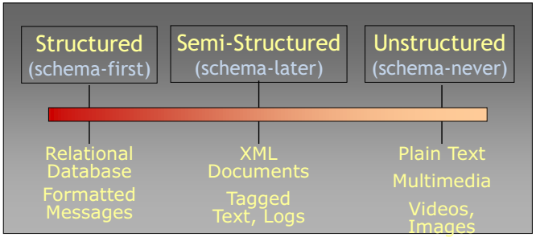
The Structure Spectrum

Slide 6
Data and its types

Slide 7
Definition
Data Science is the science which uses computer science, statistics and machine learning, visualization and human computer interactions to collect, clean, integrate, analyze, visualize, interact with data to create data products.

Slide 8
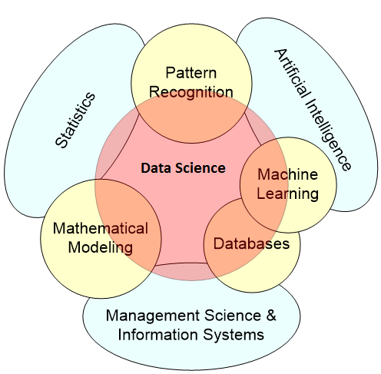
Data Science

Slide 9
Goal of Data Science
Turn data into data products.

Slide 10
Data to Data Products
Transaction Databases → Fraud Detection
Wireless Sensor Data → Smart Home
Social Media Data → Product Review and Consumer Satisfaction
Software Log Data → Automatic Trouble Shooting
Genotype and Phenotype Data → New treatment for Cancer

Slide 11
Other Data Products
Financial products for investment or retirement funds
Legal profession uses e-discovery tool for retrieval and review of legal documents
Political campaign management
Sports (e.g., Oakland baseball team)
Remote Sensing for Environment Monitoring

Slide 12
Data Products – Google
• Web Search
• Google Ads
• News Recommendation Engine
• Google Maps

Slide 13
Data Products – Netflix
• Personalized Movie Ratings
• Movie Recommendations
• Similar Movies
• Movie Categories (e.g., 80’s movie with a strong female lead, Kung Fu movies)

Slide 14
Data Products – LinkedIn/Facebook
• People you may know
• Applications you may like
• Jobs/Events you might be interested
• Classifier for bad users and bad content
• With high accuracy, Facebook can guess whether you are single or married
Who does not have LinkedIn/Facebook Account?

Slide 15
Data Products – Twitter
• Text Analysis – Spam Filter/Similarity Search
• User Sentiment/Satisfaction/Feedback
• News Breakout
• Trend and Topics

Slide 16
Data Products – Splunk
• Degradation, Failure Detection
• Identify Security Breach
• Event Monitoring
• Troubleshoot Tools
• Cross-platform Event Correlation

Slide 17
Splunk
• Grab data from many machines • Index it • Check for unusual events: • Disk problems • Network congestion • Security attacks • Monitor Resources • Network • Memory usage • Disk use, latency • Threads • Dashboard for cloud
• administration.

Slide 18
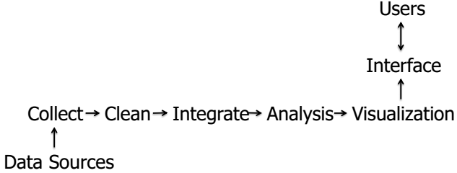
The Life of Data (state-of-the-art)

Slide 19
Challenges in Data Science
• Preparing Data (Noisy, Incomplete, Diverse, Streaming …)
• Analyze Data (Scalable, Accurate, Real time, Advanced Methods, Probabilities and Uncertainties ...)
• Represent Analysis Results (i.e. data product) (Story-telling, Interactive, explainable…)

Slide 20
Who’s hiring Data Scientist?
• IT companies: Google, Twitter, Lexis/Nexis, Facebook, Pivotal/EMC…
• Media and Financial sectors Fox, CNN, NYT, Bloomburg,…
• Research: Biology, Medicine, Physics, Psychology,…
• Information office in government and corporations…
• Law firms: e-discovery tools…

Slide 21
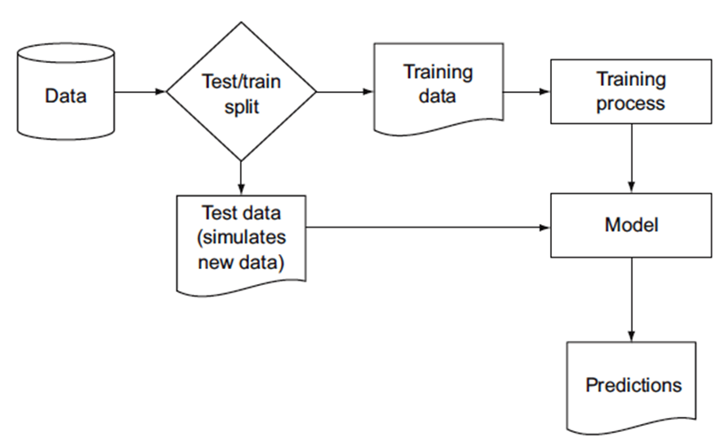
Model Construction and Evaluation

Slide 22
Commonly used Models
Model | Description
Classification | Deciding if something belongs to one category or another
Scoring | Predicting or estimating a numeric value, such as a price or probability
Ranking | Learning to order items by preferences
Clustering | Grouping items into most-similar groups
Finding Relations | correlations or potential causes of effects seen in the data
Characterization | Very general plotting and report generation from data

Slide 23
Some Common Classification Methods
Method | Description
Naïve Bayes | especially useful for problems with many categorical input variables, with a very large number of possible values, and text classification. Naive Bayes would be a good first attempt at solving the product categorization problem.
Decision Tree | useful when input variables interact with the output in “if-then” kinds of ways (such as IF age > 65, THEN insurance=T) or when input variables are redundant or correlated. an important extension of decision trees is random forests

Slide 24
Some Common Classification Methods
Method | Description
Logistic Regression | appropriate when you want to estimate class probabilities in addition to class assignments. An example use of a logistic regression–based classifier is estimating the probability of fraud in credit card purchases.
Support vector machines (SVMs) | are useful when there are very many input variables or when input variables interact with the outcome or with each other in complicated (nonlinear) ways. SVMs make fewer assumptions about variable distribution than do many other methods

Slide 25
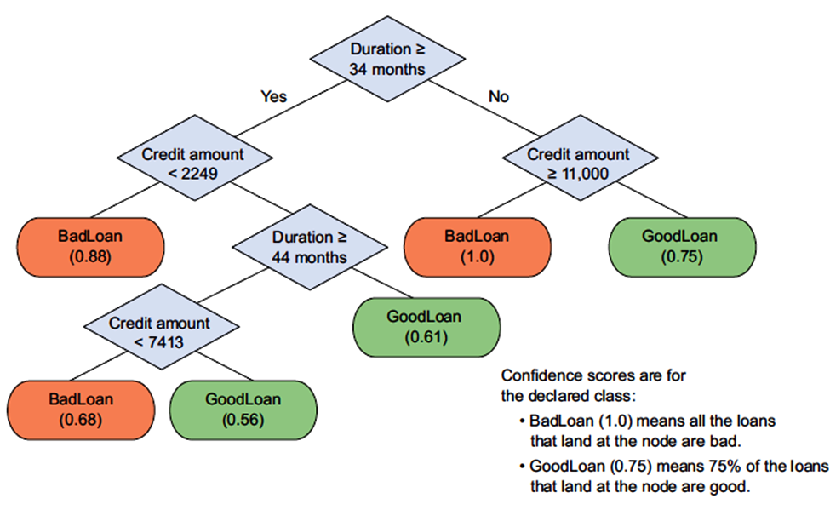
A decision tree model for finding bad loan applications

Slide 26
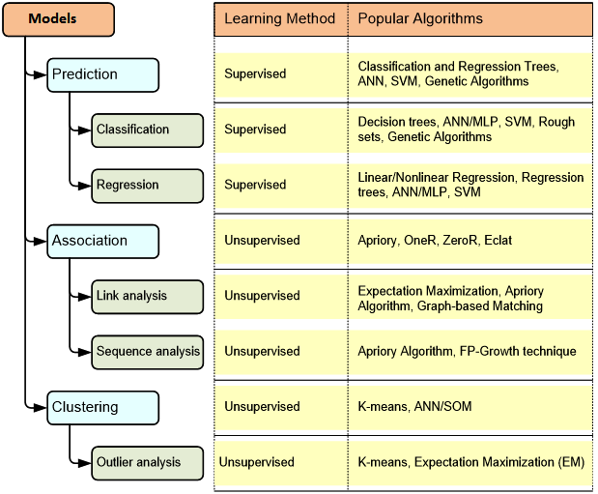
Models in Data Science

