Slide 1
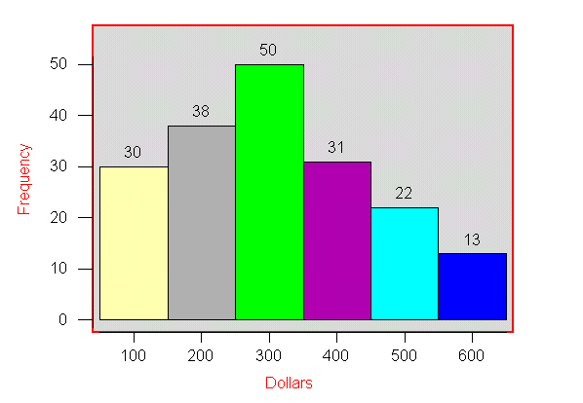
Histogram Example
Frequency Histogram

Slide 2
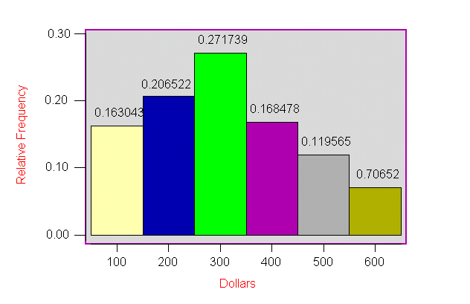
Histogram Example
Relative Frequency Histogram

Slide 3
Skewness and Kurtosis
Skewness
Measure of asymmetry of a frequency distribution
Skewed to left
Symmetric or unskewed
Skewed to right
Kurtosis
Measure of flatness or peakedness of a frequency distribution
Platykurtic (relatively flat)
Mesokurtic (normal)
Leptokurtic (relatively peaked)

Slide 4
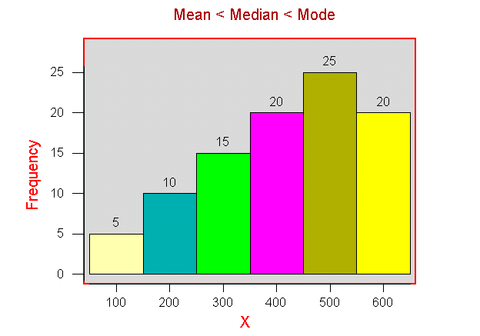
Skewness
Skewed to left

Slide 5
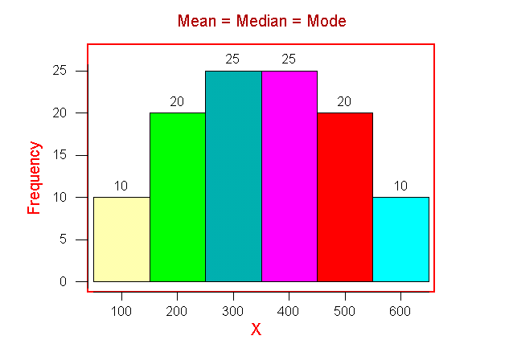
Skewness
Symmetric

Slide 6
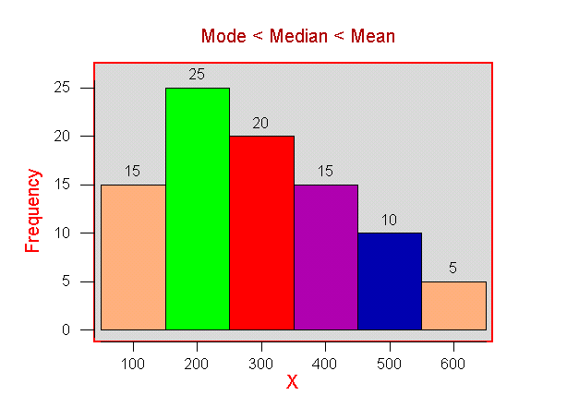
Skewness
Skewed to right

Slide 7
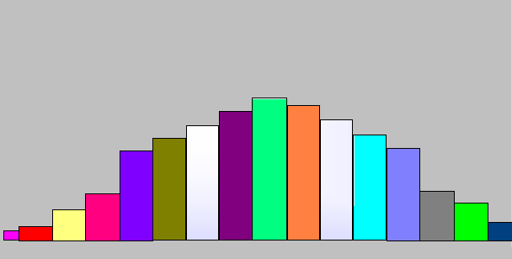
Kurtosis
Platykurtic - flat distribution

Slide 8
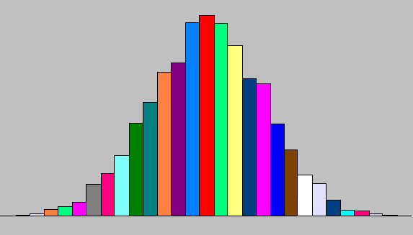
Kurtosis
Mesokurtic - not too flat and not too peaked

Slide 9
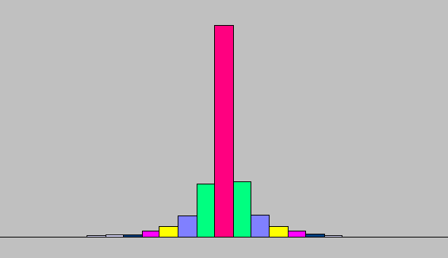
Kurtosis
Leptokurtic - peaked distribution

Slide 10
Methods of Displaying Data
Pie Charts
Categories represented as percentages of total
Bar Graphs
Heights of rectangles represent group frequencies
Frequency Polygons
Height of line represents frequency
Ogives
Height of line represents cumulative frequency
Time Plots
Represents values over time

Slide 11
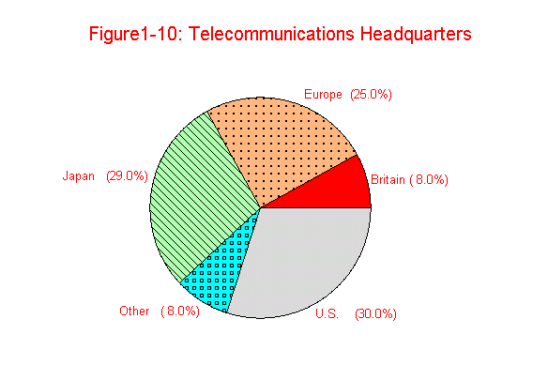
Pie Chart

Slide 12
Bar Chart
Fig. 1-11 Airline Operating Expenses and Revenues
1
2
Average Revenues
1
Average Expenses
0
8
6
4
2
0
American
Continental
Delta
Northwest
Southwest
United
USAir
A
i
r
l
i
n
e

Slide 13
Frequency Polygon and Ogive
Relative Frequency Polygon
Ogive
0
.
3
1
.
0
0
.
2
0
.
5
Relative Frequency
Cumulative Relative Frequency
0
.
1
0
.
0
0
.
0
0
1
0
2
0
3
0
4
0
5
0
0
1
0
2
0
3
0
4
0
5
0
Sales
Sales

Slide 14
Time Plot
M
o
n
t
h
l
y
S
t
e
e
l
P
r
o
d
u
c
t
i
o
n
(
P
r
o
b
l
e
m
1
-
4
6
)
8
.
5
s
7
.
5
n
o
T
f
o
s
n
o
i
l
l
i
6
.
5
M
5
.
5
M
o
n
t
h
J
F
M
A
M
J
J
A
S
O
N
D
J
F
M
A
M
J
J
A
S
O
N
D
J
F
M
A
M
J
J
A
S
O

Slide 15
1-9 Exploratory Data Analysis - EDA
Techniques to determine relationships and trends, identify outliers and influential observations, and quickly describe or summarize data sets.
Stem-and-Leaf Displays
Quick-and-dirty listing of all observations
Conveys some of the same information as a histogram
Box Plots
Median
Lower and upper quartiles
Maximum and minimum

Slide 16
Example: Stem-and-Leaf Display
Construct a stem & leaf graph of the following data
11,12, 12, 13, 15, 15, 15,16,17,20,21,21, 21,22,22,22,23,24,26,27,27,27,28,29,29, 56
30,31,32,34,35,37,41,41,42,45,47,50,52,53,62
1 122355567
2 0111222346777899
3 012457
4 11257
5 0236
6 02

Slide 17
Box Plot
Elements of a Box Plot
Smallest data point not below inner fence
Largest data point not exceeding inner fence
Suspected outlier
Outlier
o
*
X
X
Inner
Fence
Q₁
Median
Q₃
Outer
Fence
Inner
Fence
Outer
Fence
Q₁-1.5(IQR)
Interquartile Range
Q₃+1.5(IQR)
Q₁-3(IQR)
Q₃+3(IQR)

Slide 18
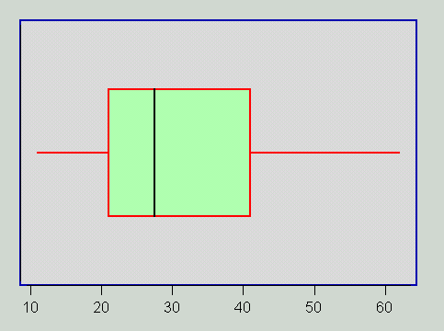
Example: Box Plot

Slide 19
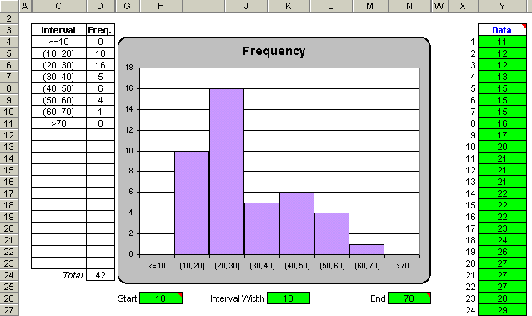
Histogram

Slide 20
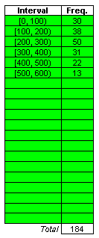
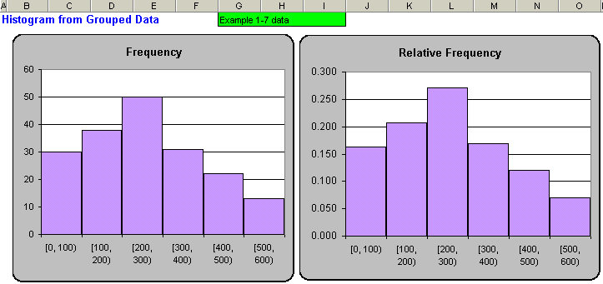
Histograms

Slide 21
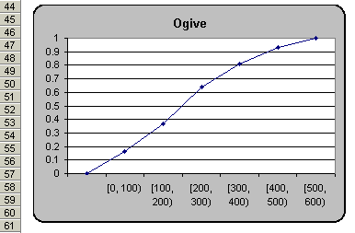
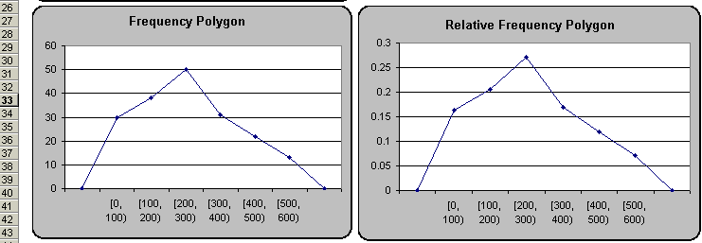
Frequency Polygons & the Ogive

Slide 22
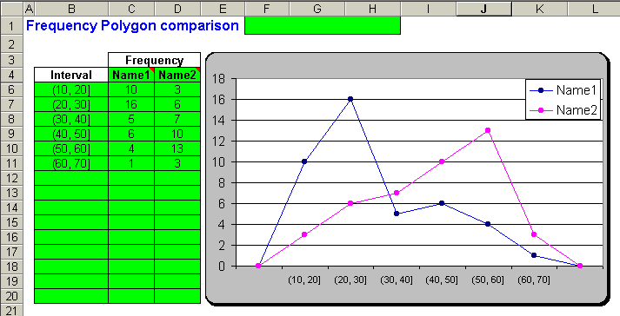
Two Frequency Polygons

Slide 23
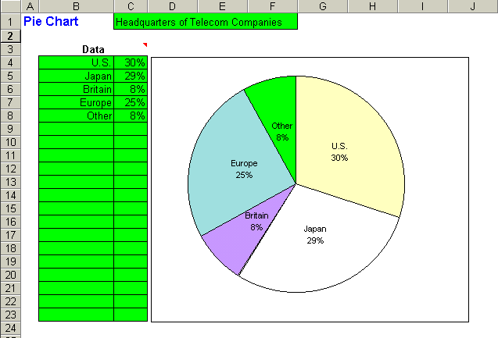
Pie Chart

Slide 24
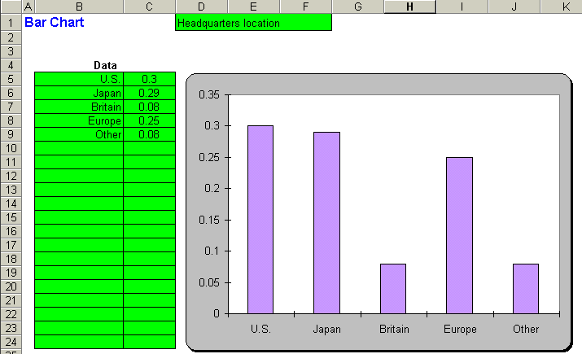
Bar Chart

Slide 25
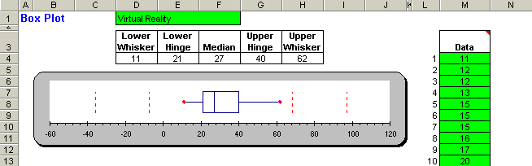
Box Plot

Slide 26
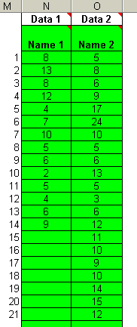
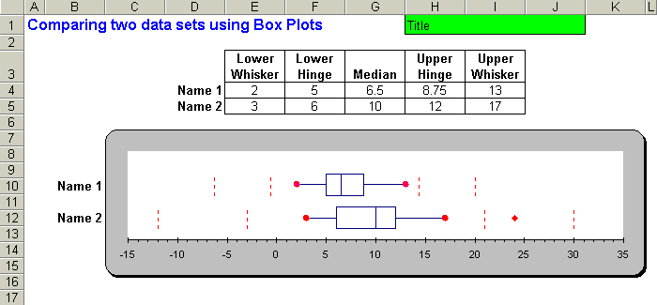
Box Plot Compare Two Data Sets

Slide 27
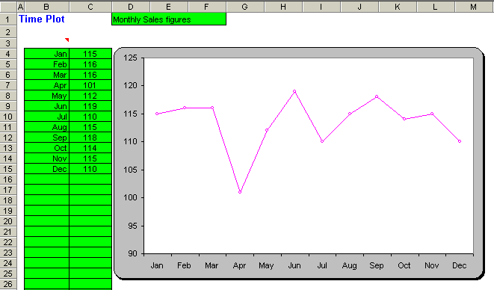
Time Plot

Slide 28

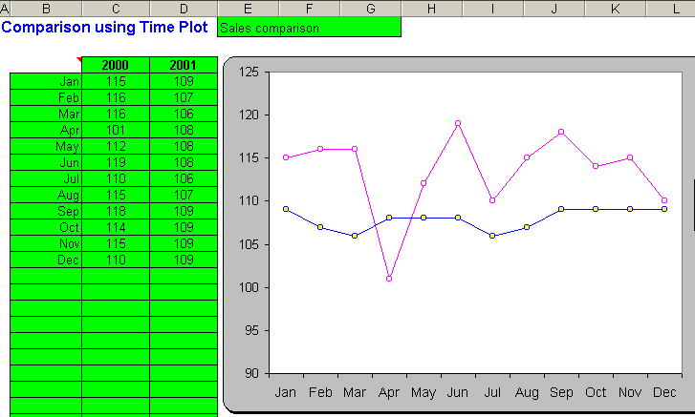
Time Plot

Slide 29
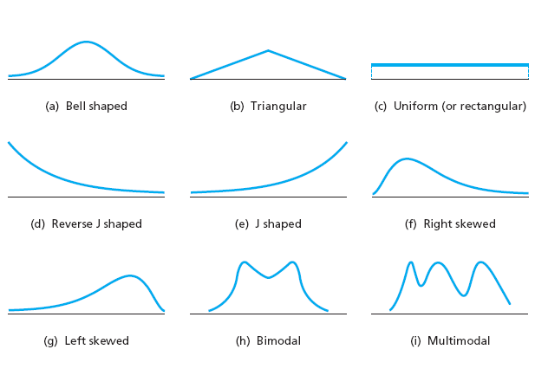
Typical Types of distributions?
Dr. Akhter

Slide 30
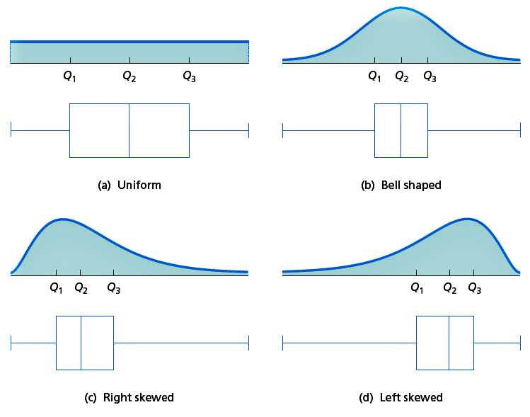
Dr. Akhter

Slide 31
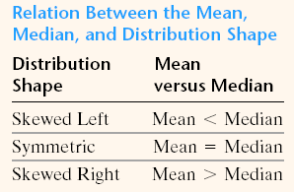
Dr. Akhter

Slide 32
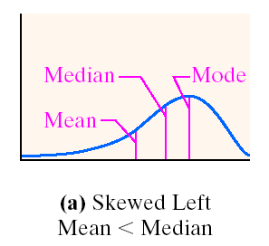
Dr. Akhter

Slide 33
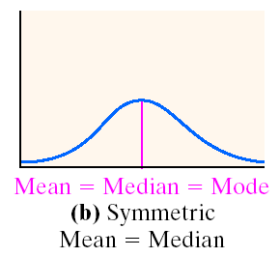
Dr. Akhter

Slide 34
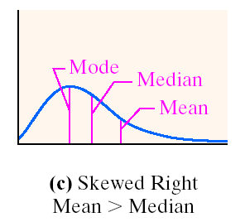
Dr. Akhter

