Slide 1



Course: Network Security
Amir Mehmood

Slide 2


Course Objectives
The main objective of this course is to understand the basic network security concepts, issues , principles , attacks and proposed protection techniques including protocols and standards.
Pre requisites: Computer Networks

Slide 3


Course Style
Descriptive
Critical
Interactive
Explore

Slide 4


Course Outline
Understanding Basic Concepts of Networks
Packet Tracer Simulators
Understanding of the basic security attributes/concepts
Basics of cryptography, cryptosystems & encryption techniques
Confidentiality using symmetric cryptography
Message authentication & Digital signature
Vulnerabilities and attacks
Firewall design ,principle & trusted system
Intrusion Detection & Prevention, GIDP
Securing Wireless Networks
Email Security
IP Security
Security protocols such as kerberos
Web security
6

Slide 5

Literature
Books
W. Stallings, “Cryptography and Network Security”, Prentice Hall PTR, Upper Saddle River, NJ, 2003.
W. Stallings, “Network Security Essentials applications and standards”, Third edition.
Behrouz.A.Forouzan “Cryptography and Network Security”, 2nd Edition McGrawHill. Background Reading
Behrouz.A.Forouzan, ”Data communication and networking”, 3rd or 4th Edition McGraw Hill. Research & Reviews
Relevant conference and journal papers.

Slide 6


Introduction to Network Security

Slide 7


Background
Information Security requirements have changed in recent times
traditionally provided by physical and administrative mechanisms
computer use requires automated tools to protect files and other stored information
Intrusion detection & prevention methods use to protect networks from attackers
use of networks and communications links requires measures to protect data during transmission

Slide 8

Definitions
Computer Security - generic name for the collection of tools designed to protect data and to thwart hackers
Network Security - measures to protect data during their transmission & network services and resources
Internet Security - measures to protect data during their transmission over a collection of interconnected networks
(William Stallings )

Slide 9


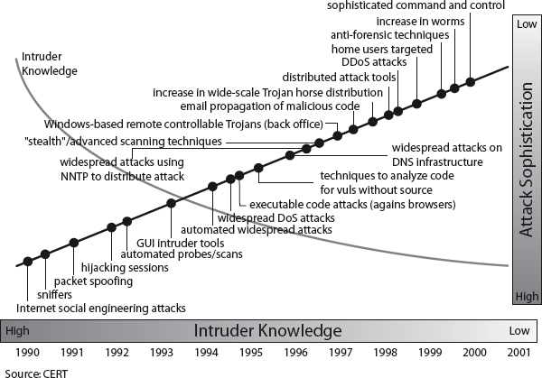
Security Trends

Slide 10


Aspects of Security
consider 3 aspects of information security:
.
security attack
security mechanism
security service

Slide 11


Security Attack
any action that compromises the security of information owned by an organization
information security is about how to prevent attacks, or failing that, to detect attacks on information- based systems
often threat & attack used to mean same thing
have a wide range of attacks
can focus of generic types of attacks
passive
active

Slide 12

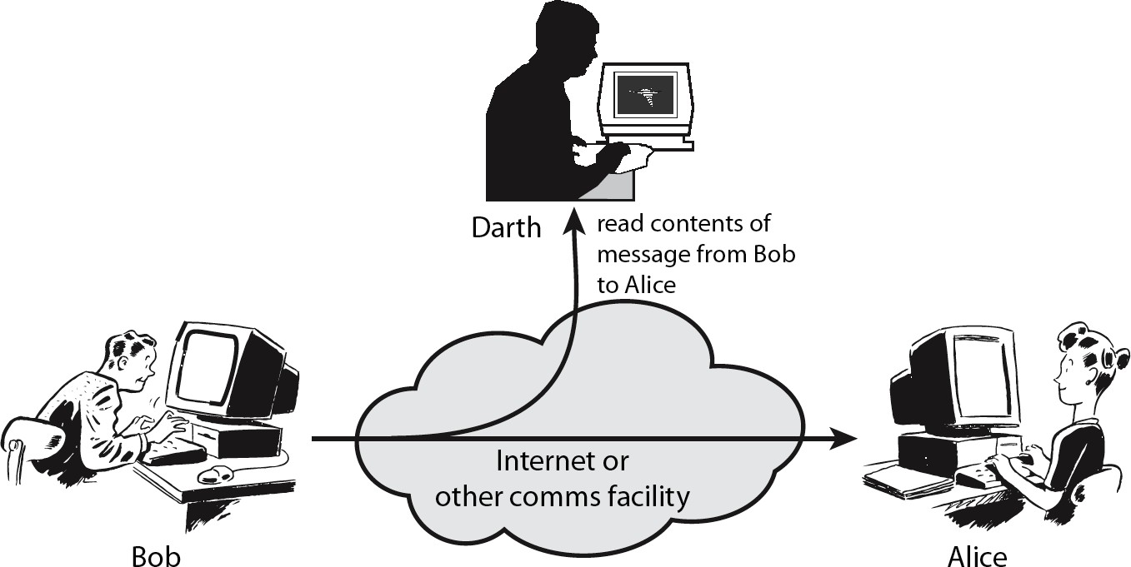
Passive Attacks

Slide 13


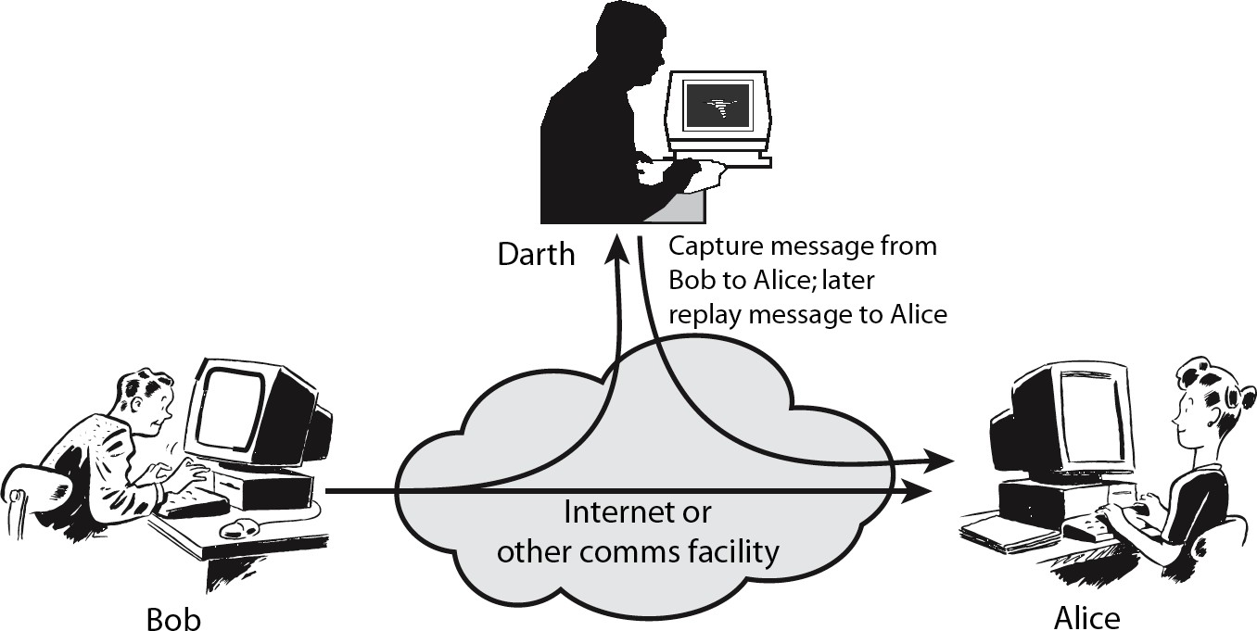
Active Attacks

Slide 14


Security Service
enhance security of data processing systems and information transfers of an organization
intended to counter security attacks
using one or more security mechanisms
often replicates functions normally associated with physical documents
which, for example, have signatures, dates; need protection from disclosure, tampering, or destruction;

Slide 15

Security Services
X.800:
“a service provided by a protocol layer of communicating open systems, which ensures adequate security of the systems or of data
transfers”
RFC 2828 (internet Security Glossary):
“a processing or communication service provided by a system to give a specific kind of protection to system resources”

Slide 16

Security Services (X.800)
Authentication - assurance that the communicating entity is the one claimed
Access Control - prevention of the unauthorized use of a resource
Data Confidentiality –protection of data from unauthorized disclosure
Data Integrity - assurance that data received is as sent by an authorized entity
Non-Repudiation - protection against denial by one of the parties in a communication

Slide 17

Security Mechanism
feature designed to detect, prevent, or recover from a security attack
no single mechanism that will support all services required
however one particular element underlies many of the security mechanisms in use:
– cryptographic techniques
hence our focus on this topic

Slide 18


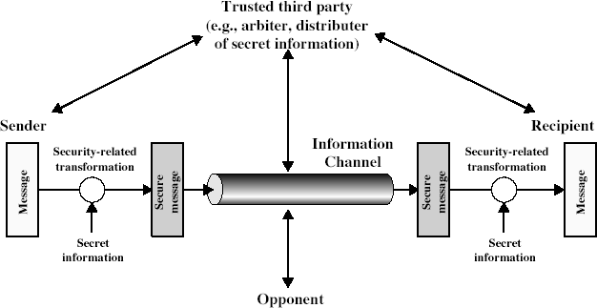
Model for Network Security

Slide 19

Model for Network Security
using this model requires us to:
design a suitable algorithm for the security transformation
generate the secret information (keys) used by the algorithm
develop methods to distribute and share the secret information
specify a protocol enabling the principals to use the transformation and secret information for a security service

Slide 20


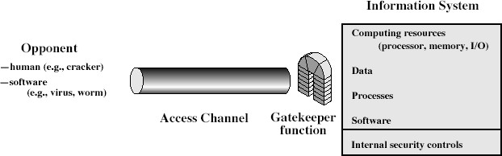
Model for Network Access Security

Slide 21


Model for Network Access Security
using this model requires us to:
select appropriate gatekeeper functions to identify users
implement security controls to ensure only authorised users access designated information or resources
trusted computer systems may be useful to help implement this model

Slide 22

Summary
Course Objectives , style & outline
Background & definitions
Aspects of security attacks, services, mechanisms
models for network (access) security

Slide 23
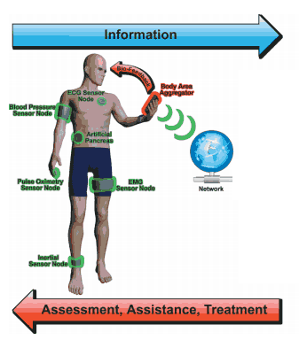


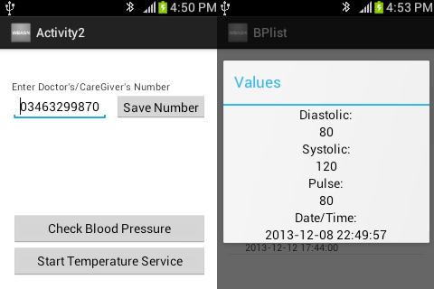

FYP Projects
Monitoring & Assistance of Patients using Body Area Wireless Sensor Network
I Health BP Sensor
Temperature sensor
SMS
Ambulance
Wifi
Figure 2: Proposed model for remote monitoring & assistance of patients

Slide 24

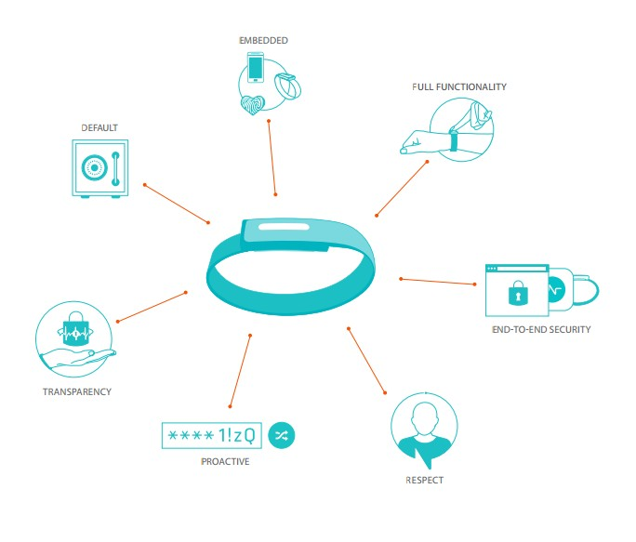



FYP Projects
Secure & Smart User Authentication Application using a Heart wave sensing wrist band
– Authentication App

Slide 25
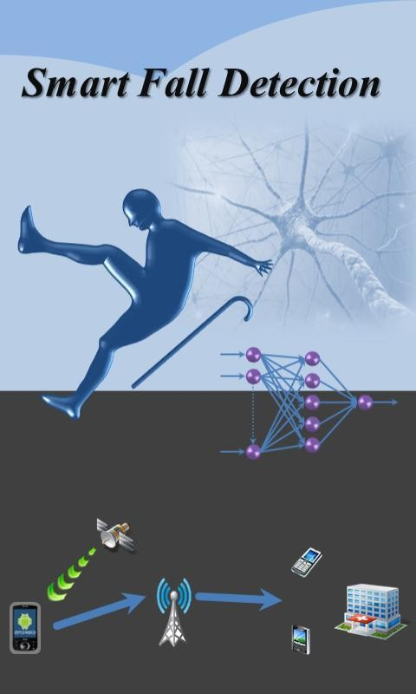

Proposed FYP Projects
Fall detection of elderly peoples by using SHIMMER Sensors
– Shimmer Sensors Kit

