Slide 1



Course: Network Security Sajid Majeed
/
Public Key Cryptography Key Management
Lecture is from Network Security Essential by William Stallings

Slide 2
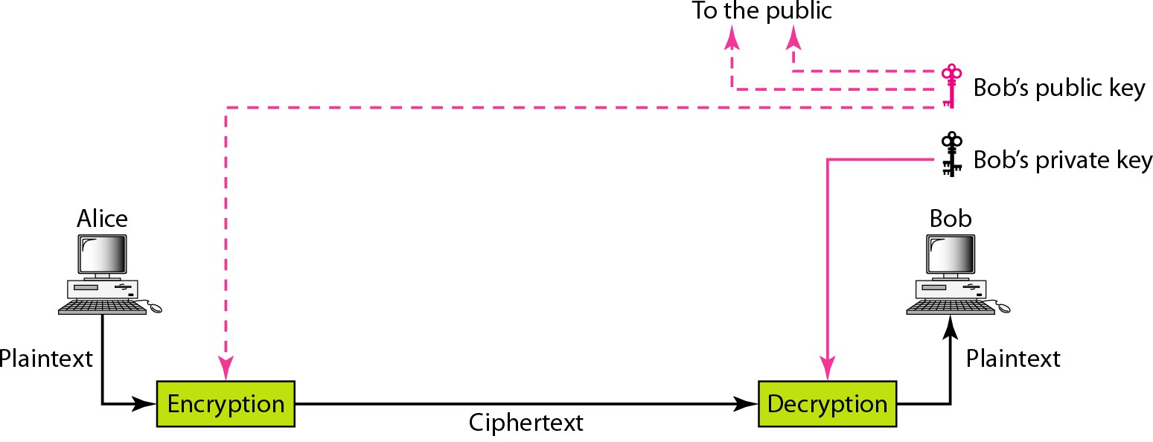
Public-key cryptography

Slide 3
Public-Key Cryptography – General Characteristics
public-key/two-key/asymmetric cryptography
A concept, there are several such cryptosystems
uses 2 keys
public-key
may be known by anybody, and can be used to encrypt messages, and verify signatures
private-key
known only to the recipient, used to decrypt messages, and sign (create) signatures
keys are related to each other but it is not feasible to find out private key from the public one

Slide 4
Public-Key Cryptography – General Characteristics
Keys are related to each other but it is not feasible to find out private key from the public one
It is computationally easy to en/decrypt messages when the relevant keys are known
Trap-door one-way function
Y=f_{ku}(X) easy, if ku and X are known
X=f ⁻¹(Y)easy, if kr and Y are known,
kr
but infeasible if Y is known but kr is not known
– ku: public-key, kr: private key

Slide 5
Public-Key Cryptography – General Characteristics
based on number theoretic hard problems
rather than substitutions and permutations
3 misconceptions about PKC
it replaces symmetric crypto
PKC rather complements private key crypto
PKC is more secure
no evidence for that, security mostly depends on the key size in both schemes
key distribution is trivial in PKC since public keys are public
making something public is not easy. How can you make sure that a public key belongs to the intended person?
key distribution is easier, but not trivial

Slide 6
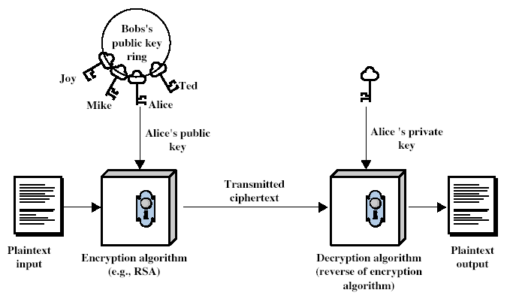
Public-Key Cryptography - Encryption
Bob
Alice

Slide 7
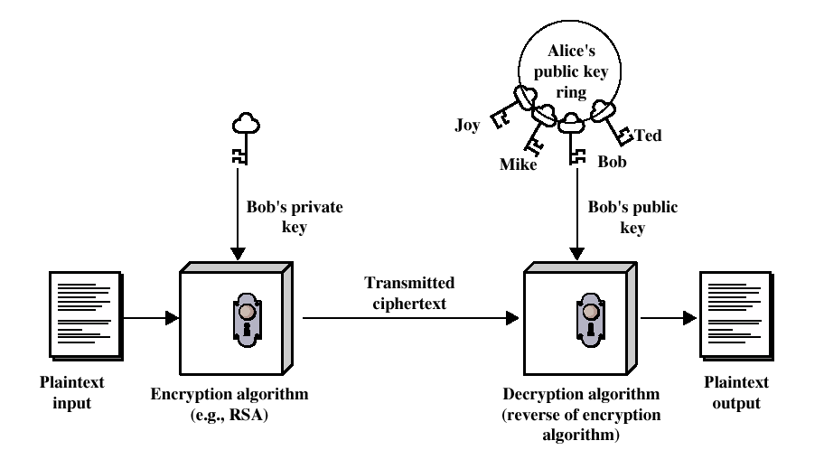
Public-Key Cryptography - Authentication
Bob
Alice

Slide 8
Why Public-Key Cryptography?
Initially developed to address two key issues:
key distribution
symmetric crypto requires a trusted Key Distribution Center (KDC)
in PKC you do not need a KDC to distribute and know secret keys, but you need trusted third parties
digital signatures (non-repudiation)
not possible with symmetric crypto

Slide 9
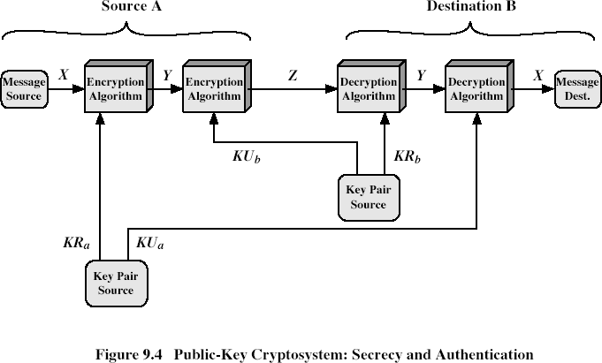
Public-Key Cryptosystems
KU_{a} | A’s Public Key | KU_{b} | B’s Public Key
KR_{a} | A’s Private Key | KR_{b} | B’s Private Key

Slide 10
Public-Key Applications
3 categories
encryption/decryption
to provide secrecy
digital signatures
to provide authentication and non-repudiation
key exchange
to agree on a session key
some algorithms are suitable for all uses, others are specific to one

Slide 11
Security of Public Key Schemes
like private key schemes brute force attack is always theoretically possible
use large keys
consider the security / performance tradeoff
due to public key / private key relationships number of bits in
the key should be much larger than symmetric crypto keys
to do the hard problem really hard
80-bit symmetric key and 1024-bit RSA key has comparable resistance to cryptanalysis
a consequence of use of large keys is having slower encryption and decryption as compared to private key schemes
thus, PKC is not a proper method for bulk encryption

Slide 12
Key Management
public-key encryption helps address key distribution problems
have two aspects of this:
distribution of public keys
use of public-key encryption to distribute secret keys

Slide 13
Distribution of Public Keys
can be considered as using one of:
public announcement
publicly available directory
public-key authority
public-key certificates

Slide 14
Public Announcement
users distribute public keys to recipients or broadcast to community at large
eg. append PGP keys to email messages or post to news groups or email list
major weakness is forgery
anyone can create a key claiming to be someone else and broadcast it
until forgery is discovered can masquerade as claimed user

Slide 15
Publicly Available Directory
can obtain greater security by registering keys with a public directory
directory must be trusted with properties:
contains {name,public-key} entries
participants register securely with directory
participants can replace key at any time
directory is periodically published
directory can be accessed electronically
still vulnerable to tampering or forgery
Participant can use LDAP (lightweight directory access protocol)

Slide 16
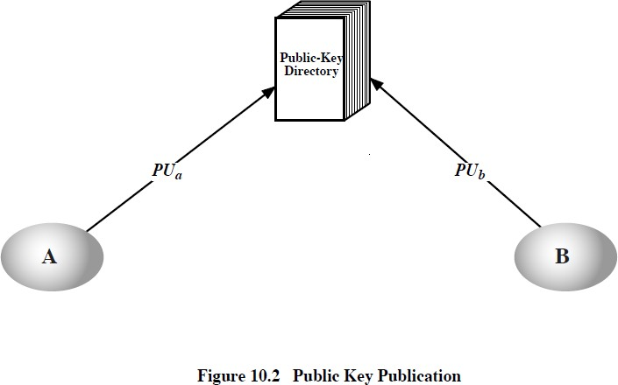
Publicly Available Directory
3/1
5/2015 Secret Key Cryptography 16

Slide 17
Public-Key Authority
improve security by tightening control over distribution of keys from directory
has properties of directory
and requires users to know public key for the directory
then users interact with directory to obtain any desired public key securely
– does require real-time access to directory when keys are needed

Slide 18
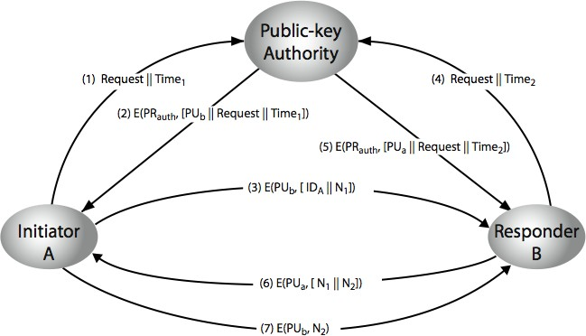
Public-Key Authority

Slide 19
Public-Key Certificates
certificates allow key exchange without real-time access to public-key authority
a certificate binds identity to public key
– usually with other info such as period of validity, rights of use etc
with all contents signed by a trusted Public- Key or Certificate Authority (CA)
can be verified by anyone who knows the public-key authorities public-key

Slide 20
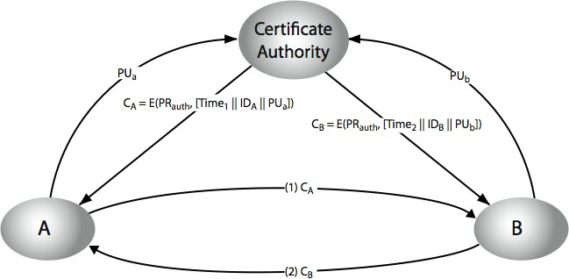
Public-Key Certificates

Slide 21
Public-Key Distribution of Secret Keys
use previous methods to obtain public-key
can use for secrecy or authentication
but public-key algorithms are slow
so usually want to use private-key encryption to protect message contents
hence need a session key
have several alternatives for negotiating a suitable session

