Slide 1
Course: Network Security By Sajid Majeed

Slide 2
Security attributes & basics of Cryptography

Slide 3





Key Security Attributes
Alice
secure sender |  | secure receiver
 | channel
Bob

Slide 4


Key Security Attributes
Confidentiality
Integrity
Authentication
Availability
Non Reputation

Slide 5



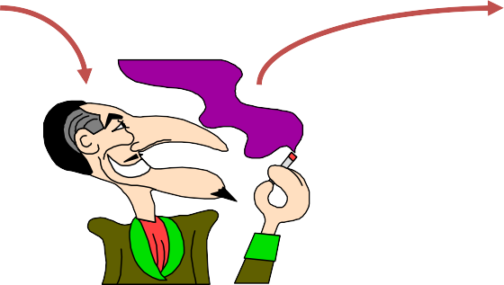

Confidentiality
It ensures that information content cannot be revealed by unauthorized entities.
It is a Process of concealing information on
the network.
It prevents eavesdropping.
Alice
secure sender |  | secure receiver
 | channel
Bob
Sam Snoop

Slide 6


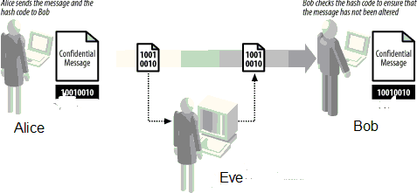
Integrity
It ensures data packets are unaltered during transition from source to destination.
Attackers can violate data integrity through insertion, substitution, deletion or forging .
Different ways of maintaining integrity.

Slide 7





Authentication
It is a process that allows node to verify the identity of the communicating node.
Two types of authentications
1)Entity authentication 2)Data authentication
Alice
Packet
secure
sender
secure
receiver
Bob
Alice receive Packet
Packet
Sam

Slide 8
Entity Authentication :
Entity authentication is a technique designed to let one party prove the identity of another party. An entity can be a person, a process, a client, or a server. The entity whose identity needs to be proved is called the claimant; the party that tries to prove the identity of the claimant is called the verifier.

Slide 9
Data Authentication:
Data authentication is the process of confirming the origin and integrity of data. The term is typically related to communication, messaging and integration. Data authentication has two elements: authenticating that you're getting data from the correct entity and validating the integrity of that data.

Slide 10
There are three common factors used for authentication:
Something you know (such as a password)
Something you have (such as a smart card)
Something you are (such as a fingerprint or other biometric method)

Slide 11


Availability
It ensuring that system resources and services are available for use by authorized users of the system.
Intruders can deny services through denial of services attacks
Alice
secure sender |  | secure receiver
Bob
System resources
& services
Alice receive Packet

Slide 12




Non Repudiation
It ensures a entity in a dispute cannot falsely deny its action.
Non repudiation service prevents the sender from denying sending a message which
he sent earlier
Receiver cannot claim to have received the message falsely
Alice
secure sender |  | secure receiver
Bob
channel
Alice falsely claim to have received packet

Slide 13

Key Concepts in cryptography
Cryptosystems
Encryption & decryption
Cryptography
Crypto analysis
Cryptology

Slide 14


Cryptosytems
Crypto system or a cipher system is the method of disguising messages so that only certain people can see through the disguise
The original message is called the plain text.
The disguised message is called a cipher text.
The message is disguised using ENCRYPTION

Slide 15


Cryptosytems
The message is received on the receiver side by means of DECRYPTION
The people who are supposed to be able to see through the disguise are called recipients .
The people who are not supposed to be able to see through the disguise are called enemies , opponents ,interlopers or third parties

Slide 16


ENCRYPTION :
Encryption means any procedure to convert plain text into cipher text .
Procedure is usually a whole collection of algorithms. The algorithms are labeled ; the labels are called keys. For instance Caesars use shift by n Encryption .
Decryption :
Decryption means any procedure to convert cipher text into plaintext.
Cipher text is decrypted by applying the procedure or algorithm . For instance if shift by n is used then it will be decrypt in the same way

Slide 17





Example
the message ( plain text) is written in 8 columns and 4 rows
CIPHER TEXT
PLAIN TEXT
D O * E
O * B *
* I E A
N * * T O W T 2
T I H *
* L E * G L R *
D O * N O T * G O * I * W I L L
* B E * T H E R E * A T 2
Prepared by ADNAN NADEEM

Slide 18


Cryptography
Cryptography is the art of creating and using cryptosystems.
Cryptography is the art or science of keeping messages secret
Cryptography deals with Security Standards Methods, Principals for Security
Cryptography deals with all aspects of secure messaging, authentication, electronic money, and other applications.

Slide 19

Crypto Analysis
Cryptanalysis is the art of breaking cryptosystems-
--seeing through the disguise.
Classical cryptanalysis involves an interesting combination of analytical reasoning, application of mathematical tools, Pattern finding, patience, determination, and luck
Crypto analysis attacks : cipher-text only, know- plaintext, chosen-plaintext & chosen-ciphertext

Slide 20


Cryptology
Cryptology is the study of both cryptography and crypto analysis.
Cryptology is the branch of mathematics that studies the mathematical foundations of cryptographic methods

Slide 21
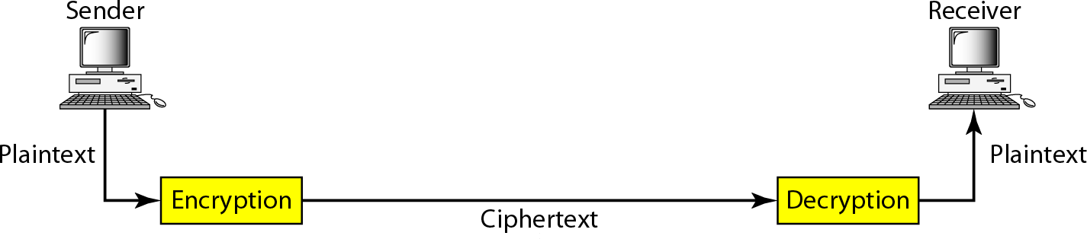
Cryptography components

Slide 22
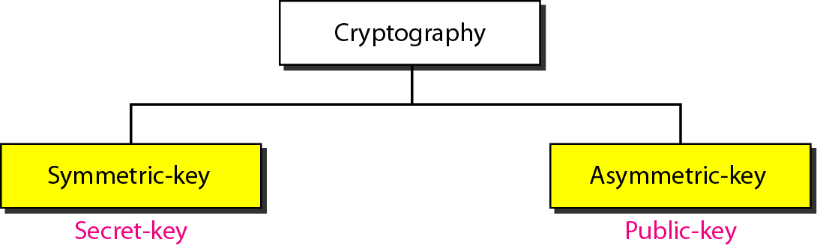
Categories of cryptography :

Slide 23
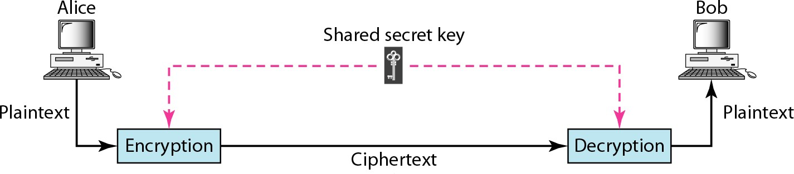
Symmetric-key cryptography
In symmetric-key cryptography, the same key is used by the sender (for encryption)
and the receiver (for decryption).
The key is shared.

Slide 24
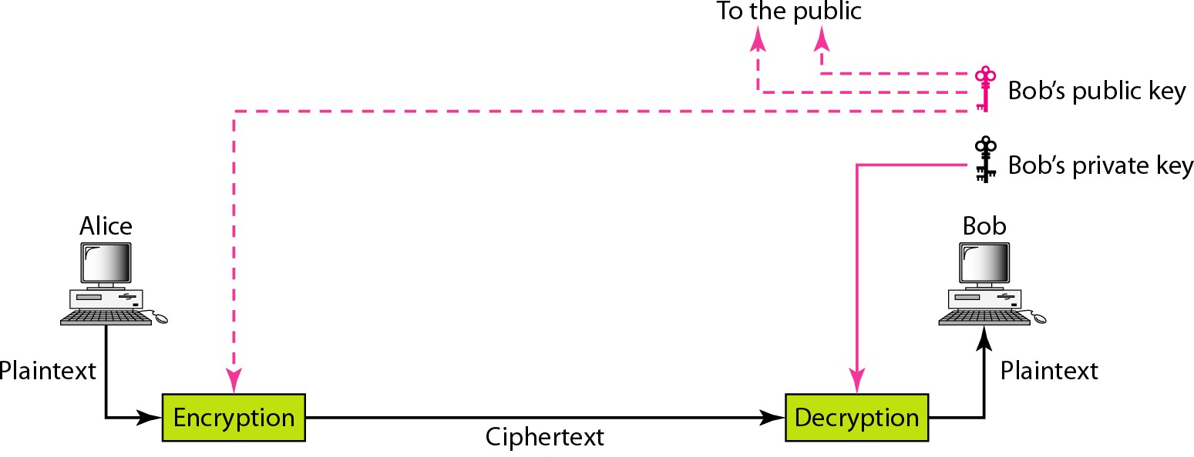
Asymmetric-key cryptography

Slide 25
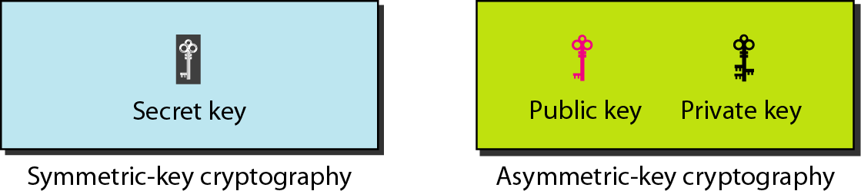
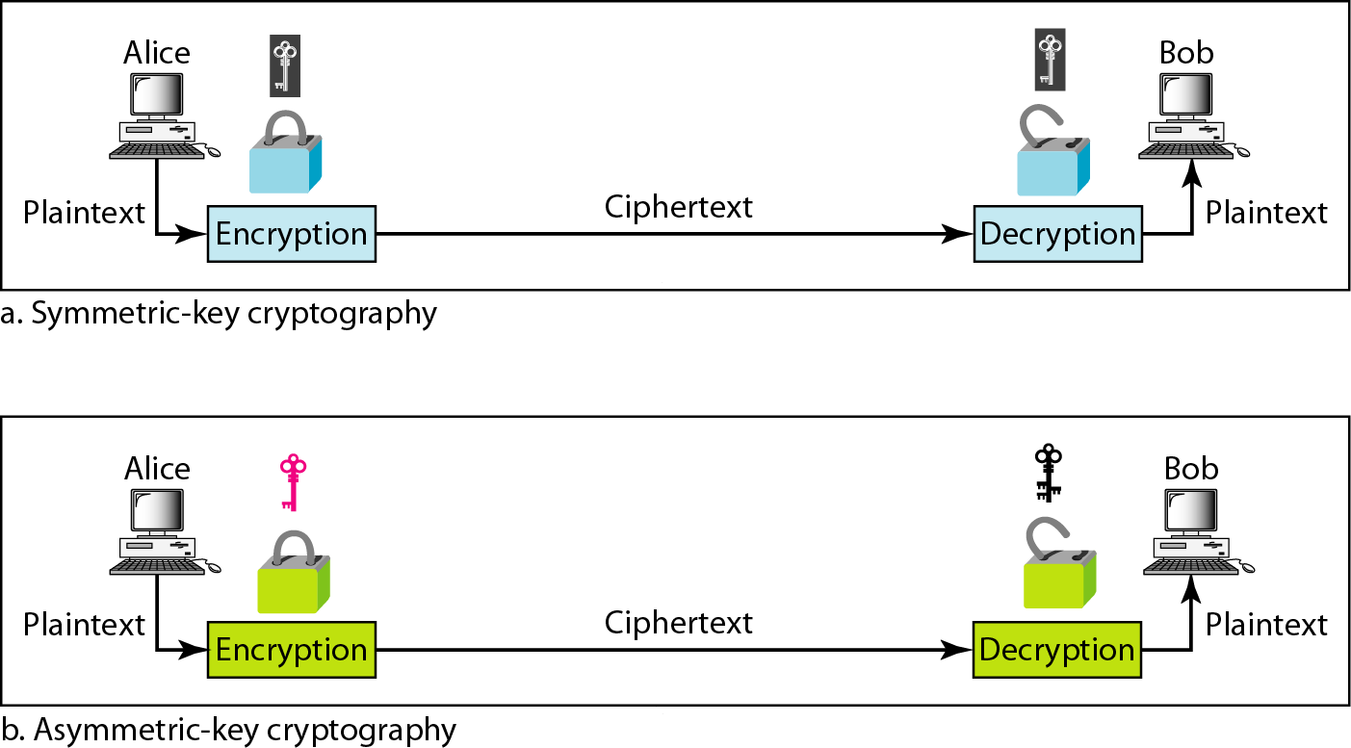
Keys used in cryptography
Comparison between two categories of cryptograph

Slide 26
Comparison Chart
BASIS FOR COMPARISON | SYMMETRIC ENCRYPTION | ASYMMETRIC ENCRYPTION
Basic | Symmetric encryption uses a single key for both encryption and Decryption. | Asymmetric encryption uses a different key for encryption and decryption.
Performance | Symmetric encryption is fast in execution. | Asymmetric Encryption is slow in execution due to the high computational burden.
Algorithms | DES, 3DES, AES, and RC4. | Diffie-Hellman, RSA.
Purpose | The symmetric encryption is used for bulk data transmission. | The asymmetric encryption is often used for securely exchanging secret keys.

