Slide 1



Course: Network Security Sajid Majeed
Symetric key, Block cipher & DES

Slide 2
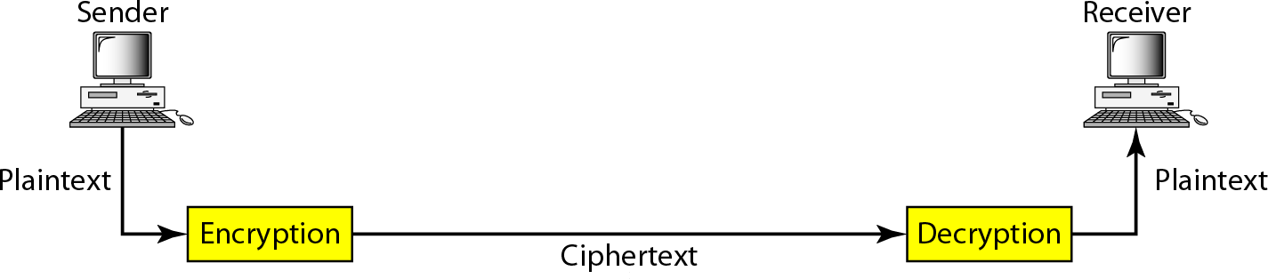
Cryptography components

Slide 3
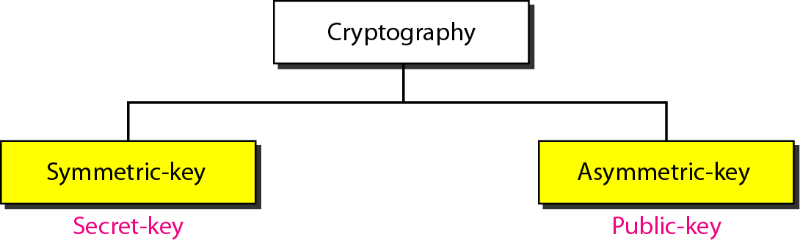
Categories of cryptography

Slide 4
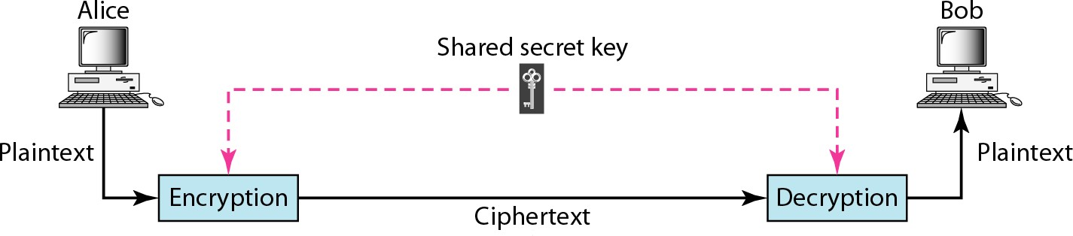
Symmetric-key cryptography
In symmetric-key cryptography, the same key is used by the sender (for encryption)
and the receiver (for decryption).
The key is shared.

Slide 5
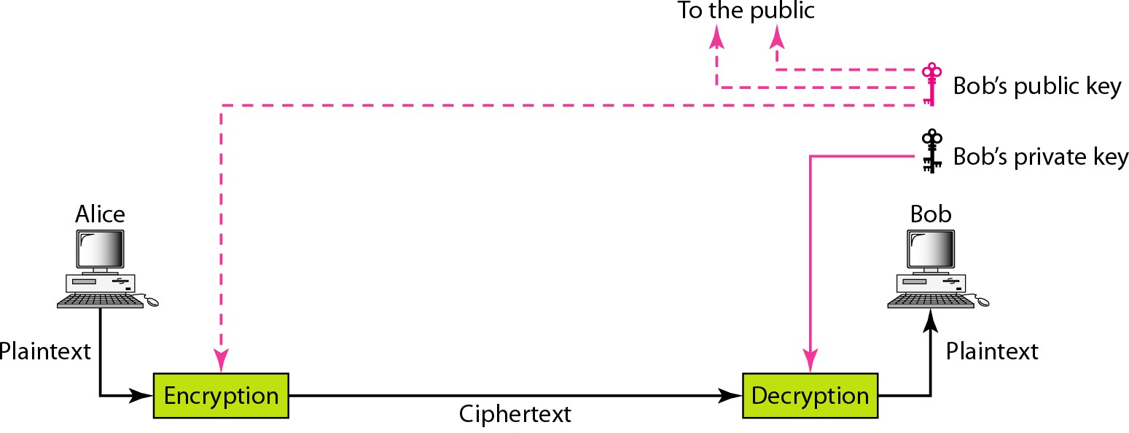
Asymmetric-key cryptography

Slide 6
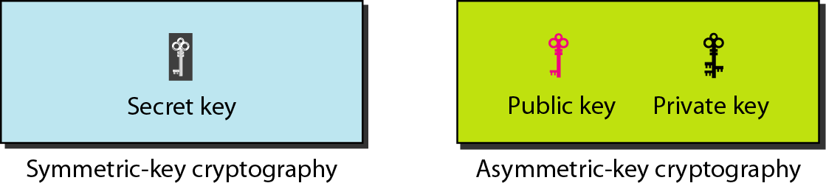
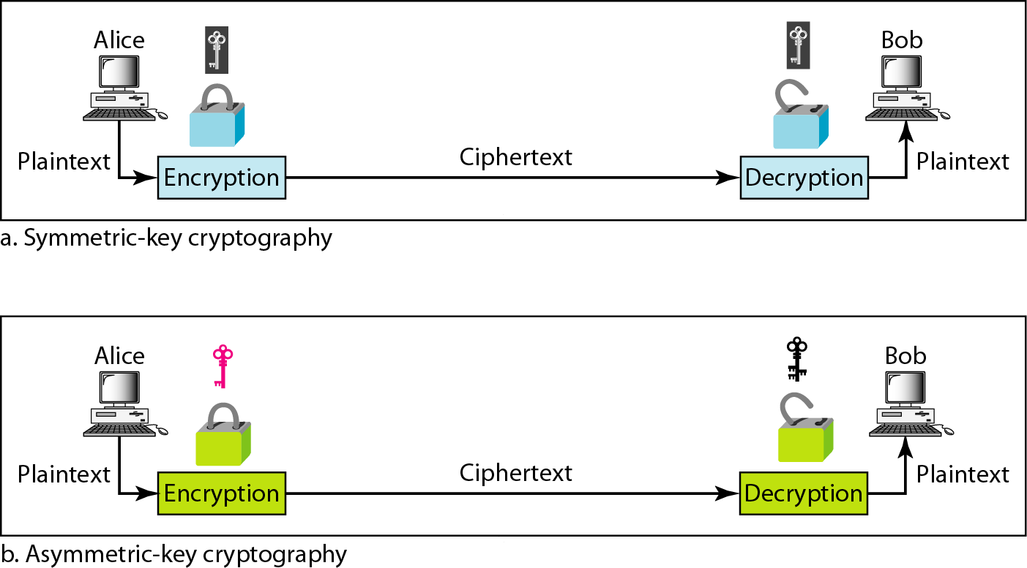
Keys used in cryptography
Comparison between two categories of cryptography

Slide 7











































SYMMETRIC-KEY CRYPTOGRAPHY
Symmetric-key cryptography started thousands of years ago when people needed to exchange secrets (for example, in a war). We still mainly use symmetric-key cryptography in our network security.
Topics discussed in this section:
Traditional Ciphers Simple Modern Ciphers Modern Round Ciphers
Data Encryptions Standard (DES)

Slide 8
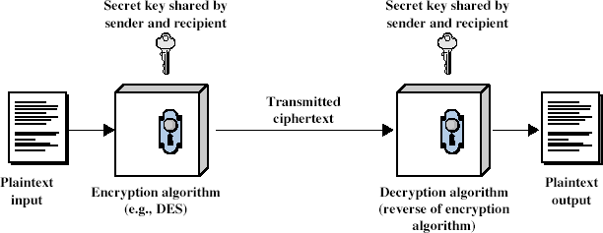
Symmetric Cipher Model

Slide 9
Requirements
two requirements for secure use of symmetric encryption:
a strong encryption algorithm
a secret key known only to sender / receiver
Y = E_{K}(X)
X = D_{K}(Y)
assume encryption algorithm is known
implies a secure channel to distribute key

Slide 10
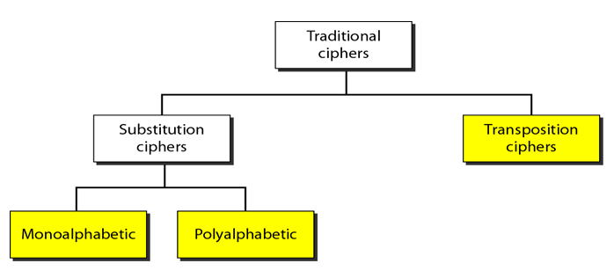
Traditional ciphers
A substitution cipher replaces one symbol with another.
A transposition cipher is some sort of permutation on plaintext.

Slide 11




Example 1
The following shows a plaintext and its corresponding ciphertext. Is the cipher monoalphabetic?
Solution
The cipher is probably monoalphabetic because both occurrences of L’s are encrypted as O’s.
30.11

Slide 12



Example 2
The following shows a plaintext and its corresponding ciphertext. Is the cipher monoalphabetic?
Solution
The cipher is not monoalphabetic because each occurrence of L is encrypted by a different character. The first L is encrypted as N; the second as Z.
30.12

Slide 13


Shift cipher Example 3
The shift cipher is sometimes referred to as the Caesar cipher.
Use the shift cipher with key = 15 to encrypt the message “HELLO.”
Solution
We encrypt one character at a time. Each character is shifted 15 characters down. Letter H is encrypted to W. Letter E is encrypted to T. The first L is encrypted to A. The second L is also encrypted to A. And O is encrypted to
D. The cipher text is WTAAD.

Slide 14


Example 4
Use the shift cipher with key = 15 to decrypt the message “WTAAD.”
Solution
We decrypt one character at a time. Each character is shifted 15 characters up. Letter W is decrypted to H. Letter T is decrypted to E. The first A is decrypted to L. The second A is decrypted to L. And, finally, D is decrypted to O. The plaintext is HELLO.

Slide 15
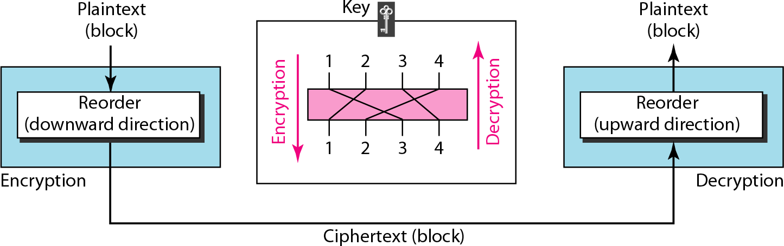
Transposition cipher
A transposition cipher reorders (permutes)
symbols in a block of symbols.

Slide 16


Example 5
Encrypt the message “HELLO MY DEAR,” using the key shown in Figure above.
Solution
We first remove the spaces in the message. We then divide the text into blocks of four characters. We add a bogus character Z at the end of the third block. The result is HELL OMYD EARZ. We create a three-block ciphertext ELHLMDOYAZER.

Slide 17


Example 6
Using Example “ELHLMDOYAZER”.
5, decrypt
the message
Solution
The result is HELL OMYD EARZ. After removing the bogus character and combining the characters, we get the original message “HELLO MY DEAR.”
30.17

Slide 18
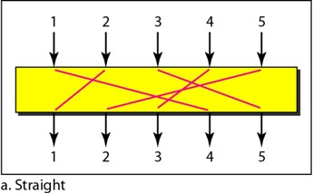
P-boxes:
Permutation box perform transposition at bit level
It can be implemented in both hardware and software
Encryption and decryption algorithm are normally embedded in the hardware

Slide 19
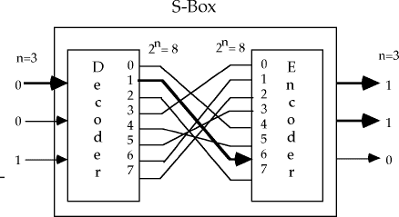
S-box (substitution)
S-box performs substitution at bit level
S box components
-encoder
-decoder
- P-box

Slide 20
DATA ENCRYPTION STANDARDS (DES)
Secret Key Cryptography

Slide 21
Data Encryption Standard (DES)
most widely used block cipher in world
adopted in 1977 by NBS (now NIST)
encrypts 64-bit data using 56-bit key
has widespread use

Slide 22
DES Design Controversy
although DES standard is public
was considerable controversy over design
in choice of 56-bit key (vs Lucifer 128-bit)
and because design criteria were classified
subsequent events and public analysis show in fact design was appropriate
DES has become widely used, esp in financial applications

Slide 23
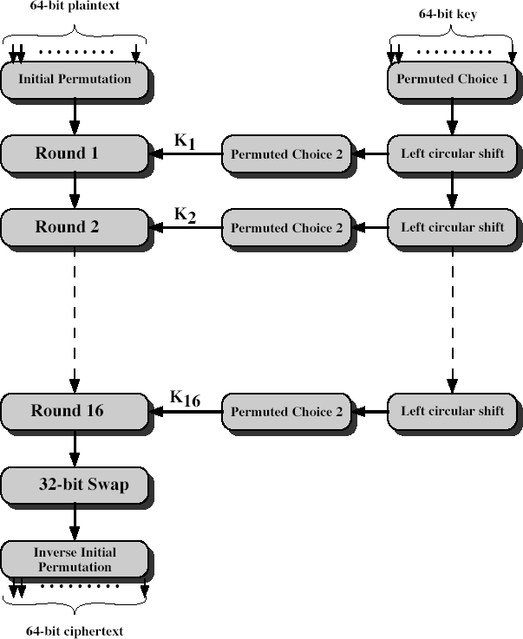
DES Encryption

Slide 24
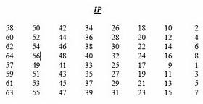
Initial Permutation IP
first step of the data computation
IP reorders the input data bits
even bits to LH half, odd bits to RH half
quite regular in structure
see text Table 3.2
example:
₅₈th
it becomes the 1st bit

Slide 25
DES Round Structure
uses two 32-bit L & R halves
as for any Feistel cipher can describe as:
^{L}i ^{= R}i–1
R_{i} = L_{i–1} xor F(R_{i–1}, K_{i})
takes 32-bit R half and 48-bit sub key and:
expands R to 48-bits using Expansion permutation(table 32c)
adds to sub key
passes through 8 S-boxes to get 32-bit result
finally permutes this using 32-bit perm P (table 3.2d)

Slide 26
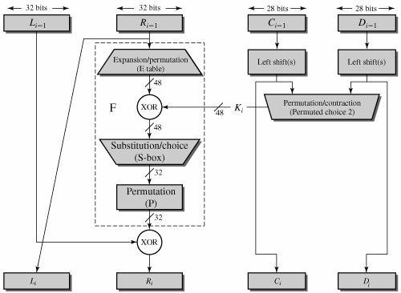
Single round of DES
3/15/2015 Secret Key Cryptography 26

Slide 27
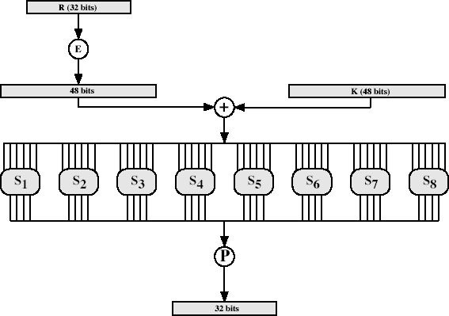
DES Round Structure
Substitution performed by s-box in DES round structure is defined in table 3.3 (Stallings)

Slide 28
Substitution Boxes S
have eight S-boxes which map 6 to 4 bits
each S-box is actually 4 little 4 bit boxes
outer bits 1 & 6 (row bits) select one rows
inner bits 2-5 (col bits) are substituted
result is 8 lots of 4 bits, or 32 bits
row selection depends on both data & key
feature known as autoclaving (autokeying)
example:

Slide 29
DES Key Schedule
forms subkeys used in each round
consists of:
initial permutation of the key (PC1) which selects 56-bits in two 28-bit halves
16 stages consisting of:
selecting 24-bits from each half
permuting them by PC2 for use in function f,
rotating each half separately either 1 or 2 places
depending on the key rotation schedule K

Slide 30
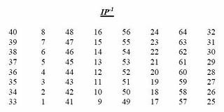
DES Decryption
decrypt must unwind steps of data computation
with Feistel design, do encryption steps again
using subkeys in reverse order (SK16 … SK1)
note that IP undoes final FP step of encryption
1st round with SK16 undoes 16th encrypt round
….
16th round with SK1 undoes 1st encrypt round
then final FP undoes initial encryption IP
thus recovering original data value

Slide 31
Strength of DES – Key Size
56-bit keys have 2⁵⁶ = 7.2 x 10¹⁶ values
brute force search looks hard
recent advances have shown is possible
in 1997 on Internet in a few months
in 1998 (EFF) broken DES using DES cracker
still must be able to recognize plaintext
now considering alternatives to DES

Slide 32
Strength of DES – Timing Attacks
attacks actual implementation of cipher
use knowledge of consequences of implementation to derive knowledge of some/all subkey bits
specifically use fact that calculations can take varying times depending on the value of the inputs to it
particularly problematic on smartcards

Slide 33
Strength of DES – Analytic Attacks
now have several analytic attacks on DES
these utilise some deep structure of the cipher
by gathering information about encryptions
can eventually recover some/all of the sub-key bits
if necessary then exhaustively search for the rest
generally these are statistical attacks
include
differential cryptanalysis
linear cryptanalysis
related key attacks

Slide 34



Summary
Summarize this topic based on your learning through the lecture:

