Slide 1
Software Requirements Engineering
Lect-1

Slide 2
Objectives of Subject
To understand the different processes in the realm of ‘Requirements Engineering’.
To see the challenges in requirements development and the importance of getting requirements right in an IT project.
To understand the different techniques used in different phases and processes of requirements development and management.

Slide 3
Software Engineering

Slide 4
Introduction
Software
Software is more than just a program code. A program is an executable code, which serves some computational purpose. Software is considered to be a collection of executable programming code, associated libraries and documentations. Software, when made for a specific requirement is called software product.
Engineering
Engineering on the other hand, is all about developing products, using well-defined, scientific principles and methods.
So, we can define software engineering as

Slide 5
Software Engineering
software engineering is a branch associated with the development of software product using well-defined scientific principles, methods and procedures. The outcome of software engineering is an efficient and reliable software product.
IEEE defines software engineering as:
“The application of a systematic, disciplined, quantifiable approach to the development, operation and maintenance of software.”

Slide 6
Software Requirements Engineering

Slide 7
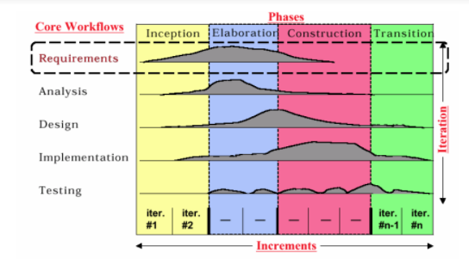
Road Map of Subject

Slide 8
Software Requirements
The software requirements are description of features and functionalities of the target system.
Requirements convey the expectations of users from the software product.
The requirements can be obvious or hidden, known or unknown, expected or unexpected from client’s point of view.

Slide 9
Requirement Engineering
Requirement Engineering
The process to gather the software requirements from client, analyze and document them is known as requirement engineering.
The goal of requirement engineering is to develop and maintain sophisticated and descriptive ‘System Requirements Specification’ document.

Slide 10
Requirement Engineering
Definition of Requirement Engineering
“ Requirements engineering is the branch of software engineering concerned with the real-world goals for, functions of, and constraints on software systems. It is also concerned with the relationship of these factors to precise specifications of software behavior, and to their evolution over time and across software families. ”

Slide 11
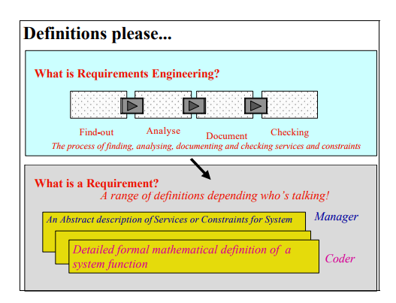

Slide 12
WHAT IS A REQUIREMENT?
A requirement is a condition or a skill that a user needs in order to solve a problem or arrive at a goal.
A condition or capability that must be met or possessed by a system or system component to satisfy a contract, standard, specification, or other formally imposed document

Slide 13
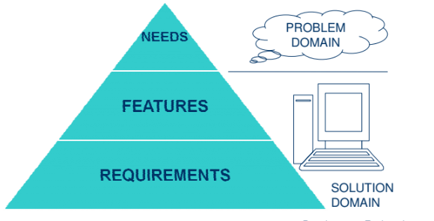
REQUIREMENT

Slide 14
Purpose of Requirement
Foundation for assessment, planning, execution and monitoring of the project activity
Customer expectations
Component of agreements, orders, project plans...
Setting of system boundaries, scope of delivery, contractual services

Slide 15
CLASSIFICATION OF REQUIREMENTS
Classification of requirements
Process requirements
Product requirements
Functional product requirements
Non-functional product requirements
User requirements
System requirements

Slide 16
User requirements
Statements in natural language plus diagrams of the services that the systems provides and its operational contraints.
Written for customers

Slide 17
System requirements
A structured document setting out detailed descriptions of the system services.
Written as a contract between client and contractor

Slide 18
Process requirements
Process requirements are costs, marketing, processing time, sales and distribution, organization, documentation
Describe needs and limitations of the business processes.

Slide 19
PRODUCT REQUIREMENTS
Product requirements consist of functional and non-functional product requirements.
Both can be regarded from the point of view of the user (external) or customer and
from the point of view of the developer (internal).

Slide 20
FUNCTIONAL PRODUCT REQUIREMENTS
Functional requirements describe the function of the system
from the user's point of view: user interface, applications, services
from the customer’s point of view: user interface, applications, services
from the developer's point of view: architecture, power supply, load distribution

Slide 21
NON-FUNCTIONAL PRODUCT REQUIREMENTS
Non-functional requirements describe the quality attributes of the system.
from the point of view of the user: reliability, performance, usability
from the point of view of the customer: reliability, performance, usability
from the point of view of the developer: testability, serviceability, tools

Slide 22
