Slide 1
Analysis Concepts and Principles

Slide 2
Overview
After system engineering is completed, software engineers need to look at the role of software in the proposed system. Software requirements analysis is necessary to avoid creating a software product that fails to meet the customer's needs. Data, functional, and behavioral requirements are elicited from the customer and refined to create a specification that can be used to design the system. Software requirements work products must be reviewed for clarity, completeness, and consistency.

Slide 3
Requirements Analysis
Software engineering task that bridges the gap between system level requirements engineering and software design.
Provides software designer with a representation of system information, function, and behavior that can be translated to data, architectural, and component-level designs.
Expect to do a little bit of design during analysis and a little bit of analysis during design.

Slide 4
Analysis as a bridge between system engineering and software design
System engineering
Software requirements analysis
Analysis
Concepts and Principle
Software design

Slide 5
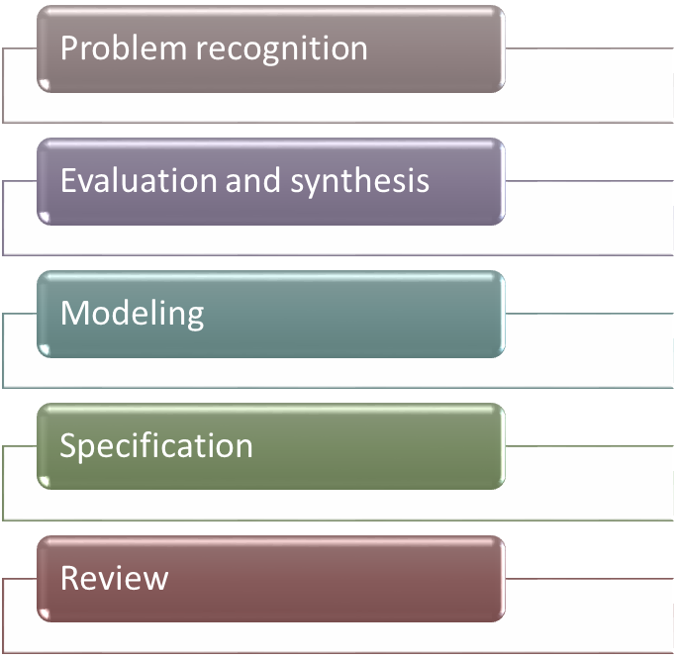
Requirements Analysis
Five Activities

Slide 6
Problem Recognition
Some problems to overcome
  Understanding what the customer really wants
  Getting inside the customers requirements
  “us-them” paradigm rather than “we”
  Federal Acquisition Regulations (FARs)
    Require customer to prepare specifications
    Limit discussion between customer and supplier during bidding process.

Slide 7
Techniques for Requirements Acquisition
Facilitated Application Specification Techniques (FAST)
  Meeting (often at neutral site) , attended by both software engineers and customers.
  Establish meeting rulesfor preparation and participation.
  Agenda to cover important points
  a "facilitator" (can be a customer, a developer, or an outsider) controls the meeting
  a "definition mechanism" (can be work sheets, flip charts, or wall stickers or an electronic bulletin board, chat room or virtual forum) is used
  the goal is
    to identify the problem
    propose elements of the solution
    negotiate different approaches, and
    specify a preliminary set of solution requirements
Notes:
To set some ground rules for out customer-developer meeting.
Develop the best estimate of process flow diagrams to help them understand and help generate questions.
Develop ACDs where feasible.
Prepare some architecture flow diagrams, if possible.
Be prepared to show some of these to create a framework for asking questions.
Construct a few scenarios of what you think is happening.
You can almost think of process flow diagrams as an organized way to describe scenarios of what is going on.
Luz to take notes -- to be distributed.
Agenda
RAV - read problem statement again.
Open floor to questions
RAV moderate
Ask for volunteer groups to show process flow diagrams.

Slide 8
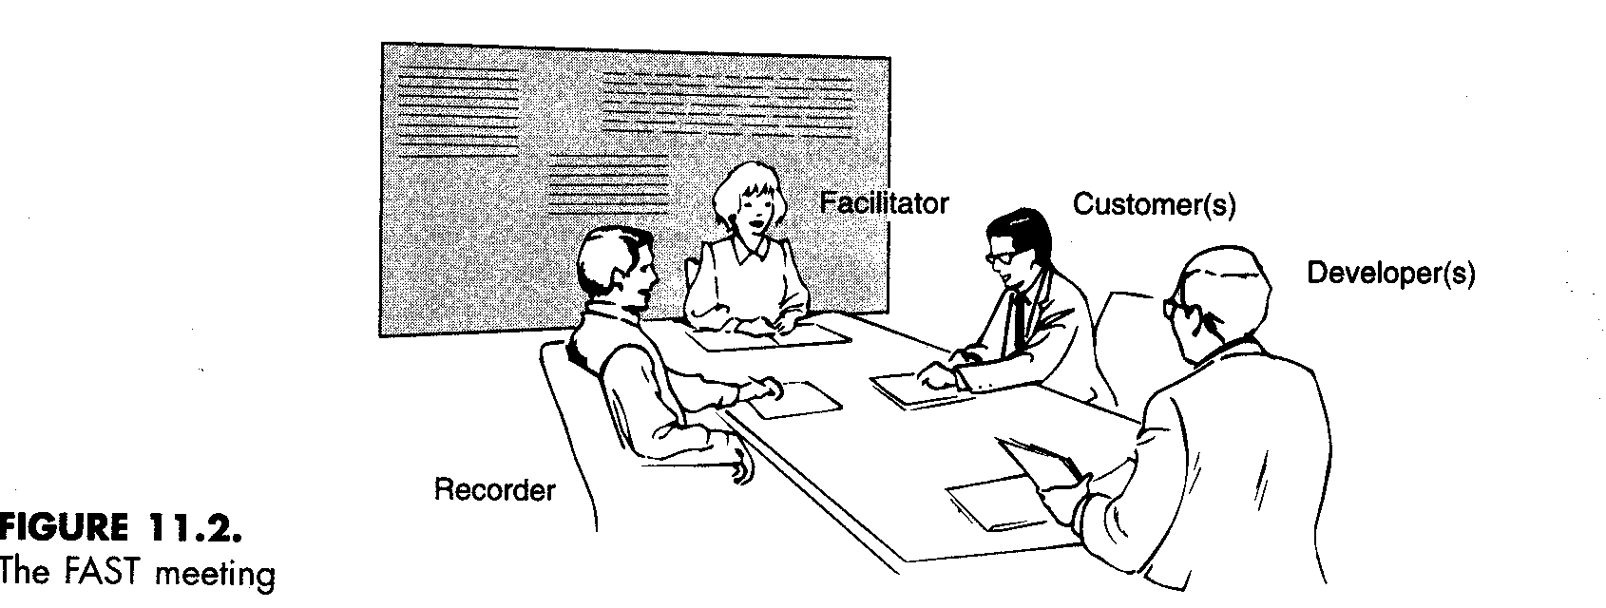
Techniques for Requirements Acquisition
Facilitated Application Specification Techniques (FAST)
  Refinement with subgroups

Slide 9
Techniques for Requirements Acquisition
Quality Function Deployment(QFD)
  Normal Requirements
    What will make customer happy
  Expected Requirements
    Unstated requirements that are so “obvious” that they need not be stated
  Unexpected Requirements
    Enhancements beyond customer requirements
Notes:
Concept developed by the Japanese

Slide 10
Quality Function Deployment
Function deployment determines the “value” (as perceived by the customer) of each function required of the system
Information deployment identifies data objects and events (tied to functions) and consumed by the system
Task deployment examines the behavior of the system within it environment
Value analysis determines the relative priority of requirements during function, information, and task deployment

Slide 11
Elicitation Work Products
a statement of need and feasibility.
a bounded statement of scope for the system or product.
a list of customers, users, and other stakeholders who participated in requirements elicitation
a description of the system’s technical environment.
a list of requirements (preferably organized by function) and the domain constraints that apply to each.
a set of usage scenarios that provide insight into the use of the system or product under different operating conditions.
any prototypes developed to better define requirements.

Slide 12
Use-Cases
A collection of user scenarios that describe the thread of usage of a system
Each scenario is described from the point-of-view of an “actor”—a person or device that interacts with the software in some way
Use-cases are designed from the actor's point of view.
Not all actors can be identified during the first iteration of requirements elicitation, but it is important to identify the primary actors before developing the use-cases.

Slide 13
Developing Use Cases
The use case describes the system’s behavior under various conditions as the system responds to a request from one of its stakeholders.
The first step in writing a use case is to define the set of “actors” that will be involved in the story.
An actor is anything that communicates with the system or product and it is external to the system itself.

Slide 14
Cont….
Because requirement elicitation is an evolutionary activity, not all actors are identified during the first iteration.
Primary actors are identified during first iteration and secondary actors as more is learned about the system.
Primary actors interact to achieve required system function and derive the intended benefit from the system.
Secondary actors support the system so that primary actors can do their work.

Slide 15
Once actors have been identified, use cases can be developed.
A number of questions that should be answered by a use case:
Who is the primary actor, the secondary actor (s)?
What are the actor’s goal?
What variations in the actor’s interaction are possible?

Slide 16
Building The Requirement Model
The intent of the analysis model is to provide a description of the required informational, functional, and behavioral domains for a computer-based system.
As the requirements model evolves, certain elements will become relatively stable, providing a solid foundation for the design task that follows.
Other elements of the model may be more volatile, indicating that stakeholders do not yet understand requirements for the system.

Slide 17
Elements Of The Requirement Model
Scenario Based Elements
Scenario-based elements of requirement model are often the first part of the model that is developed. As such, they serve as input for the creation of the other modeling elements.
Class-based Elements
Each usage scenario implies a set of objects that are manipulated as an actor interacts with the system. These objects are categorized into classes- a collection of things that have similar attributes and common behavior.

Slide 18
Behavioral Elements
The state diagram is one method for representing the behavior of a system. A state is any externally observable mode of behavior. In addition, state diagram indicates actions taken as a consequence of a particular event.
Flow-oriented Elements
Information is transformed as it flows through a computer based system. The system accepts input in a variety of forms, applies functions to transform it, and produces the output in a variety of form.

Slide 19
Analysis Principles
Basic principles
  Represent and understand information domain
  Define functions that must be performed
  Represent behavior of software (to external events)
  Partition information, function and behavior models hierarchically
  Move from essential information to implementation detail

Slide 20
Intermediate data and control
Output object(s)
Input object(s)
Transform #1
Transform #2
Figure:7.2:-Information flow and transformation
Data/control store

Slide 21
Guiding Principles
Understand problem before analysis
Develop prototypes for HCI
Record origin and reason for every requirement
Develop multiple views of each requirement
  Data, functional and behavioral models
Determine priorities of requirements
Eliminate ambiguity (by conducting formal technical reviews)
Notes:
Note KSC CLCS problem of lack of rationale documentation on earlier system.

Slide 22
Information Domain
Software processes data
  Payroll processing
  Computing control signals for radar system
Software also processes events
  Timer went off -- time to calculate a control
  Sensor turned on -- indicates intruder
  Heart rate monitor exceeded threshold -- indicates fibrillation.

Slide 23
Information Domain
Three views of information
  Information content
  Information flow
  Information structure
Process Models
  Functional -- possibly show block diagrams
  Behavioral -- define states and transitions
Try to show models diagrammatically

Slide 24
Modeling
Data model (shows relationships among system objects)
Functional model (description of the functions that enable the transformations of system objects)
Behavioral model (manner in which software responds to events from the outside world)

Slide 25
Partitioning
Process that results in the elaboration of data, function, or behavior.
Horizontal partitioning is a breadth-first decomposition of the system function, behavior, or information, one level at a time.
Vertical partitioning is a depth-first elaboration of the system function, behavior, or information, one subsytem at a time.

Slide 26
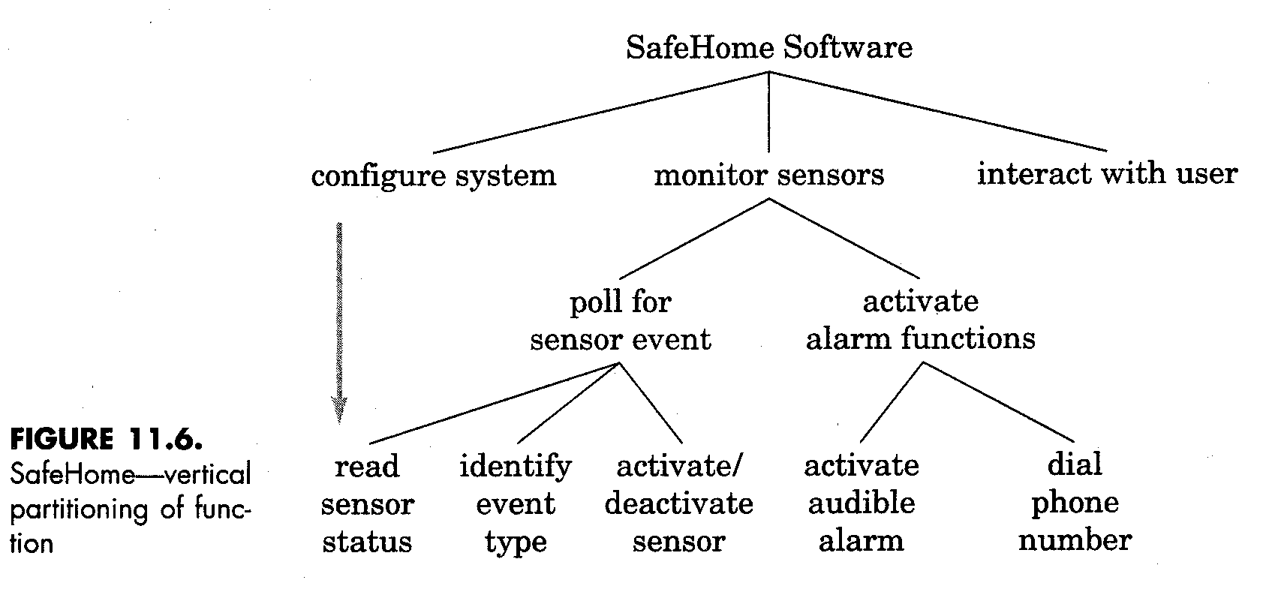
Partitioning
Notes:
Note distinction between essential and implementation views.
Essential view captures the conceptual ideas, but omits the details.

Slide 27
Specifications
Separate Function from Implementation
Develop Model
Define Environment
Define how software interacts with environ.
Create Cognitive model -- how world sees it
Recognize specs as imperfect
Flexibility -- be amenable to change

Slide 28
Representation
Format and content relevant to problem
Information should be nested
  Multiple layers or levels
Diagrams should be consistent in use
Representations should be revisable

Slide 29
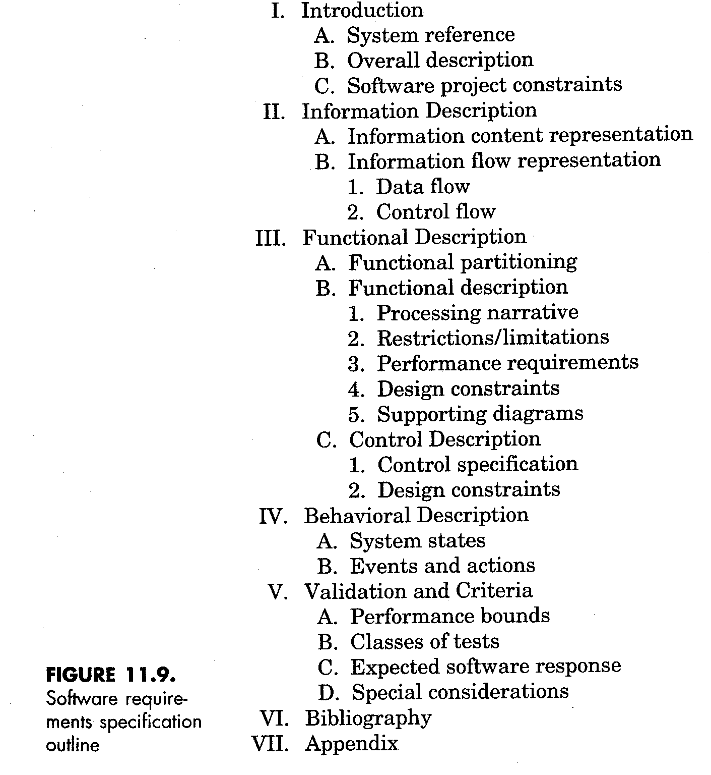
Requirements Specifications Documentation

Slide 30
Specifications Review
Macroscopic Level
  View from the top
  Goals met ?
  Alternatives explored ?
  Customer satisfied ?
Specifics
  Avoid persuasive, intimidating connectors
  Ambiguous words
  Vague language
  Watch for unstated assumptions

Slide 31
Validating Requirements-I
Is each requirement consistent with the overall objective for the system/product?
Have all requirements been specified at the proper level of abstraction? That is, do some requirements provide a level of technical detail that is inappropriate at this stage?
Is the requirement really necessary or does it represent an add-on feature that may not be essential to the objective of the system?
Is each requirement bounded and unambiguous?
Does each requirement have attribution? That is, is a source (generally, a specific individual) noted for each requirement?
Do any requirements conflict with other requirements

Slide 32
Validating Requirements-II
Is each requirement achievable in the technical environment that will house the system or product?
Is each requirement testable, once implemented?
Does the requirements model properly reflect the information, function and behavior of the system to be built.
Has the requirements model been “partitioned” in a way that exposes progressively more detailed information about the system.
Have requirements patterns been used to simplify the requirements model. Have all patterns been properly validated? Are all patterns consistent with customer requirements?

