Slide 1
Requirements management (RM)
Lect-4

Slide 2
Requirement
A requirement is something, which is desired or needed. From the software engineering point of view, a requirement is a condition or capability to which a system or software must conform to or a quality that the system must have.

Slide 3
Requirements management (RM)
Requirements management (RM) concerns activities related to controlling and tracking of changes to agreed requirements, relationships between requirements and dependencies between the requirements specifications and between specifications and other project artefacts.
Requirements management can be seen as a supportive process, which helps to manage requirements through the product’s lifecycle.
During any project or significant business undertaking, RM is a complex, comprehensive and iterative business analysis process defining business-related needs that involve the following action such as Identifying, Documenting, Analyzing, Prioritizing, Tracking, Monitoring, Controlling change, Tracing, Versioning

Slide 4
Cont..
Requirements management also demands effectively communicating to all agreed-to needs and changes to stakeholders. A requirements baseline is ultimately determined, against which all project activities are measured.
Depending on the size of your business, this process can include various stakeholders such as business and systems analysts, department representatives, IT leaders, frontline users, executives, project team members and vendors.
This key information is essential in enabling business strategy and ensures all projects and key business activities support overall companywide objectives.

Slide 5
Purpose of requirements management
The purpose of requirements management is to manage the requirements of the project's products and product components and to identify inconsistencies between those requirements and the project's plans and work products.
Moreover, another purpose is to establish a common understanding between the customer and the software project of the customer’s requirements that will be addressed by the software project.
In requirements management, the goal is to meet the stakeholders’ conditions and requirements, thus the final result will be the desired product.
Activities that are ensuring these objectives are called in general the requirements management.
The main task in requirements management is to ensure that the end product comes up to stakeholders expectations.
In the end product, there have to be all the demanded features, and these only.

Slide 6
Requirements management (RM) Activities

Slide 7
Requirements Management (RM) Activities
RM activities are considered to begin before the actual requirements engineering process phases (RM planning) and to continue during design, implementation, testing and maintenance phases.
The requirements provide the scope and direction for the projects.
Unfortunately, paying attention to the requirements management is not sufficient in practice.
If requirements are not managed well, a project can fail or be very costly.
On the other hand, a project that meets its requirements is by definition a success.
Requirements management is one of the most critical processes in the collaborative software development.

Slide 8
Under the circumstances, the requirements management can be organized under four main RM activities as follows:
Requirement identification
Requirement traceability & consistency management
Requirement change management
Requirement management planning

Slide 9
1. Requirements Identification
The requirements identification focuses on the assignment of a unique identifier for each requirement, which can be used to unambiguously refer to a requirement during product development and management.
Since requirements may evolve during product development, the management of requirement versions is essential.
Requirements are usually organized hierarchically, and in consequence of that, parent-child – relations between requirements are possible.

Slide 10
Cont..
For example, if the parent requirement is identified as REQ 2.3, then the child requirements could be identified as REQ 2.3.1 and REQ 2.3.2 and so on.
Requirement Chart
REQ 2.3
REQ 2.3.1
REQ 2.3.1

Slide 11
Cont…
The requirement attributes can be used to record additional information about the requirements, which helps users to get better management of the complexity of information.
Attributes can be included into requirements and they describe information as requirement classification, status, priority, version, relations, etc.
Clearly defined attributes can systematize the capture of requirement-related information.

Slide 12
Cont…
Requirements identification address these problems: −
Dynamic renumbering:
This technique allows the automatic interdocument renumbering of paragraphs when inserting information using e.g. word-processing systems.
It usually also allows cross-references to the paragraphs and maintains automatically information when there are changes in requirements structure.
Database record identification:
Database record identifier is assigned for each requirement entered in a requirements database.
By using this technique each requirement is considered to be an entity, which can be uniquely identified, versioned, referenced and managed.

Slide 13
Cont…
Symbolic identification:
Requirements are identified using symbolic names related to the contents of the requirement.
For example, EFF-1, EFF-2, Ö, EFF-n can be used for the identification of efficiency requirements.
The technique does not fix the requirement under certain structure. It can be used as interim identification scheme until requirements have been defined.

Slide 14
2. Requirements Traceability and Consistency Management
Traceability Management
The requirements traceability is seen as a critical part of the requirements change management.
The requirements traceability is the possibility to describe and follow the life of a requirement in both forward and backward direction.
The requirements traceability is used to estimate the impact of changes and to help to understand what the elements where changes would affect are.
Moreover, in the later phase of the development, it will enable one to check why a certain feature in the product under development was changed.
The requirements traceability can also cover the relationships with other entities, such as intermediate and final work products, changes in design documentation, test plans, and work tasks.
Traceability is in particularly needed in conducting the impact assessment of the requirements changes on the project plans, activities, and work products

Slide 15
Traceability
Vertical
Horizontal

Slide 16
vertical relationship
The vertical relationship is the traceability between requirements specification, implementation and test, when forward traceability links requirements to the design plan, product features and test cases.
Horizontal relationship
The horizontal relationship refers to traceability between requirements versions, when backward traceability links features, tests and design to the requirements.

Slide 17
Types of Traceability Table
Source traceability table:- identifies the source of each requirements
Dependency traceability table:- indicates how requirements are related to one another.
Subsystem traceability table:- categorize requirements by the subsystem that they govern.
Interface traceability table:- shows how requirements are related to internal and external system interfaces.

Slide 18
Consistency management
Consistency management is a part of the verification and validation process in software development.
Since requirements serve as a starting point for software development, consistency between requirements and following work products should be ensured throughout the development lifecycle.
Consistency management makes it certain that the produced software will meet its specified requirements.
Both requirements traceability and consistency management can be used to ensure that the product really meets the stakeholders' requirements.

Slide 19
3. Requirements change Management
The requirements change management is concerned with the processes that are used to manage changes to the system requirements.
Information is collected for each proposed change similarly and general estimation is made about the costs and benefits of the proposed change.
Most of the customers’ requirements become clarified during the preliminary study and requirements definition, but it is normal that the requirements change during the project.
It is not reasonable to wait until everything about the requirements is known; otherwise, the design phase can never start.
Therefore, the change management is a vital part of the requirements management.

Slide 20
Cont…
The iterative development approach accepts that change will happen.
The benefits of continuous feedback need to be realized without losing control of the project scope, quality, cost and timescales.
It is important to ensure that the teams working on a particular increment, but at different stages of the lifecycle, are able to determine the correct version of the requirements specification for that increment which they should be working to satisfy.
For example, if the user requirements are being modified for increment 2, while the system architects are working on the design for increment 1, the system architects should still be deriving their designs from the user requirements established for increment 1.

Slide 21
4. Requirements Management Planning
The definition of the requirements management policies is seen as one guideline for RM.
These policies include the definition of the goals and procedures for RM, which should be followed in the
An organization can have general policies for RM, but still each project should evaluate their applicability, and select and tailor the related ones for the project.
It should be noticed that it is not possible to define the total set of generic policies for an organization at once.
Under the circumstances, they need to be developed incrementally according practical experiences.

Slide 22
REQUIREMENT ENGINEERING PROCESS
Software specification or requirements engineering is the process of understanding and defining what services are required and identifying the constraints on these services.
Requirements engineering processes ensures your software will meet the user expectations, and ending up with a high quality software.
It’s a critical stage of the software process as errors at this stage will reflect later on the next stages, which definitely will cause you a higher costs.
At the end of this stage, a requirements document that specifies the requirements will be produced and validated with the stockholders.

Slide 23
Cont…
The main objective of requirement engineering is to discover quality requirements that can be implemented into software development.
The identified requirements must be clear, consistent, modifiable and traceable to produce a quality product.
The processes used for RE vary widely depending on the application domain, the people involved and the organization developing the requirements.

Slide 24
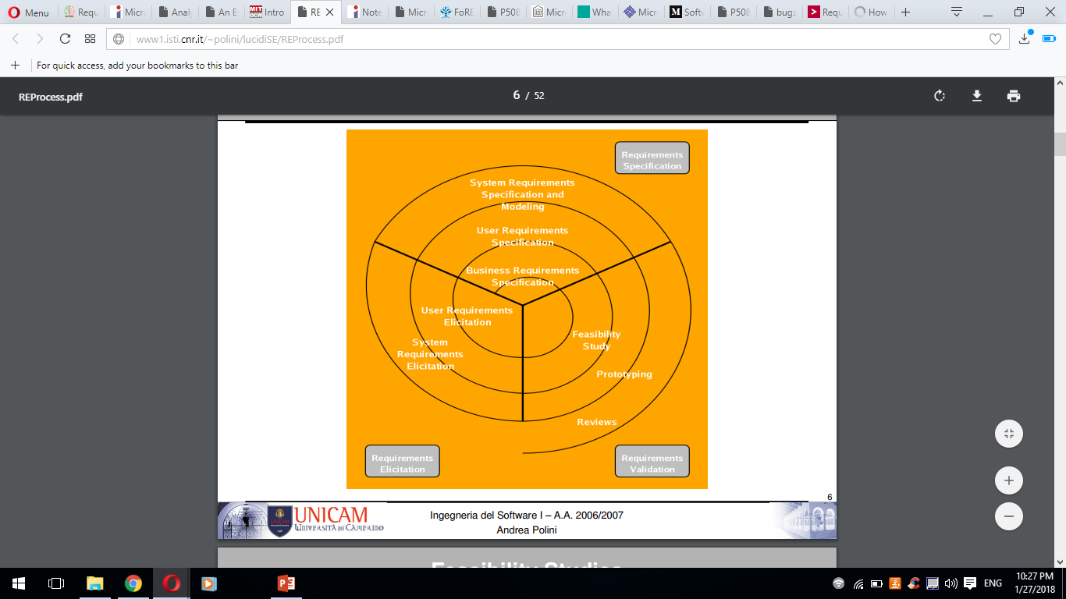

Slide 25
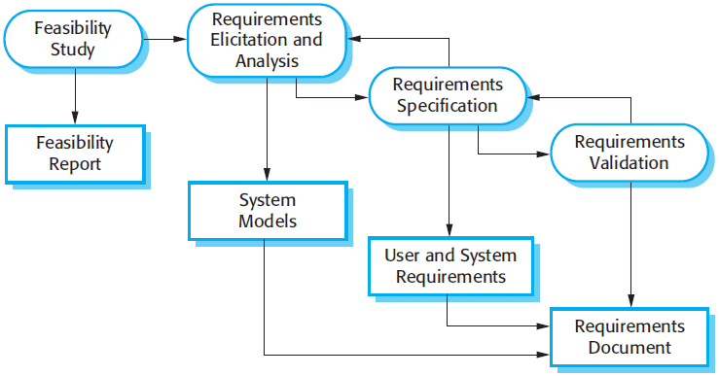
Process of requirements engineering
There are four main process of requirements engineering:

Slide 26
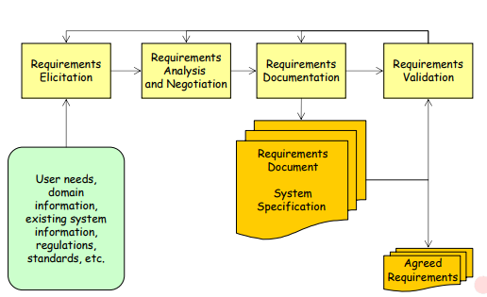

Slide 27
Feasibility study
An estimate is made of whether the identified can be achieved using the current software and hardware technologies, under the current budget, etc.
The feasibility study should be cheap and quick; it should inform the decision of whether or not to go ahead with the project.
A feasibility study decides whether or not the proposed system is worthwhile.
A short focused study that checks
If the system contributes to organizational objectives;
If the system can be engineered using current technology and within budget;
If the system can be integrated with other systems that are used.

Slide 28
Requirements elicitation and analysis
This is the process of deriving the system requirements through observation of existing systems, discussions with stakeholders, etc.
This may involve the development of one or more system models and prototypes that can help us understanding the system to be specified.
Requirement elicitation and development phase mainly focuses on examining and gathering desired requirements and objectives for the system from different viewpoints (e.g., customer, users, constraints, system's operating environment, trade, marketing and standard etc.).
Requirements elicitation phase begins with identifying stakeholders of the system and collecting raw requirements from various viewpoints.

Slide 29
Cont…
Raw requirements are requirements that have not been analyzed and have not yet been written down in a well-formed requirement notation.
The elicitation phase aims to collect different viewpoints such as business requirements, customer requirements, user requirements, constraints, security requirements, information requirements, standards etc.
Typically, the specification of system requirements starts with observing and interviewing people

Slide 30
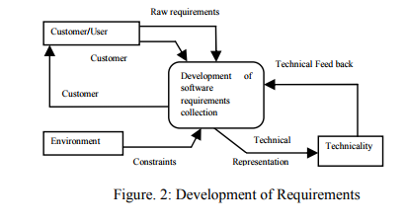
Cont…

Slide 31
Cont…
Furthermore, user requirements are often misunderstood because the system analyst may misinterpret the user’s needs.
In addition to requirements gathering, standards and constraints play an important role in systems development.
The development of requirements may be contextual, which is shown in figure 2.
It is observed that requirement engineering is a process of collecting requirements from customer and environment in a systematic manner.
The system analyst collects raw requirements and then performs detailed analysis and receives feedbacks.
Thereafter, these outcomes are compared with the technicality of the system and produce the good and necessary requirements for software development

Slide 32
Cont…
Sometimes called requirements elicitation or requirements discovery.
Involves technical staff working with customers to find out about the application domain, the services that the system should provide and the system’s operational constraints.
May involve end­users, managers, engineers involved in maintenance, domain experts, trade unions, etc. These are called stakeholders.

Slide 33
Cont..
Software engineers work with a range of system stakeholders to find out about the application domain, the services that the system should provide, the required system performance, hardware constraints, other systems, etc.
Stages include:
Requirements discovery,
Requirements classification and organization,
Requirements prioritization and negotiation,
Requirements specification.

Slide 34
The requirements elicitation and analysis process

Slide 35
Process activities
Requirements discovery
Interacting with stakeholders to discover their requirements. Domain requirements are also discovered at this stage.
Requirements classification and organisation
Groups related requirements and organises them into coherent clusters.
Prioritisation and negotiation
Prioritising requirements and resolving requirements conflicts.
Requirements specification
Requirements are documented and input into the next round of the spiral.

Slide 36
Problems of Requirements Analysis
Stakeholders don’t know what they really want.
Stakeholders express requirements in their own terms.
Different stakeholders may have conflicting requirements.
Organizational and political factors may influence the system requirements.
The requirements change during the analysis process.
New stakeholders may emerge and the business environment change

Slide 37
Documentation of Requirements
A formal document is prepared after collecting requirements, which contains a complete description of the external behavior of the software system.
Requirements development process is the activity of determining which functionality of the system will be performed by software.
Non-functional requirements are combined together with functional requirements into the software requirements specification with the help of flow-down, allocation, and derivation.
A software requirements specification will be established for each software subsystem, software configuration item, or component is part of this phase.

Slide 38
The documentation of requirements includes:
Documentation of Requirements
Requirements Identification
Requirement Specification

Slide 39
Requirements Identification:
Requirements identification practices focus on the assignment of a unique identifier for each requirement.
These unique identifiers are used to refer requirements during product development and management.
Requirements identification process consists of three sub activities.
The basic numbering activity includes significant numbering and non-significant numbering whereas identification activity includes labelling, structure based identification and symbolic identification.
The last technique is to support and automate the management of items, which includes dynamic renumbering, database record identification and base lining requirements

Slide 40
Requirement Specification:
Requirements specification document is produced after the successful identification of requirements.
The document describes the product to be delivered rather than the process of its development.
Software requirement specification (SRS) is an effective tool for requirement specification which is a complete description of the behaviour of the system or software to be developed.
It includes a set of use cases that describe all the interactions that users will have with the system/software.
In addition to use cases, the SRS also contains non-functional (or supplementary) requirements.
Non-functional requirements are requirements which impose constraints on the design or implementation.
SRS is a comprehensive description of the intended purpose and environment for software under development. The SRS fully describes what the software will do and how it will be expected to perform.

Slide 41
An SRS minimizes the time and effort required by developers to achieve desired goals and also minimizes the development cost.
A good SRS defines how an application will interact with system hardware, other programs and users in a wide variety of real-world situations.
Parameters such as operating speed, response time, availability, portability, maintainability, footprint, security and speed of recovery from adverse events are evaluated in SRS.

Slide 42
Requirements Verification and Validation
When the entire requirement are described and specified in the SRS, then different parties involved have to agree upon its nature.
One should ascertain that the correct requirements are stated (validation) and these requirements are stated correctly (verification).
Validation and verification activities include validating the system requirements against raw requirements and verifying the correctness of system requirement documentation.
The most common techniques for validating requirements are requirements reviews with the stakeholders, and prototyping.
Software requirements need to be validated against system level requirements and SRS needs to be verified.
Verification of SRS includes correctness, consistency, unambiguousness and understandability of requirements.

Slide 43
In requirement verification and validation, requirements traceability mechanism can generate an audit trail between the software requirements and finally tested code.
Traceability should be maintained to system level requirements, between software requirements, and to later phases, e.g., architectural work products.
The outcome of the software requirements development phase is a formal document including a baseline of the agreed software requirements.

Slide 44
Requirements checking
Validity. Does the system provide the functions which best support the customer’s needs?
Consistency. Are there any requirements conflicts?
Completeness. Are all functions required by the customer included?
Realism. Can the requirements be implemented given available budget and technology
Verifiability. Can the requirements be checked?

Slide 45
Requirements management planning
Establishes the level of requirements management detail that is required.
Requirements management decisions:
Requirements identification Each requirement must be uniquely identified so that it can be cross-referenced with other requirements.
A change management process This is the set of activities that assess the impact and cost of changes. I discuss this process in more detail in the following section.
Traceability policies These policies define the relationships between each requirement and between the requirements and the system design that should be recorded.
Tool support Tools that may be used range from specialist requirements management systems to spreadsheets and simple database systems.

Slide 46
Requirements change management
Deciding if a requirements change should be accepted
Problem analysis and change specification
During this stage, the problem or the change proposal is analyzed to check that it is valid. This analysis is fed back to the change requestor who may respond with a more specific requirements change proposal, or decide to withdraw the request.
Change analysis and costing
The effect of the proposed change is assessed using traceability information and general knowledge of the system requirements. Once this analysis is completed, a decision is made whether or not to proceed with the requirements change.
Change implementation
The requirements document and, where necessary, the system design and implementation, are modified. Ideally, the document should be organized so that changes can be easily implemented.

Slide 47
Requirements change management

