Slide 2
10 Top Reasons for Not Doing Requirements
We don't need requirements, we're using objects/java/web/...
The users don't know what they want
We already know what the users want
Who cares what the users want?
We don't have time to do requirements
It's too hard to do requirements
My boss frowns when I write requirements
The problem is too complex to write requirements
It's easier to change the system later than to do the requirements up front
We have already started writing code, and we don't want to spoil it

Slide 3
Software Requirements
Main activities involved in Software Requirements engineering:
Elicitation: Identify sources; Elicit requirements
Analysis: Classify requirements; Model; Top-level architecture; Allocate requirements to components; Negotiate requirements
Specification: Requirements Definition Doc; Software Requirements Specification; Document Standards; Document Quality
Validation: Reviews; Prototypes; Modelling; Test definition
Management: Traceability; Attributes; Change/Evolution

Slide 4
Scenario based example of Requirements management (RM) Activities
Volunteer Bank (VolBank)

Slide 5
Volunteer Bank (VolBank)
1. To develop a system that will handle the registration of volunteers and the depositing of their time. To record:
The details of volunteers, contact details, skills and needs
The time that each volunteer deposits in the system
To transfer from the web server details of volunteers and the time they are depositing.
2. To handle recording of opportunities for voluntary activity:
Details of voluntary organizations
Needs of voluntary organizations
Needs of individuals (inc volunteers) for help

Slide 6
Cont..
3. To match volunteers with people or organizations that need their skills:
Match volunteer with local opportunities
Match local opportunity with a team of volunteers
Record matches between volunteers and opportunities
Notify volunteers of a match
Notify organizations of a match
Record if agreement is reached from a particular match
4. To generate reports and statistics on volunteers, opportunities an time deposited.

Slide 7
VolBank: Elicitation
Identify potential sources of requirements:
Goals (why the system is being developed): high level goal is to increase the amount of volunteer effort utilized by needy individuals and organizations – suggests possible requirements in measurement and monitoring
Domain Knowledge: not much relevant here but in some areas e.g. safety – hazard analysis; security – vulnerability and threat analysis
Stakeholders: at least: volunteers, organizations, system administrators, needy people, operator, maintenance, manager
Operating Environment: may be constrained by existing software and hardware in the office
Organizational Environment: legal issues of keeping personal data, safety issues in “matching”

Slide 8
Cont…
Approaches to eliciting requirements:
i. Interviews with stakeholders:
i. Operator identifies:
The need to change details when people move home
The need to manage disputes when a volunteer is unreliable, or does bad work
ii. Female Volunteer identifies: the need for security/assurance in contacting organisations, …
iii. Management identifies number of hours volunteered per month above a given baseline as the key metric
ii. Scenarios: means to elicit the usual flow of work iii. Prototypes: mock-up using paper or powerpoint or software
iv. Facilitated Meetings: professional group work
v. Observation: observing “real world” work

Slide 9
VolBank: Requirements Analysis
Large volume of requirements information, need to analyze to
detect and resolve conflicts
scope the system and define interfaces with the environment
translate system requirements into software requirements.
Analysis involves:
Classification
Conceptual Modelling
Architectural Design and Requirements Allocation
Requirements Negotiation

Slide 10
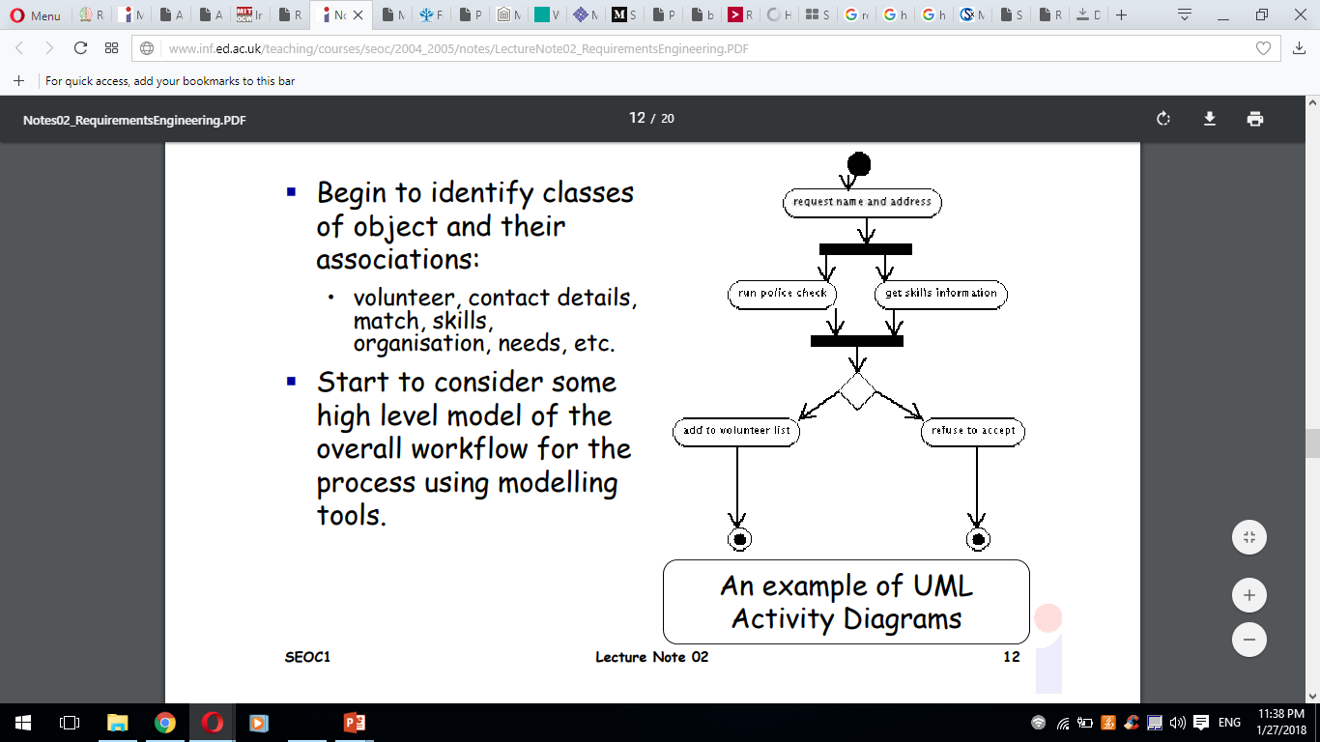
VolBank: Conceptual Modelling
Begin to identify classes of object and their associations:
volunteer, contact details, match, skills, organization, needs, etc.
Start to consider some high level model of the overall workflow for the process using modelling tools.

Slide 11
VolBank: Negotiation
Safety and Privacy requirements may be inconsistent
need to modify one or both
Privacy: only authorized releases for safety checks will be permitted and there is a procedure for feeding back to the individual if a check fails.
Some requirements may be achievable but only at great effort – attempt to downscale
it may be too much effort to implement a fault reporting system in the first release of the system

Slide 12
Other Activities
Constructing specifications
System requirements definition: customer facing, at system level
Software Requirements Specification: developer facing, at software level.
Requirements validation
key activity aim to get as much as possible
define the acceptance test with stakeholders.
Requirements Management
requirements change because the environment changes and there is a need to evolve, need tools to manage the collection and maintain traceability.

Slide 13
Requirements Development
The Requirements Development Process is a very comprehensive, iterative and recursive process
Requirements Development fits into Step One of the Systems Engineering Process: Requirements Analysis. There are six (6) basic requirements development steps and really don’t change depending on which model is used. All models are similar in their approach; they just depict them differently graphically.

Slide 14
Step 1:
Develop Requirements The first step is to gather, analyze and develop requirements from the Concept of Operations (CONOPS), stakeholder needs, objectives and other external requirement. Once requirements are documented, they are prioritized, de-conflicted, and validated with the stakeholders.
Step 2:
Write and Document Requirements The second step focuses on writing down the functional and performance requirements into the appropriate requirements documents;Initial Capabilities Document (ICD), Capability Development Document (CDD), and Capability Production Document (CPD). Requirements must be documented in order to establish a requirements baseline to start building a system and manage any changes. Requirements can be developed using the Capability Development Tracking and Manager (CDTM) tool for DoD programs.

Slide 15
Step 3:
CheckCompleteness The third step is to check that a complete set of requirements have been developed and documented that defines all system functions that are needed to satisfy the stakeholder needs with their associated performance, environmental, and other non-functional requirements. Requirement Tracing is a big tool in this step.
Step 4:
Analyze,Refine,andDecomposeRequirements Requirements Analysis is the first major step in the Systems Engineering Process. This step examines each requirement to see if it meets the characteristics of a good requirement. Each requirement is then decomposed into a more refined set of requirements that are allocated to sub-systems and documented in the Weapons System Specification (WSS). Newly derived requirements are expected to emerge from this process, which continues until all requirements are defined and analyzed.

Slide 16
Step 5:
ValidateRequirements In step five each requirement must be verified and validated to ensure that these are the correct requirements. This ensures that the requirements meet the overall objective of the system and all stakeholder needs.
Step 6:
ManageRequirements In step six the requirements have been accepted and a baseline is established by the stakeholders. Any changes to the requirements are controlled using a Configuration Management process.

