Slide 1
Hopping energy in Projected states
Fuyan Lu

Slide 2
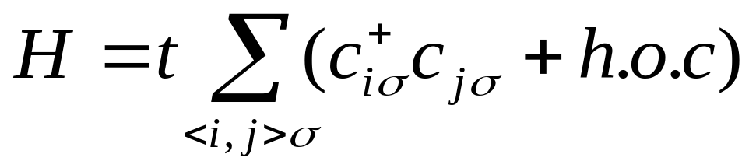
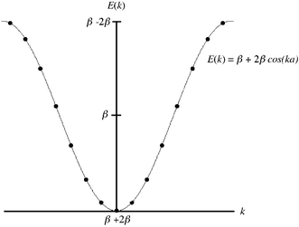
The Hamiltonian
The ground states (filling factor <1/2)
Fermi Surface

Slide 3
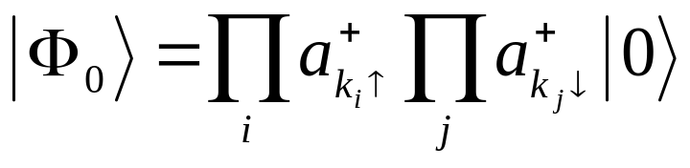
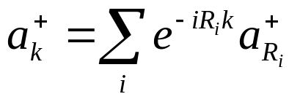
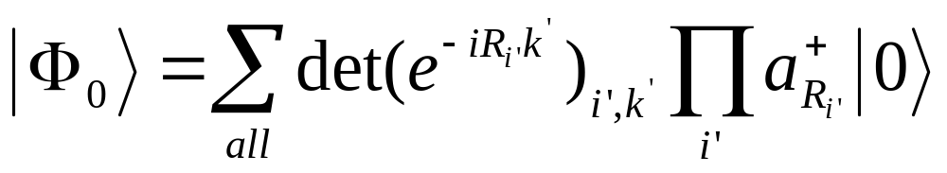
Define ground state.
Fourier Transformation

Slide 4
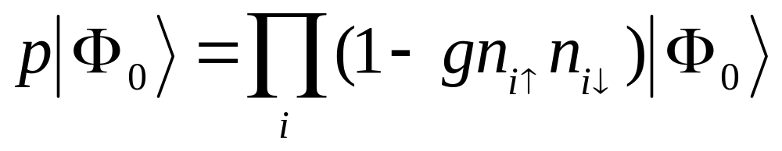
P is the projection operator
g is projection parameter, and g=0 is unproject limit, and g=1 is completely projected.
To figure out how hopping energy change with different projected parameter is different situation

Slide 5

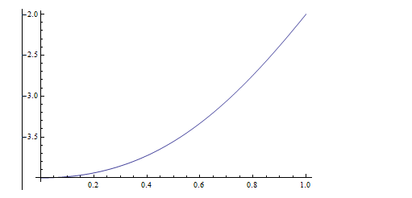
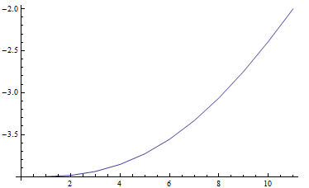
Programming and Check
3 sites and two electron, analytic solution
3 sites and two electron, simulation result from programming

Slide 6
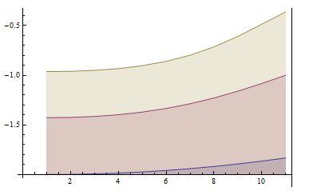
Keep size constant (13), one change the number of electrons (2,6,10). Plot the hopping energy per electron with different g
10 electron
6 electron
2 electron

Slide 7
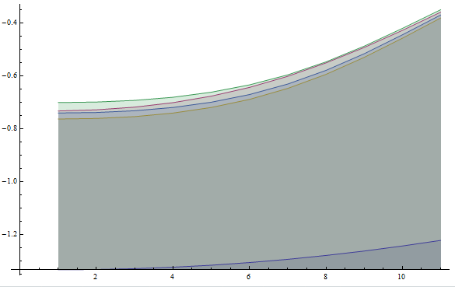
Keep the electron density constant (2/3), one varies the size of the system (3,6,9,12,15). Plot hoping energy per fermion.(scalling properties)
from botom to top 3, 6,9,12,15

Slide 8
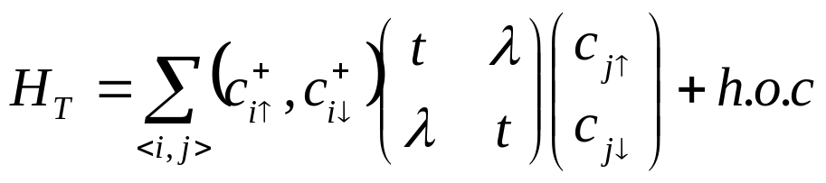


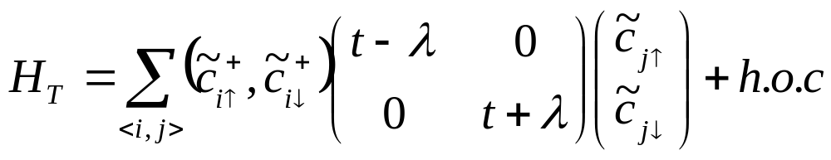
Sub-space Rotation
We have assumed hoping term is bond independent. What's More, the interaction term is invariant under SU(2) Rotation in spin-space. Therefore, one can figure out a global spin-rotation to diagonalize the hoping matix.
After rotation, one can get and .

