Slide 1
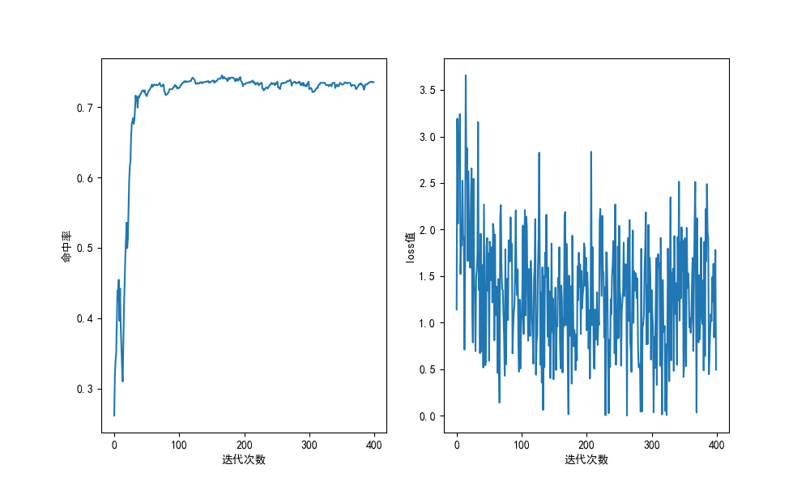
train_set ：/test7/trainData_full.txt
test_set ：/test6_testdata/testData.txt
alpha =0.05
batch_size =5
times =400
w =[-0.75094564 -1.26645375 0.10501698 0.15050324 -4.02355505 -0.58273381]
b =[ 1.09386461 0.57835649 -0.05017277 -0.00468651 -2.1787448 0.26207643]

Slide 2
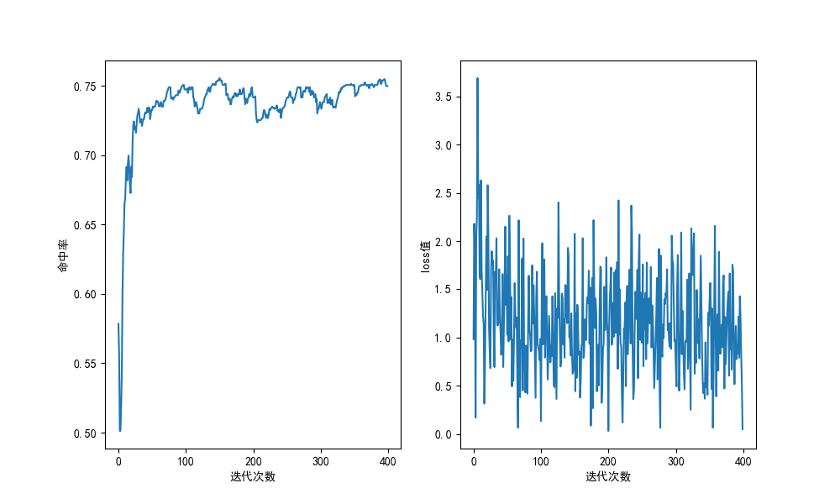
train_set ：/test7/trainData_ part1.txt
test_set ：/test6_testdata/testData.txt
valve =0.6 (如果sig>valve，即可认为二者是1)
alpha =0.05
batch_size =5
times =400
w =[-0.63611137 -1.07651501 0.3147759 0.45770024 -3.10460405 -0.36672506]
b =[ 0.90308925 0.46268562 -0.14602348 -0.00309914 -1.56540343 0.17247556]

Slide 3
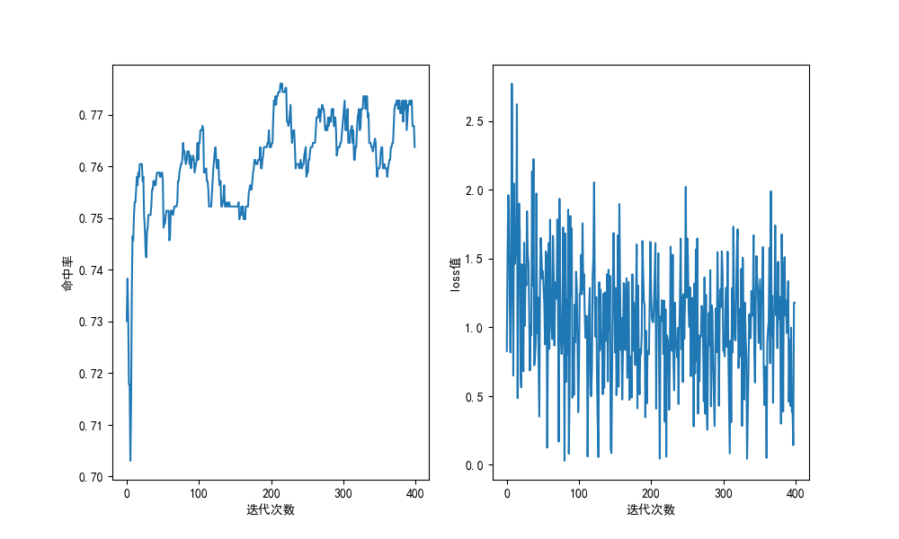
train_set ：/test7/trainData_ part1.txt
test_set ：/test6_testdata/testData.txt
valve =0.7 (如果sig>valve，即可认为二者是1)
alpha =0.05
batch_size =5
times =400
w =[-0.5609068 -0.99845217 0.40952666 0.57734695 -2.97799733 -0.25119751]
b =[ 0.83473257 0.3971872 -0.19483397 -0.02701367 -1.58235796 0.14444186]

Slide 4
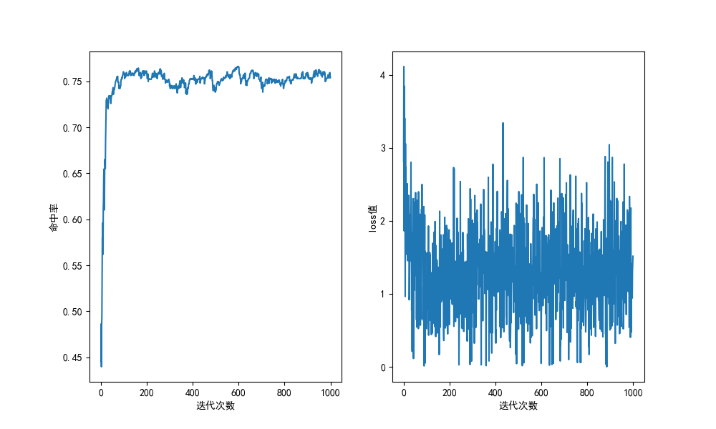
train_set ：/test7/trainData_ part1.txt
test_set ：/test6_testdata/testData.txt
valve =0.7 (如果sig>valve，即可认为二者是1)
alpha =0.05
batch_size =5
times =1000
w =[-0.71661184 -1.28302366 0.1485969 0.20466747 -4.71551778 -0.52157122]
b =[ 1.07574195 0.50933014 -0.0590493 -0.00297873 -2.92316399 0.27078258]

Slide 5
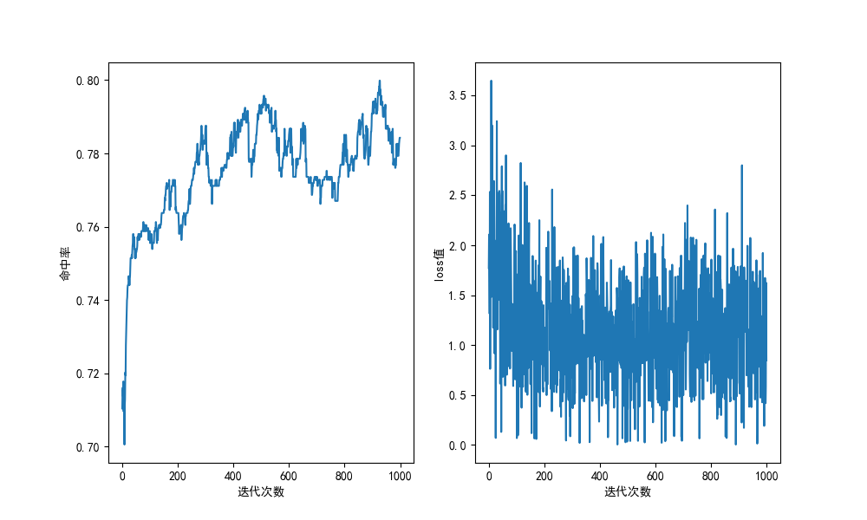
train_set ：/test7/trainData_part1.txt
test_set ：/test6_testdata/testData.txt
valve =0.8 (如果sig>valve，即可认为二者是1) （row:-1 1）
alpha =0.02
batch_size =5
times =1000
w =[-0.60925763 -1.1013422 0.3171342 0.44784021 -3.80370639 -0.36453653]
b =[ 0.92344152 0.43135695 -0.15016665 -0.01946064 -2.27100723 0.16816262]

Slide 6
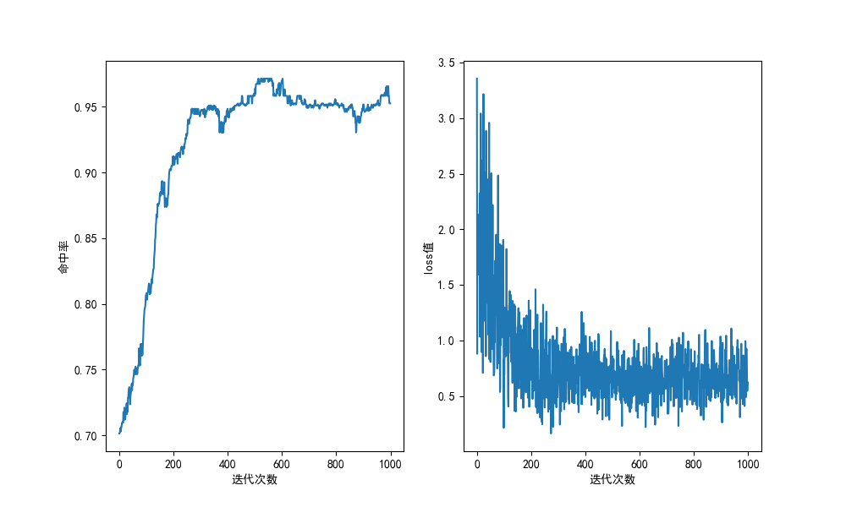
train_set ：/test7/trainData_part1.txt
test_set ：/test6_testdata/testData.txt
valve =0.8 (如果sig>valve，即可认为二者是1) （row:1 -1）
alpha =0.015
batch_size =5
times =1000
w =[-0.60245898 -1.13058121 0.29626557 0.41666105 0.27931003 -0.31227137]
b =[ 0.96414375 0.43602152 -0.13713169 -0.01673621 -0.15408724 0.15433137]

Slide 7
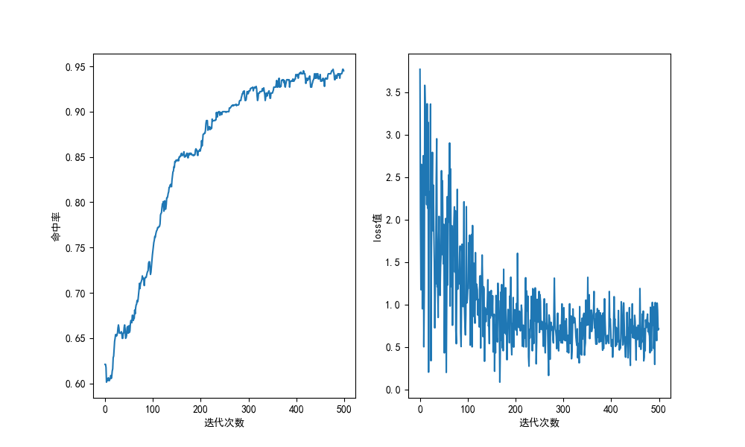
train_set ：/test7/trainData_part1.txt
test_set ：/test6_testdata/testData.txt
valve =0.8 (如果sig>valve，即可认为二者是1) （row:1 -1）
alpha =0.015
batch_size =5
times =1000
w =[-0.60245898 -1.13058121 0.29626557 0.41666105 0.27931003 -0.31227137]
b =[ 0.96414375 0.43602152 -0.13713169 -0.01673621 -0.15408724 0.15433137]

Slide 8
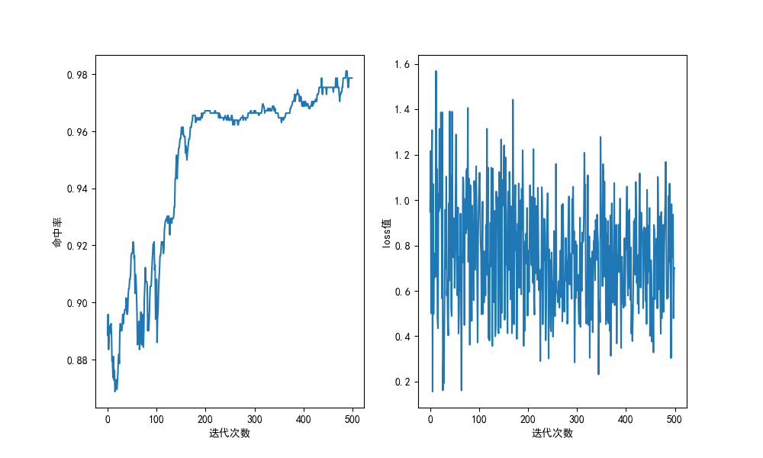
train_set ：/test7/trainData_ part1.txt
test_set ：/test6_testdata/testData.txt
valve =0.9 (如果sig>valve，即可认为二者是1) （row:1 -1）
alpha =0.015
batch_size =5
times =500
w =[-0.45822466 -0.84502753 0.57923204 0.80603466 0.55007691 -0.0402431]
b =[0.70883638 0.32203351 -0.25370692 -0.02690429 -0.28286205 0.02681794]

Slide 9
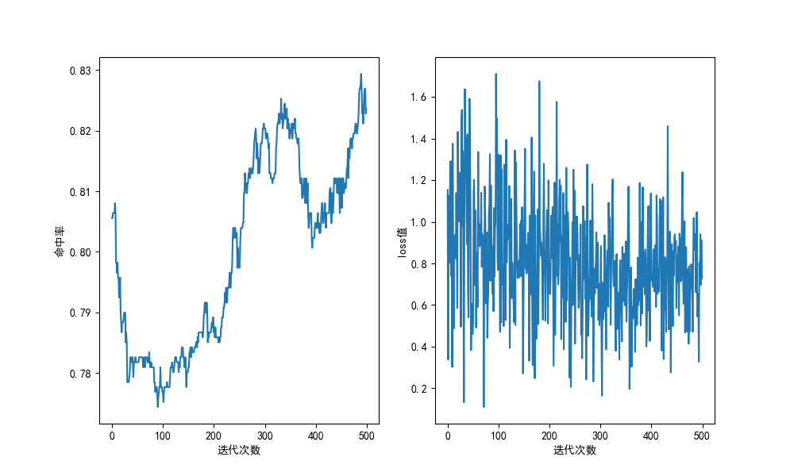
train_set ：/test7/trainData_ part1.txt
test_set ：/test6_testdata/testData.txt
valve =0.65 (如果sig>valve，即可认为二者是1) （row:1 -1）
alpha =0.015
batch_size =5
times =500
w =[-0.44857498 -0.79699855 0.57057966 0.83297502 0.54682325 -0.04382866]
b =[7.18591561e-01 3.70167994e-01 -2.62253800e-01 1.41568953e-04 -2.86010206e-01 2.33378805e-02]
true_num : 26 true_bingo : 26 true_bingo_rate : 1.0
false_num : 1193 false_bingo: 978 false_bingo_rate : 0.8197820620284996

Slide 10
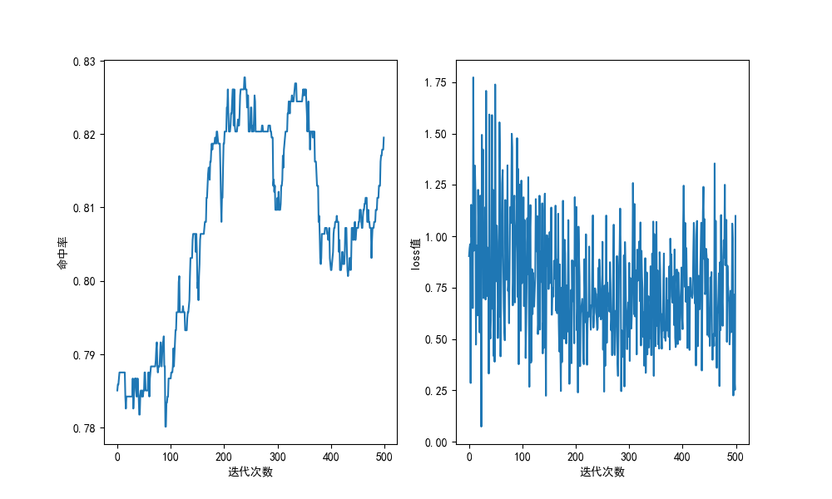
train_set ：/test7/trainData_ part1.txt
test_set ：/test6_testdata/testData.txt
valve =0.67 (如果sig>valve，即可认为二者是1) （row:1 -1）
alpha =0.015
batch_size =5
times =500
w =[-0.4642477 -0.85702 0.53094664 0.76878286 0.5338443 -0.08599944]
b =[0.76152468 0.36875238 -0.24328099 -0.00544477 -0.24038333 0.03977294]
true_num : 26 true_bingo : 26 true_bingo_rate : 1.0
false_num : 1193 false_bingo: 973 false_bingo_rate : 0.815590947191953

Slide 11
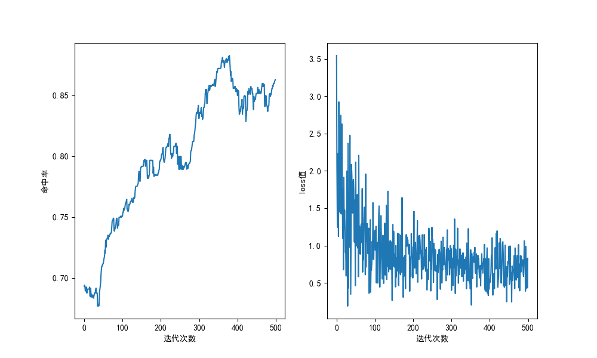
train_set ：/test7/trainData_part1.txt
test_set ：/test6_testdata/testData.txt
valve =0.70 (如果sig>valve，即可认为二者是1) （row:1 -1）
alpha =0.015
batch_size =5
times =500
w =[-0.55593403 -1.05157897 0.35801744 0.52451041 0.34678067 -0.27584307]
b =[ 0.93309942 0.43745448 -0.15294911 0.01354386 -0.16418588 0.11319038]
true_num : 26 true_bingo : 19 true_bingo_rate : 0.7307692307692307
false_num : 1193 false_bingo: 1033 false_bingo_rate : 0.865884325230511

Slide 12
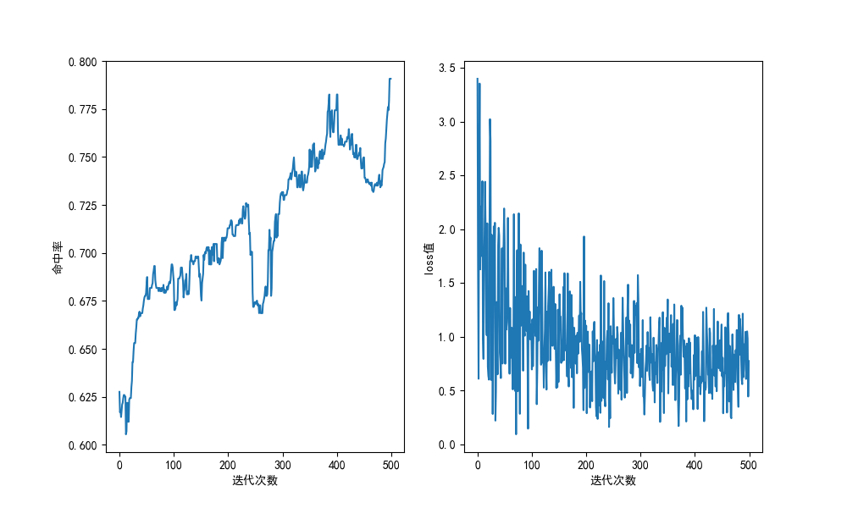
train_set ：/test7/trainData_part2.txt
test_set ：/test6_testdata/testData.txt
valve =0.70 (如果sig>valve，即可认为二者是1) （row:1 -1）
alpha =0.015
batch_size =5
times =500
w =[-0.58206924 -0.94215725 0.28293547 0.39201862 0.33302789 -0.42165872]
b =[ 1.01642106 0.65633305 -0.11857423 -0.00949108 -0.06848181 0.07683158]
true_num : 26 true_bingo : 25 true_bingo_rate : 0.9615384615384616
false_num : 1193 false_bingo: 939 false_bingo_rate : 0.7870913663034

Slide 13
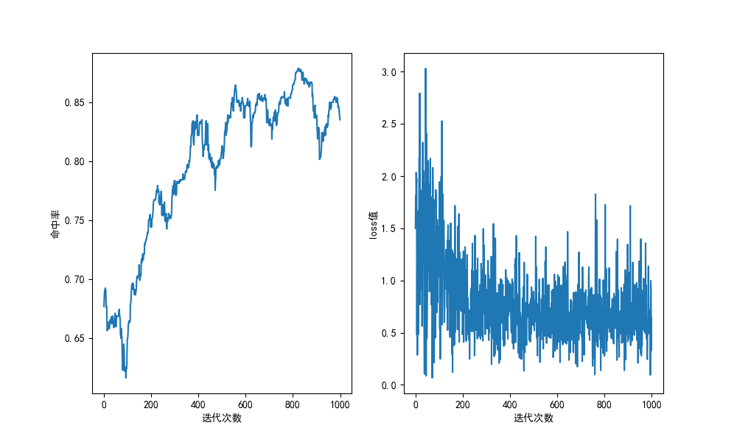
train_set ：/test7/trainData_part2.txt
test_set ：/test6_testdata/testData.txt
valve =0.70 (如果sig>valve，即可认为二者是1) （row:1 -1）
alpha =0.015
batch_size =5
times =1000
w =[-0.57594943 -0.94426039 0.3337293 0.45899012 0.38589977 -0.32775884]
b =[ 0.93714141 0.56883045 -0.15317985 -0.02791904 -0.10100939 0.085332]
true_num : 26 true_bingo : 22 true_bingo_rate : 0.8461538461538461
false_num : 1193 false_bingo: 996 false_bingo_rate : 0.8348700754400671

Slide 14
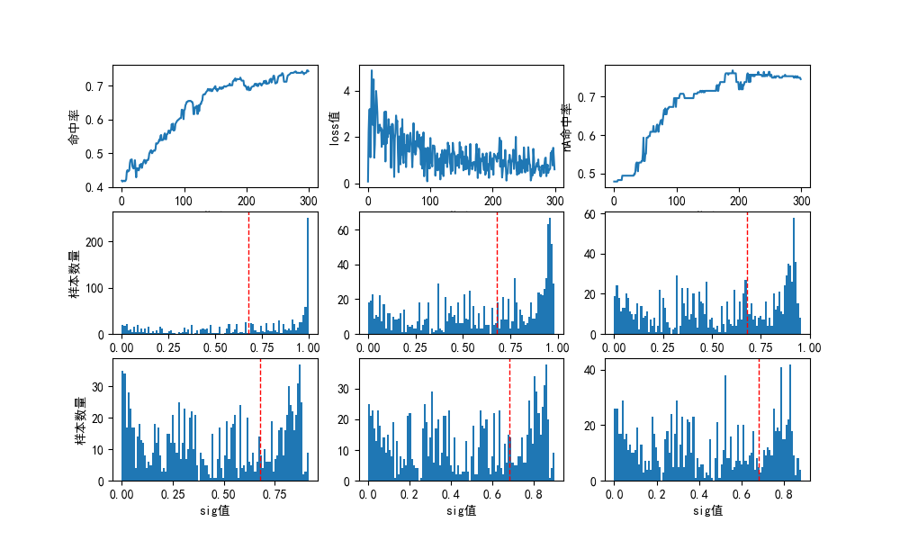
train_set ：/test7/trainData_part2.txt
test_set ：/test6_testdata/testData.txt
valve = 0.68 (如果sig>valve，即可认为二者是1) （row:1 -1）
alpha = 0.015
batch_size = 5
times = 300
bingo_valve= 0.80
w = [-0.64611056 -1.03375699 0.20305171 0.29869536 0.22193102 0.21065857]
b = [ 1.11639191 0.72874549 -0.03444581 0.06119784 -0.0155665 -0.02683895]
true_num : 26 true_bingo : 22 true_bingo_rate : 1.0
false_num : 1193 false_bingo: 996 false_bingo_rate : 0.7367979882648784

Slide 15
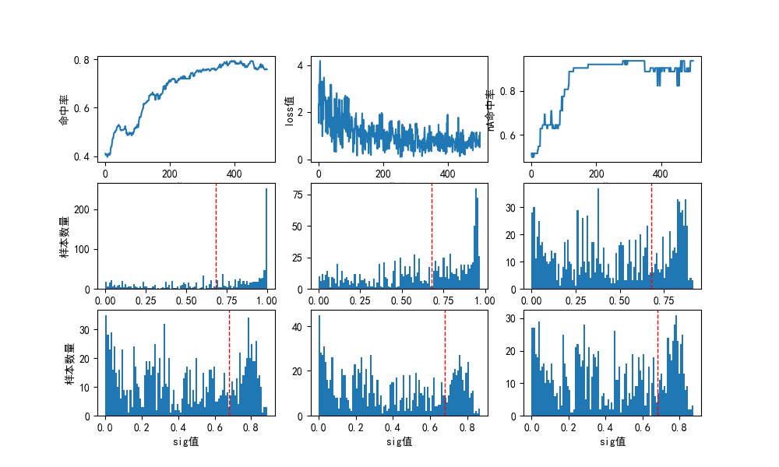
train_set :/test7/trainData_part2.txt bingo_set :
test_set :/test6_testdata/testData.txt
valve = 0.68 (如果sig>valve，即可认为二者是1) （row:1 -1）
alpha = 0.015
batch_size = 5
times = 500
bingo_valve= 0.80 init_B=[-1, -1, 1, 1, 1, 0.5]
w = [-0.64530985 -1.05633889 0.17002826 0.23984189 0.21142088 -0.22791236]
b = [ 1.12145012 0.71042108 -0.06321177 0.00660186 -0.02181915 0.03884761]
true_num : 26 true_bingo : 26 true_bingo_rate : 1.0
false_num : 1193 false_bingo: 899 false_bingo_rate : 0.7535624476110645

Slide 16
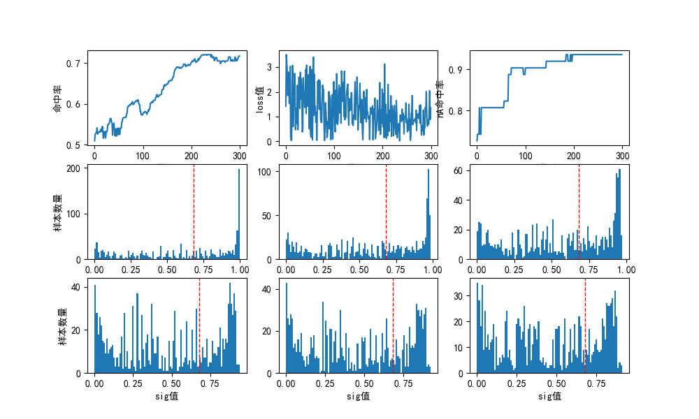
train_set :/test7/trainData_part2.txt bingo_set :nA1B_testData/2021-7-7-NA1B-ALL.txt
test_set :/test6_testdata/testData.txt
valve = 0.68 (如果sig>valve，即可认为二者是1) （row:1 -1）
alpha = 0.015
batch_size = 3
times = 600
bingo_valve= 0.85 init_B=[-1, -1, 1, 1, 1, 0.5]
w = [-0.69491735 -1.13652613 0.2408595 0.34789461 0.25997217]
b = [ 1.12087484 0.67926606 0.05665169 0.1636868 0.07576436]
true_num : true_bingo : true_bingo_rate :
false_num : false_bingo: false_bingo_rate :

