Slide 1
COEN 146 Computer Networks
Network Commands

Slide 2

General Information
Labs will be due the next Friday
Office Hours
Isaac Wu
W 4:00 pm - 5:00 pm
F 1:00 pm - 2:00 pm
Rachael Brooks
T 12:00 pm - 12:30 pm

Slide 3
Objectives
To demonstrate network commands
To measure packet delays
To setup client-side connection to HTTP server

Slide 4
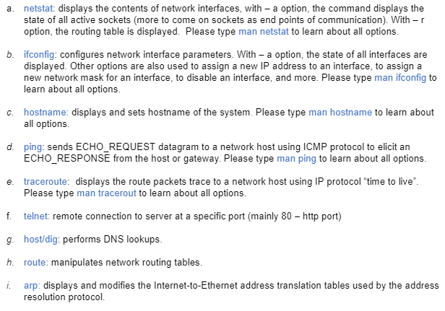
1. Network Commands and tools

Slide 5
2.Ping Command
ping -s [size] [domain name]
identify the packet loss.
identify the RTT “Round-Trip-Time”.
Explain the correlation between these measurements to the geographical location of the hosts.
Check ip location:
https://www.ip2location.com/

Slide 6
3. Write a Program to calculate
Assuming zero transmission time for the HTML object, how much time elapses from when the client clicks on the link until the client receives the object?
Now suppose the HTML object references 6 very small objects on the same web server. Neglecting transmission times, how much time elapses from when the client clicks on the link until the base object and all 6 additional objects are received from web server at the client, assuming non-persistent HTTP and no parallel TCP connections?
Assume that the client is configured to support n parallel TCP connections, compute the response time in both persistent and non-persistent cases.

Slide 7
4 and 5. Http client connection
4. Setup a client side to connect to gaia.cs.umass.edu 80, record observations
5. Repeat step 4
With hosts selected in step 2
With port other than 80

Slide 8
Demo and submission
Demo:
run code for step 3
Submission:
Submit the .c file and the observations

