Slide 1
COEN 146 Computer Networks
TCP/IP Socket Programming

Slide 2
Objectives
To develop client/ server applications using TCP/IP Sockets
To write a C program to transfer file over TCP/IP Socket

Slide 3
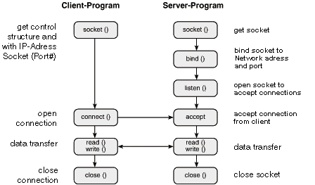
TCP/IP

Slide 4
Functions used on server
int sockfd = socket(domain, type, protocol);
int bind (int sockfd, const struct sockaddr *addr, socklen_t addrlen);
int listen(int sockfd, int backlog);
int new_socket= accept(int sockfd, struct sockaddr *addr, socklen_t *addrlen);

Slide 5
Functions used on client
int sockfd = socket(domain, type, protocol);
int connect(int sockfd, const struct sockaddr *addr, socklen_t addrlen);
struct sockaddr_in {
sa_family_t sin_family; /* address family: AF_INET */
in_port_t sin_port; /* port in network byte order */
struct in_addr sin_addr; /* internet address */
};
/* Internet address. */
struct in_addr {
uint32_t s_addr; /* address in network byte order */
};

Slide 6
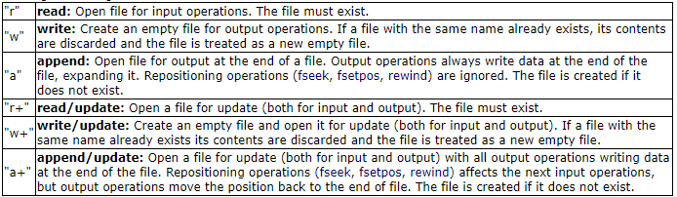
Recap: Copy with functions
#include <stdio.h>
FILE *fopen(const char *filename, const char *mode)
size_t fwrite(void* ptr, int size, int n, FILE *fp); or fprintf() (for text files)
size_t fread(void* ptr, int size, int n, FILE *fp); or fscanf() (for text files)
fclose(ptr);
More info: https://www.cplusplus.com/reference/cstdio/fopen/
modes:

Slide 7
Recap: Copy with system calls
#include<sys/types.h>
#include<sys/stat.h>
#include <fcntl.h>
int open (const char* Path, int flags [, int mode ]); //access mode flags: O_RDONLY, O_WRONLY, O_RDWR
size_t read (int fd, void* buf, size_t cnt);
size_t write (int fd, void* buf, size_t cnt);
int close(int fd)
More info: https://man7.org/linux/man-pages/man2/open.2.html

Slide 8
Recap: Threads
#include <pthread.h>
Compile with -lpthread flag
Functions to create threads
pthread_create(pthread_t *thread, pthread_attr_t *attr, void *(*start_routine) (void *arg), void *arg)
pthread_exit()
pthread_join(pthread_t thread, void **retval)

Slide 9
Steps to follow
TCP server
TCP client
Demo
Concurrent server(using pthread)
Demo

