Slide 1
COEN 146 Computer Networks
UDP/IP Socket Programming

Slide 2
Objectives
To develop client - server (P2P) applications using UDP/IP Sockets
To write a C program to transfer file over UDP/IP Socket

Slide 3
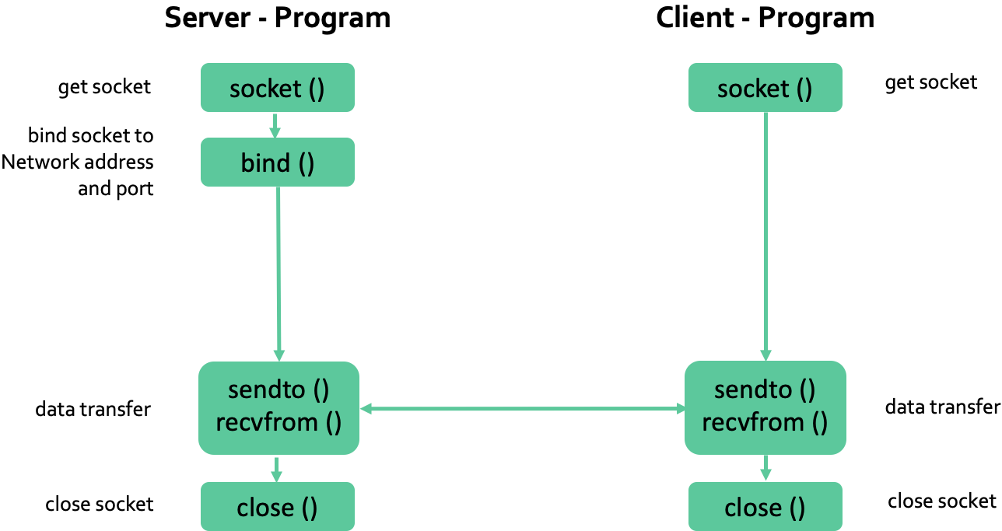
UDP/IP Server and Client

Slide 4
Functions used
int sockfd = socket(domain, type, protocol)
int bind (int sockfd, const struct sockaddr *addr, socklen_t addrlen);
sendto(sockfd, sbuf, strlen(sbuf), 0, (struct sockaddr *)&servAddr, sizeof(struct sockaddr));
recvfrom(sockfd, rbuf, strnlen(rbuf), 0,(struct sockaddr *)&clienAddr, sizeof(struct sockaddr));

Slide 5
Address Structure
struct sockaddr_in {
sa_family_t sin_family; /* address family: AF_INET */
in_port_t sin_port; /* port in network byte order */
struct in_addr sin_addr; /* internet address */
};
/* Internet address. */
struct in_addr {
uint32_t s_addr; /* address in network byte order */
};

Slide 6
Steps
Write Server Code
Write Client Code
Test if sending works correctly
Demo to TA

