Slide 1

COEN 146 Computer Networks
Lab 5: Stop and Wait for an Unreliable Channel

Slide 2
Objectives
To build a Stop and Wait reliable protocol on top of UDP to provide a reliable transport service

Slide 3
Client & Server
Implement rdt2.2 (Handles error bits)
The communication is unidirectional (one way)
Client sends data to the server

Slide 4
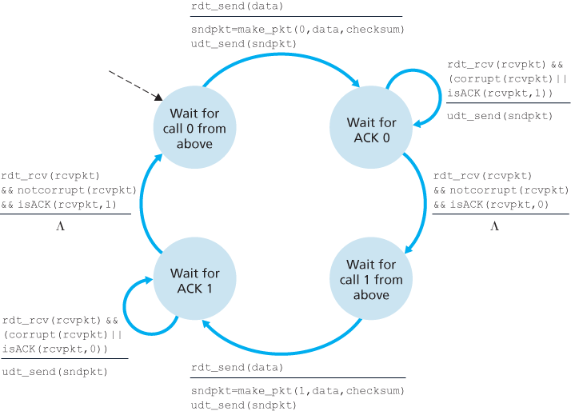
Client(Sender)
Read a line
Call the Client Send(call from above)
Calculate checksum
Take keyboard input for error
To make incorrect: 0 checksum
Send the packet
Wait/resend until correct response
Change the sequence number
…

Slide 5
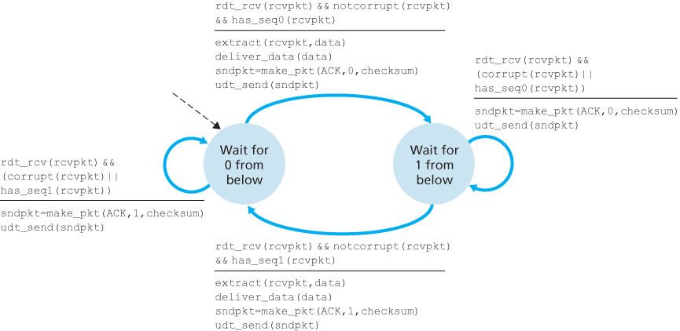
Server(Receiver)
Receive a Packet
Verify checkSum
Ask for resend if incorrect
Change the sequence number
…

Slide 6
Steps to follow
Finish the Server
Finish the Client
Test without changed bit
Test with changed bit
Demo and explain the result.
This lab is due Feb.18th

