Slide 1
COEN 146 Computer Networks
Lab6: Stop and Wait for an Unreliable Channel, with Loss

Slide 2
Objective
To build a Stop and Wait reliable protocol on top of UDP to provide a reliable transport service while considering loss

Slide 3
Sender & receiver
Both have a chance not to send out the packet
Use the rand() to determine whether the packet is being sent.
Receiver doesn’t have any further changes

Slide 4
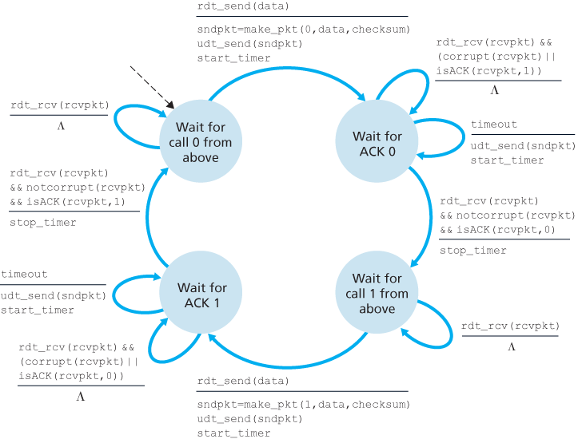
Sender
Timeout added for missing packets
If the packet times out
Resend the package

Slide 5
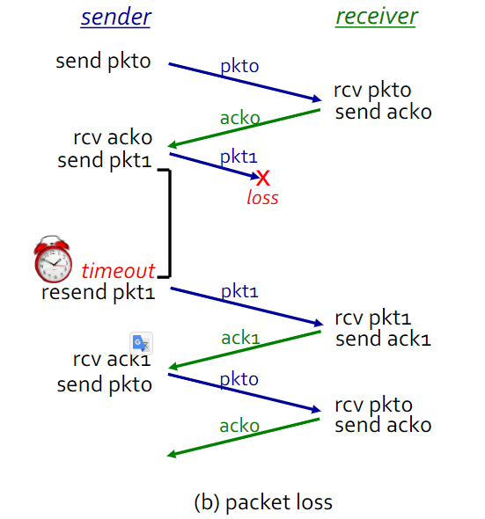
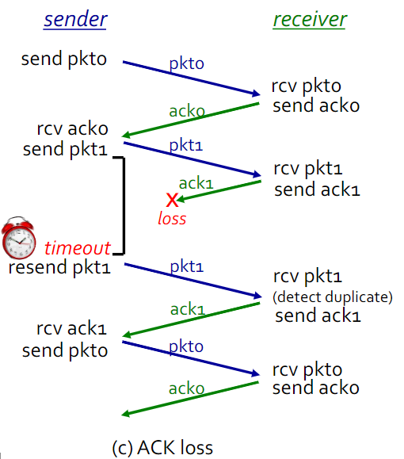

Slide 6
Structure for the select
// local variables needed
struct timeval tv; // timer
int rv; // select returned value
// set it up, in the beginning of the function
fd_set readfds;
fcntl (sock, F_SETFL, O_NONBLOCK);
// start before calling select
FD_ZERO (&readfds);
FD_SET (sock, &readfds);
// set the timer
tv.tv_sec = 10;
tv.tv_usec = 0;
// call select
rv = select (sock + 1, &readfds, NULL, NULL, &tv); // sock is the socket you are using, you are asking select() to notify you when file descriptor is ready for reading.
if (rv == 0)
{
// timeout, no data
}
else if (rv == 1)
{
// there is data to be received
}

