Slide 1
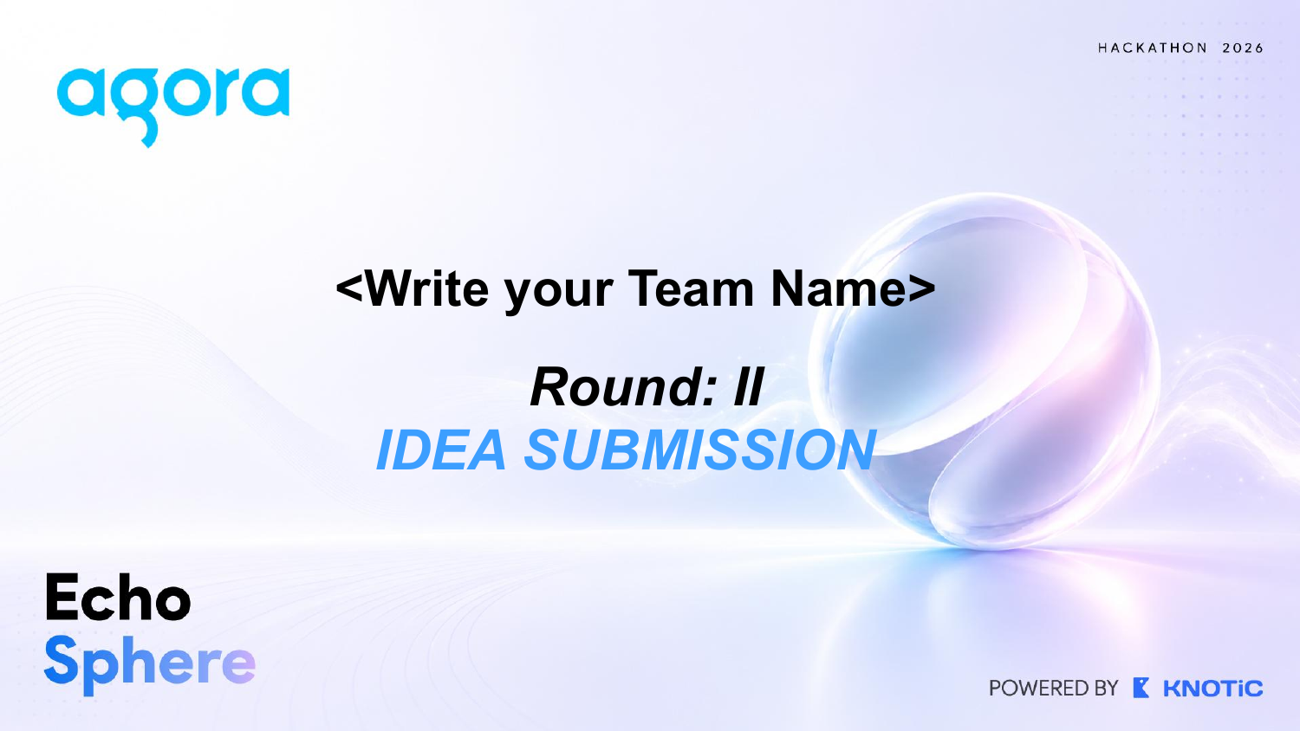
The Falcons
ORBIT — Real-time AI Incident Commander
Operational Response & Briefing Intelligence Team
PS41 | EchoSphere Hackathon 2026
Fuzail Ahmad • Lakshya Garg • Aryan Rai

Slide 2
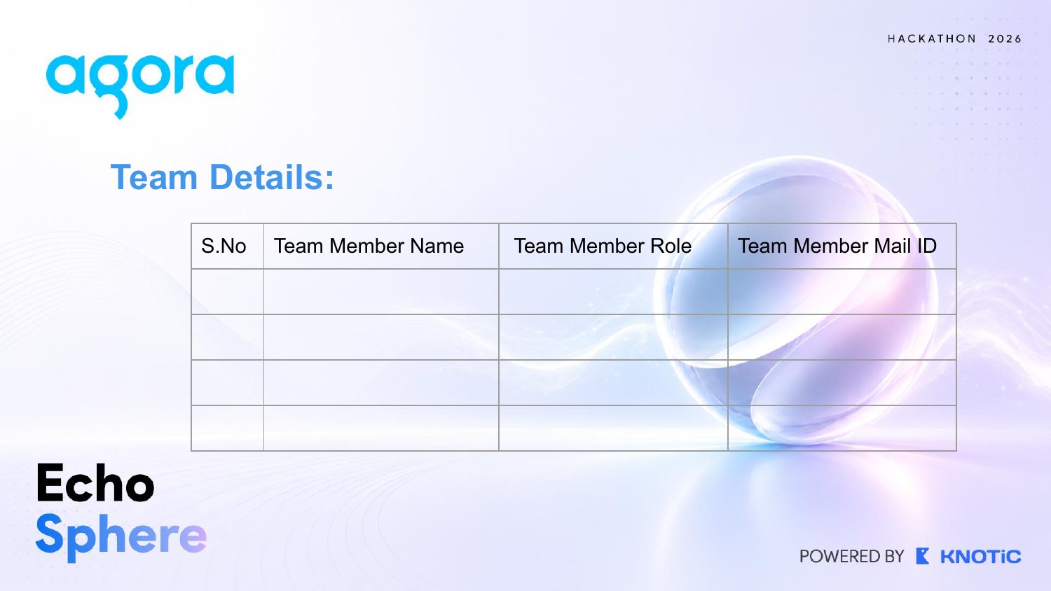
1
Fuzail Ahmad
Product & AI Orchestration
fuzailahmad2006@gmail.com
2
Lakshya Garg
Real-time Voice & Backend
lgarg7112@gmail.com
3
Aryan Rai
Frontend & Integrations
aryanbrijrajrai@gmail.com

Slide 3
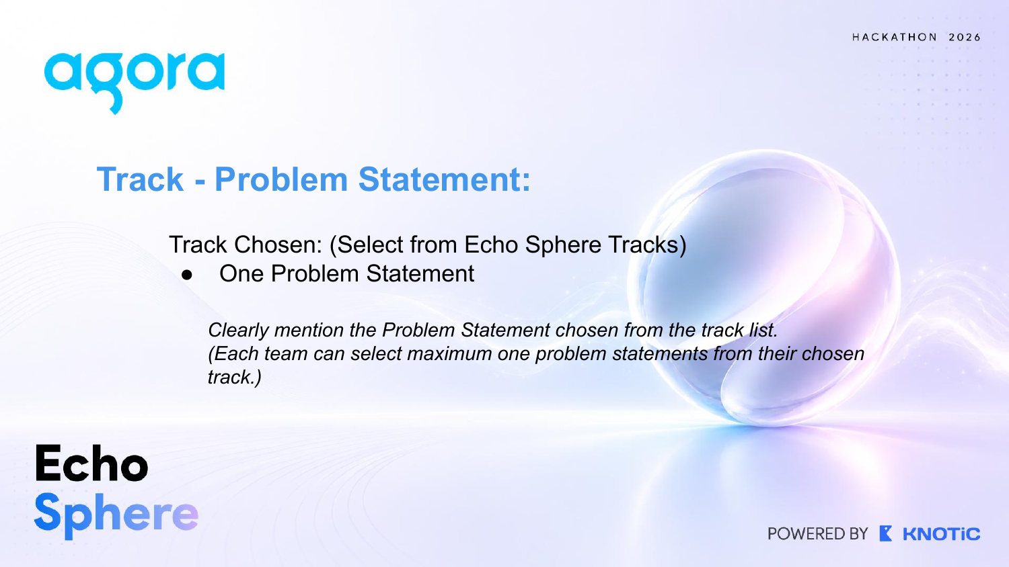
Track Chosen: Voice AI
PS41 — Real-time AI Incident Commander
An AI teammate for live operational and technical incident rooms — built to maintain shared truth, ownership, and momentum during high-pressure outages.
Agora Conversational AI = core real-time voice layer

Slide 4
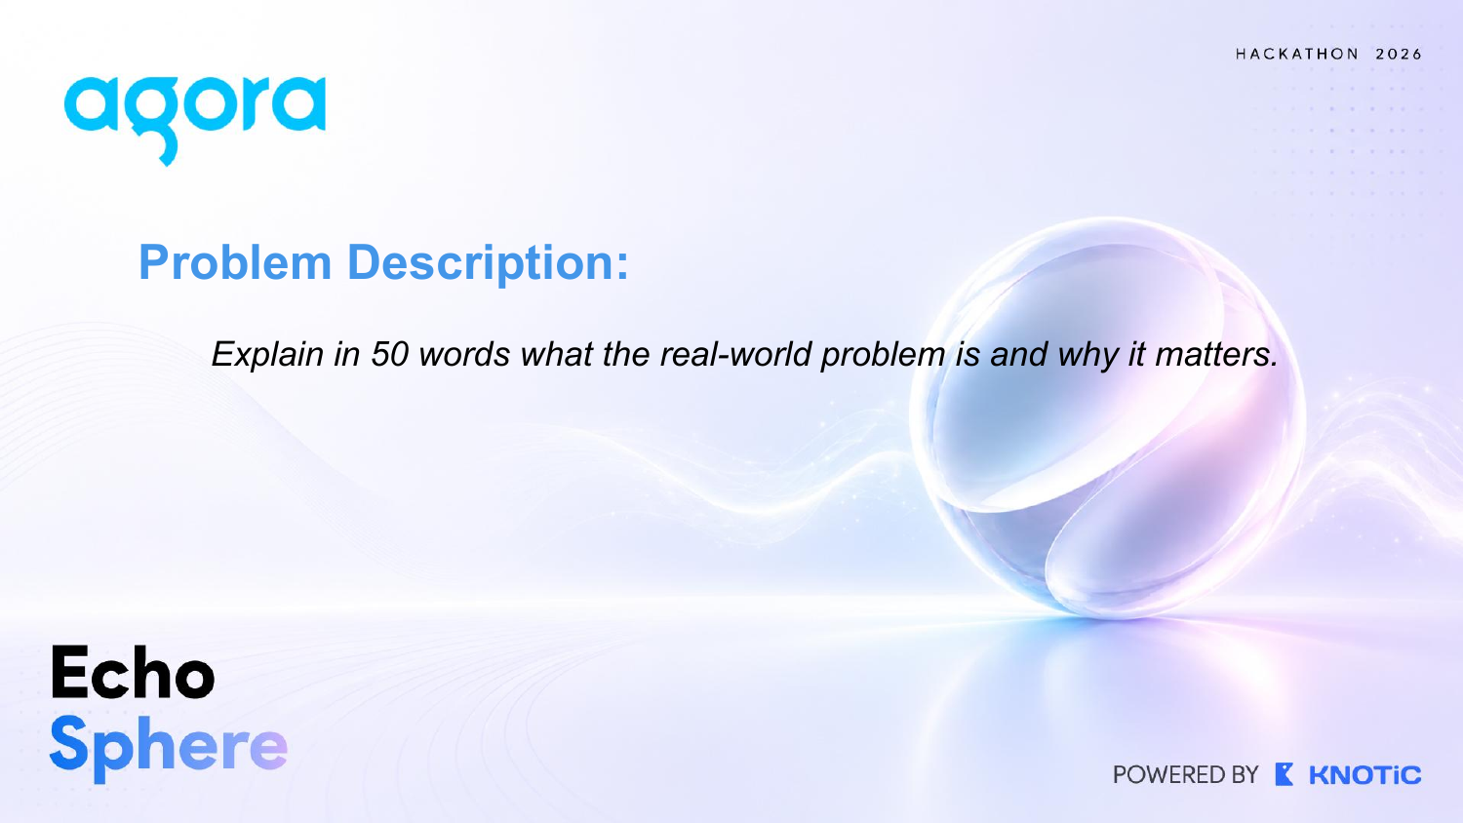
During an outage, teams speak in fragments: facts mix with guesses, owners are unclear, decisions vanish, and updates arrive late. This slows recovery and erodes trust. Existing incident rooms capture conversation, not a defensible shared operating picture — especially when evidence conflicts and critical actions require human approval.
50-word problem description

Slide 5
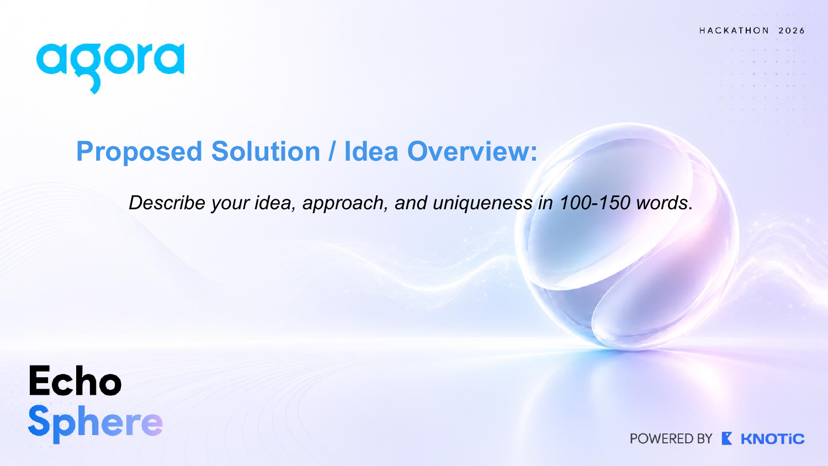
ORBIT joins an Agora-powered live incident room as a multilingual conversational AI teammate. It recognizes speakers and roles, structures every update as a confirmed fact, hypothesis, decision, or action, and maintains a live Incident Digital Twin with provenance and confidence. Specialized agents reconcile conflicts, expose what is still unknown, build the timeline, track owners, retrieve runbooks and similar incidents, and call approved tools across Slack, Jira, PagerDuty, and monitoring. The Commander speaks concise status summaries at useful moments, while human approval gates every critical action. ORBIT never claims a root cause without evidence: it organizes, correlates, recommends, and keeps the team aligned until recovery and post-incident review.
Proposed solution / idea overview (134 words)

Slide 6
Technical Architecture
One live room. One trusted incident state.
1
2
3
4
Agora Conversational AI
→
Commander + specialist agents
→
Incident Digital Twin
→
Human-controlled actions
Live voice, diarization, multilingual speech
Listen, classify, investigate, coordinate
Evidence graph, timeline, ownership, confidence
Approve critical changes; stream updates
Planned use of Agora: the core low-latency voice room, conversational interface, and spoken incident briefings. WebSockets and RBAC complete the production-ready layer.

Slide 7
Specialist agents keep the room coordinated.
Listener
Evidence
Conflict
Timeline
speaker + role
facts + provenance
gaps + contradictions
Digital Twin
Action
Investigation
Commander
owners + escalation
tools + RAG
spoken briefings
Listen → understand → structure → verify → recommend → human approves → act → monitor → learn

Slide 8
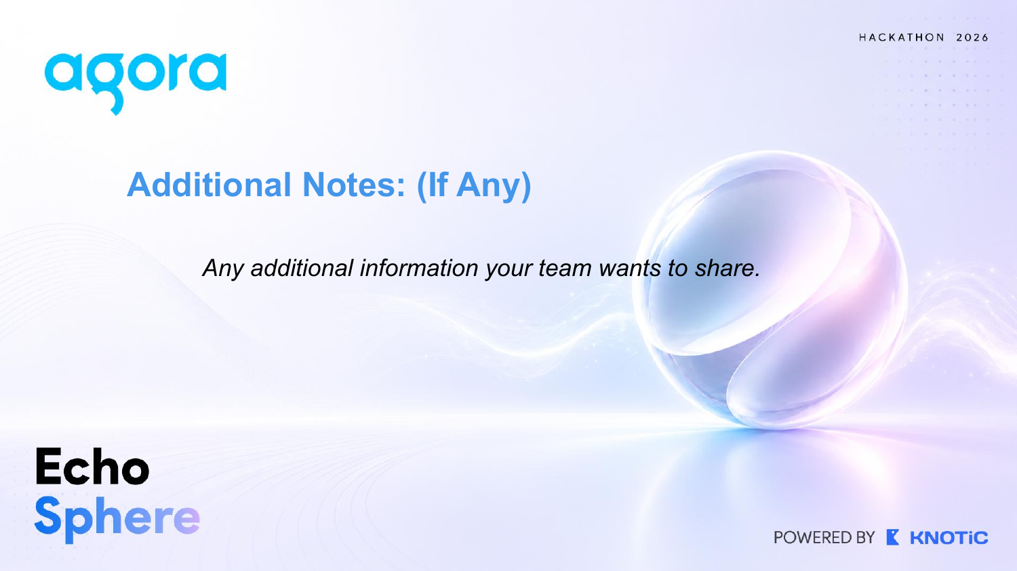
Traceable evidence at every step.
Shared truth
Safety & alignment
Deep intelligence
Close the loop
Confirmed facts vs assumptions / hypotheses
Decisions, action items, ownership
Live incident timeline
Missing-info and contradiction graph
“What We Still Don’t Know” engine
Human confirmation for critical actions
Evidence Knowledge Graph + confidence
Historical memory, vector DB, similar incidents
Runbooks, anomaly correlation, severity + blast radius
Action aging / escalation
Recovery verification + decision audit trail
Incident replay, analytics, automatic postmortem

Slide 9
Demo: payment outage becomes shared truth.
14:31
Backend: “Payment API is failing.”
Confirmed fact + timeline event
14:33
DevOps: “DB pool may be exhausted.”
Hypothesis — not confirmed
14:34
Metrics show normal DB saturation.
Conflict surfaced; evidence linked
14:35
“Fuzail, inspect gateway logs.”
Action assigned; owner + follow-up
14:38
Commander speaks a status summary.
No root cause claimed; risks remain visible
Recovery
Human approves mitigation; system verifies.
Final summary + unresolved risks

Slide 10
Additional Notes: Complete Prototype Scope
ORBIT = Operational Response & Briefing Intelligence Team
Live room intelligence
Evidence & coordination
Agora real-time voice • speaker + role recognition • multilingual conversations • conversational agents • spoken status summaries
Facts / hypotheses / decisions / actions • provenance • confidence • Digital Twin • timeline • owners • follow-ups • contradiction + missing-info detection
Investigation & prediction
Controlled operations & learning
Evidence Knowledge Graph • “What We Still Don’t Know” • RAG/vector memory • similar incidents • runbooks • anomaly correlation • blast radius • severity prediction • screenshot/log/chart analysis
Jira / Slack / PagerDuty / monitoring tool calls • WebSocket dashboard • RBAC • human approval • action aging • recovery verification • audit trail • replay • analytics • automatic postmortem
Expected Impact & Future Vision: Faster alignment, safer evidence-led decisions, clearer accountability, and a living incident memory that helps every team recover and learn faster after each outage.

