Slide 1
OVERTHRONE
The GameSmiths, Quinton Randall, Khoi Tran

Slide 2
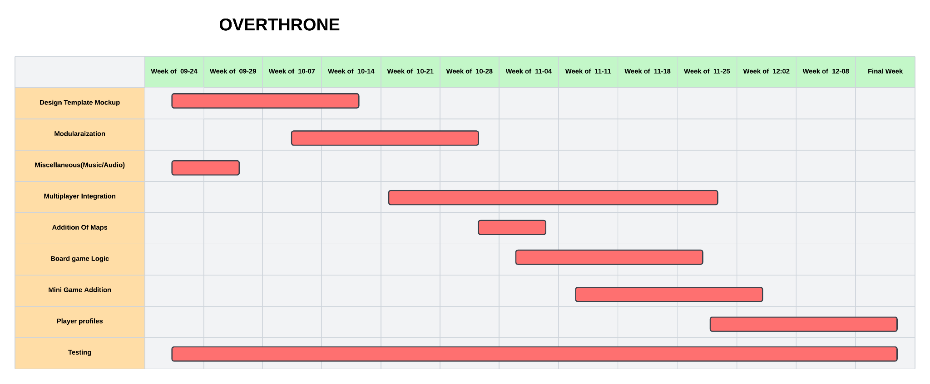
Project Timeline

Slide 3
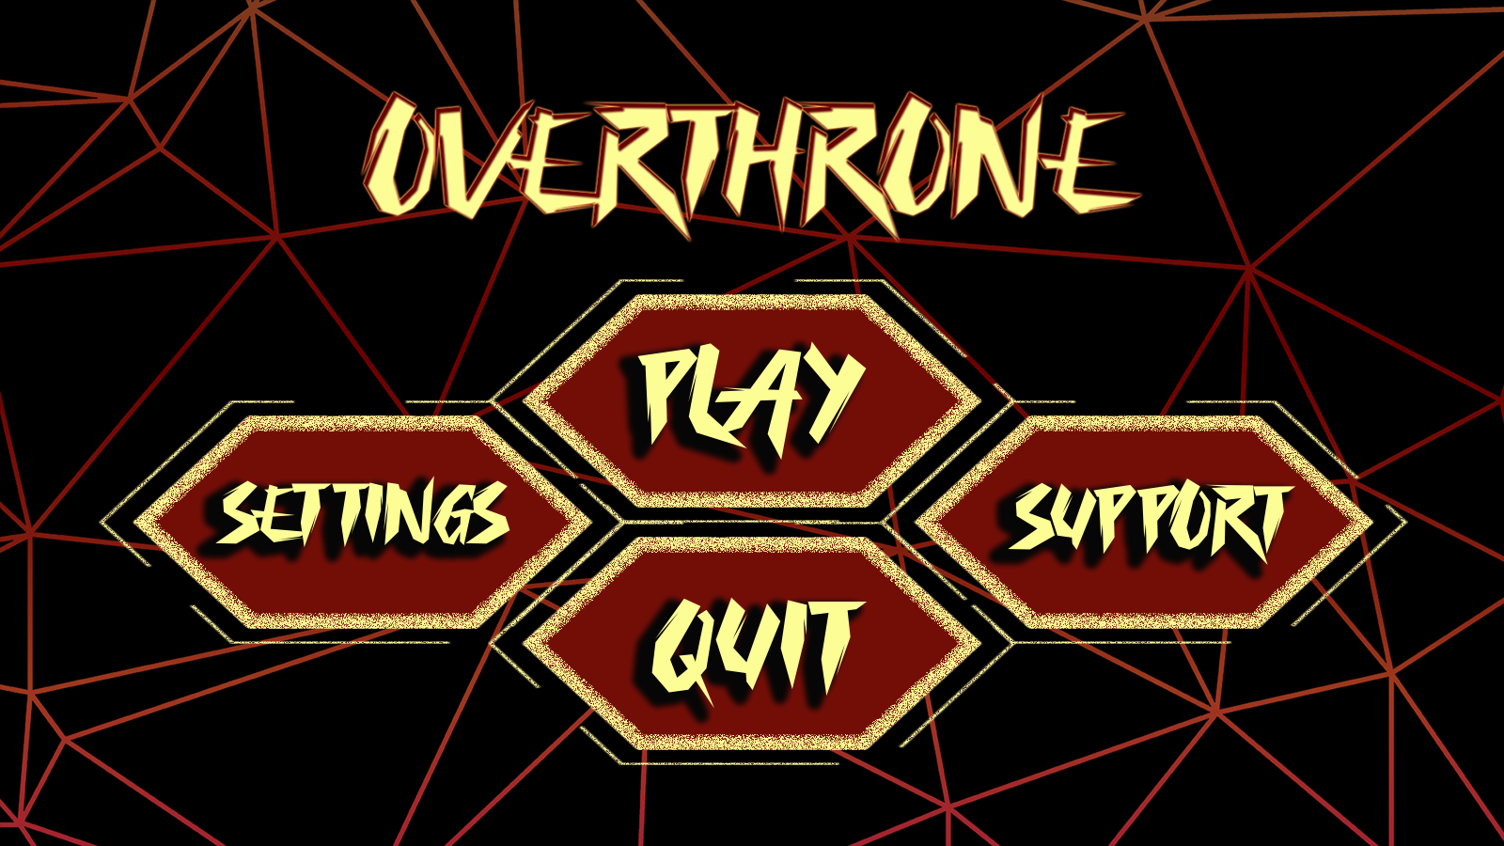

Slide 4
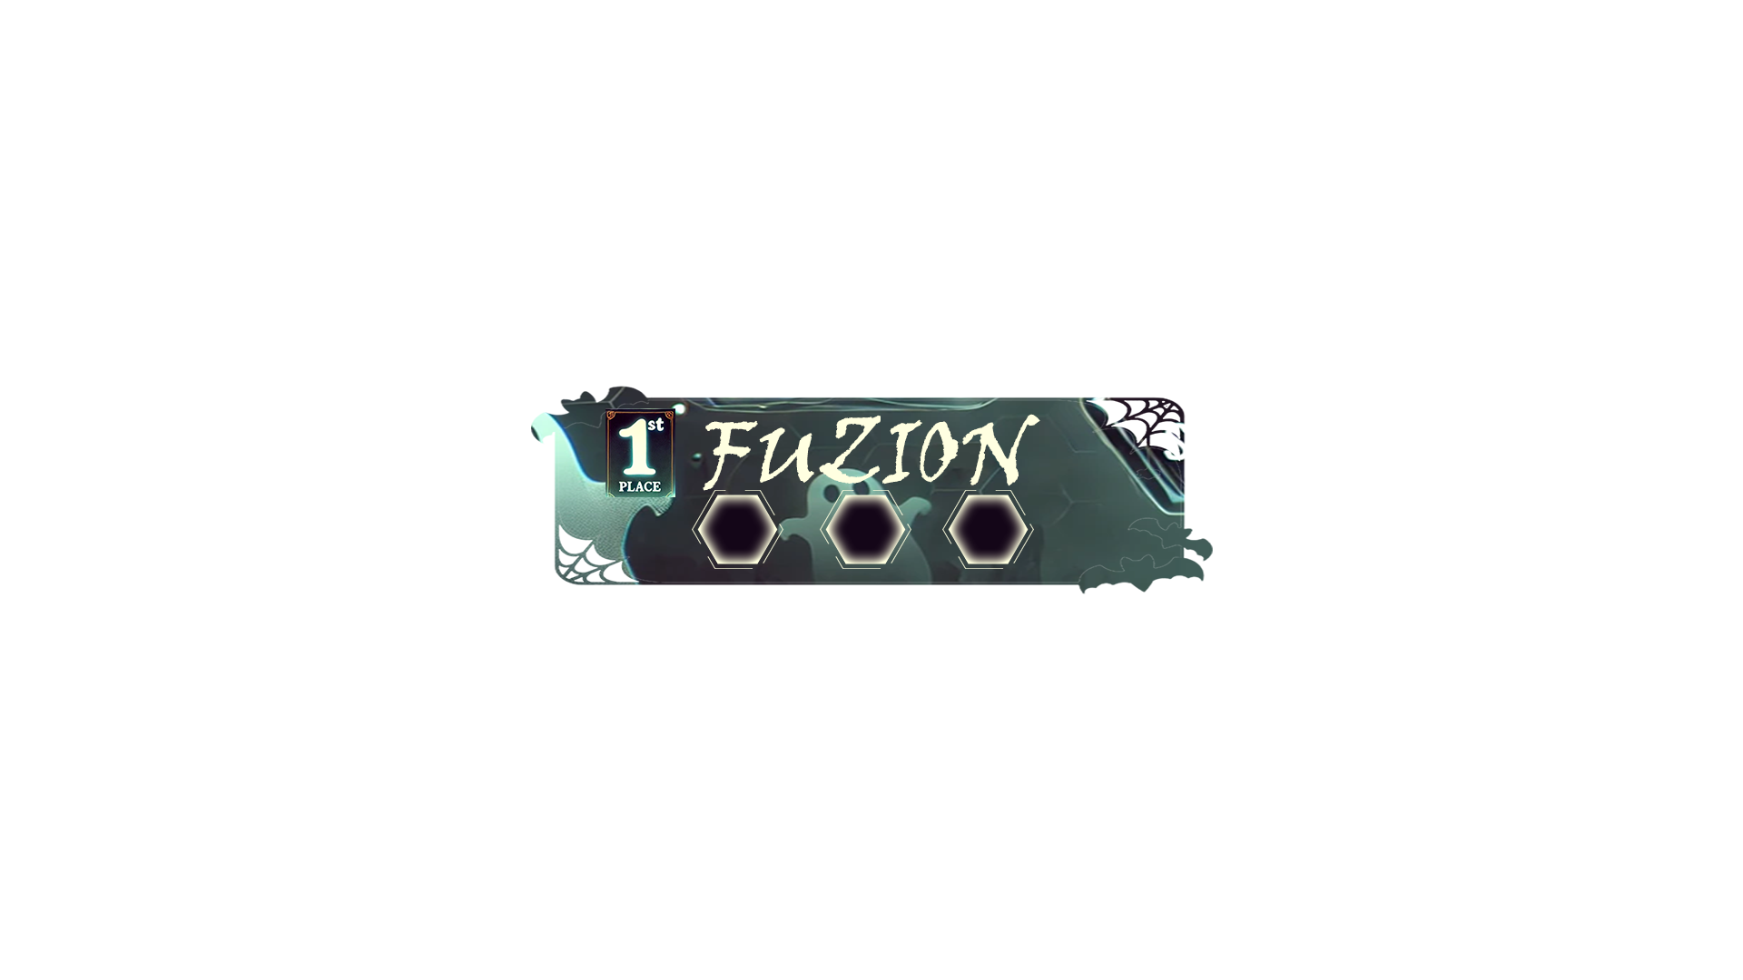
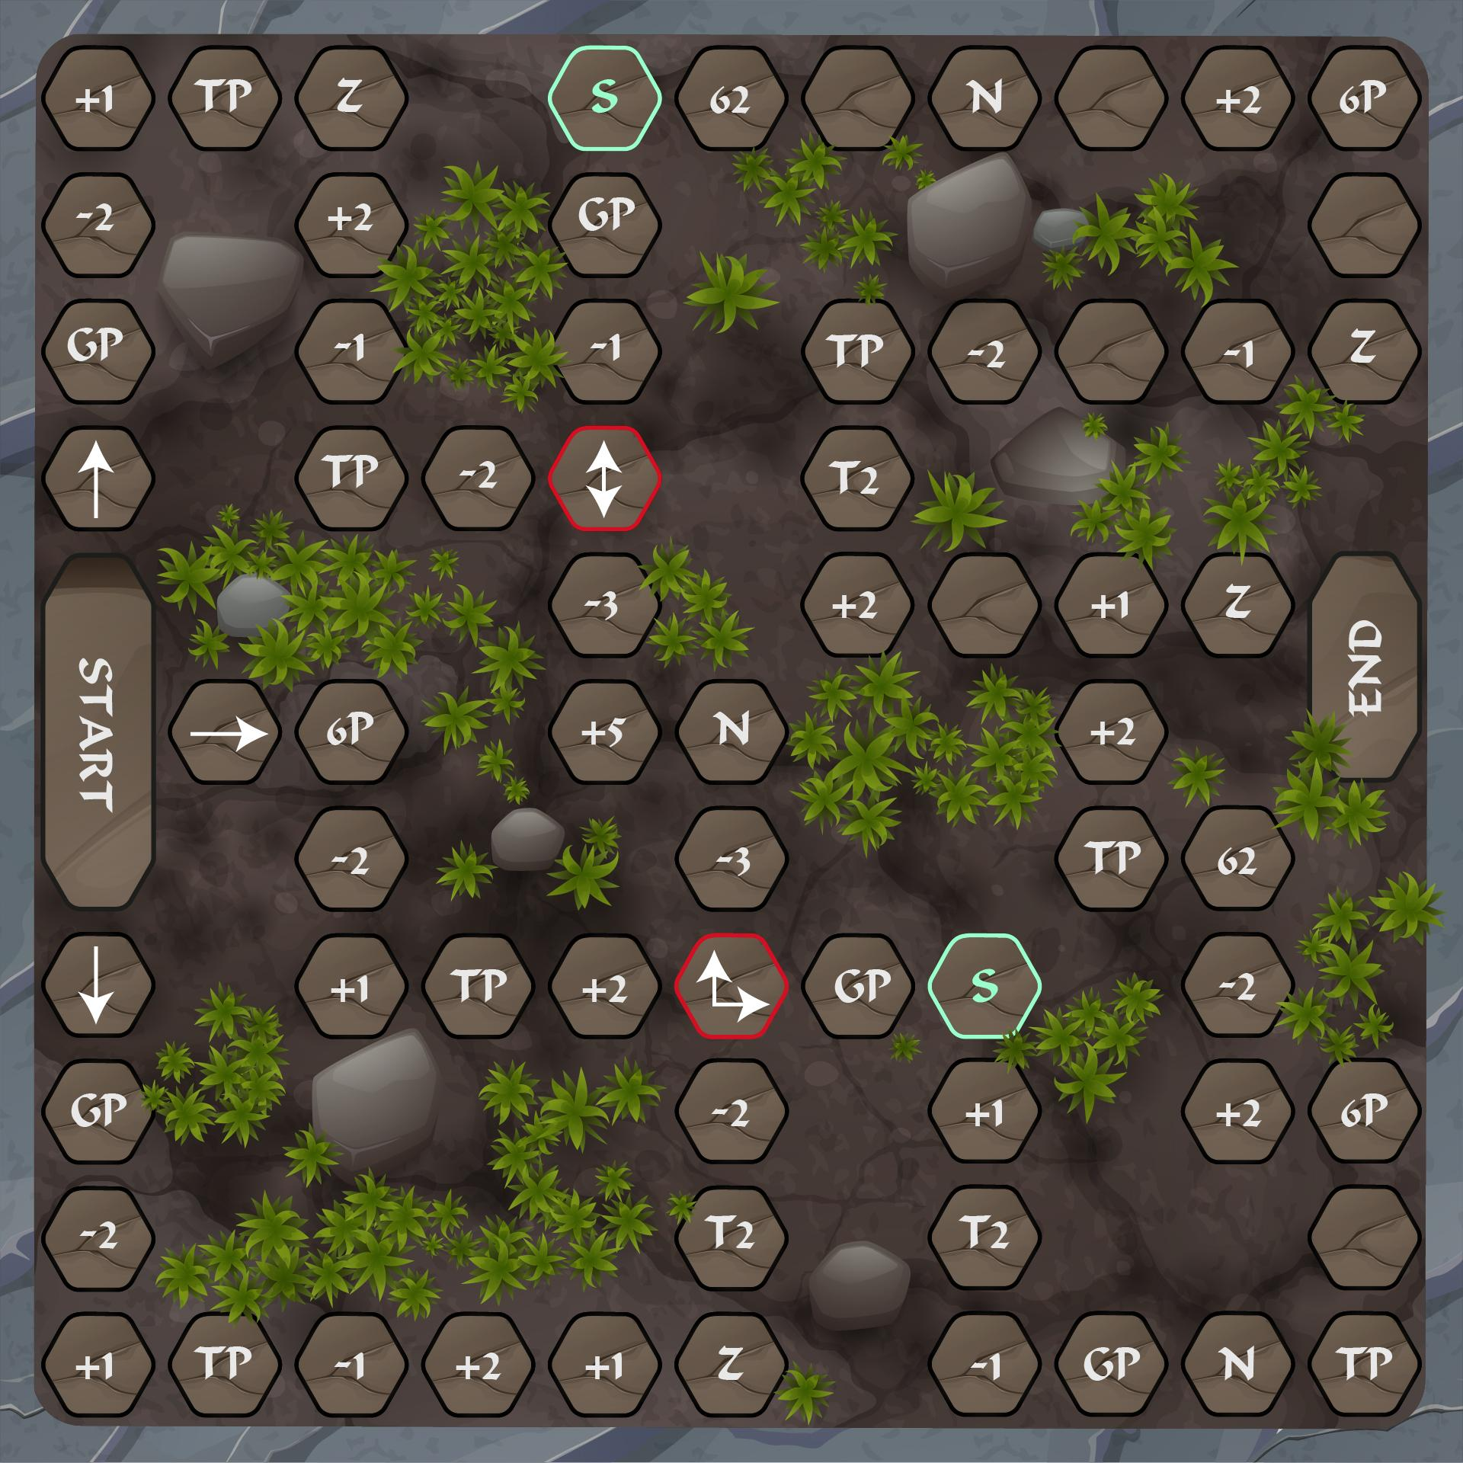
+ and -
S - Safe
N - Neutral
Z - Move Backwards
Choose Path
TP - Take Points
Gp - Give Points

Slide 5
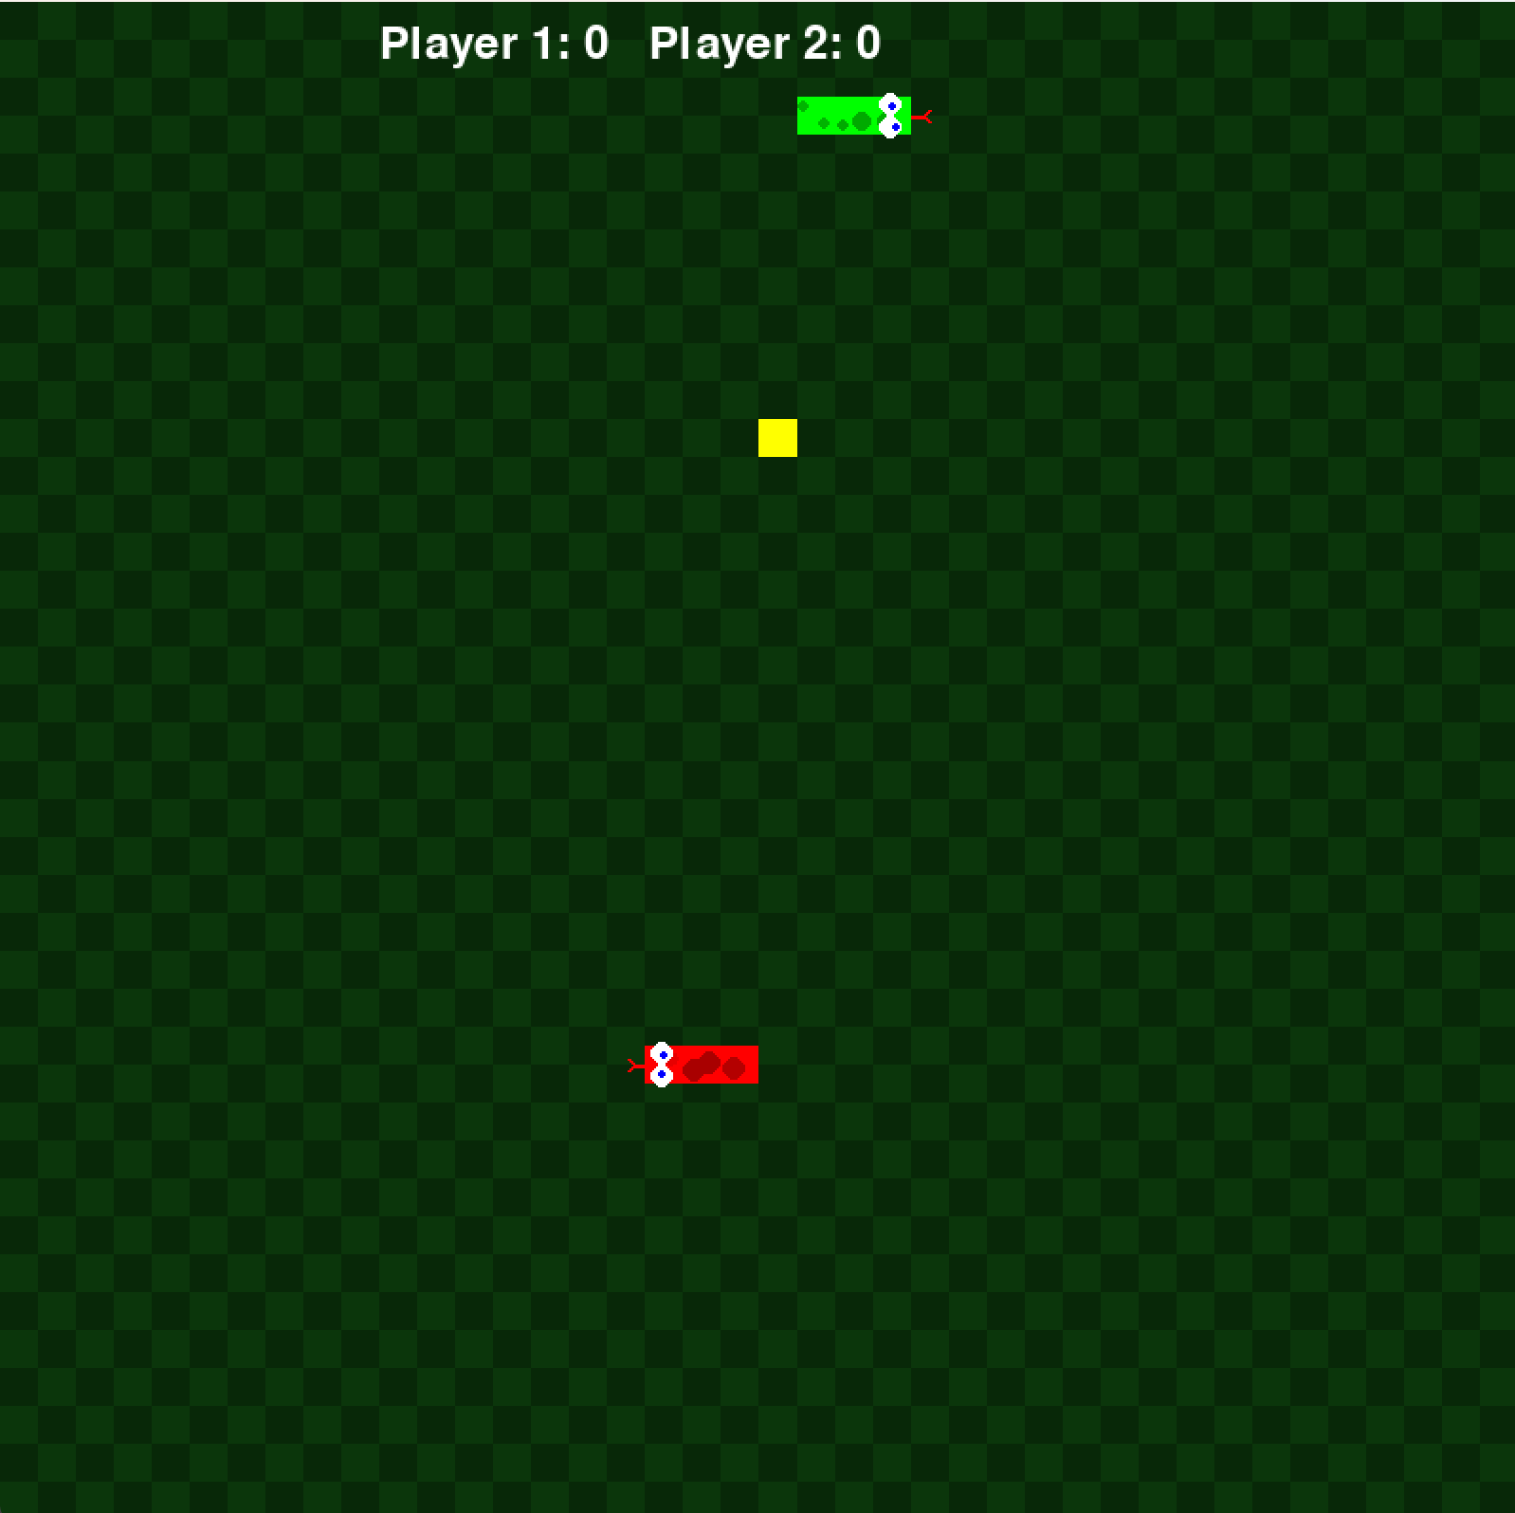
Mini game 1 - Modified Snake Game
1m30s
Attack each other or eat more food
More food options

Slide 6
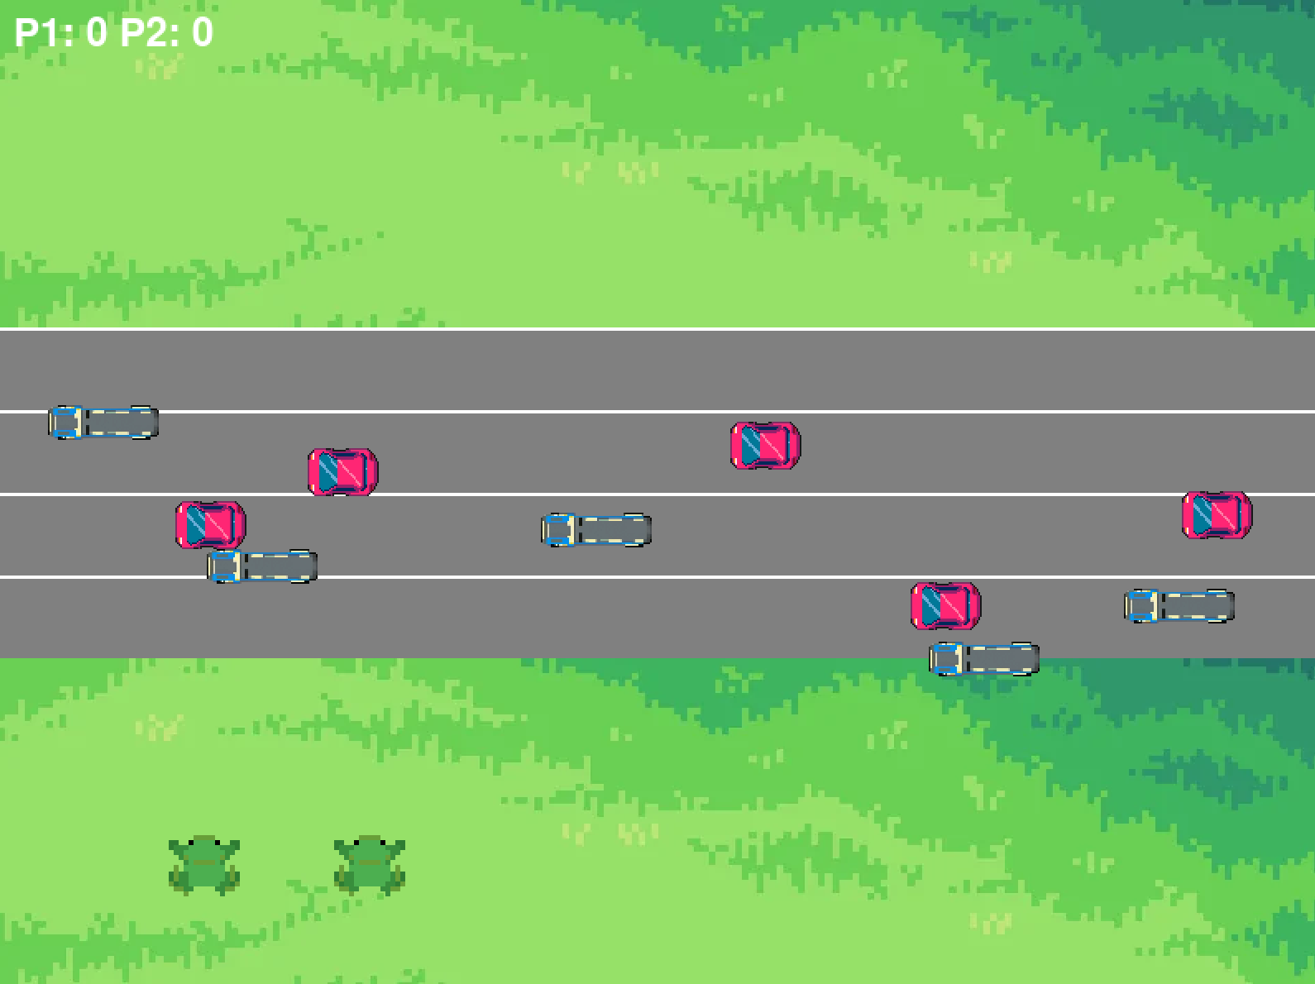
Mini game 2 - Frogs Crossing
1m30s
Cross the road
Might have another player to adjust the vehicles speed

Slide 7
