Slide 1


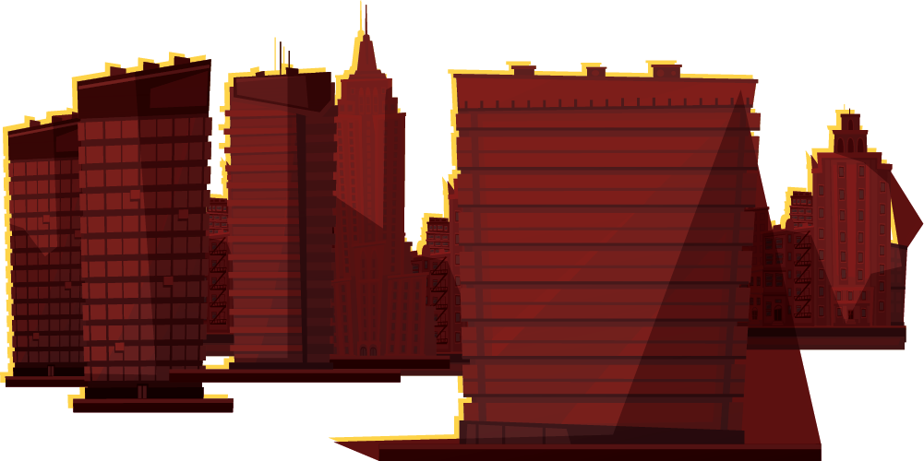

STOP TALKING AND EVERYBODY EXPLODES…EXTENDED
Human Mimic VS Software Design Process

Slide 2
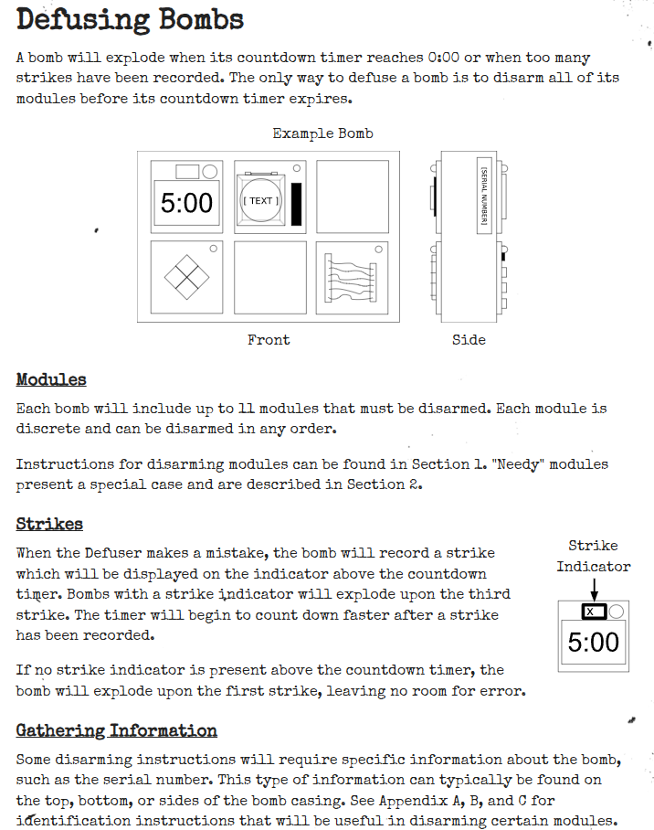
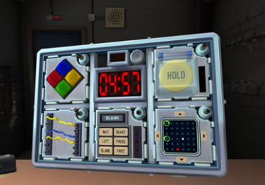
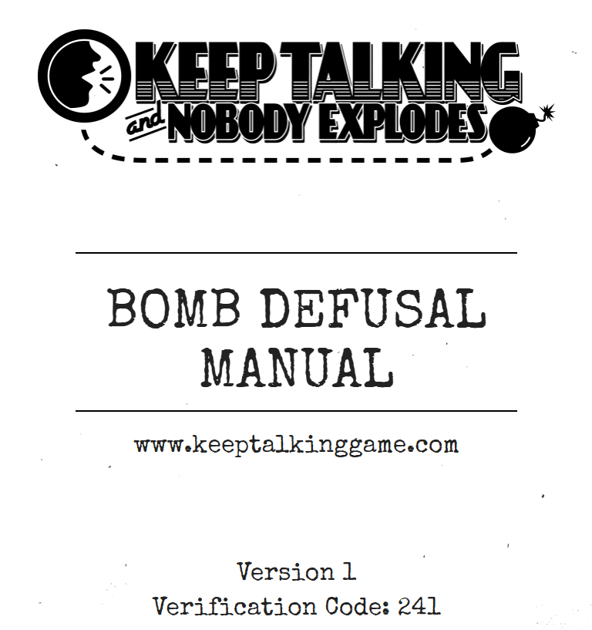
What is this?
KEEP TALKING AND NOBODY EXPLODES
For more info: Website
You can visit our sister projects: Manual | PDF

Slide 3
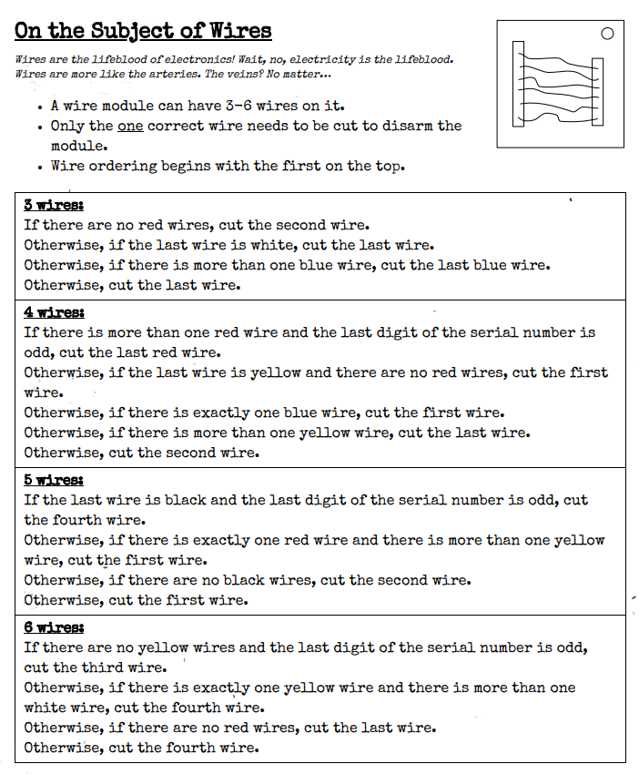
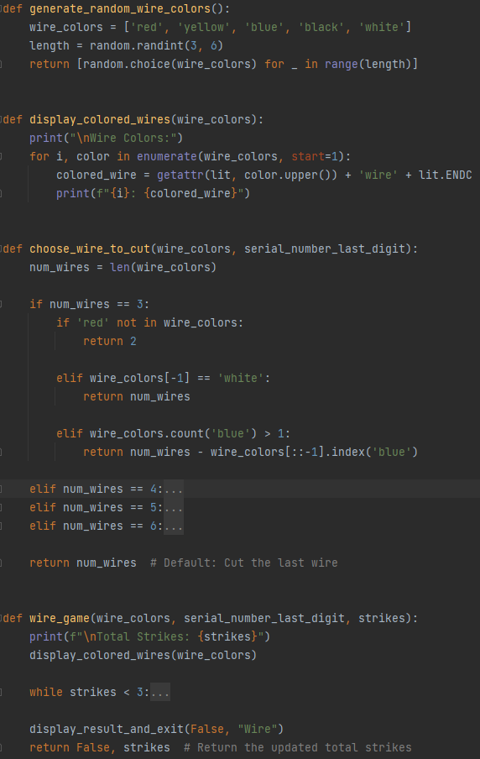
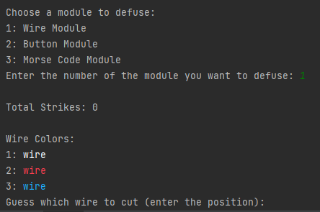
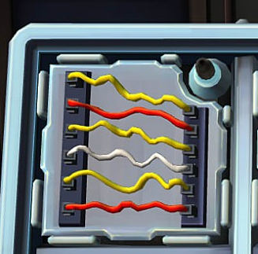
INITIAL IMPLEMENTATION
Wires

Slide 4
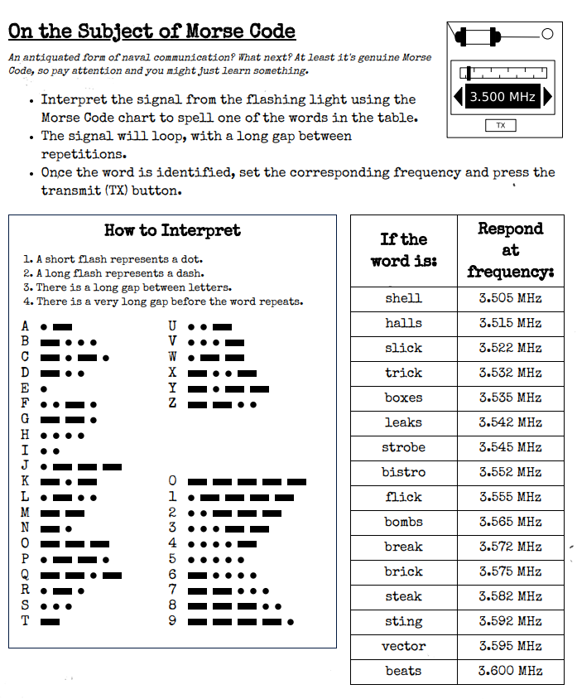
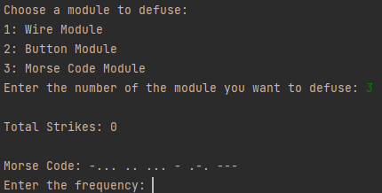
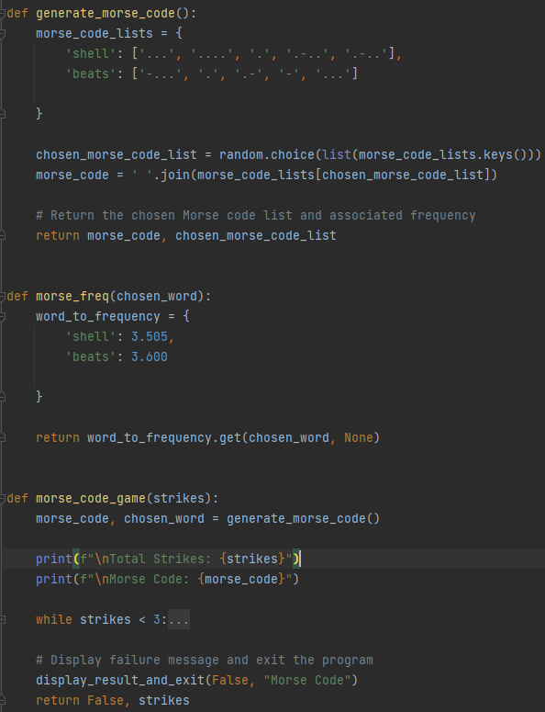
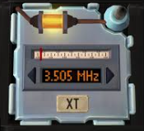
INITIAL IMPLEMENTATION
Morse Code

Slide 5
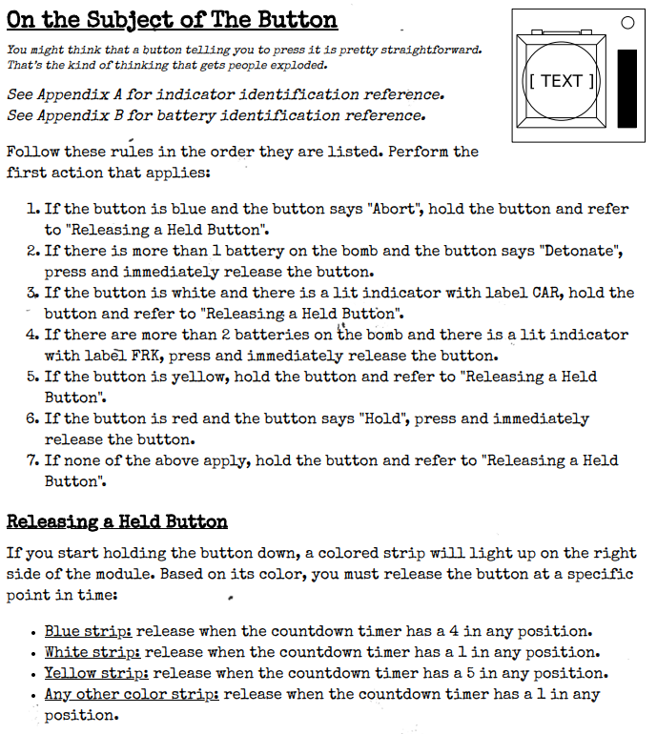
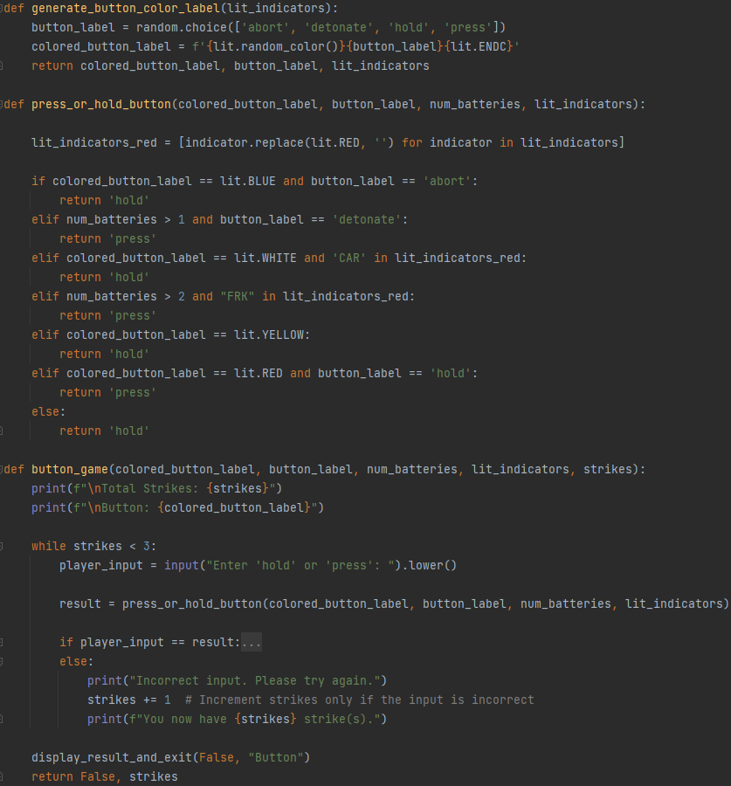
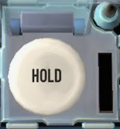
INITIAL IMPLEMENTATION
Button/Strip

Slide 6
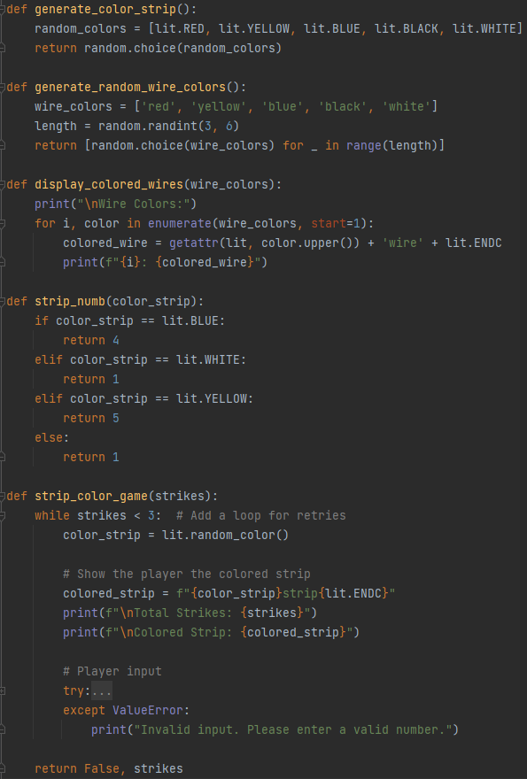
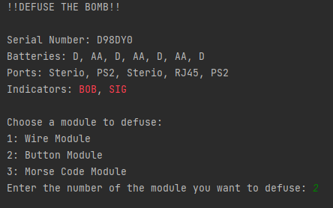
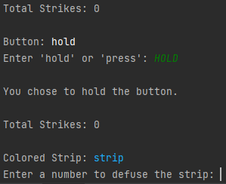
INITIAL IMPLEMENTATION
Button/Strip- cONTINUED

Slide 7



WHAT IS NEW?
LAYERED ARCHITECTURE
Presentation
Business
Data
Features
Random Select
Code Smells
Modularity
Refactoring

Slide 8
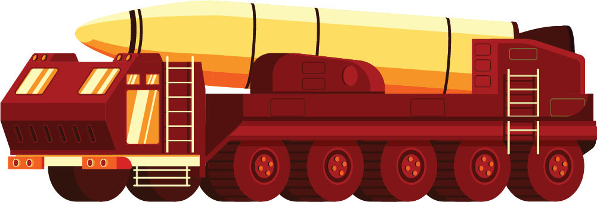

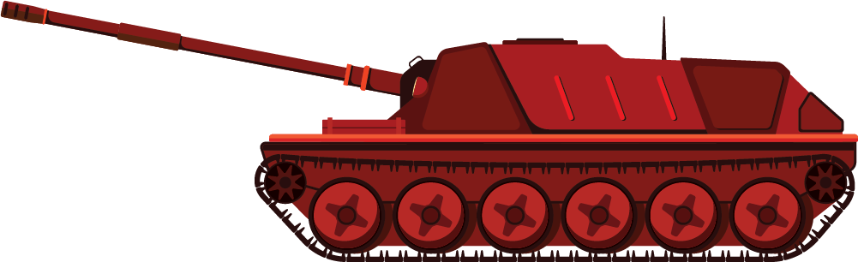

What is layered Architecture?
Presentation
Business
Data
This is the UI layer, responsible
for all user interactions. Display,
input, events, etc…
This is the logic layer, responsible how the game actually works. Game rules/ state, response to player actions, event handling, etc…
This is the domain layer, responsible for managing and storing data.

Slide 9
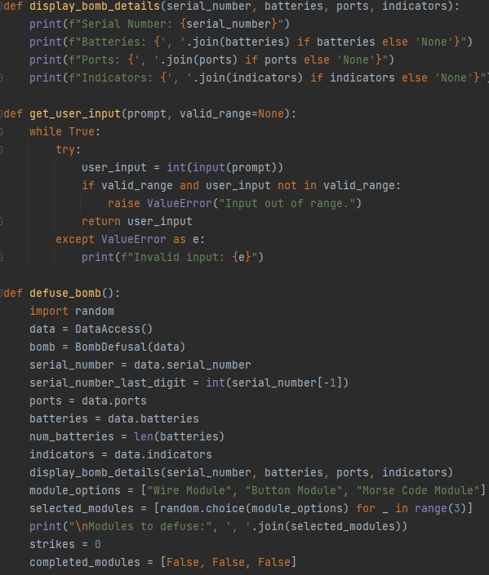
presentation
UI
Player Views
(display_bomb_details)
(Modules to defuse)
Inputs
Handles Player Input
(get_user_input)

Slide 10
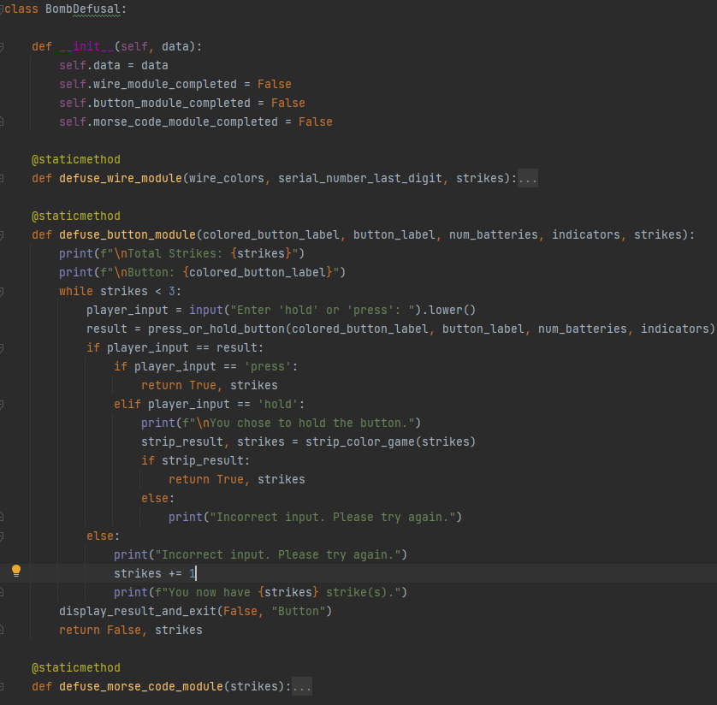
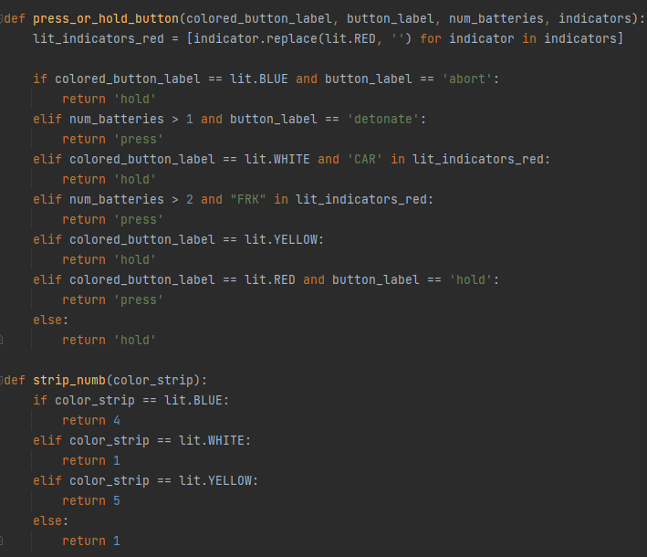
Business

Slide 11
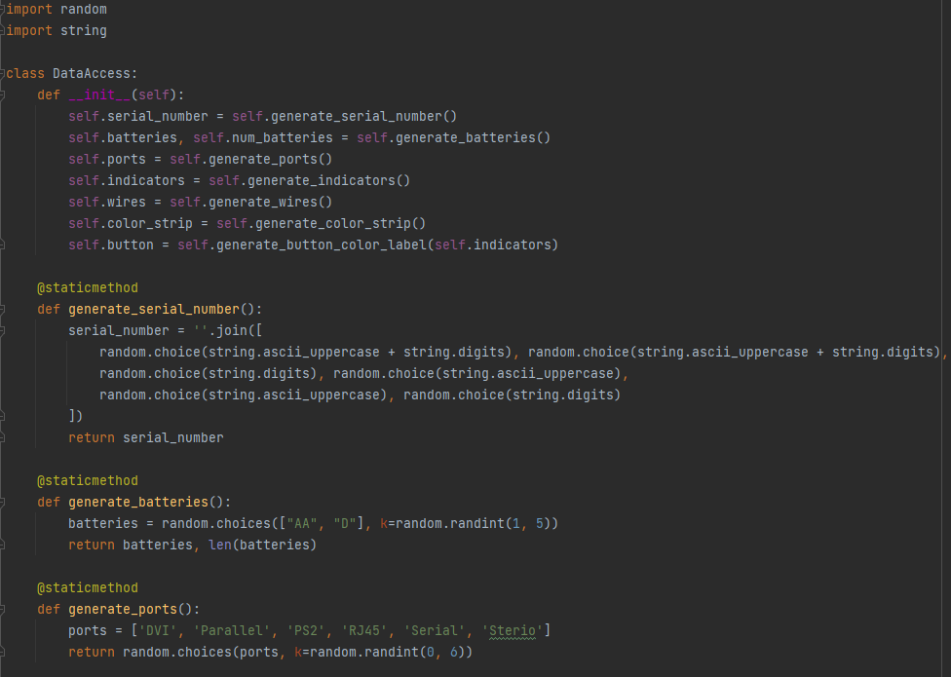
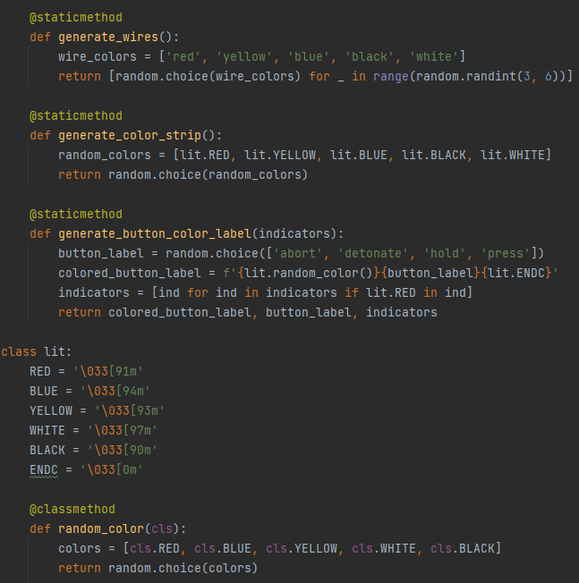
Data/Domain

Slide 12
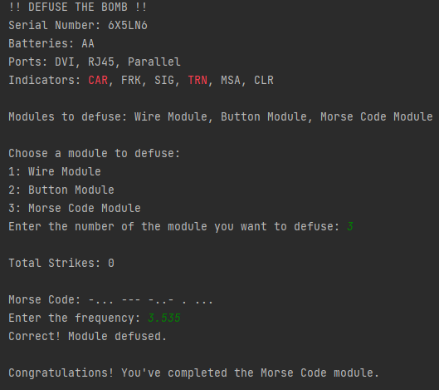
Demo
Morse code = boxes

Slide 13
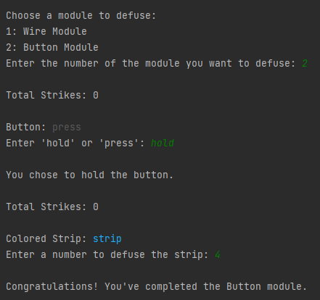
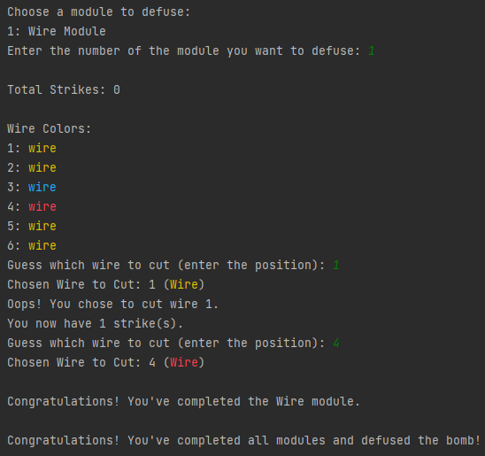
Demo Cont.

Slide 14
Pros/Cons | Differences | Problems
Modularity
Standardization
Layered Architecture, allows for everything to be stored in different files for its specific task. Easy to expand, add new modules, and change current modules.
Layered architecture allows for more concise functions, and common setup between layers
Circular Imports
With everything being separated, you need to be sure that each item is correctly placed to avoid circular imports, and may have to do extra refactoring if a system is already in place.

Slide 15
—Future Work
Convert to Pygame
Add more modules
Add Time/ countdown
Add Level Select

Slide 16



Questions?

