Slide 1

Mini-project: Bus Safety
A comprehensive guide to understanding a C program that helps travelers find the safest bus routes between cities

Slide 2

OVERVIEW
What This Program Does
This smart bus routing system helps passengers find safe travel options by analyzing risk levels of different bus routes. It searches for direct routes first, then checks connecting routes if needed.
The program maintains a database of buses with departure times, destinations, and safety ratings to recommend the safest journey.

Slide 3
Program Structure: Core Components
Header Files
Constants
Bus Structure
Helper Function
stdio.h for input/output and string.h for text comparison functions
MAX_BUSES (10) limits array size, SAFETY_THRESHOLD (12) defines acceptable risk
Stores ID, cities, times, and risk level for each bus route
calculateDuration() computes travel time in minutes

Slide 4

The Bus Structure Explained
arr_hour / arr_min
Key Fields
from_city (30)
bus_id: Unique identifier for each bus
from_city & to_city: Route endpoints (max 30 characters)
Departure/Arrival: Times stored as hour and minute pairs
risk_level: Safety rating from 0 (safest) to 10 (most risky)
bus_id (int)
to_city (30)
dep_hour / dep_min

Slide 5




HOW IT WORKS
Program Flow: Step by Step
Initialize Data
Pre-load 6 buses with routes between Pune, Mumbai, Nashik, and Satara
Get User Input
Request source and destination cities from the traveler
Search Direct Routes
Loop through buses to find matching source and destination
Identify Safest Option
Track the route with lowest risk level and display recommendation

Slide 6
The Duration Calculator
How It Works
int calculateDuration(struct Bus b) {
int dep = b.dep_hour * 60 + b.dep_min;
int arr = b.arr_hour * 60 + b.arr_min;
return arr - dep;
}
This function converts departure and arrival times into total minutes since midnight, then calculates the difference.
Example: If a bus departs at 6:30 (390 minutes) and arrives at 10:30 (630 minutes), the duration is 240 minutes (4 hours).

Slide 7


Direct Route Search Logic
The program uses strcmp() to compare city names. When both from_city and to_city match the user's input, that bus is displayed. The system tracks the lowest risk_level found to recommend the safest direct option.
The strcmp() function returns 0 when strings match exactly, which is why we check "== 0" in the condition.

Slide 8


ADVANCED FEATURE
Two-Hop Route Finding
When Direct Routes Fail
If no direct bus exists, the program searches for connecting routes using nested loops. It checks if any bus's destination matches another bus's origin.
The algorithm calculates combined risk (hop1 + hop2) and selects the safest two-bus combination to complete the journey.
Find First-Hop
Find Second-Hop
Choose Lowest Risk

Slide 9
Safety Features & Warnings
Risk Assessment
Threshold Alert
User Guidance
Each bus has a risk_level (0-10). Lower values indicate safer routes based on factors like road conditions and accident history.
SAFETY_THRESHOLD is set to 12. Routes exceeding this combined risk trigger a warning: "Travel not advised due to high safety risk."
The program displays ✅ for safe options and ⚠ symbols for risky routes, helping users make informed decisions.

Slide 10
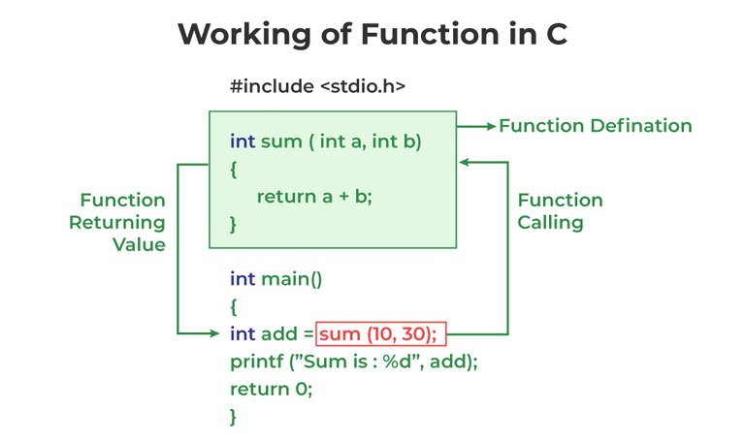



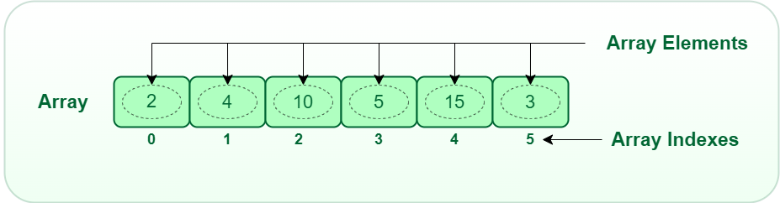
Key Programming Concepts Used
Arrays & Structs
Nested Loops
String Comparison
Functions
Stores multiple bus records efficiently using structured data
Searches through combinations for two-hop routes
Uses strcmp() to match city names accurately
Modular design with calculateDuration() helper function
This project demonstrates practical application of fundamental C programming concepts while solving a real-world problem: finding safe travel routes. 🚍

