Slide 1
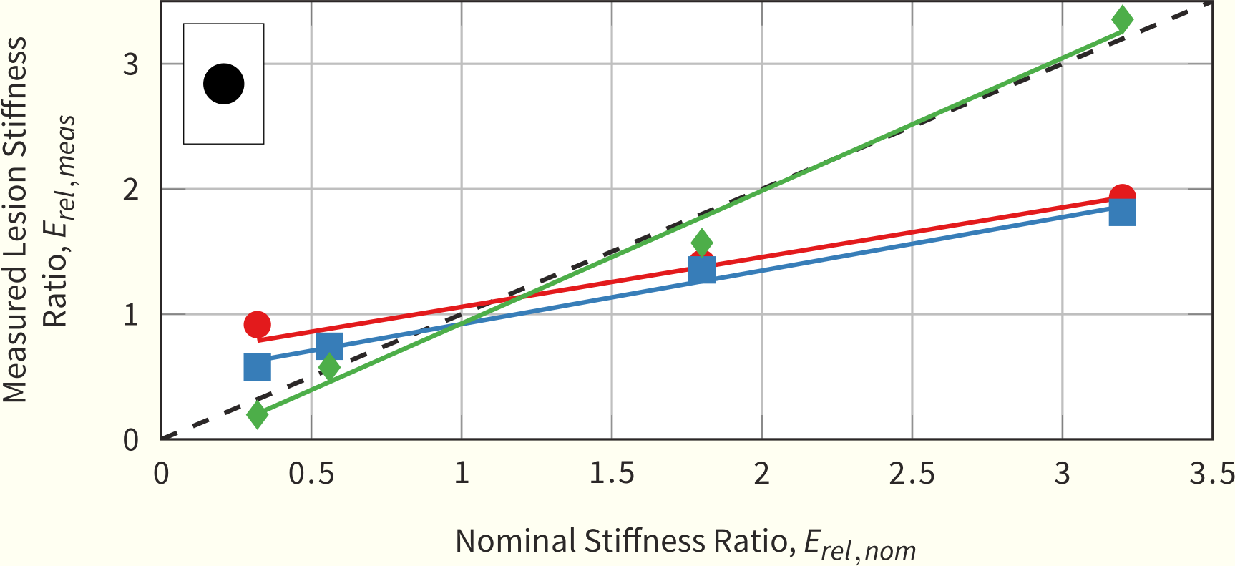
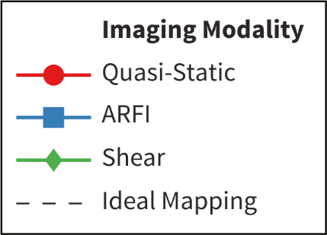
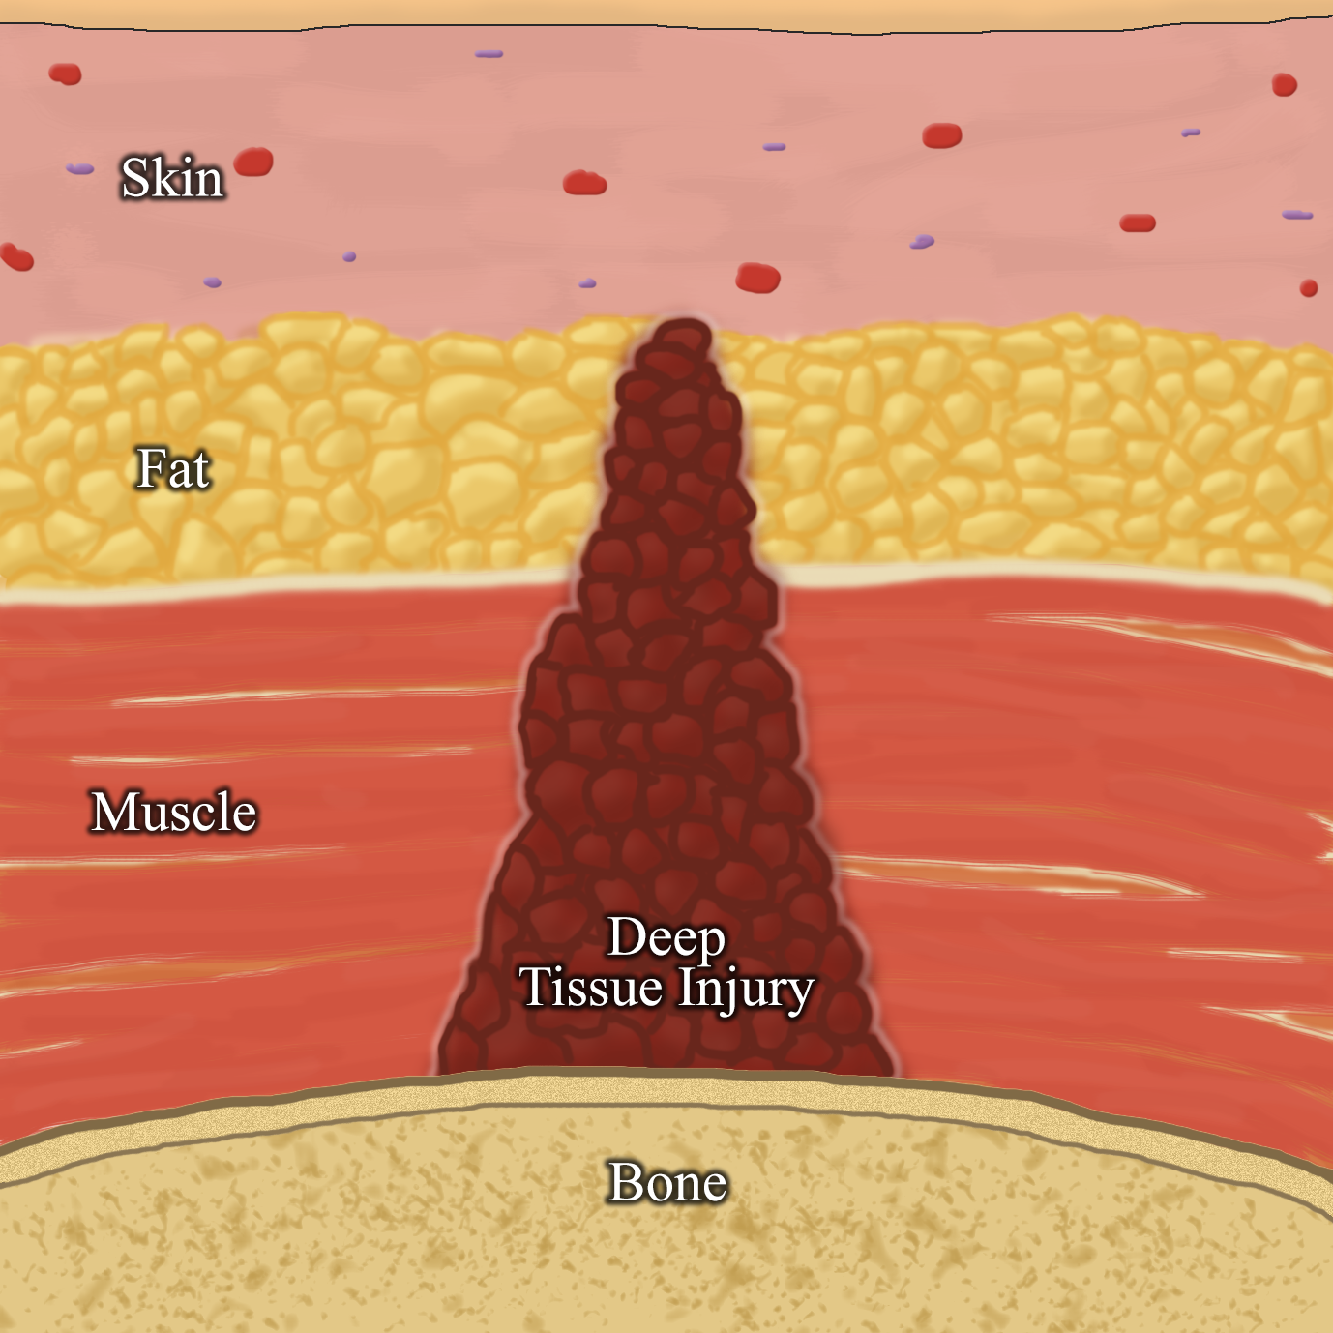
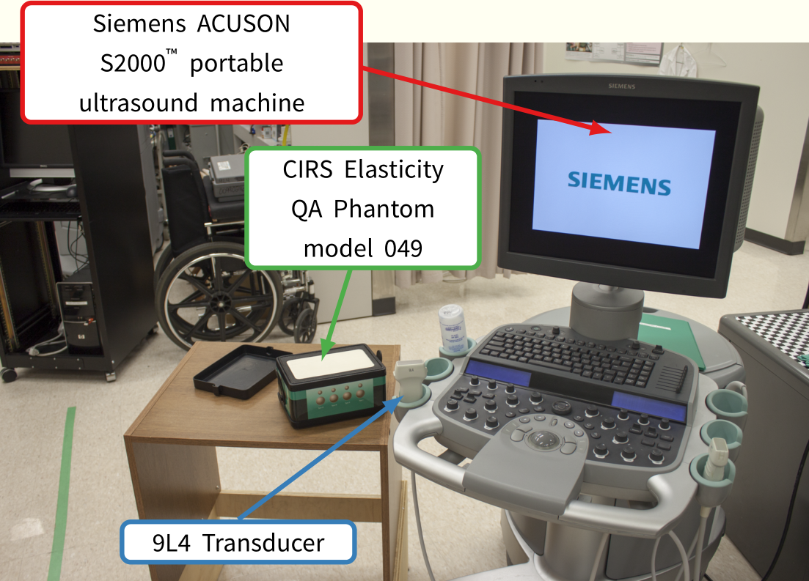

Numerical Characterization of Ultrasound Elastography for the Early Detection of Deep Tissue Injuries
Name | Degree | Year | Supervisor or Sponsor
Kenton Hamaluik | M.Sc. | 2014 | Dr. W. Moussa & Dr. M. Ferguson-Pell
Deep Tissue Injuries
Deep tissue injuries are secondary wounds often suffered by people with limited mobility such as those with spinal cord injuries and the elderly and represent a severe health burden to both patients and the health-care system. These injuries are currently classified as a type of pressure ulcer, with the major distinction that they form at the bone-muscle interface and tunnel toward the surface of the skin. Due to the nature of their formation, a major hurdle to treating these injuries is the lack of any clinical detection ability—by progressing undetected, deep tissue injuries can form large open wounds which are prone to infection and complications.
Numerical Characterization
Through k-space pseudo-spectral simulations of acoustic radiation forces and finite-element models of soft tissue deformation coupled with image processing techniques, a wide array of deep tissue injury models were investigated through parametric analysis. Key parameters included both deep tissue injury lesion properties as well as elastography device-design parameters.
Fig. 2: Comparing the numerical characterization of the detection ability of a spherical lesion across the three investigated modalities
Experimental Validation
Numerical simulations have limited use without experimental validations. To this end, a Siemens ACUSON S2000™ ultrasound machine was used to compare simulation results in all three imaging modalities to a parametrically-similar gel phantom.
Fig. 1: Schematic of a deep tissue injury
Ultrasound Elastography
Ultrasound elastography is a collection of techniques relating to the use of ultrasound to interrogate tissue stiffness rather than its acoustic properties. These techniques include: quasi-static ultrasound elastography, acoustic radiation force impulse imaging, and shear wave speed quantification. Ultrasound elastography can be used to detect deep tissue injuries as the stiffness of these injuries changes substantially during their formation and progression.
This study was completed to better understand and characterize the use of various modalities of ultrasound elastography toward the early detection and monitoring deep tissue injuries.
Fig. 3: Experimental setup used to validate the simulation results.
Conclusions
Ultrasound elastography is capable of detecting and monitoring formative and progressive deep tissue injury lesions, albeit with some challenges. Future work should involve studies in animals and humans.
Department of
Mechanical Engineering

