Slide 1
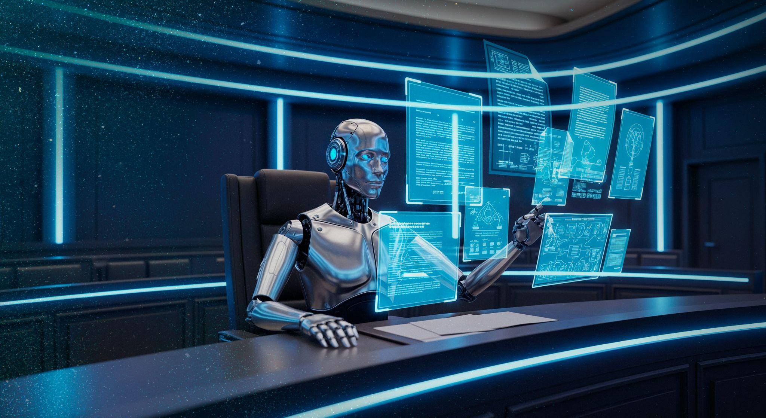
Investigación forense digital y respuesta ante incidentes sobre un endpoint Windows comprometido mediante análisis correlacionado de disco, registro, eventos y memoria
Integrantes
Acevedo Valer, Milagros Soledad
Bernal Belisario, Brigitte
Colla Cervantes, Marelly Massiel
Condori Mamani, Nardy Liz
Toribio Alvarado, Stephany Marilyn
2026
Temas Avanzados de Seguridad Informática

Slide 2

CONTENIDO
Introducción y problemática
Diseño, metodología y arquitectura
Implementación y gestión
Pruebas, resultados y cierre
Capítulo I y II
Capítulo III
Capítulo IV
Capítulo V + VI

Slide 3
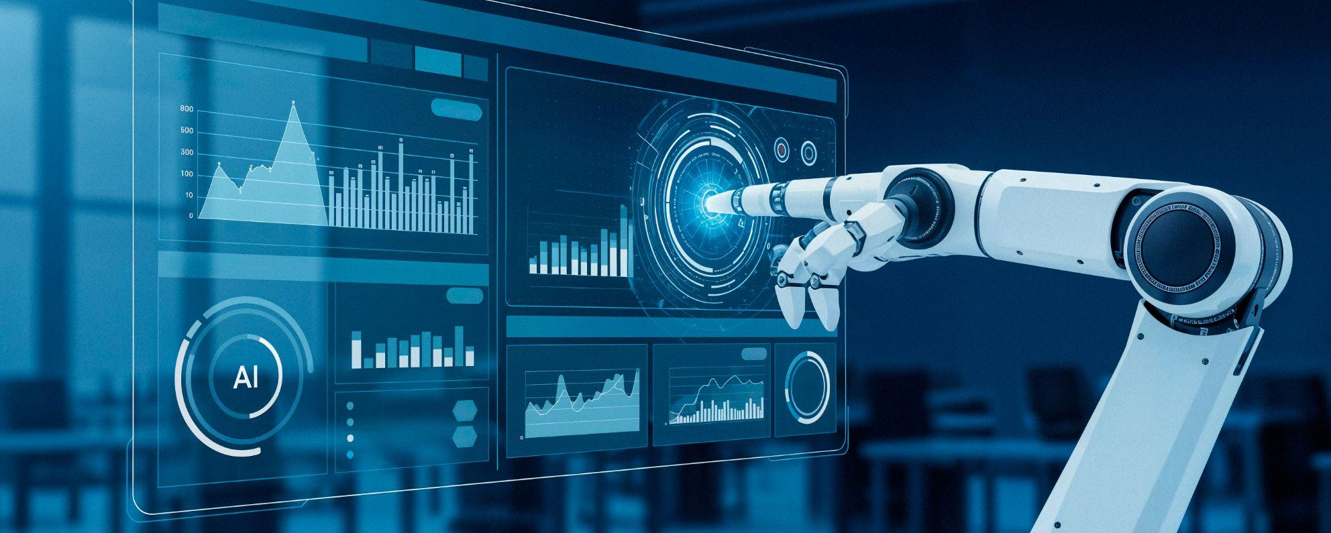
Introducción

Slide 4
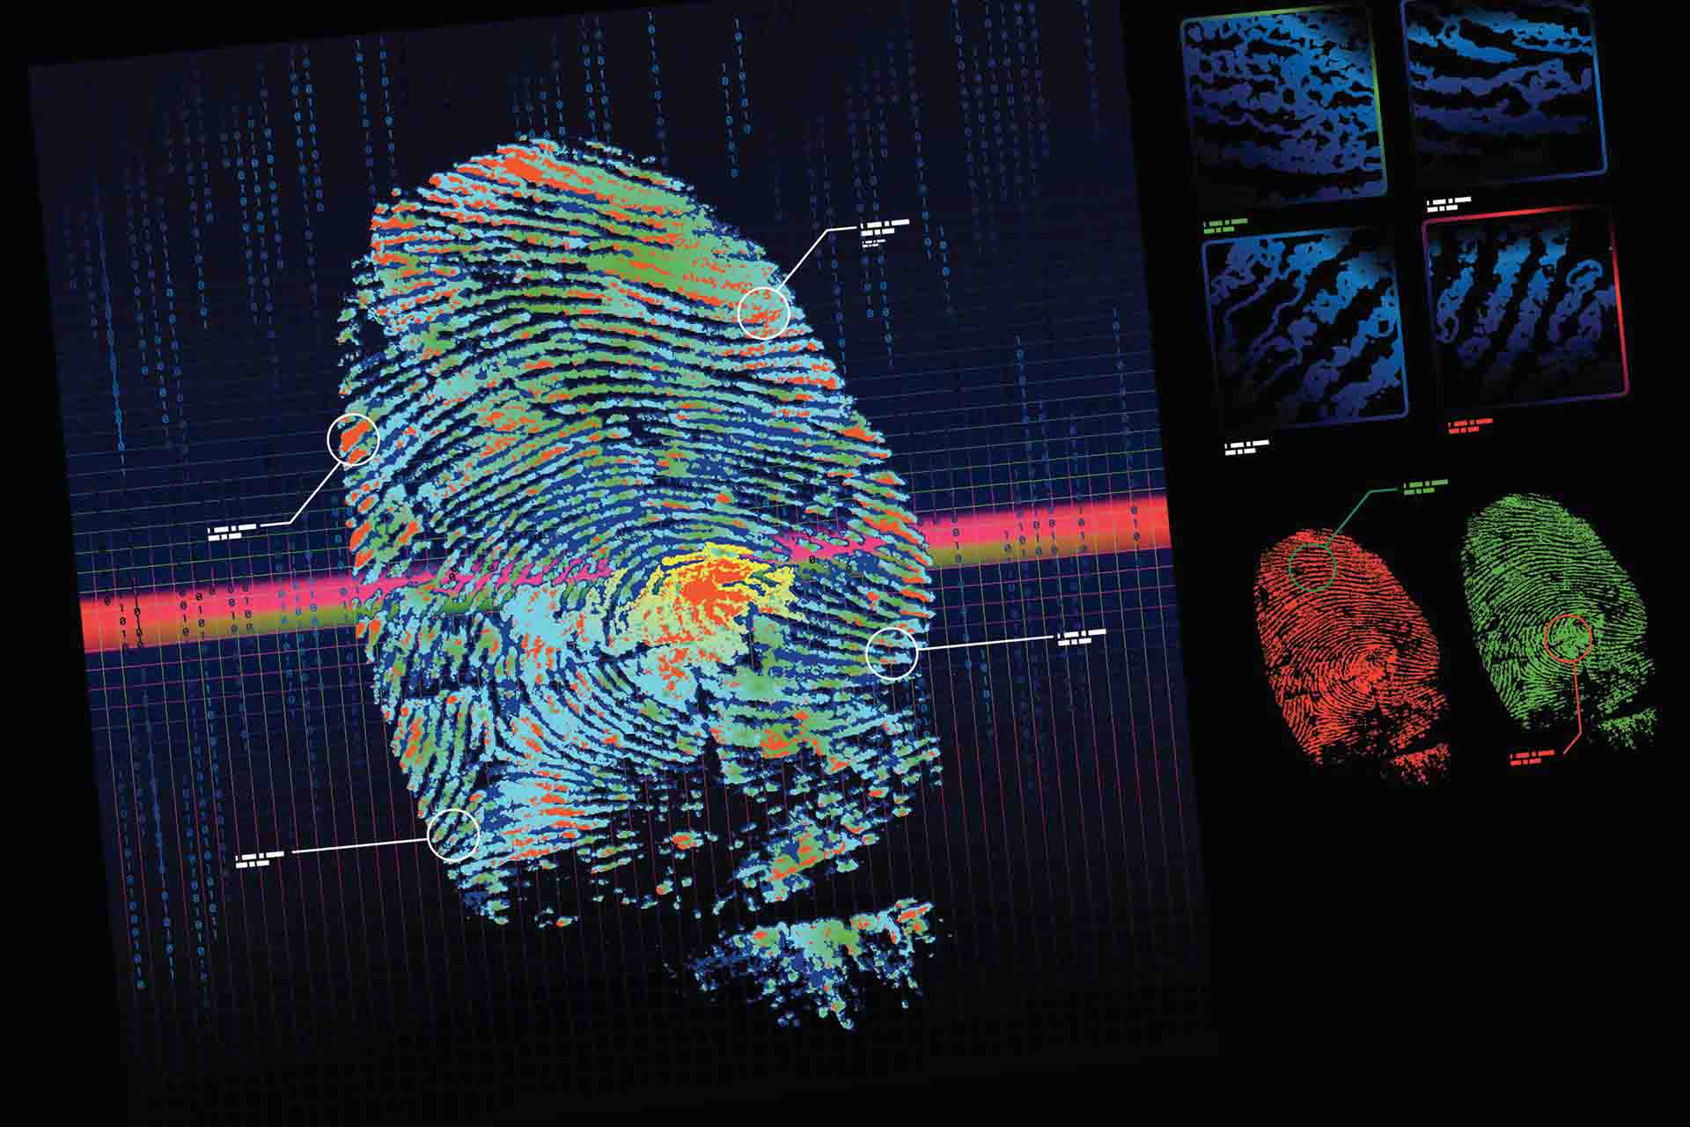
“The hacker used Gnu to swap his special atrun file for the system's legitimate version. Five minutes later, the system hatched his egg, and he held the keys to my computer.” Traducción:El hacker usó Gnu para intercambiar su archivo especial atrun por la versión legítima del sistema. Cinco minutos después, el sistema abrió su huevo, y él tenía las llaves de mi computadora.
(The Cucko Egg,Cliff Stoll,1989)

Slide 5
Análisis forense digital aplicado a ciberseguridad.
Endpoint Windows comprometido.
Análisis de disco, Registry, eventos y memoria.
Correlación de evidencias para reconstruir el ataque.

Slide 6
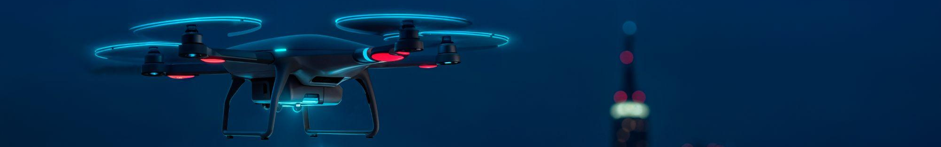
Capítulo I: Problemática
1.1
1.2
1.5.1
1.3.1
1.5.2
1.3.2
1.6
Contexto
1.4
Justificación
Descripción de problema
Alcance
Objetivo general
Limitaciones
Objetivos específicos
Cronograma de trabajo e hitos del proyecto

Slide 7
I
Problemática

Slide 8
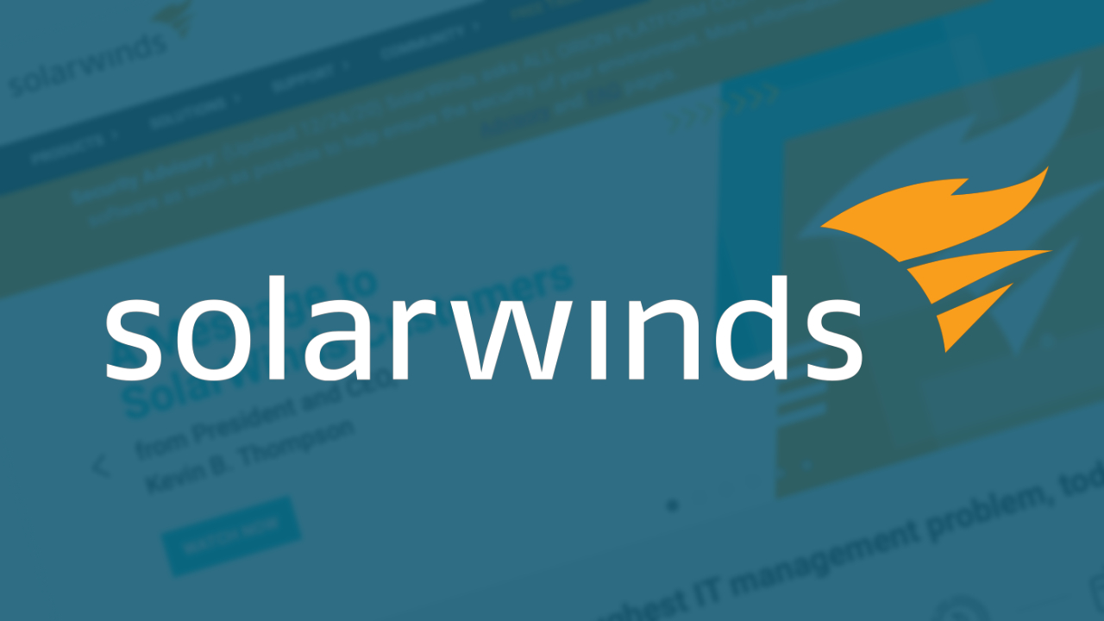
1.1 Contexto
Windows: objetivo frecuente de ciberataques.
Ataques modernos: fileless, ransomware y APT.
Evidencias distribuidas en múltiples artefactos.
Necesidad de correlacionar fuentes DFIR.

Slide 9
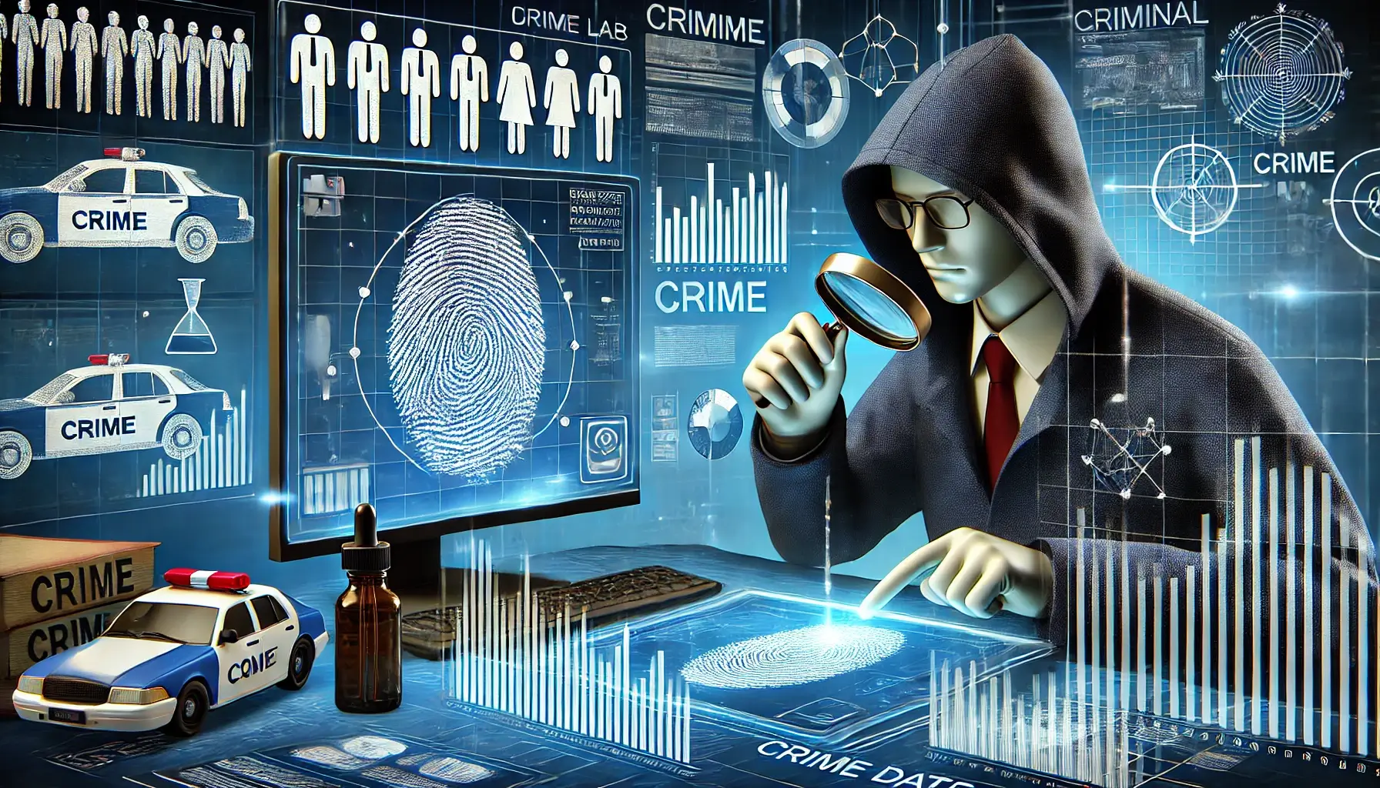
1.2 Descripción del problema
Análisis forense frecuentemente aislado por fuente.
Falta de una metodología integral y estructurada.
Se pueden omitir indicadores de compromiso.
Dificultad para reconstruir la línea de tiempo del atacante.
CFAVDFD

Slide 10
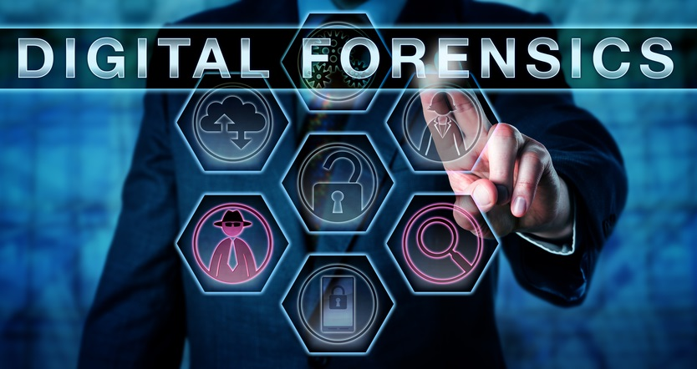
1.3.1 Objetivo general
Implementar un proceso de investigación forense digital y respuesta a incidentes para un endpoint Windows comprometido, correlacionando disco, Registry, eventos y memoria.

Slide 11
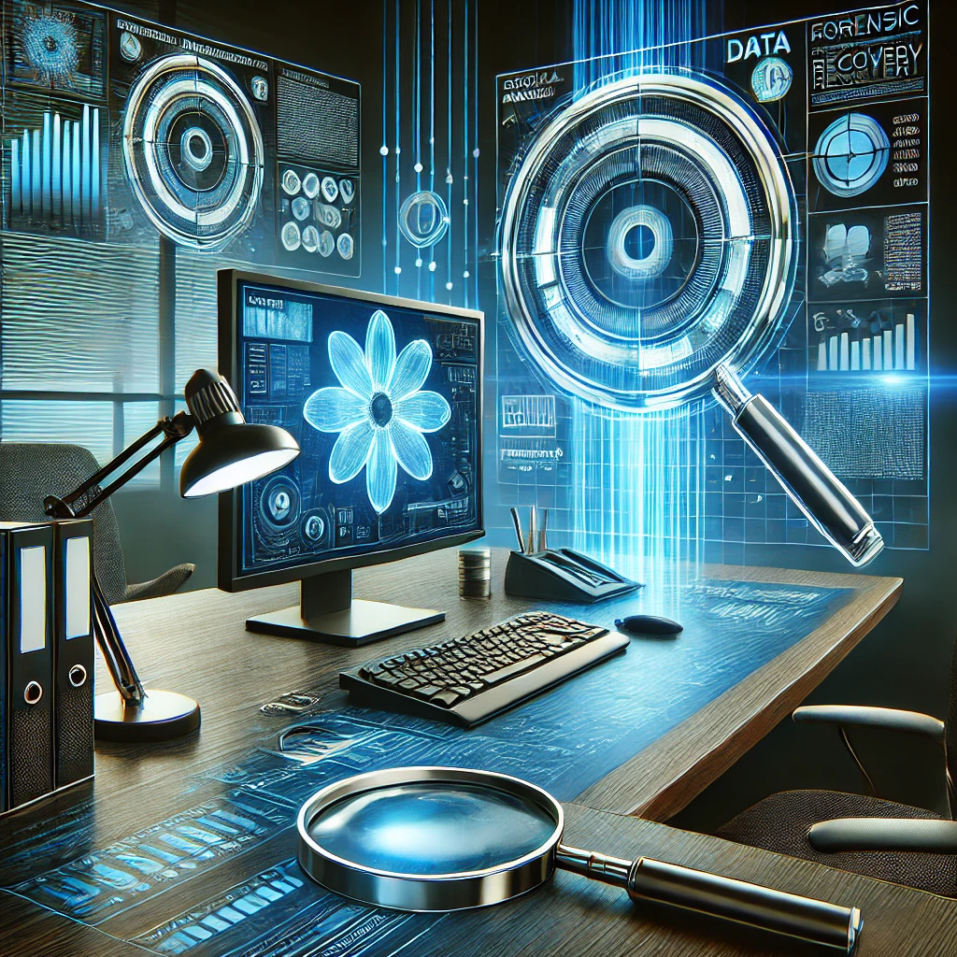
1.3.2 Objetivos específicos
Adquirir evidencias con cadena de custodia e integridad.
Analizar disco, Registry, Event Logs y memoria.
Correlacionar evidencias y reconstruir la línea de tiempo.
Identificar vector de entrada, persistencia e IoCs.
Elaborar informe técnico con recomendaciones DFIR.

Slide 12
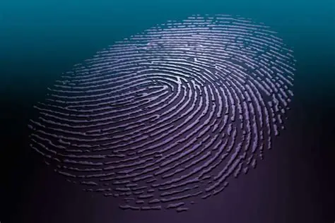
1.4 Justificación
Fortalece competencias en Digital Forensics & Incident Response.
Permite detectar malware fileless y persistencia avanzada.
Integra evidencias volátiles y no volátiles.
Aplica herramientas y metodologías reconocidas en DFIR.

Slide 13
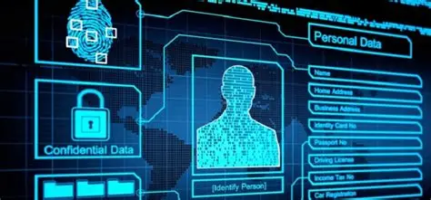
1.5.1 Alcances
1 endpoint Windows 10 en laboratorio.
Análisis de:
NTFS y artefactos de disco
Registry
Event Logs + Sysmon
Memoria RAM
Informe técnico de investigación y respuesta.
CFAVDFD

Slide 14
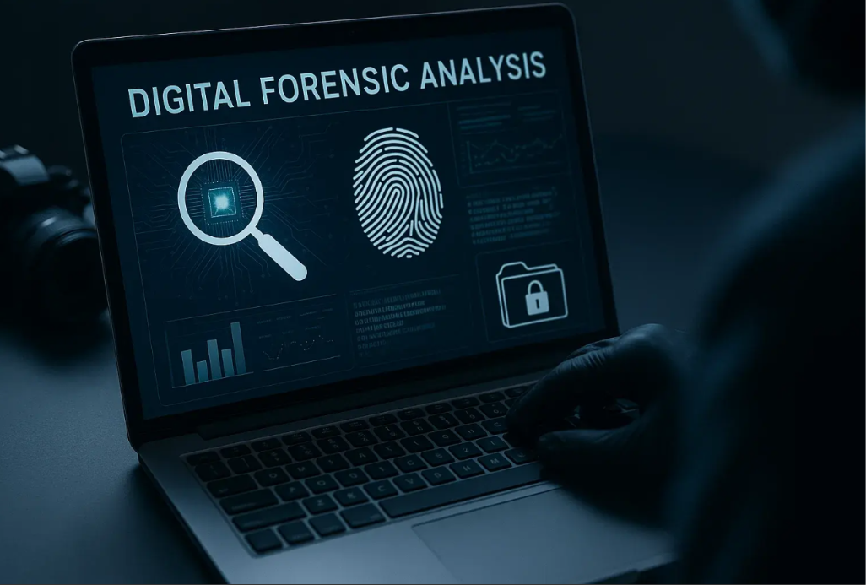
1.5.2 Limitaciones
CFAVDFD
Sin sistemas ni datos de producción reales.
Escenario controlado de laboratorio.
No contempla red empresarial ni movimiento lateral.
Recursos de hardware/almacenamiento pueden limitar el análisis.

Slide 15
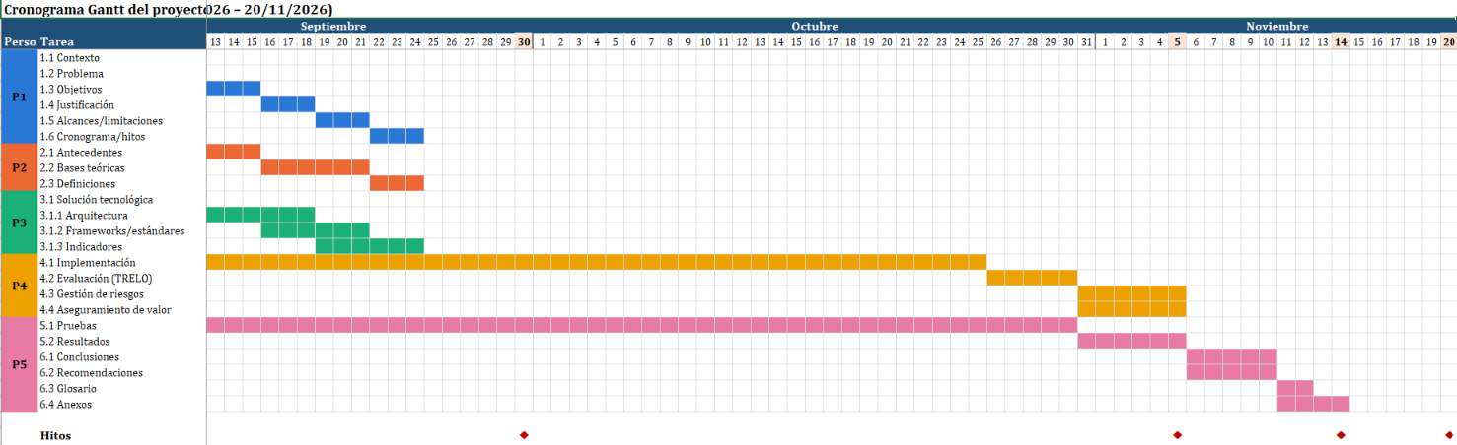
1.6 Cronograma de trabajo e Hitos
09 sep → 20 nov 2026
12 sep: Primera entrega
30 sep: Diseño cerrado
05 nov: Avance de implementación
14 nov: Documento completo
20 nov: Entrega final
Distribución:
Brigitte→ Problemática
Milagros → Marco teórico
Stephany→ Arquitectura
Nardy→ Implementación
Marelly→ Pruebas y cierre
Diagrama de Gantt (Fig.1)

Slide 16
II
Marco teórico científico

Slide 17
III
DISEÑO METODOLÓGICO Y ARQUITECTURA

Slide 18
IV
IMPLEMENTACIÓN y GESTIÓN DEL PROYECTO

Slide 19
V
PRUEBAS, VALIDACIÓN Y RESULTADOS

Slide 20
VI
Conclusiones, recomendaciones,y anexos

Slide 21
LET'S HAVE A LOOK
Mercury is the closest planet to the Sun and the smallest one in the entire Solar System. This planet’s name has nothing to do with the liquid metal, since Mercury was named after the Roman messenger god. Despite being closer to the Sun than Venus, its temperatures aren't as terribly hot as that planet’s. Its surface is quite similar to that of Earth’s Moon, which means there are a lot of craters and plains. Speaking of craters, many of them were named after artists or authors who made significant contributions to their respective fields. Mercury takes a little more than 58 days to complete its rotation, so try to imagine how long days must be there!

Slide 22
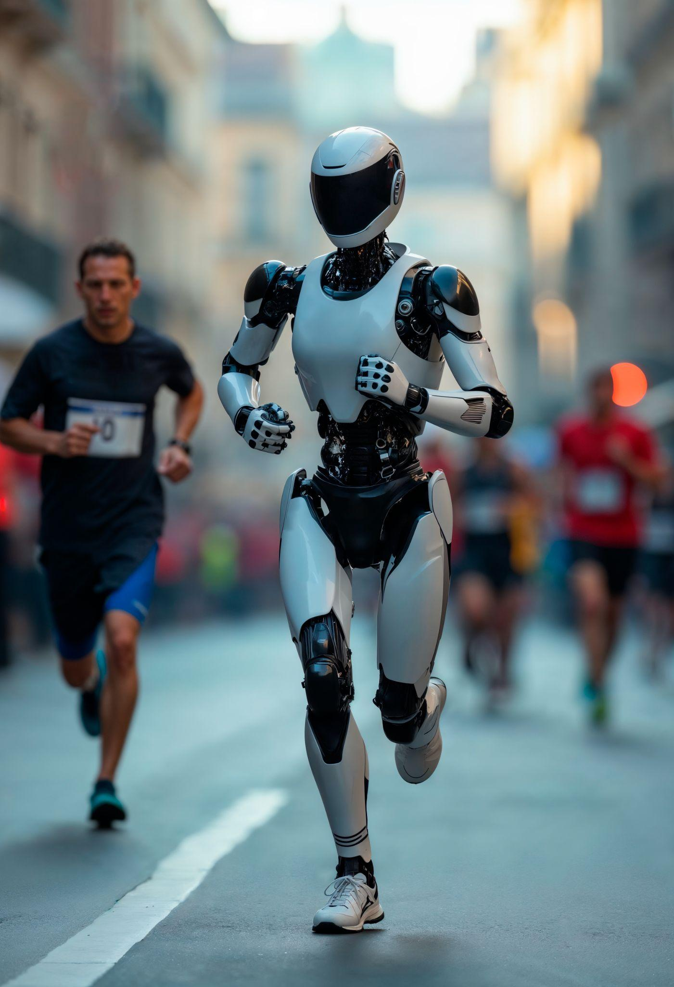
THESE ARE TWO IDEAS
This is about Saturn
This is about Venus
Saturn is a gas giant and has several rings. It’s composed mostly of hydrogen and helium. It was named after the Roman god of wealth and agriculture
Venus has a beautiful name and is the second planet from the Sun. Its atmosphere is extremely poisonous, primarily made up of carbon dioxide with clouds of sulfuric acid

Slide 23
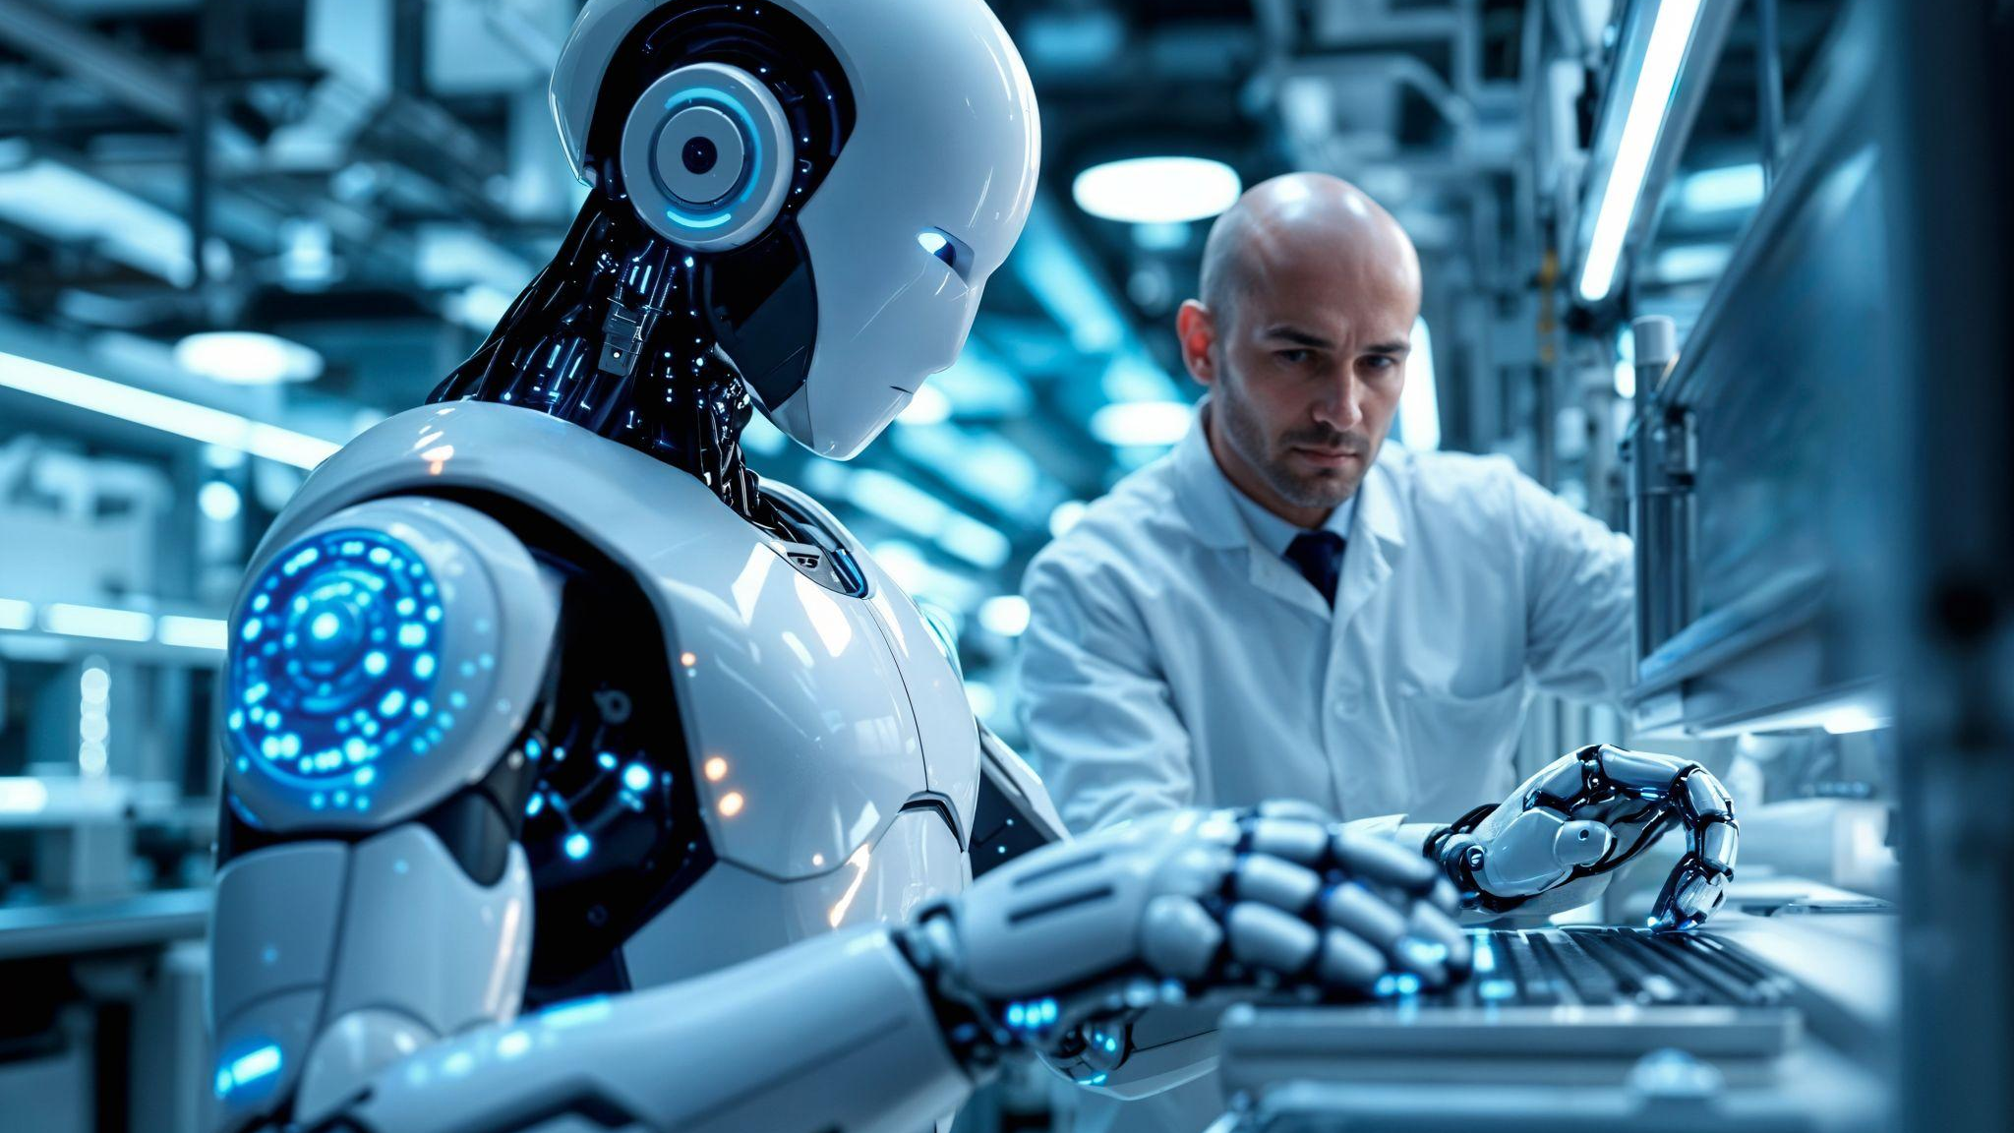
A picture is worth a thousand words

Slide 24
THIS IS A TIMELINE
01
02
03
04
05
This is Venus
This is Earth
This is Mars
This is Jupiter
This is Saturn
Venus has a beautiful name and is the second planet from the Sun. It’s terribly hot, even hotter than Mercury
Earth is the third planet from the Sun and the only one that harbors life in the Solar System
Despite being red, Mars is actually a cold place. It’s full of iron oxide dust, which gives the planet its reddish cast
Jupiter is the fourth-brightest object in the night sky. It was named after the Roman god of the skies and lightning
Saturn is a gas giant and has several rings. It’s composed mostly of hydrogen and helium

Slide 25
THANK
YOU
Do you have any questions?
youremail@freepik.com | +00 000 000 000 | yourwebsite.com
Please keep this slide for attribution

Slide 26
Instructions for use
If you have a free account, in order to use this template, you must credit Slidesgo by keeping the Thanks slide
As a Free user, you are allowed to:
Modify this template
Use it for both personal and commercial projects
You are not allowed to:
Sublicense, sell or rent any of Slidesgo Content
Distribute Slidesgo Content unless it has been expressly authorized by Slidesgo
Include Slidesgo Content in an online or offline database or file
Offer Slidesgo templates (or modified versions of Slidesgo templates) for download
Acquire the copyright of
Slidesgo Content
For more information about editing slides, please read our FAQs or visit our blog

Slide 27
Instructions for use (premium users)
As a Premium user, you can use this template without attributing Slidesgo or keeping the Thanks slide
You are allowed to:
Modify this template
Use it for both personal and commercial projects
Share this template in an
editable format
Hide or delete the “Thanks” slide and the mention to Slidesgo in the credits
You are not allowed to:
Sublicense, sell or rent any of Slidesgo Content
Distribute Slidesgo Content unless it has been expressly authorized by Slidesgo
Use any of the elements that are part in a separated way
Register any of the elements as a trademark or logo in an intellectual property registry
For more information about editing slides, please read our FAQs or visit our blog

Slide 28
Fonts
Colors
This presentation has been made using the following fonts:
All the colors used in this presentation
Click on the button of the link to the fonts
#ffffff
#0b0f1a
#2dd4bf
Unbounded
Raleway
To view this template correctly in PowerPoint, download and install the fonts we used

Slide 29
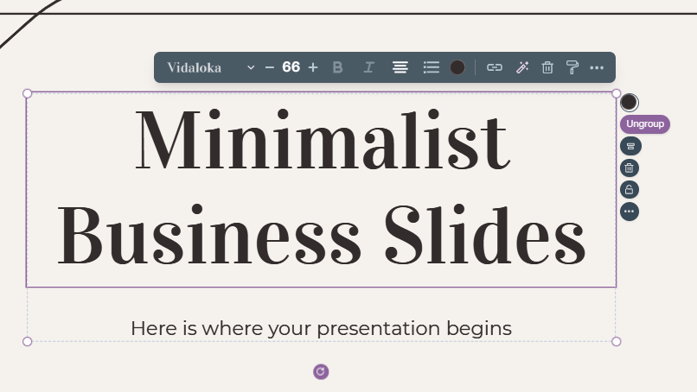
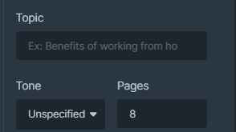
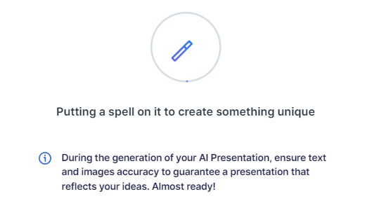
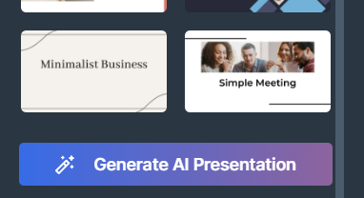
Presentation Maker
Slidesgo introduces its latest feature: the Presentation Maker. Enjoy two main functionalities - firstly, with a few clicks, create marvelous presentations with Artificial Intelligence that adapt to your needs. And it's completely free
Generate AI Presentation

Slide 30
Use our editable graphic resources...
You can easily resize these resources without losing quality. To change the color, just ungroup the resource and click on the object you want to change. You can also look for more infographics on Slidesgo

Slide 33
 | Jan | Feb | Mar | Apr | Jun
Task 1
Task 2
Task 3
 | No | Yes | Yes | No | Yes
 | Yes | No | Yes | No | Yes
 | Yes | Yes | No | Yes | No
 | Jan | Feb | Mar | Apr | Jun
Task 1
Task 2
Task 3

Slide 35
6/10 | 8/10 | 7/10 | 4/10

Slide 36
...and our sets of editable icons
You can resize these icons without losing quality
You can change the stroke and fill color; just select the icon and click on the paint bucket/pen
In Google Slides, you can also use Flaticon’s extension, allowing you to customize and add even more icons

Slide 37
Educational icons
Medical icons

Slide 38
Business icons
Teamwork icons

Slide 39
Help & support icons
Avatar icons

Slide 40
Creative process icons
Performing arts icons

Slide 41
Nature icons

Slide 42
SEO & marketing icons

Slide 43
CONTENTS OF THIS TEMPLATES
Introducción
Contexto
Problemática
Alcance
To view this template correctly in PowerPoint, download and install the fonts we used
You can see on the link all the colors used in this presentation
You must keep it so that proper credits for our design are given
These can be used in the template, and their size and color can be edited
For more info: SLIDESGO | SLIDESGO AI TOOLS | BLOG | FAQs
You can edit the master slides easily. For more info, click here
You can visit our sister projects: FREEPIK AI TOOLS | FREEPIK LIBRARY RESOURCES
You can delete this slide when you’re done editing the presentation

Slide 44
Capítulo I: Problemática
01
05
02
06
03
07
04
08
Contexto
Alcance
Descripción
Limitaciones
Objetivos generales
Cronograma de trabajo e hitos del proyecto
Objetivos específicos
Name of the section

Slide 45


