Slide 1

SIMPLE WALLET
01
Thêm vài chức năng bổ sung, use-case
02
Triển khai và giải thích code

Slide 2
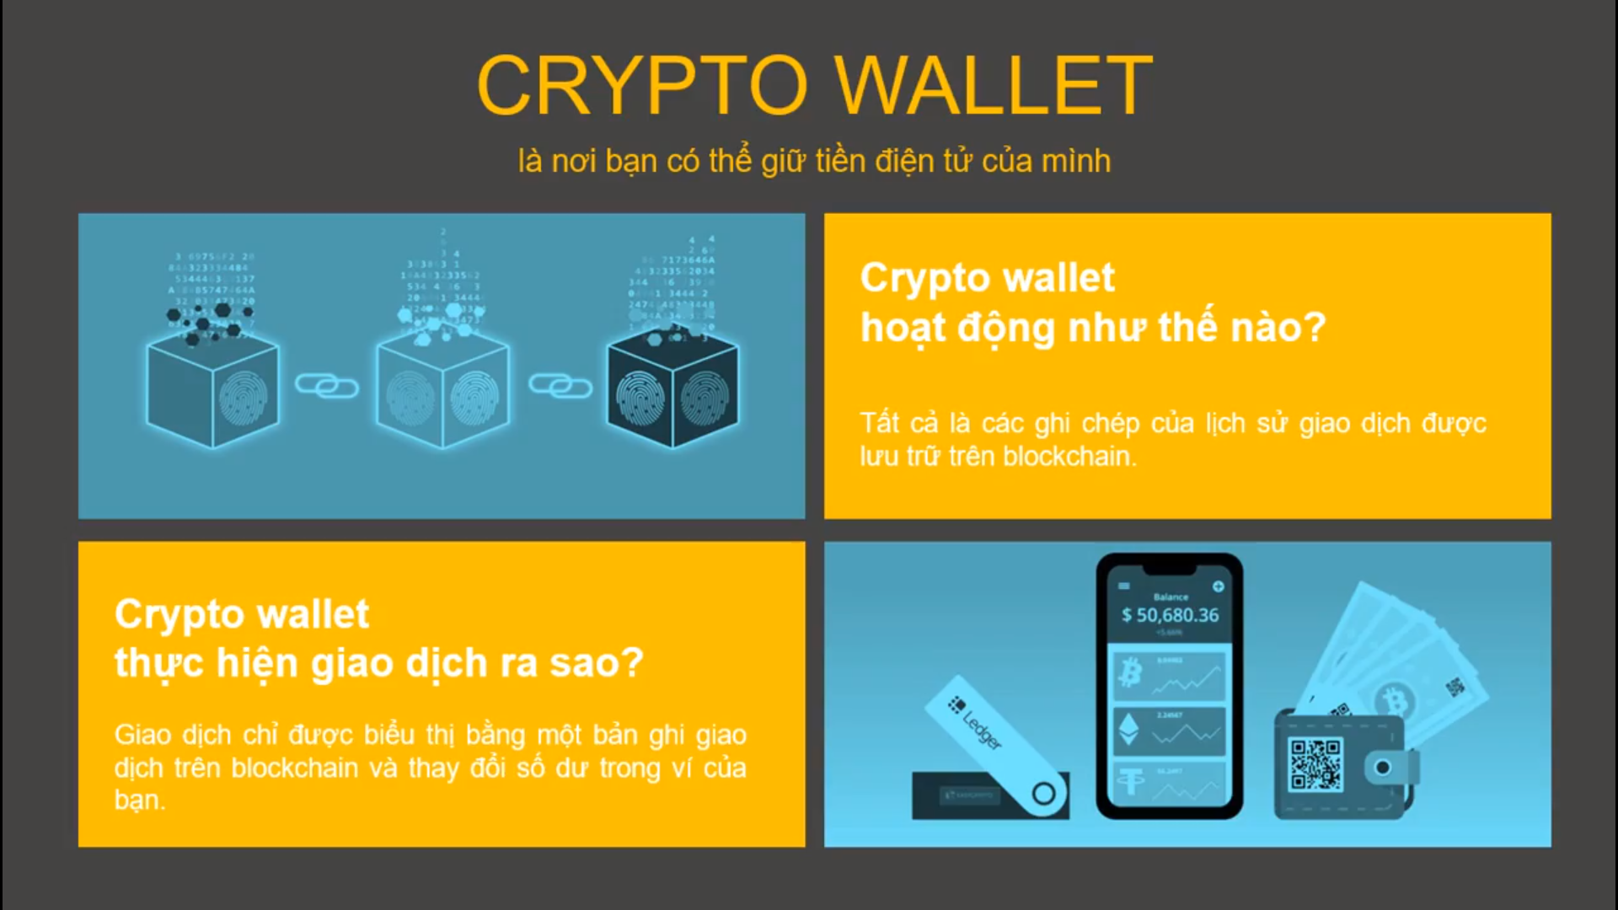

Slide 3
Functions
Keywords | Description
fallback | executed if none of the other functions match the function identifier or no data was provided with the function call. Only one unnamed function can be assigned to a contract and it is executed whenever the contract receives plain Ether without any data
constructor | inside a smart contract and it is invoked - only once - while deploying it. The compiler creates default constructor if there is no constructor defined explicitly.
modifier | Modifiers can be used to change the behaviour of functions in a declarative way. Modifiers are inheritable properties of contracts and may be overridden by derived contracts, but only if they are marked virtual.
view | Functions can be declared view in which case they promise not to modify the state.
pure | Functions can be declared pure in which case they promise not to read from or modify the state.

Slide 4
KẾT LUẬN
Keywords | Syntax | Description
events | event eventName(); | Events are inheritable members of contracts. When you call them, they cause the arguments to be stored in the transaction’s log - a special data structure in the blockchain. These logs are associated with the address of the contract, are incorporated into the blockchain, and stay there as long as a block is accessible.
 | emit eventName();
libraries | library libraryName{}; | Libraries are similar to contracts, but their purpose is that they are deployed only once at a specific address and their code is reused using the DELEGATECALL (CALLCODE until Homestead) feature of the EVM.
ABI |  | The Contract Application Binary Interface (ABI) is the standard way to interact with contracts In the Ethereum ecosystem, both from outside the blockchain and for contract-to-contract interaction. Data is encoded according to its type, as described in this specification. The encoding is not self describing and thus requires a schema in order to decode.

