Slide 1

An online store’s customer analysis
Question:
Sales were decreasing and the customers were churned
Goal:
keeping customers and increasing sales

Slide 2
Monthly consumption tendency
Customer behavior
Individual consumption

Slide 3
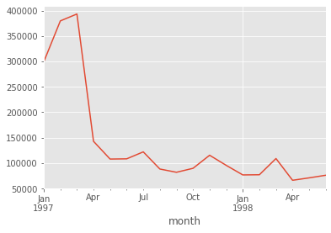
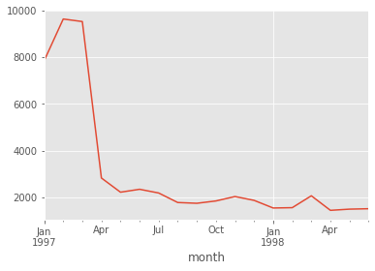
Monthly consumption tendency
Monthly amount of consumption
Monthly number of customers

Slide 4
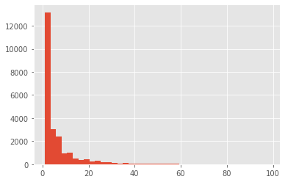
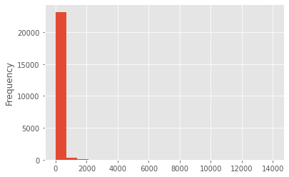
Individual consumption analysis
Number of products of consumption
Amount of consumption

Slide 5
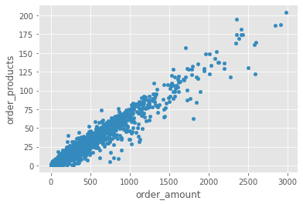
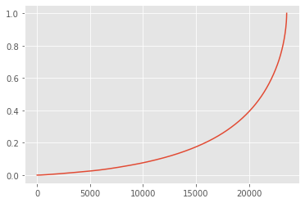
Individual consumption analysis

Slide 6

Strategy
Top 5000
60% sales
Customer stickiness
Pareto
Principle(80/20)
KPI

Slide 7
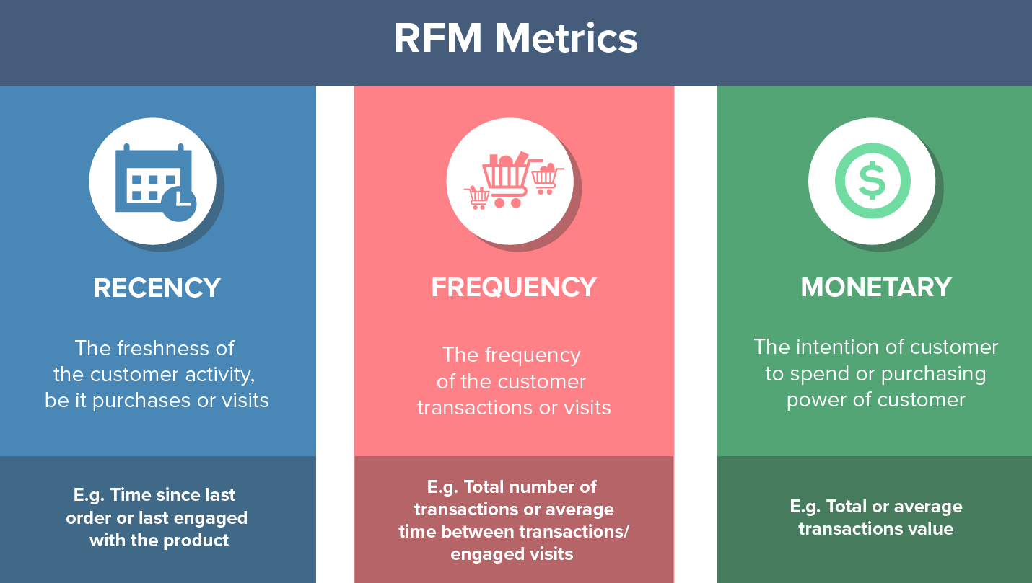
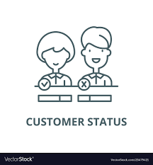
Customer behavior analysis

Slide 8
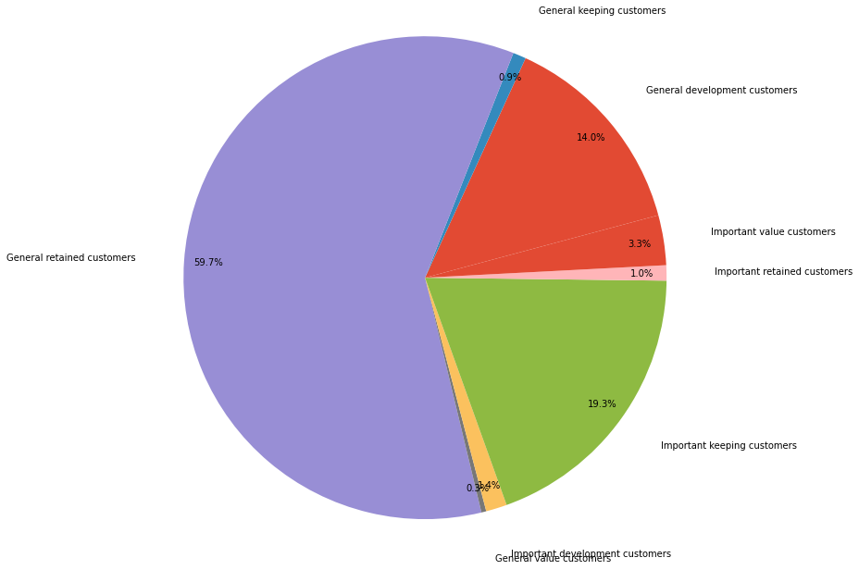
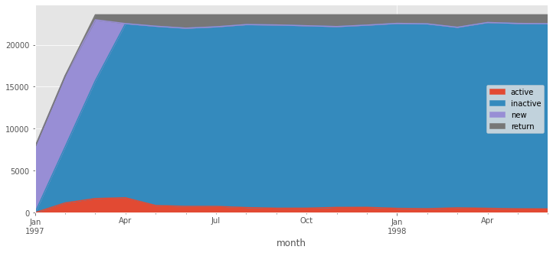
RFM segmentation
Customer status

Slide 9
Recommendations
Email campaign
Important development customers
Special offers
Surprise gifts and discounts
Offer membership or loyalty programs
Important value customers
Important keeping customers
Important retained customers

Slide 10
Recommendations
Customer status
Optimize website and redesign new page (A/B testing)
Simplify purchasing process
Improve services and communication
Active
Inactive
New
Return

