Slide 1
AI and AIGC
Focus
What AI is, where we use it, and how to use it responsibly.
SMART TOOLS
AIGC
RESPONSIBLE USE

Slide 2
AI / AIGC
01
AI and AIGC
What is AI?
Artificial Intelligence helps machines learn, think, solve problems, and create content.
AI means Artificial Intelligence.
It is a field of computer science.
AI helps machines learn and solve problems like humans.
AIGC can create text, pictures, and music.
LEARN
THINK
CREATE
AI can be our smart tool for knowledge, creativity, and communication.

Slide 3
DAILY USE
02
Uses of AI
AI is already part of daily life and learning.
Examples
Smart assistants
Translation apps
Face recognition
Education
AI helps with communication, convenience, safety, and personalized study.

Slide 4
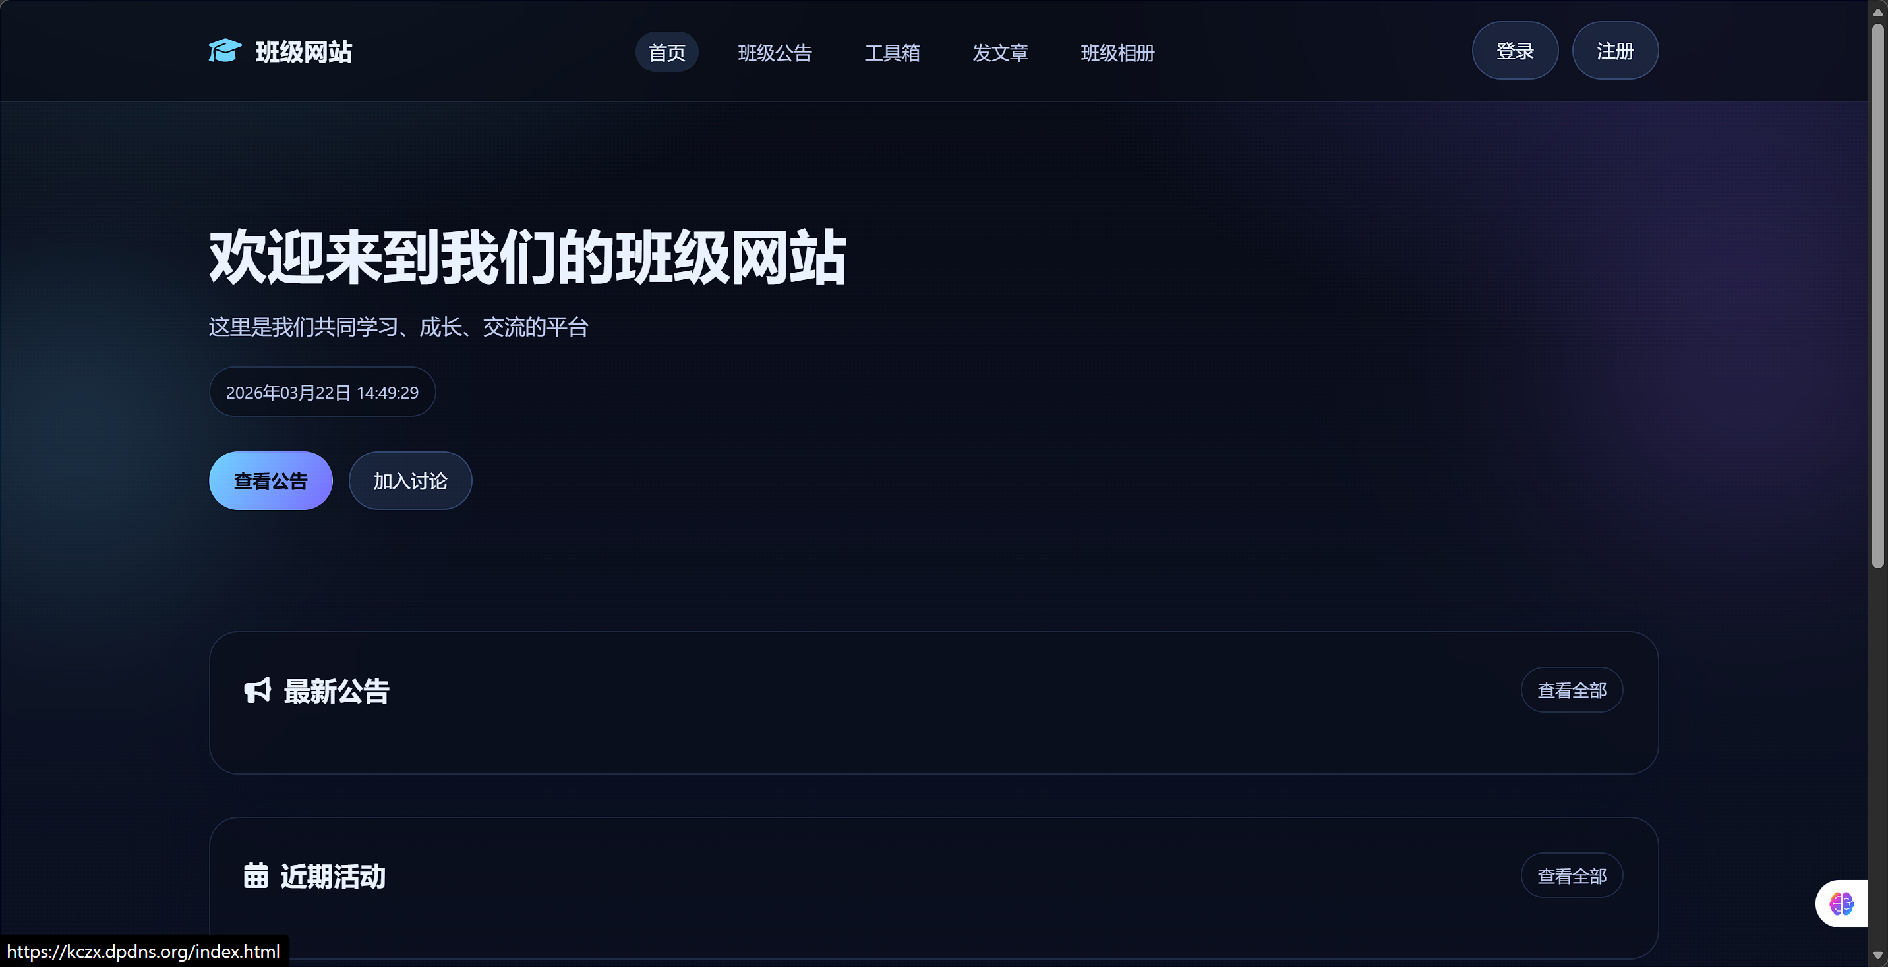
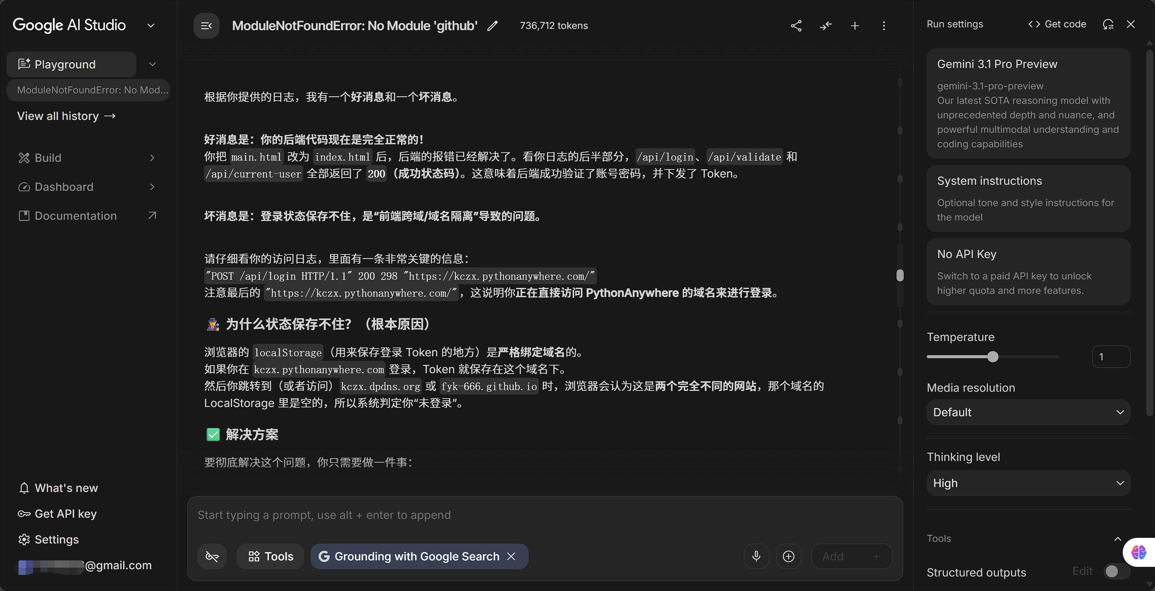
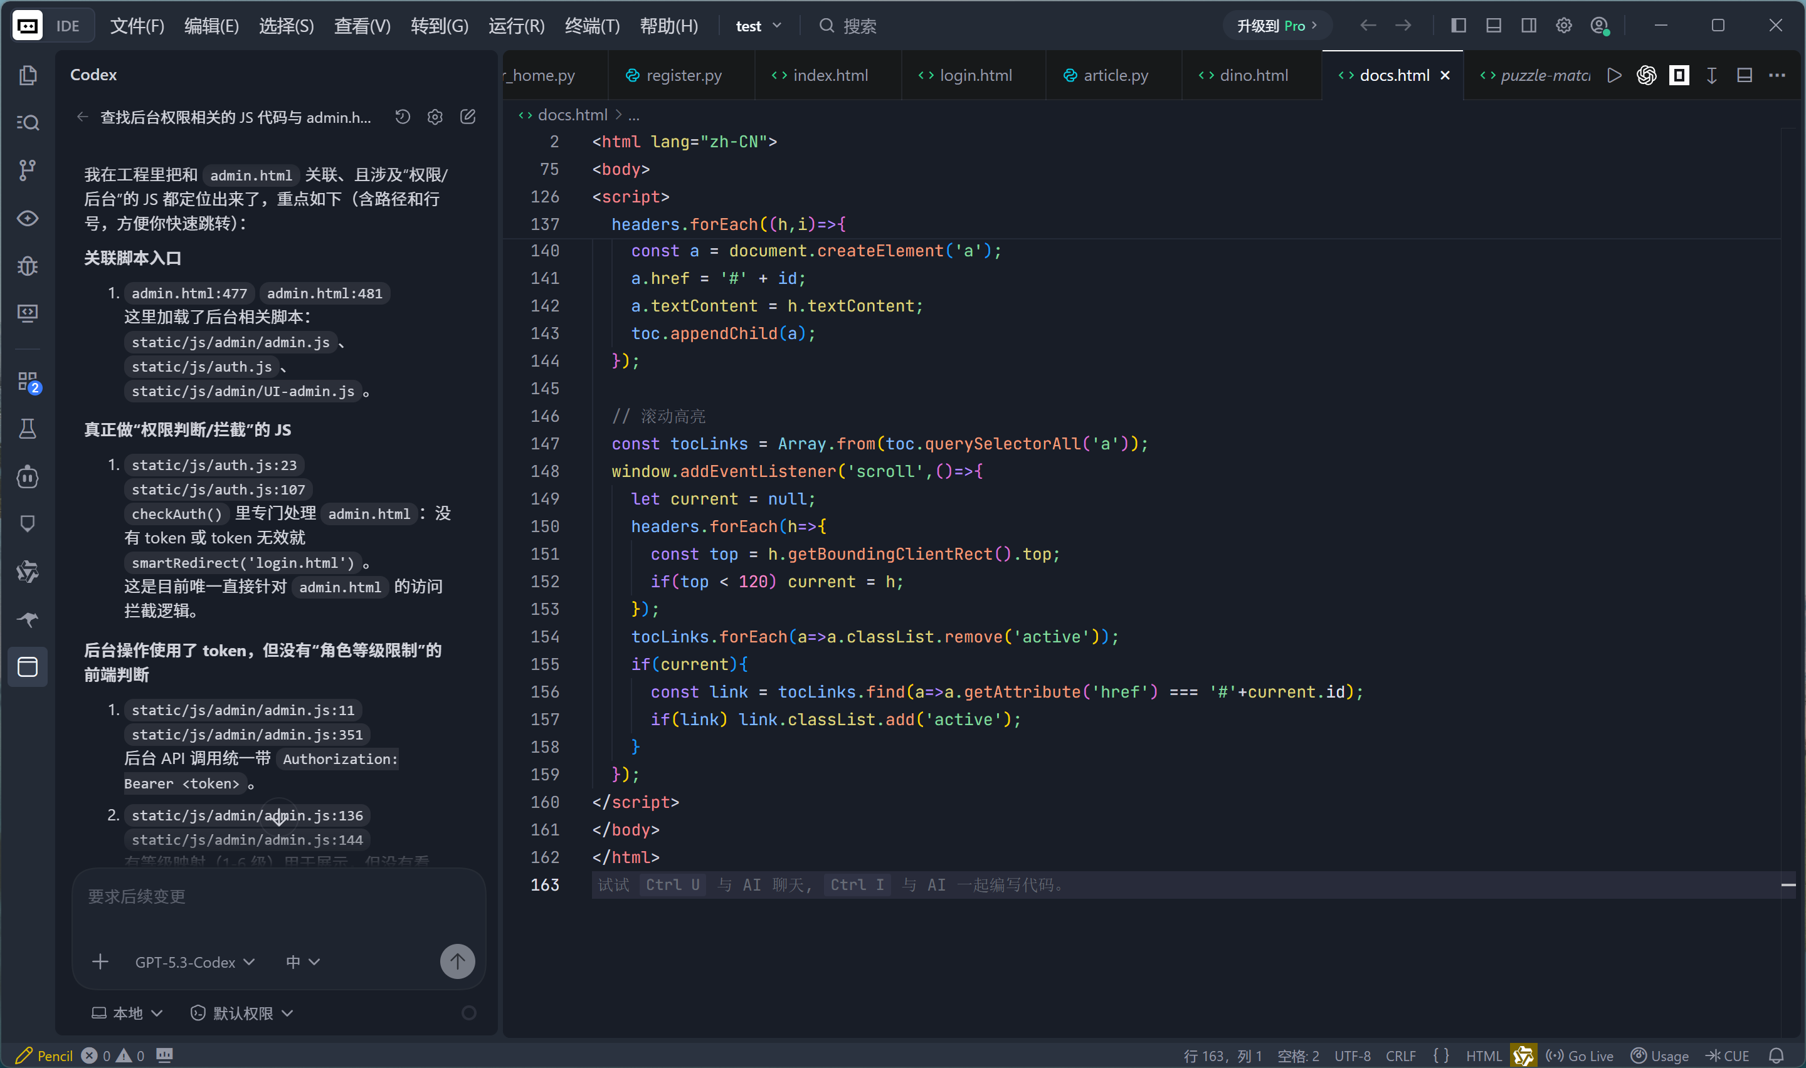
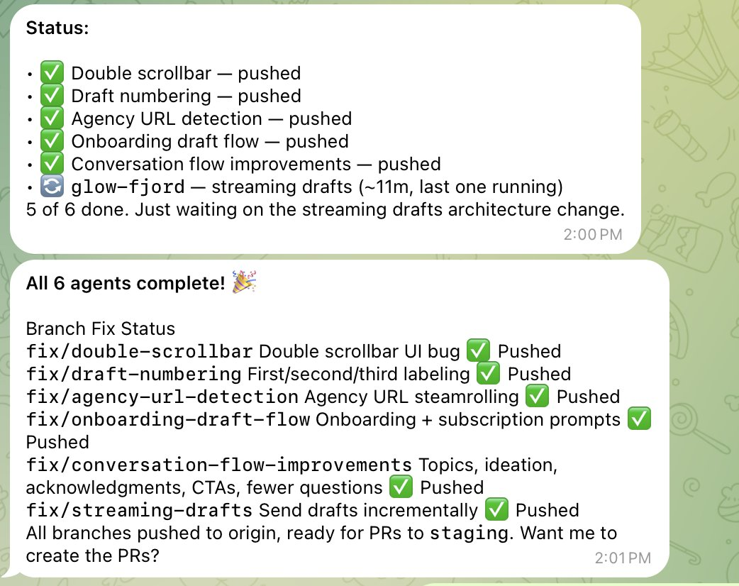
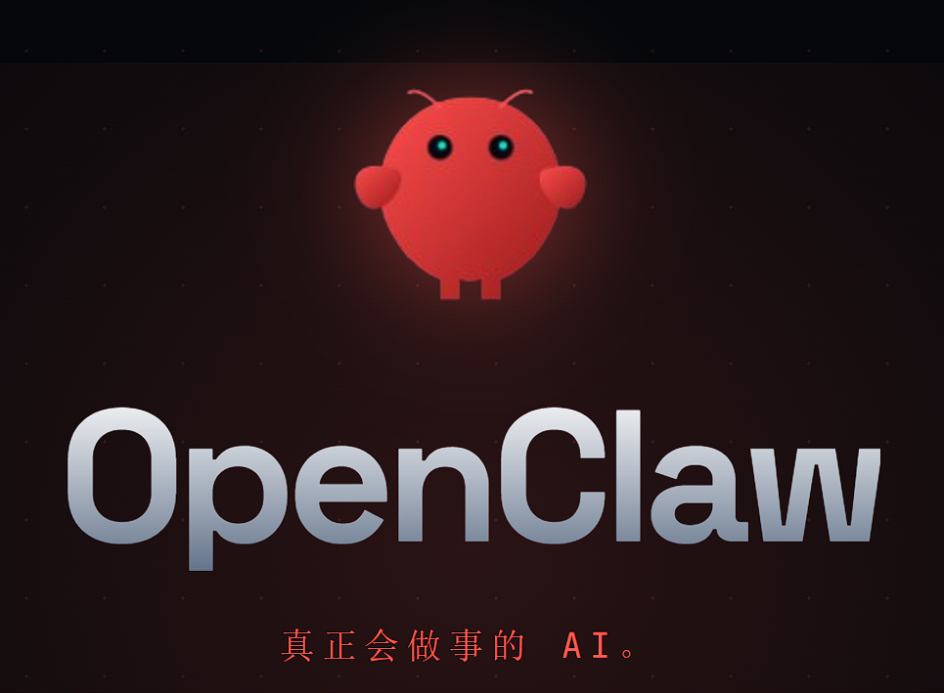
RESPONSIBLE USE
03
How to Use AI Well
My Personal Experience with AI
In the wave of AI, I also started using AI to help me code and fix mistakes. I use tools like OpenCode and Claude Code to work faster and more efficiently. Have you heard of OpenClaw? It has become very popular and caused a lot of discussion. Now it can be a personal assistant on your phone. It can help us read and reply to emails, check the daily news, and make study plans for us.

Slide 5

RESPONSIBLE USE
04
How to Use AI Well
Use AI wisely, safely, and honestly.
1
Use AI as a tool
Let AI support your thinking instead of replacing it.
2
Check information
Always verify facts and compare important answers.
3
Protect privacy
Do not share personal or sensitive information.
4
Learn, don't cheat
Use AI to understand better and improve yourself.

Slide 6
CONCLUSION
05
AI Is Changing Our World
We should use AI safely and responsibly.
Key message
AI is changing study, work, and communication.
Use it with care, privacy awareness, and responsibility.
Human judgment is still the most important part.
Question:What would you like to do with AI?

Slide 7
THANK YOU
AI is powerful, but thoughtful people make it meaningful.
AI / AIGC

