Slide 2


Slide 3
IaC
Infrastructure as Code
Manage and provision machines through readable and computable definition files.

Slide 4
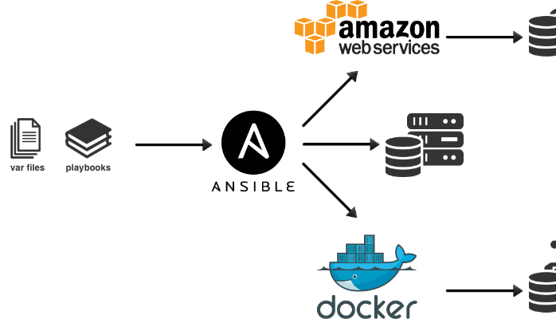
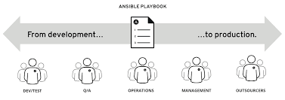
Why ?

Slide 5
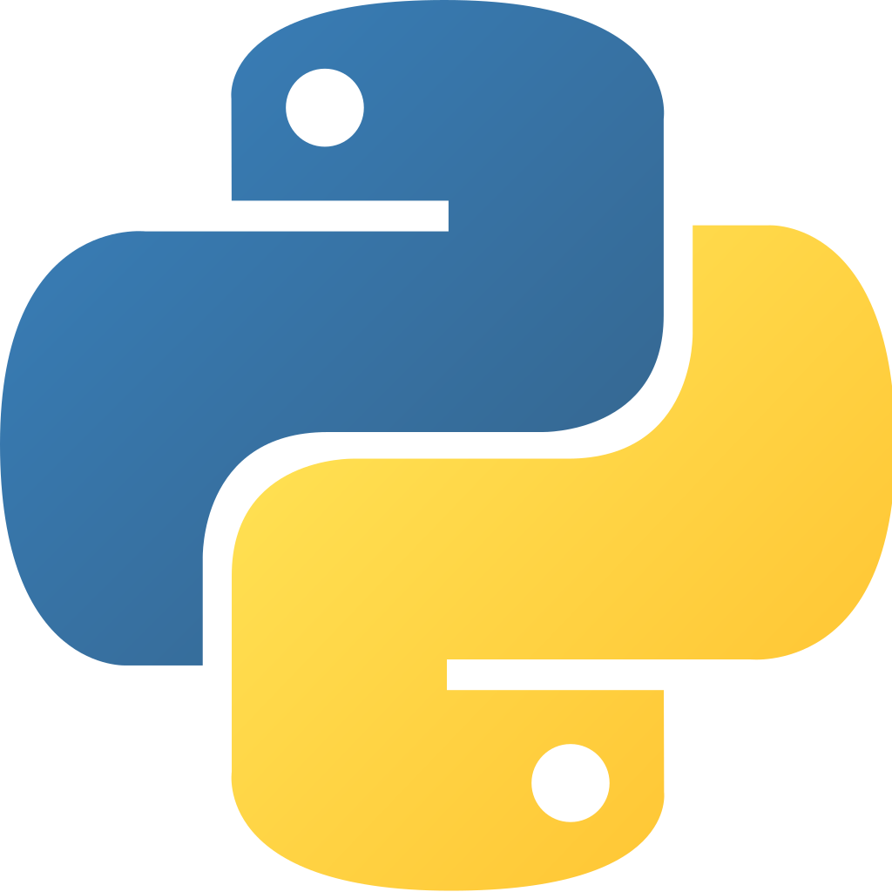

What ?
An Open Source IT automation engine
Provisioning
Set up AUTOMATED INFRASTRUCTURE or CLOUD VMs
2. Configuration management
Applications, OS, device.
Start and stop services, install/update applications, implement security policy, ...etc
3. Application deployment
Ansible just requires that systems have Python and SSH

Slide 6
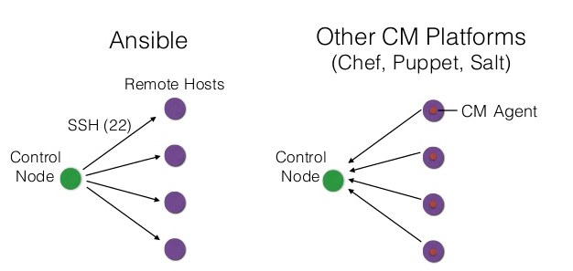

How ?
Ansible is Agentless (SSH)
No need to install agents on nodes
Declarative vs Imperative

Slide 7
How ?
Managed
Node 1
SSH
domain1
Control
Node
Managed
Node 2
domain2
Managed
Node 3
domain3

Slide 8
Let’s dive in
[groupA]
Managed
Node 1
SSH
domain1
Control
Node
Managed
Node 2
domain2
Managed
Node 3
Inventory
Playbook
domain3
[groupB]
[groupA]
domain1
[groupB]
domain2
domain3

Slide 9
[groupA]
Managed
Node 1
SSH
domain1
Control
Node
Managed
Node 2
domain2
Managed
Node 3
Inventory
domain3
[groupB]
Playbook
Play
---
- hosts: groupB
remote_user: user
tasks:
- name: Ensure apache is at the latest version
yum:
name: httpd
state: latest
- name: Write the apache config file
template:
src: /srv/httpd.j2
dest: /etc/httpd.conf
roles:
- common
- deploy
[groupA]
domain1
[groupB]
domain2
domain3
...

Slide 10
[groupA]
Managed
Node 1
SSH
domain1
Control
Node
Managed
Node 2
domain2
Managed
Node 3
Inventory
domain3
[groupB]
Playbook
Play
---
- hosts: groupB
remote_user: user
tasks:
- name: Ensure apache is at the latest version
yum:
name: httpd
state: latest
- name: Write the apache config file
template:
src: /srv/httpd.j2
dest: /etc/httpd.conf
roles:
- common
- deploy
Task
[groupA]
domain1
[groupB]
domain2
domain3
Role
Module
Role
common
tasks:
- name: Close all ports
iptables:
policy: drop
- name: Open port 80
firewalld:
port: 80/tcp
- name: Open port 22
firewalld:
port: 22/tcp

Slide 11
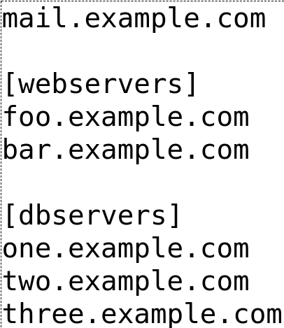
Inventory
Ansible needs to know where to run the commands
Ansible’s inventory is a portion of systems listed
Hosts and Groups
Host/Group Variables
Tags, SSH keys, Aliases, Login User ...
Save your whole infrastructure in a file
http://docs.ansible.com/ansible/latest/intro_inventory.html

Slide 12
Modules
Lots of build in modules :
setup : Display all the informations Ansible has on a host
ping : Ping a host to see if ansible can access it
yum : Install a package
service : Start / Stop SystemD daemons
docker_container : Manage docker containers
Can add new ones :
https://galaxy.ansible.com/
Write them (in python)
Ansible v2.9
has about 3,681 modules

Slide 13
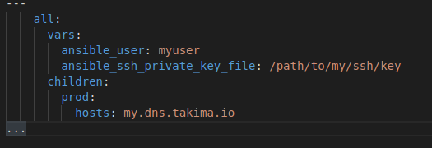
inventory/setup.yml

Slide 14
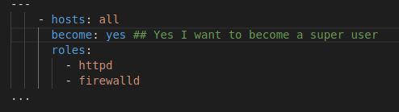
playbook.yml

Slide 15
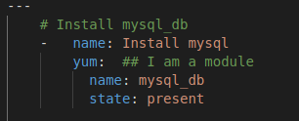
tasks/main.yml

Slide 16
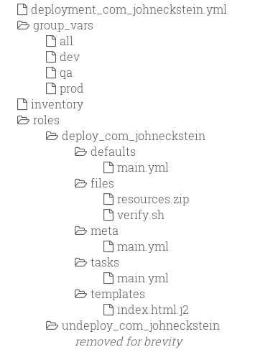
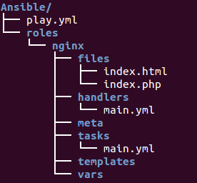
Good practice
Proper file structure
Keep playbook small (<100 lines)
Use GIT
Version & release
Document -> README file
Use linting

Slide 17
References
https://docs.ansible.com/ansible/latest/playbooks_best_practices/html
https://www.ansible.com/overview/how-ansible-works

