Slide 1
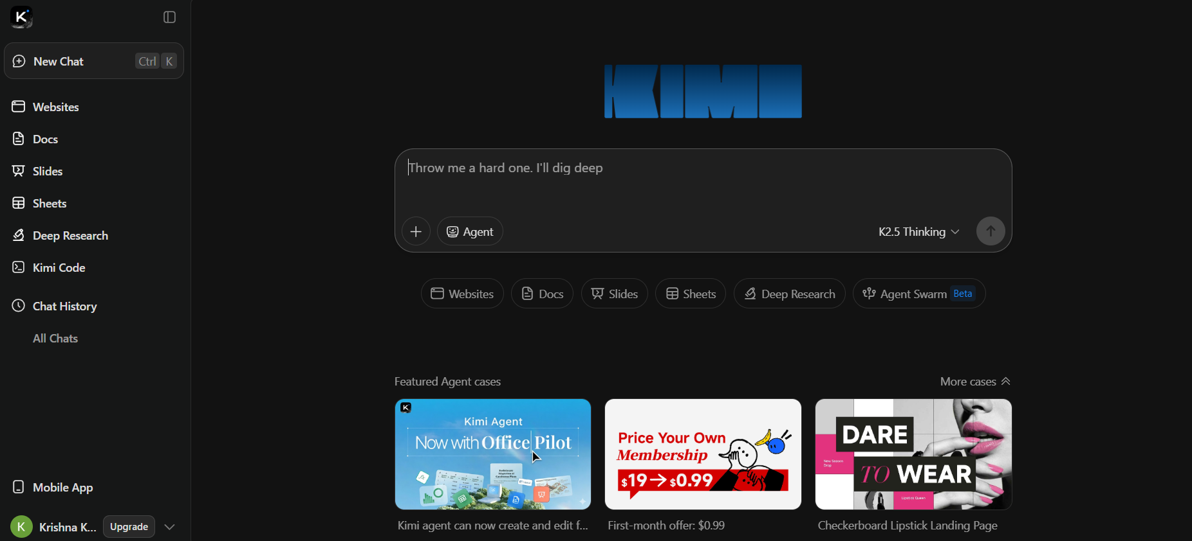
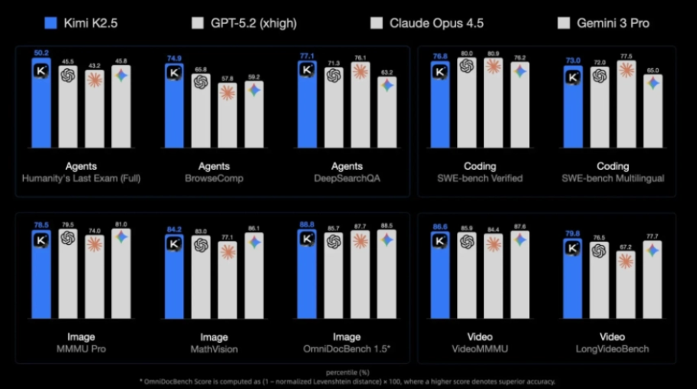
https://www.kimi.com/ai-models/kimi-k2-5

Slide 2
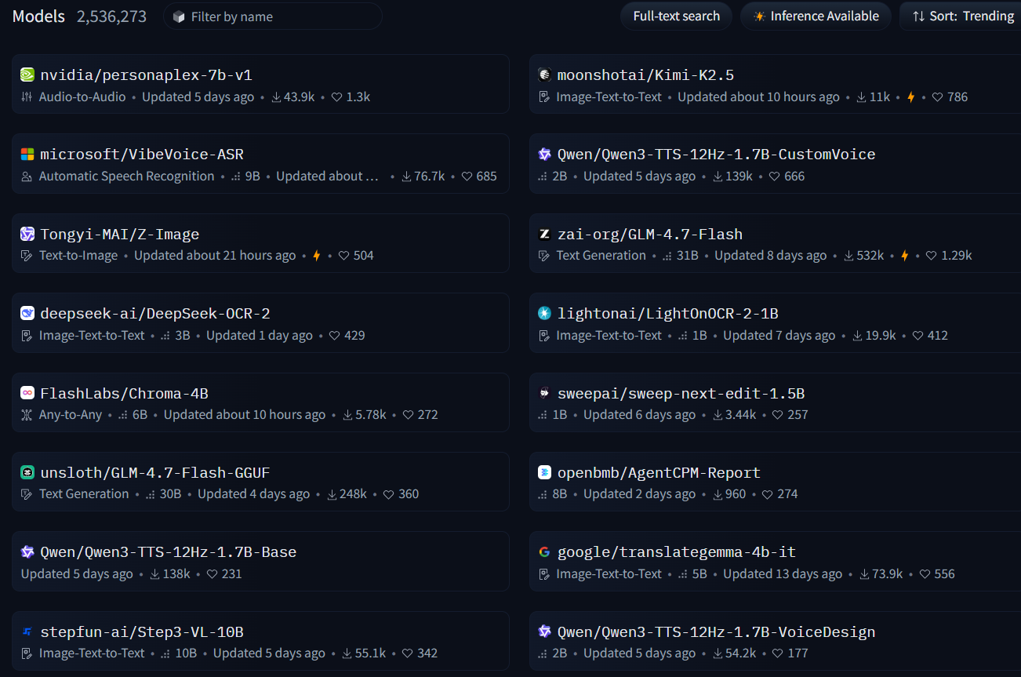

Slide 3
https://github.com/QwenLM/Qwen3-VL-Embedding
Multi-modal RAG

