Slide 1
F.m procurement

Slide 2
What is procurement?

Slide 3
What is “procurement”?
Procurement is the process by which goods and/or services are acquired to fulfil the needs of a business or project.
The aim is to select the bidder best able to supply the defined services over a set term at a price that is acceptable to the client, with optimal commercial and legal outcome for both parties.
‘Procurement is the process which creates, manages and fulfils
contracts. Procurement can, as such, be described as a succession of
logically related actions occurring or performed in a definite manner and
which culminate in the completion of a major deliverable or the
attainment of a milestone’
-BS ISO 10845-1:2010

Slide 4
Key stages in the procurement process
1: Planning: Strategic factors, planning activities, assessment of market trends, identification of potential bidders, procurement strategy to maximise completion.
2: Procurement: Defining scope, pricing structure, baseline requirements, performance mechanisms, form of contract, procurement process, contract award.
3: Post Procurement: Contract management and re-procurement

Slide 5
planning

Slide 6
Strategic factors
Scope of services
Baseline – what do the basic services or costs look like?
Vision – what does success look like? What do you hope to achieve?
This can include the look and feel of services, intergration, partnersip working and customer satisfaction.
Strategy – what is the organisations wider strategy? The services procured must ensure flexibility to deal with change in the portfolio.
Business Case – Why do we need to procure the services?
Stakeholder communication – ensuring support is there throughout the process, and the right people are signing off at the correct points in the process.

Slide 7

Project planning team

Slide 8
Project planning team
Sponsor – senior leader within the business providing leadership and governance throughout the process.
Project manager – providing coordination for day to day management of the process
Procurement lead – someone experienced in the market for the service being procured
Technical lead – someone who understand the requirements of the business
Financial lead – understanding of costs, budgets and affordability
Legal lead – able to advise of legal issues and terms and conditions of the contract
HR lead – for considerations of the implications on people
Other specialist advisers (It, H&S etc)

Slide 9
Objective setting
It is critical to know what the procurement process needs to achieve – what is the overall objective? For example, “the objective is to cut costs”
However this Is very vague; objectives should be considered using the SMART model. For example, “the objective is to reduce costs by 10% of the 2016/17 baseline by the end of the 2017/8 financial year”.

Slide 10
Market analysis
Prior to launching the procurement process it is important to understand the market which you are seeking services from
Analyse current market trends to identify bidders – what does your business need? The requirement for a local dairy with one site is completely different to Amazon.
Global or European suppliers?
National suppliers?
Regional, e.g South East, London
Local – just in the town you’re based in

Slide 11
Market analysis (continued)
Some other considerations:
Do they have expertise in the services required, and in the sector?
Contracts of similar size and complexity?
Have you worked with them before (or your competitors?)
Do they have a local presence?
Are they being awarded contracts? Or perhaps not?
Do they have a good work ethos?

Slide 12
Briefing/soft market testing
Once you have selected bidders, provide them with a written brief
Request that the bidders sign an NDA to ensure benefit from pre-procurement engagement
Invite bidders to discuss/go over your brief – this will give you a better view of what is out there, and will go on to inform the procurement strategy and process
It also allows suppliers to promote their business, and gauge whether they will be successful.
It is important to be open and transparent with the market so as not to give one bidder an advantage – procurement directives must be carefully managed to prevent any problems (for example allegations of bribery)

Slide 13
Route to market
What is the route to market?
How do you go about finding suppliers to bid for your contract
This will differ for public and private organisations
Public sector will be subject to specific governance as defined by the government. They may be required to use an existing framework.
Private sector may go to market with a few pre-selected suppliers – although they may be subject to criteria laid out by parent organisations.

Slide 14
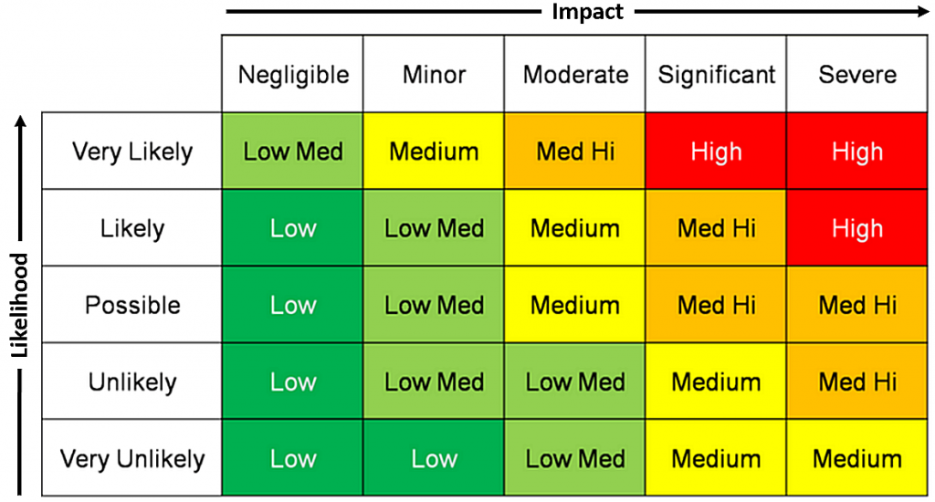
risks
The project plan for the procurement process must be realistic, setting out key activities and milestones.
There are inherent risks to any procurement process which should be identified in a risk register
Risks should be mitigated and constantly monitored to minimise their impact on the procurement project.

Slide 15
Submission requirements
To evaluate bids, submissions must adhere to a specified structure
The submission requirements should be clear and link to the evaluation criteria.
Questions asked of the supplier must be clear and unambiguous
You may wish to include guidance – perhaps the supplier must reference a particular statutory instrument.
Terms and conditions should also be outlined in the submission, and the supplier asked to accept them – to prevent any ambiguity following award of contract
Having well defined submission requirements will help later in the Q&A stage of the procurement process.

Slide 16
Evaluation methodology
Evaluation criteria and methodology should be linked to the submission criteria.
You must be clear about what and how you are going to evaluate the submissions.
Evaluation criteria should be transparent and shared with bidders, and remain unchanged throughout the process.
Typically scoring will be on at % basis spread out across various factors; some factors will be weighted differently depending on its importance to the business.
For example, 50% may be on price, 20% on service delivery, 15% on innovation, 15% on tracking systems

Slide 17
Procurement

Slide 18
Detailed scope
Detailed scoping is essential to allow bidders to accurately price for the services required.
The scope should include all elements expected of the bidder, for example:
Cleaning: Periodic Cleaning, Day to Day Cleaning
R&M – Reactive Repairs, PPM, Long term maintenance
Catering: Staff canteen, hospitality, vending services
Building A: R&M, Cleaning, Grounds Maintenance
Building B: Security, R&M, Cleaning
Building C: Specialist Cleaning, R&M, Static Security

Slide 19
Service specifications
The service specification must be clear on what is required
This could detail hours of operation, number of operatives required, particular processes that must be adhered to such as carrying ID at all times, or wearing uniform.
Language used when determining service specifications must be clear and unambiguous
Each specification should be kept separate so as to allow the supplier to price appropriately – including day to day and ad-hoc cleaning on the same line would not be suitable.
Be clear about exclusions – for example grounds maintenance may include path washing but exclude barrier greenery as this could fall outside the demise.

Slide 20
Asset registers
When pricing for R&M a schedule of all assets within the business must be provided so the supplier can price appropriately
Failure to provide complete and accurate data can result in serious problems once the contract is awarded
For example, if the data provided for a given estate is on the basis of 1 year’s PPM schedule, it will not take into account PPM which falls outside of this period (fixed wire testing)
This exposes the business to unforeseen financial risk as statutory maintenance may not have been costed for.

Slide 21
Price structures
Fixed Price – Fixed price for a volume of work at a set standard
Variable price – Input costs are known but volume is subject to high variation. Input costs agreed on schedule of rates.
Guaranteed maximum price – variable price with an upper threshold
Cost plus – actual cost of the services plus an agreed markup
Pass through – costs are passed through with no margin or budget overhead

Slide 22
insurance
Limits of liability is the level of damages one party will pay to the other under the terms stipulated in the contract.
This is a key commercial decision – too high and the market will not accept it. Too low and you are at risk.
As the client, you must ensure the supplier has sufficient insurance to meet any financial obligations should something go wrong. The client’s insurers may expect a certain level of indemnity to minimise their exposure.

Slide 23
Performance evaluation
Service levels and KPI’s should be clearly laid out. They are an effective tool for contract management.
To be applied a KPI must have a frequency and method of measurement and reporting. They must be fair and achieveable – the supplier must have the power to succeed at the task.
The supplier may be expected to take a financial penalty should they fail to meet their SLA’s. For example:
Service Level: Answer all calls within 30s
KPI: Ensure the SL is met 90% of the time
Consequence: If the supplier drops below 90% in a given month they will provide a 5% rebate to the client for that month’s helpdesk management cost

Slide 24
Contract Details
The contract must:
Account for change control – acquisitions and disposals within the business
Specify a length of time for the contract – often in FM a contract will be for an initial set period +X number of years (extension clauses)
Contain processes for dispute resolution
Provision for contract exit and termination – including transfer of assets, TUPE, work in progress, ownership of data and final payments.

Slide 25
Procurement process
supplier selection – issue a selection questionnaire assessing the suitability of the potential supplier.
Invite an appropriate number of bidders to tender.
Issue RFP and ITT documents including background information, objectives, service specifications, tender return forms, evaluation criteria and timetable & key contacts.
Filter out bidders in stages on the basis of understanding of the requirements, affordability, or ability to fulfil the business needs.
Open dialogue with relevant suppliers for receipt and answer of questions. Share all answers to all bidders to ensure transparency. Allow bidders to conduct site visits to improve their understanding of the business requirements.
Invite bidders to present to members of the project team – this can allow them to give information not included in written proposals, and allows the client the opportunity to evaluate the supplier first hand.
Evaluate the bids in line with the defined methodology
Award of contract to the successful bidder

Slide 26
award of contract
Feed back to unsuccessful bidders with caution to avoid damaging a relationship – they may be invited to bid in future. Try to keep feedback top line.
Begin to plan for mobilisation. In the case of the incumbent supplier winning the bid, there may be no mobilisation costs.
Costs for transferring suppliers may be negotiated during the bid stage – often borne by the supplier as a goodwill gesture, or included in the price.
Mobilisation includes 3 categories:
People: Transfer of staff, communications, training plans, HR support, uniforms etc.
Equipment: Purchase and installation of new equipment – this may be bought out from the previous supplier.
Systems: ensuring all reporting systems are in place prior to contract go live date.

Slide 27
Post procurement

Slide 28
Contract management
Management structure should be designed to match the contract.
Performance management
Financial Management
Compliance
Supplier Relations
Responsibilities
Data analysis – to assist in identifying issues
Technology – PDA’s, GPS, Dashboards
Ensure supplier and client are aligned in delivery objectives at all times

Slide 29
Re-procurement
Towards the end of the contract term, the client must decide how to proceed.
Contract extension?
Re-procurement of same contract?
Update current contract?
Bring services in house

Slide 30
Q&A

Slide 31
sources
Procurement of Facility Management 1st Edition (RICS)
Chartered Institute of Procurement and Supply (www.cips.org)
BIFM (www.bifm.co.uk)
IMFA (www.IMFA.org)
RIBA Plan of Work

