Slide 1
Aerogel
Investigations into a space age super material

Slide 2
agenda
What is an Aerogel
How Aerogels are made
Applications in the built environment
Q&A

Slide 3
WHAT IS IT?

Slide 4
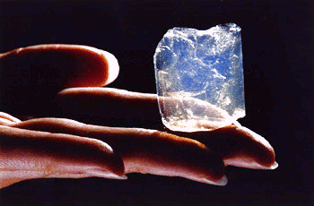
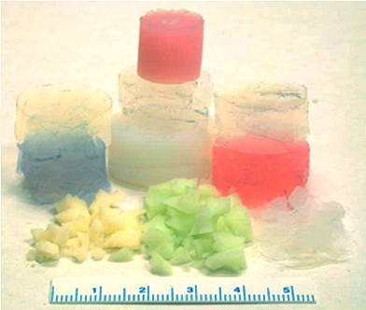
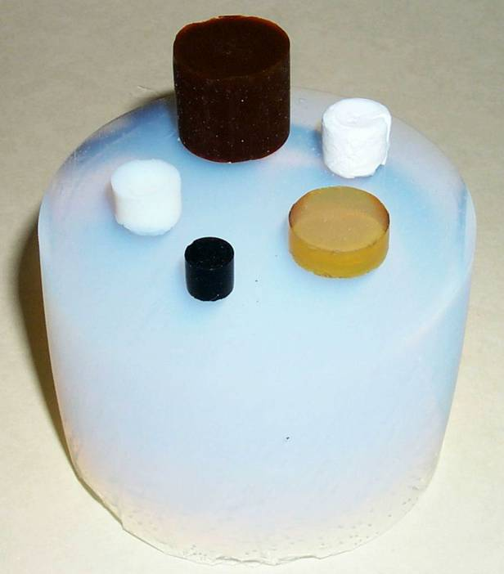
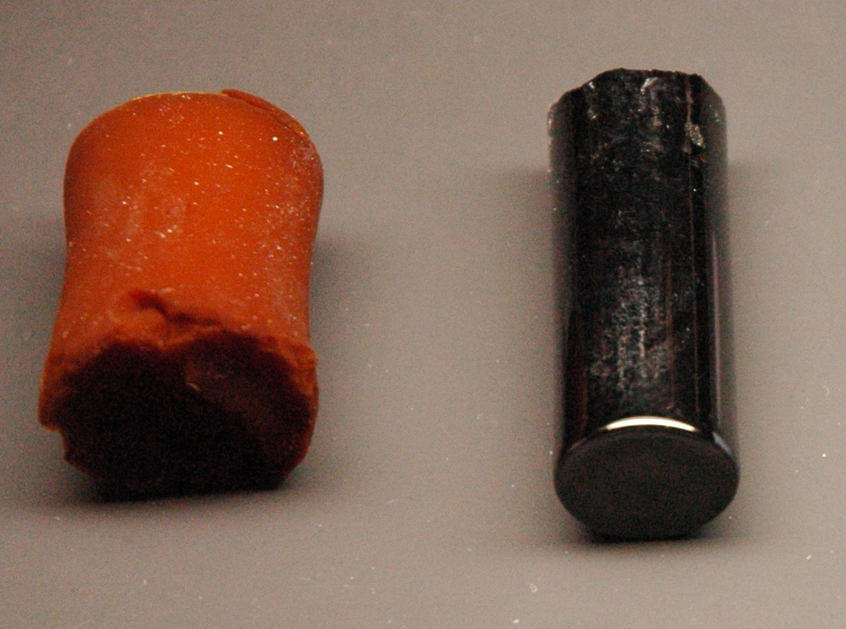
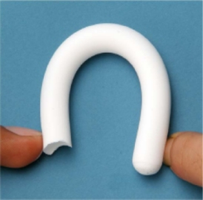
What is aerogel?
Notes:
What is an aerogel?
In short: The dry, low density, porous framework of a gel – the bit that makes a gel semi-solid – isolated from the gel’s liquid component, with the liquid removed.
Aerogels are a class of objects – not just one thing. They are a form of nanotechnology owing to their miniscule framework which gives them their properties.
The most common type is silica aerogel, but they can be made from various materials:
Clockwise from top left:
Traditional silica monolith
Lanthanide Oxide gels – coloured
Various aerogels made from metal oxide
Mechanically strong silica aerogel
Polymer aerogel (part formaldehyde) and electrically conductive carbon aerogel

Slide 5
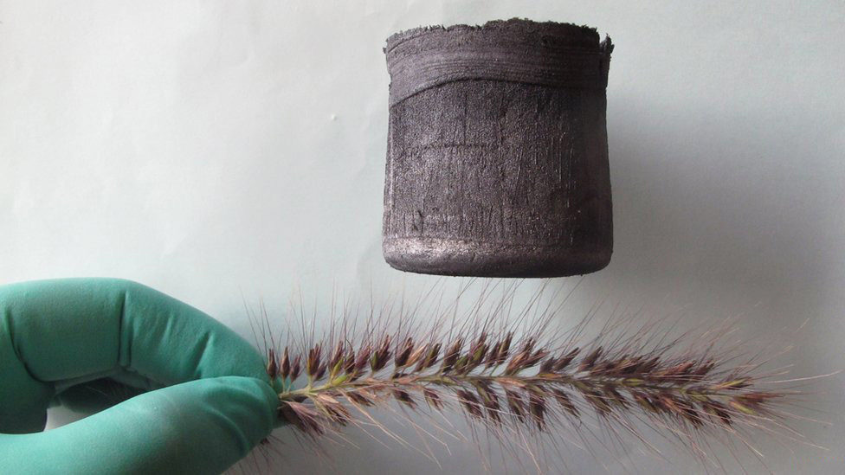
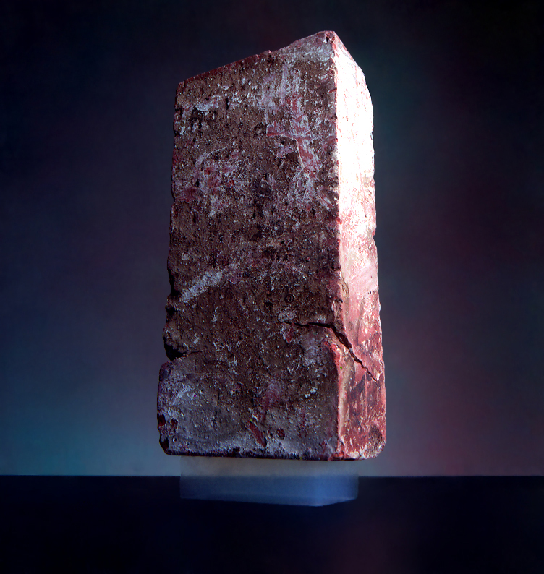
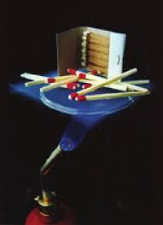
PROPERTIES
Super Lightweight
(95-99% air)
Super Strong
(High compression strength)
Super Insulator
(Thermal, Electrical and Acoustic Energy)
Notes:
What are the properties of an aerogel?
Lightweight: Most aerogels are 95-99% air. World record for lightest aerogel is 7x lighter than air using graphene (Pictured, created by Zhengjian University in 2013). Usual density is 0.020 g m-3 (15 times heavier than air).
Strong: Very high compression strength due to being made from nanostructures; aerographene retains 90% of original shape in compression tests.
Insulator: Specially formulated aerogels hold world records for: lowest thermal conductivity, lowest speed of sound through a material and lowest dielectric constant
Not all aerogels are created equal – properties are subjective dependent on the base material the gel is made from and process used.
Because of these properties Aerogels have been used in spacecraft and even on mars rovers – but they also have more mundane applications as we will see later.

Slide 6
HOW IS IT MADE?

Slide 7
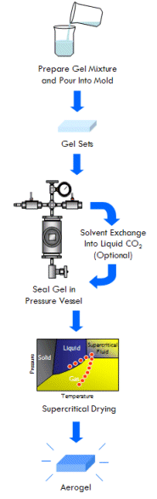
How is it made?
Step 1: Make a gel mixture & pour it into a mold.
Step 2: Gel sets in the desired shape.
Step 3: Seal the gel in a pressure vessel for supercritical drying.
Step 4: Aerogel!
Notes:
Once the gel is made it must be purified by soaking it under a solvent, such as acetone. This usually takes a few days depending on the sample, during which the solvent will be exchanged several times. This will remove any impurities which could hinder the drying process.
In modern Aerogel production the solvent will be exchanged with liquid C02.
Because liquid C02 has a lower critical point, which reduces the amount of heat and pressure required during the supercritical drying process
Normally drying a gel results in the gel collapsing in on itself due to capillary action. To retain the desired shape a process called supercritical drying is used.

Slide 8
What is supercritical drying?
Notes:
I’m no big city materials physicist, but here goes:
Material is placed in a volume of liquid of the same type held in its pores
Liquid in vessel is gradually heated under pressure to the liquids critical temperature
Liquid in vessel and the gel becomes a supercritical fluid – sharing properties with liquid and gas
As a supercritical fluid, the liquid has no ability to exert capillary stress on the solid around it
Then gradually depressurize the vessel – removing some of the supercritical fluid – but not allowing the vessel to drop below the fluids critical pressure or temperature
Once repeated several times, the temperature is brought back below the liquids critical point
Because there is not enough fluid left following the process, the supercritical fluid cannot recondense as a liquid
This leaves the solid lattice/structure (aerogel) in the tank with liquid removed
In modern production processes the solvent in the tank is replaced with liquid CO2, then CO2 is used for the supercritical drying process.
CO2 is beneficial as it evaporates at room temperature – leaving only gas and dry ice. It also has a low critical point – around 30 degrees
Only limitation on production is the size of the pressure vessel!

Slide 9
applications
IN THE BUILT ENVIRONMENT

Slide 10
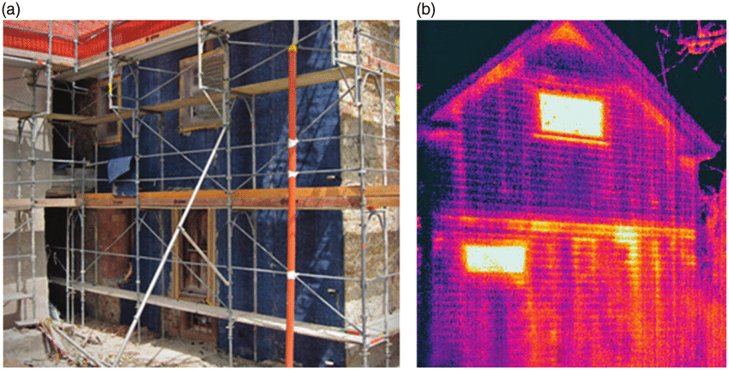
Applications in the built environment
Insulating cladding
A: Aerogel containing insulation being retrofitted onto a brick dwelling. B: thermal imaging of a brick building where the studs of the upper floor have been insulated with aerogel, whereas the lower floor has not
Notes:
Insulating cladding can either be made entirely from aerogel or more commonly contain aerogel particulate to improve the insulating properties of the material. It can also be used as a filler for cavity wall insulation.
Improved thermal insulation will reduce the overall energy usage, saving money and increasing the building’s sustainability.

Slide 11
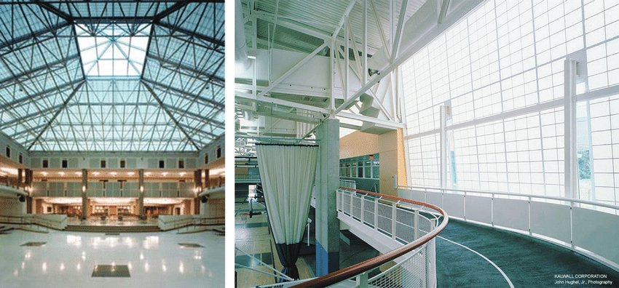
Applications in the built environment
Use for daylighting
Notes:
Aerogel can be made to allow the majority of light through it – allowing its use for windows and ceilings allowing light into a building.
Because Aerogels are excellent insulators, they are a great choice for daylighting by reducing the risk of thermal bridging between the interior and exterior of the building.
One day we may be able to produce fully transparent aerogel to use as windows.

Slide 12
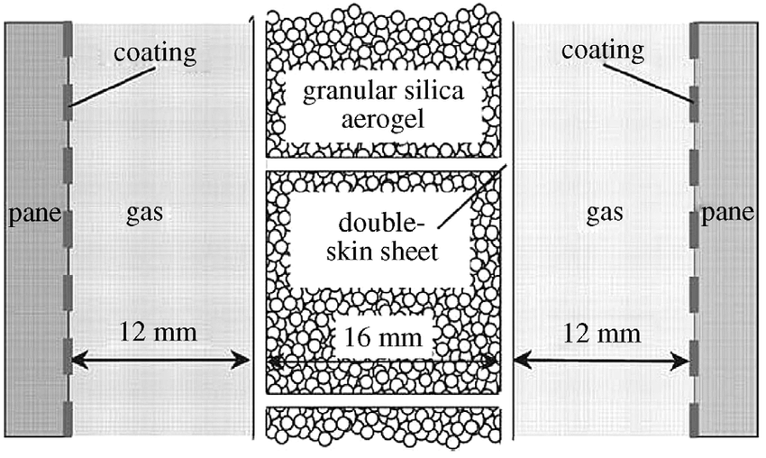
Applications in the built environment
Windows
Notes:
Double glazing unit with a granulated aerogel core – improves the insulating properties of the glass – another step towards a full aerogel window pane.

Slide 13
summary

Slide 14
summary
Properties
Can be engineered dependent on the material basis of the gel used; Low Thermal Conductivity, Transparency, Electrical Conductivity. All Aerogels very lightweight, some lighter than others depending on production process and base material. Aerogels can be coloured, allowing creativity when using them in building refurbishment or construction.
Production
Create a gel, remove impurities with solvent, achieve critical pressure and temperature, liquid turns supercritical and is removed through pressurisation and depressurisation. Solid is left behind. Modern methods include freeze drying.
Applications in the built environment
Insulation (cavity, cladding, windows), adding into other materials as particulate. Daylighting Important current material for use in construction.
Future?
Graphene aerogels 7x lighter than air; completely transparent aerogel windows

Slide 15
Q&a
Thanks for listening!

Slide 16
Appendicies

Slide 17

A brief history
1931: Steven S. Kistler publishes paper in journal “Nature” on replacing liquid in a jelly jar with gas
1937: First Patent (Aerogels of silica etc, US Patent No. 2,093,454)
1952: Water repellent aerogels patented
1970’s: Team under S. Teichner refine production method
1996: First samples produced in space
1997: Aerogel insulation on “Soujourner” mars rover
2013: Aerographene invented at Zhejiang University, China
Notes:
Space production: Production in space or zero-G environment means less gravity during the drying process – allowing a more uniform finished product. NASA have produced samples in a plane called a K-135A (known as the vomit comet) to produce zero G environments by plummeting at a high angle. The zero G parts of Apollo 13 were filmed on this plane!
Mars Rover Soujourner – qualities of aerogel make it perfect for space missions given weight is critical when determining how much fuel, thrust etc is needed to launch a rocket, or power a rover – every gram of mass counts.
Aerographene – Developed at Zhejiang university, China, using a new freeze drying process instead of the traditional supercritical drying method.

Slide 18
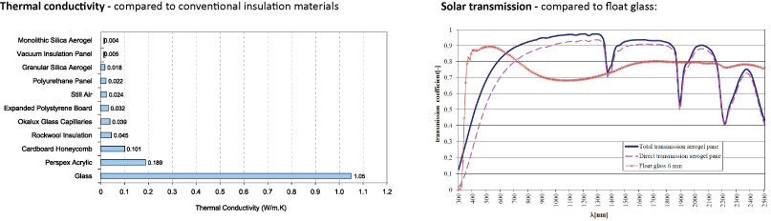
Applications in the built environment
Graph showing thermal conductivity (heat) and solar transmission comparative to standard insulation and materials used in windows
Notes:
Graph showing thermal conductivity (heat) and solar transmission comparative to standard insulation and materials used in windows

Slide 19
Sources
www.aerogel.org – Amazing resource for aerogels, includes instructions on how to make aerogels at home.
www.designingbuildings.co.uk – designing buildings wiki – incredible resource for building construction and management.
www.burohappold.com – very good resource for aerogel research and application.
Peter Jelle, B. et al, Aerogel Insulation for Building Applications, published in The Sol-Gel Handbook; synthesis, characterisation and applications (2015) .
Garcia Gonzalez, C.A et al, Supercritical drying of aerogels using CO₂: Effect of extraction time on the end material textural properties, published in The Journal of Supercritical Fluids, Issue 66 (2012)

