Slide 1
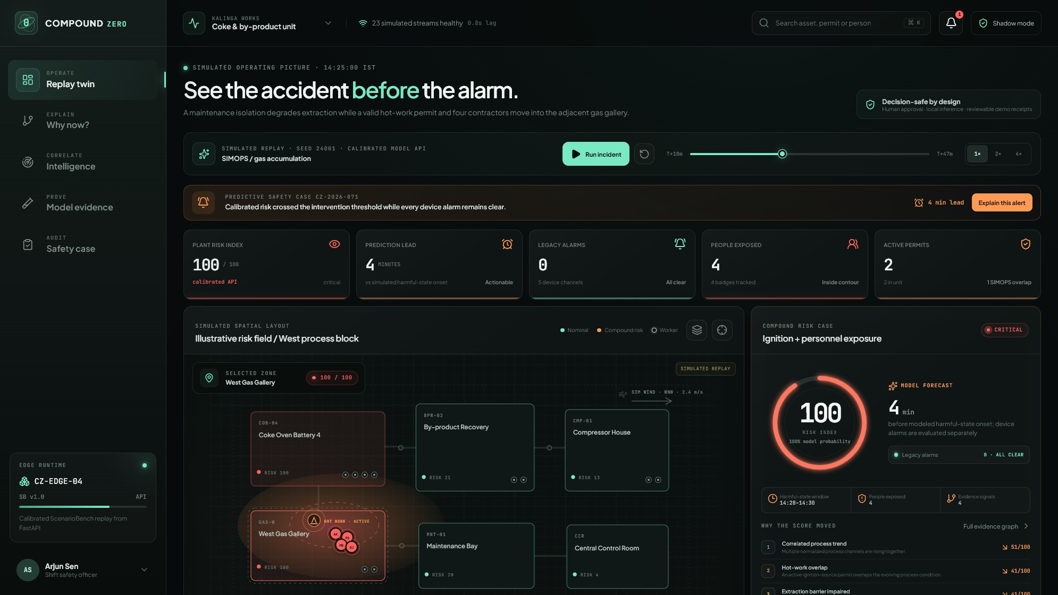
ET AI HACKATHON 2026 · PS1
AI-POWERED INDUSTRIAL SAFETY INTELLIGENCE
Every alarm is clear.
The system is not safe.
Compound Zero connects process trends, barrier state, permits and worker exposure—before any one device crosses its threshold.
RISK 100
4 MIN REMAIN
0 DEVICE ALARMS
See the accident before the alarm.
SIMULATED REPLAY · SEED 24001 · NOT FIELD VALIDATION
github.com/Fyxod/compound-zero
01

Slide 2
WHY PS1 / WHY THIS PRODUCT
Built for the two heaviest judging criteria.
A high-stakes, visually legible problem where technical proof and business impact reinforce each other.
THE BLIND SPOT
JUDGING FIT
The data exists.
The context does not.
Innovation
25%
compound intersections, not another chatbot
Business impact
25%
SCADA
process levels + slopes
early review + lower nuisance burden
Technical excellence
20%
CMMS
barrier impairment
calibrated model + reproducible evidence
PTW
ignition + SIMOPS
Scalability
15%
CCTV
anonymous events
edge-first contracts + container path
User experience
15%
SHIFT
handover context
five coherent operator workspaces
COMPOUND ZERO / SIMULATED PROTOTYPE
Source: ET AI Hackathon 2026 organiser brief · PS1 and judging weights
02

Slide 3
SIGNATURE REPLAY
The warning arrives while every device still says clear.
Authoritative deterministic replay · compound_hot_work · seed 24001 · all values simulated
T+08
T+09
T+18
T+22
+1 min
+9 min
+4 min
Barrier impaired
Initial advisory
Compound case
Authored onset
EF-04 isolated; devices clear
Risk 30 · 13 min to onset
Risk 100 · 4 workers · hot work
Simulated harmful-state label
INITIAL LEAD
T+18 SCORE
DEVICE ALARMS
RISK ENGINE
13 min
100 / 100
0
NO LLM
T+09 → authored T+22 onset
hot work + 4 in-zone workers
across all 48 replay minutes
calibrated gradient boosting
REPLAY-SPECIFIC RESULT · NOT A FIELD-PERFORMANCE CLAIM
COMPOUND ZERO / SIMULATED PROTOTYPE
Evidence: model-backed API replay · artifacts/compound_zero_model.joblib
03

Slide 4
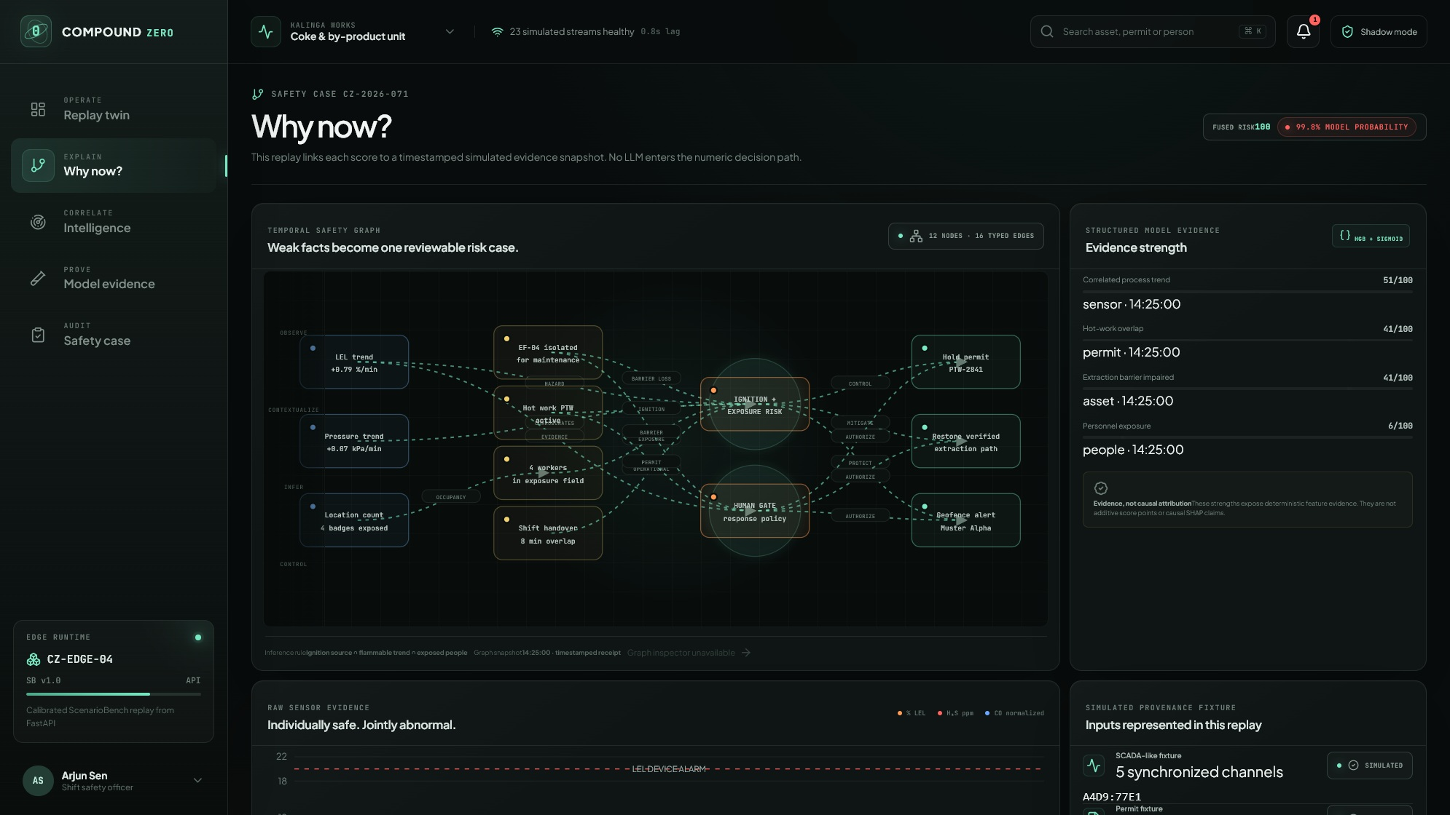
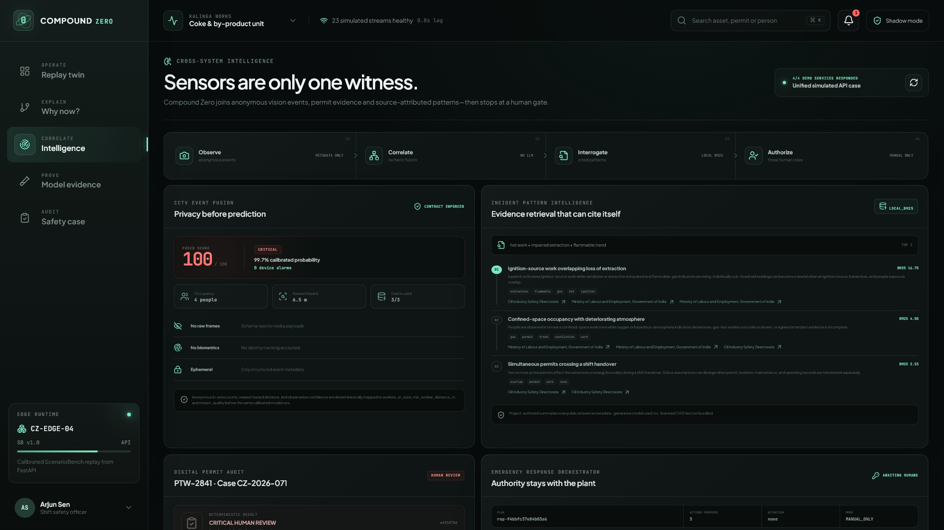
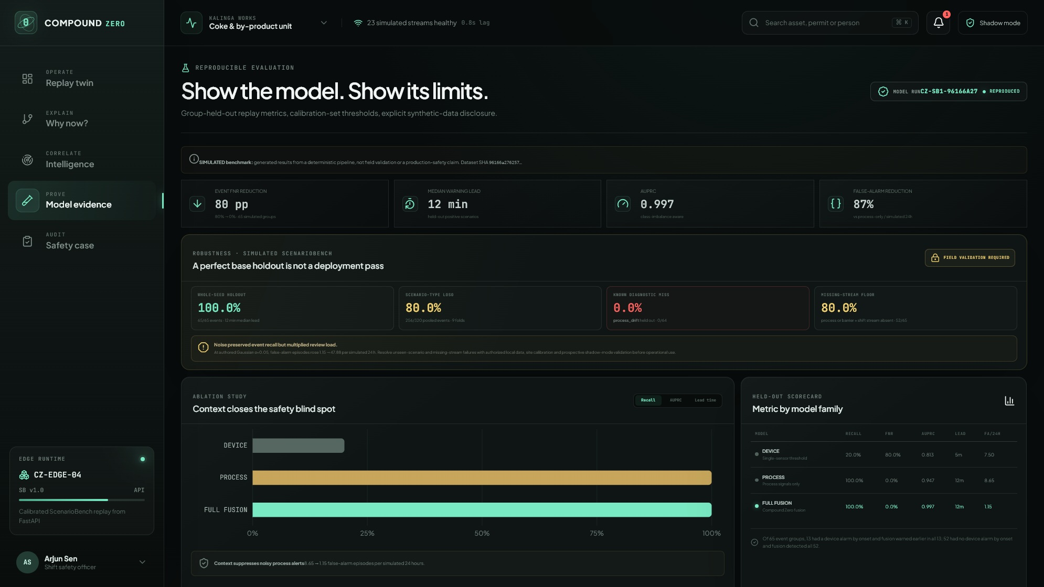
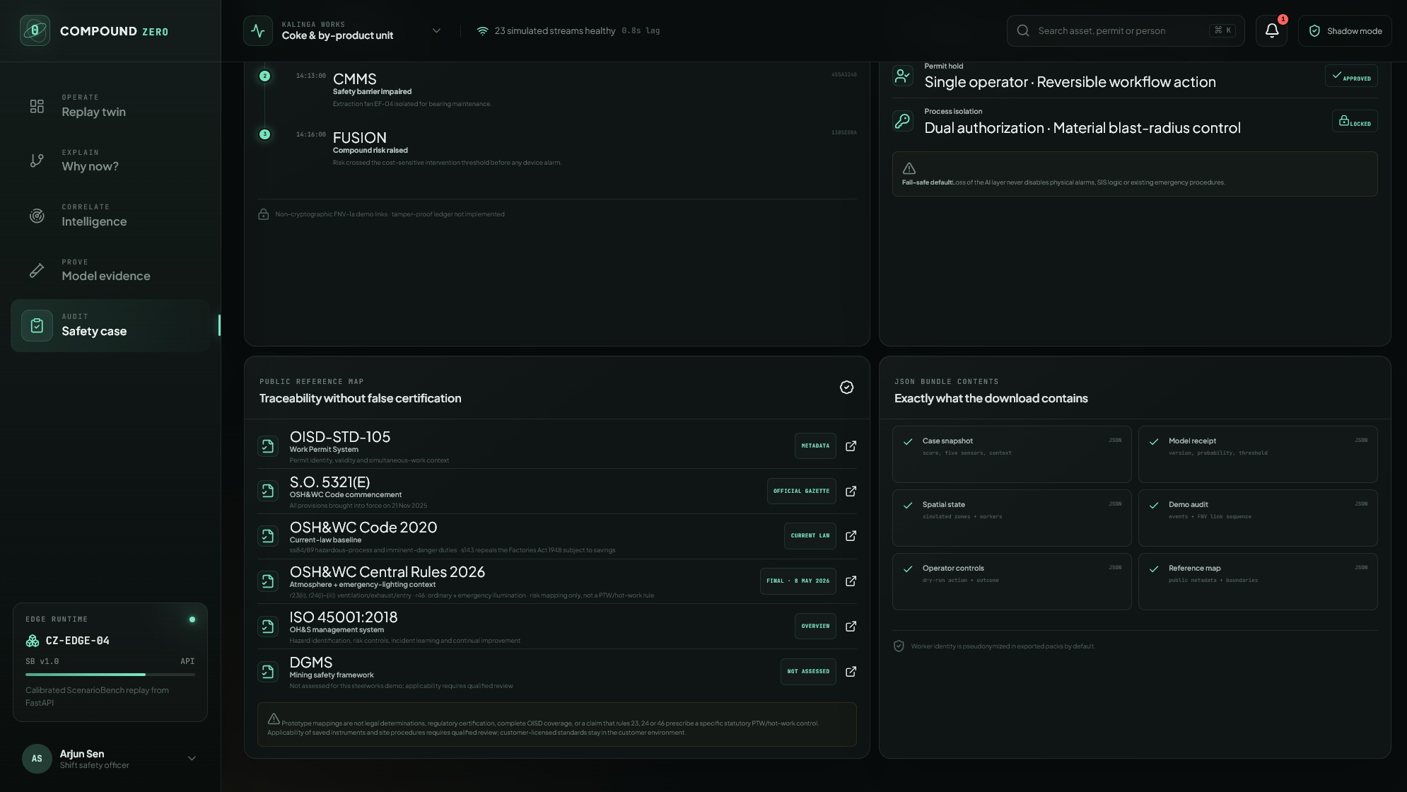
PRODUCT EXPERIENCE
One safety case. Five operator workspaces.
The interface moves from detection to explanation, correlation, proof and reviewable receipts.
01
02
03
04
05
Replay twin
Why now?
Intelligence
Model evidence
Safety case
DETECT
EXPLAIN
CORRELATE
PROVE
AUDIT
MACHINE
EVIDENCE
PEOPLE
scores + proposes
explains + cites
review + authorize
ACTUATION NONE
COMPOUND ZERO / SIMULATED PROTOTYPE
All screenshots are captured from the working local prototype
04

Slide 5
OPERATING PICTURE
Dense context, legible in one glance.
T+18 model-backed replay: score 100, four minutes remaining, four pseudonymous workers, zero device alarms.
01
Simulated spatial layout
Risk field, local zones and pseudonymous badges
02
Evidence intersection
Gas trend + barrier + permit + people
03
Calibrated warning
Probability, threshold and remaining lead
04
Human response
Compare a bounded dry run before recording it
COMPOUND ZERO / SIMULATED PROTOTYPE
SIMULATED · no real plant, worker or device data shown
05

Slide 6
EXPLAINABILITY
The alert is evidence—not generated prose.
Typed, timestamped factors connect the weak signals to the fused decision; no language model sits in the risk path.
THE INTERSECTION
01
Signal
LEL, H₂S, CO, oxygen and pressure trend together.
02
Barrier
Extraction fan EF-04 is unavailable under maintenance.
03
Ignition
PTW-2841 activates hot work in the adjacent gallery.
04
Exposure
Four pseudonymous badges enter the illustrative field.
STRUCTURED FACTORS
SOURCE RECEIPTS
NO CAUSAL CLAIM
COMPOUND ZERO / SIMULATED PROTOTYPE
Explanation factors are deterministic interaction values, not a root-cause verdict
06

Slide 7
CROSS-SYSTEM INTELLIGENCE
Four bounded services. One simulated case.
Vision metadata, numeric fusion, cited pattern retrieval and deterministic permit checks converge before a manual-only gate.
METADATA ONLY
No raw frames or biometrics
NUMERIC FUSION
Calibrated model; no LLM
LOCAL BM25
Project-authored summaries + sources
PERMIT AUDIT
Evidence gaps stay visible
REFERENCE MAPPING ≠ COMPLIANCE DETERMINATION
COMPOUND ZERO / SIMULATED PROTOTYPE
OISD catalogue metadata and public legislation links; licensed normative text not bundled
07

Slide 8
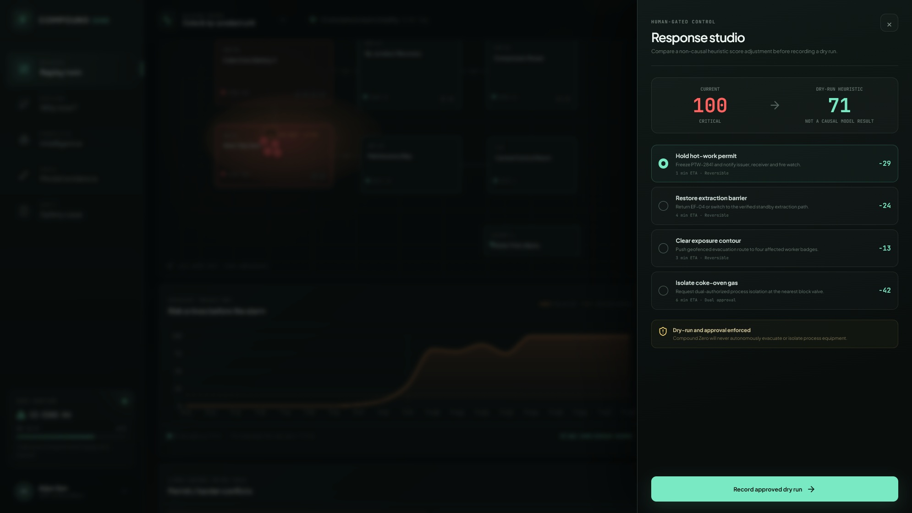
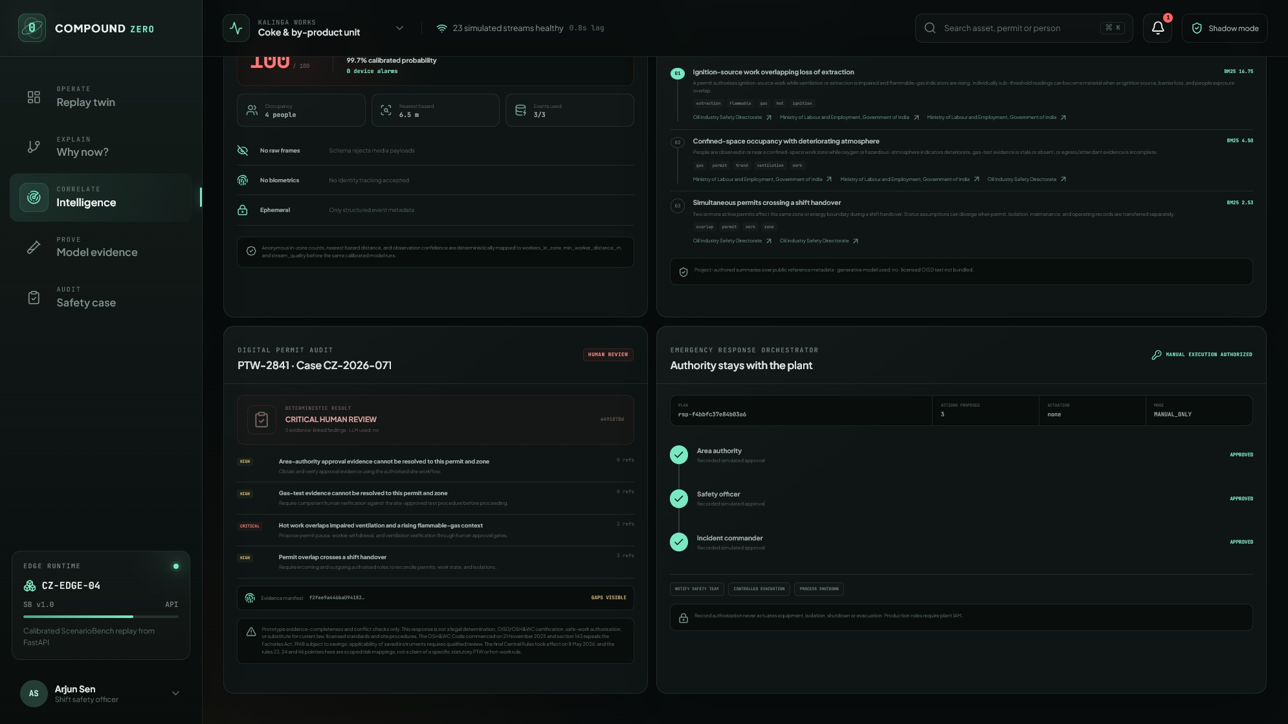
HUMAN AUTHORITY
The system can recommend. It cannot actuate.
Two complementary gates: operator-recorded counterfactual dry runs and a three-role manual response authorization receipt.
NON-CAUSAL DRY RUN
100 → 71
AREA AUTHORITY
SAFETY OFFICER
INCIDENT COMMANDER
Hold PTW-2841 · no field action
MANUAL EXECUTION AUTHORIZED
ACTUATION: NONE
COMPOUND ZERO / SIMULATED PROTOTYPE
Response records use simulated roles; production requires plant IAM and durable workflow controls
08

Slide 9
REPRODUCIBLE MODEL EVIDENCE
The ablation is the product claim.
Whole-seed holdout · separate calibration · 5,616 test rows · 65 positive event groups · zero split overlap
DEVICE EVENT RECALL
FULL-FUSION RECALL
MEDIAN WARNING LEAD
ROW AUPRC
13 / 65
65 / 65
12 min
0.997
20% · event FNR 80%
100% on simulated event groups
held-out positive scenarios
not rounded to 1.00
FALSE-ALARM EPISODES / SIMULATED 24H
DEVICE COMPARISON, SPLIT HONESTLY
Process only
8.65
13
groups had a device alarm by onset; fusion warned earlier in all 13.
Full fusion
1.15
52
groups had no device alarm by onset; fusion detected all 52.
86.7% fewer episodes while preserving event recall
Context removes nuisance escalation that process-only detection cannot distinguish.
SIMULATED · NOT FIELD VALIDATION
COMPOUND ZERO / SIMULATED PROTOTYPE
Source: artifacts/metrics.json · model compound-zero-scenariobench-v1
09

Slide 10
ROBUSTNESS / HONEST LIMITS
The failure we found changes the pilot plan.
True leave-one-scenario-type-out evaluation · every scored row came from a scenario family absent from that fold's training data
BASE HOLDOUT RECALL
POOLED TRUE LOSO
WORST HELD-OUT FAMILY
MISSING KEY STREAMS
100%
80%
0%
80%
65 / 65 simulated event groups
256 / 320 event groups
process_drift · diagnostic failure
process or barrier/shift recall
FIVE EVENT-BEARING HELD-OUT FAMILIES
WHAT THIS MEANS
Barrier loss + workers
100%
Do not deploy on the headline holdout result.
Confined space
100%
01
Expand failure coverage
Shift handover
100%
Add site-specific slow-drift and near-boundary cases.
Hot work
100%
02
Tune degraded-mode policy
Process drift
0%
Noise preserves recall but can multiply review load.
FIELD GATE: PROSPECTIVE SHADOW MODE
COMPOUND ZERO / SIMULATED PROTOTYPE
Source: artifacts/robustness_metrics.json · authored simulated data only
10

Slide 11
GEOSPATIAL EVIDENCE QUALITY
Uncertainty becomes review—not false reassurance.
GeoEvidenceBench · fictional plant-local Cartesian metres · boundary-heavy deterministic software-conformance fixtures
BOUNDARY CASE
AUTHORED CASES
BOUNDED REVIEW FNR
337
0.0%
141 positive · 196 negative
point-only baseline: 18.4%
ZONE-C7 · LOCAL PLAN COORDINATES
CERTAIN PRECISION
DISTANCE MAE
observed position
100%
0.907 m
declared localization bound
45 certain-exposure cases
P95 absolute error: 2.255 m
authored hazard + review radius
THE COST OF SAFETY
Review FPR rises 16.8% → 45.4%
POSSIBLE → HUMAN REVIEW
That is deliberate review load on a boundary-heavy stress set—not extra physical alarms and not representative plant prevalence.
COMPOUND ZERO / SIMULATED PROTOTYPE
Source: artifacts/geospatial_metrics.json · no surveyed coordinates or plume physics
11

Slide 12
BUSINESS IMPACT
A pilot can earn its case without pricing a human life.
Editable workflow sensitivity only · INR · no incident-frequency or prevented-harm valuation
LOW / AUTHORED
BASE / AUTHORED
HIGH / AUTHORED
ETHICAL BOUNDARY
₹0.38L
₹9.74L
₹39.75L
₹0
assigned to death, injury or a prevented incident
annual quantified benefit
annual quantified benefit
annual quantified benefit
No payback · 0.07 BCR
25.2 months · 1.19 BCR
6.6 months · 3.06 BCR
Only workflow capacity and administrative nuisance-hold exposure are modeled.
BASE CASE · EDITABLE ASSUMPTIONS
Permit reconciliation
₹4.02L
900 shifts
ILLUSTRATIVE / SIMULATED · NOT A FORECAST
Alert triage
₹2.68L
3,600 alerts
Investigations
₹1.15L
5,400 permits
False-alarm deep review
₹1.15L
75% adoption
Nuisance hold exposure
₹0.75L
COMPOUND ZERO / SIMULATED PROTOTYPE
Source: artifacts/pilot_economics.json · all assumptions editable
12

Slide 13
ARCHITECTURE & SCALE
Site-local inference. Normalized contracts. Independent safety systems.
A deployable edge pattern today; field readiness still requires authorized connectors, calibration and safety review.
READ-ONLY SOURCES
NORMALIZER
RISK CORE
SAFETY API
OPERATOR LAYER
SCADA · PTW · CMMS · badge/CCTV metadata
schema · freshness · quality · event time
features · calibrated model · abstention
score · explain · audit · plan
five workspaces · human authority
90-DAY PILOT GATE
DEPLOYMENT PROOF
DAYS 0–30
DAYS 31–60
DAYS 61–90
01
Containerized
FastAPI + static web + same-origin proxy
Connect read-only
Calibrate locally
Shadow mode
Data, cyber, privacy and hazard review
Time-split backtests + tabletop exercises
Prospective comparison; no control writes
02
Hardened demo
non-root · read-only FS · health gates
03
Reproducible
pinned workflows + generated artifacts
COMPOUND ZERO / SIMULATED PROTOTYPE
Physical alarms and SIS remain independent of Compound Zero
13

Slide 14
RESPONSIBLE SAFETY CASE
Truthfulness is part of the architecture.
The prototype is designed to fail visibly, preserve human authority and keep every headline claim reproducible.
IMPLEMENTED SAFETY BOUNDARIES
CLAIMS WE REFUSE TO MAKE
01
Verified model bytes before deserialization
01
No field-validation claim
Model card stores SHA-256 + byte count
ScenarioBench and GeoEvidenceBench are authored
02
Bound permit evidence to permit + zone
02
No certification claim
Gas-test age derived from timestamped evidence
Reference mappings are navigation aids
03
Bounded ephemeral response records
03
No tamper-proof-ledger claim
TTL + idempotency + manual-only status
JSON export is unsigned; links are non-cryptographic
04
Explicit simulated/reference labels
04
No autonomous control path
No UI surface claims live plant operation
No actuator client or endpoint exists
SAFETY REVIEW BEFORE ANY WORKFLOW WRITE
COMPOUND ZERO / SIMULATED PROTOTYPE
See docs/security-safety.md and docs/requirements-traceability.md
14

Slide 15
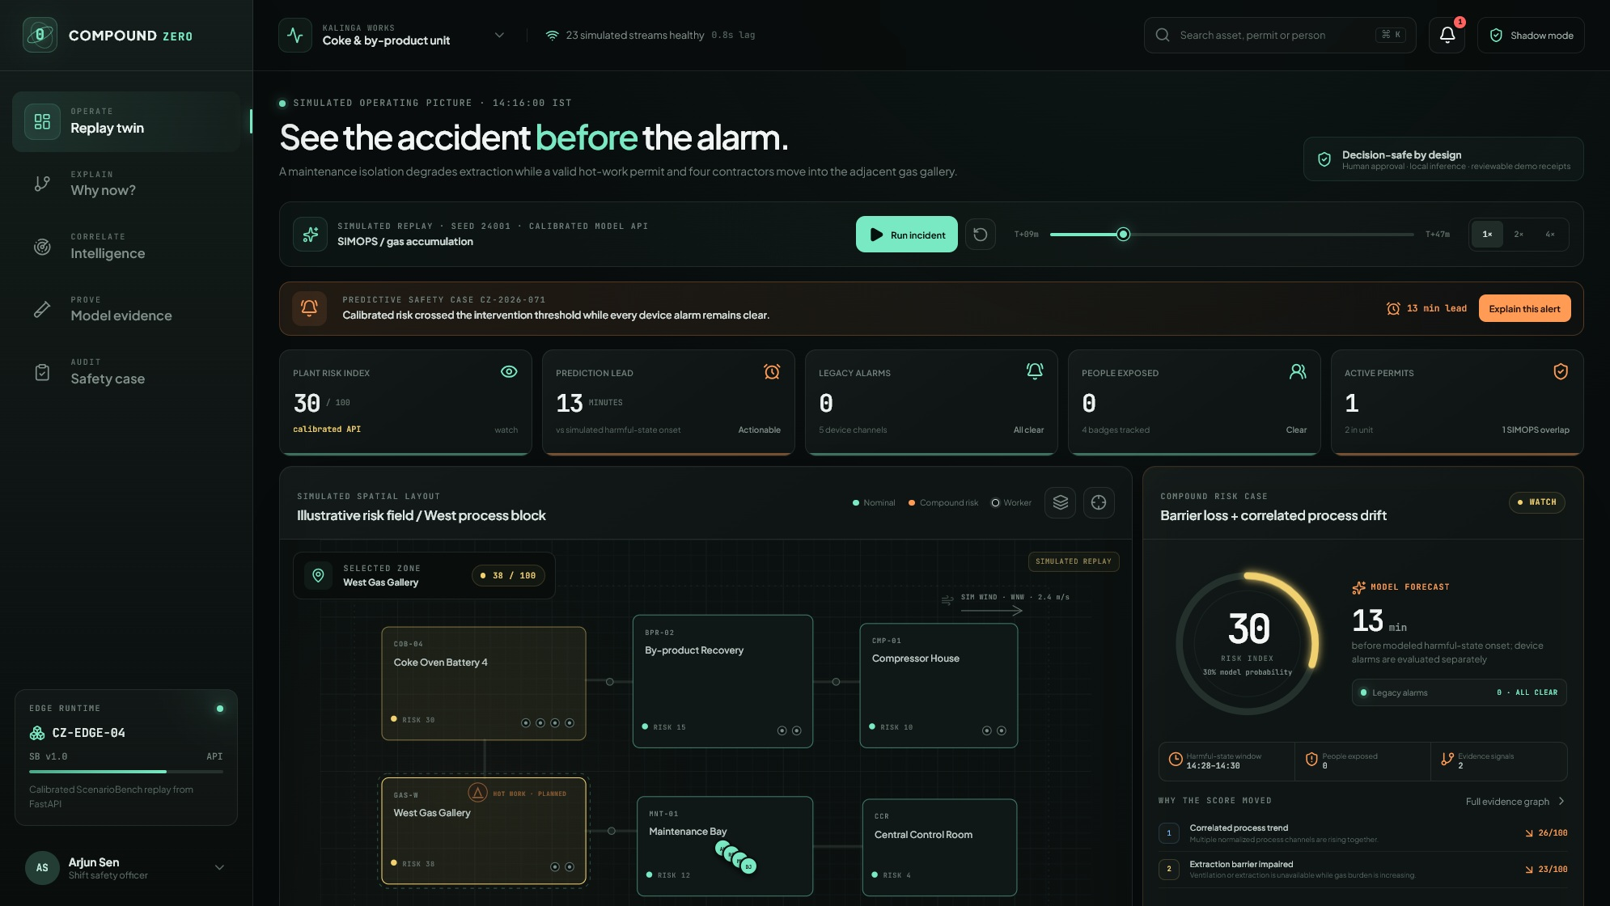
THE DECISION
Back the missing
context layer.
Compound Zero combines the strongest innovation story, measurable prototype evidence, a credible business pilot and an operator experience judges can see working.
13 min
65 / 65
initial replay lead
base-holdout events detected
86.7%
5
github.com/Fyxod/compound-zero
fewer process-only false alarms
working operator workspaces
COMPOUND ZERO
See the accident before the alarm.
SIMULATED PROTOTYPE · ET AI HACKATHON 2026
15

