Slide 1
Secure foundation. Rebuilt from code.
Team T235
Industry partner: Cyber Security Centre
JH
Jacob Hardcastle
TH
Tim Hartmann
Definition
Design
MG
Max Gosling
KD
Khai Do
A multi-account AWS landing zone and proof of concept for the Cyber Security Centre
Demo and plans
Operations
Notes:
Introduce the team and the four sections: definition, design, demo and plans, operations. About 15 minutes plus the demo.

Slide 2
Cobble needs a foundation before it needs features
8
10
5
deliverables in the brief
control areas to design
risk themes to answer
Many tenants share one platform, so a weak base exposes all of them at once
The Implementation Guide sets the target: 17 sections, from landing zone to runbooks
It has to be repeatable: deployed, torn down and rebuilt the same way every time
Notes:
Cobble will host many tenants on one platform. The brief asks for eight deliverables, covering ten control areas and five risk themes. A weak foundation would expose every tenant at once, so the base has to be right before the application is built.

Slide 3
What is the Cobble AWS platform?
The secure AWS base Cobble runs on: accounts, network, sign-in, logging and security controls, all written as Terraform.
Partner
Cyber Security Centre
“
Project
P608 / R014.1, tutorial group T235
A platform you can deploy and redeploy with confidence.
Scope
The AWS foundation; the Cobble app is out of scope
Scale
6 accounts · 3 environments · 2 solutions
Built as
Terraform modules, checked on every change
The project goal, from our README
Notes:
What we are building: the AWS foundation only. The Cobble application is out of scope; a standard web server stands in for it to prove the platform works.

Slide 4
Two solutions. One set of building blocks.
B
Minimum viable product
A
Full landing zone
Working today
What the Cyber Security Centre would run
≈ A$0
≈ A$790 / month
One account, 48 resources
Encryption, audit trail, threat detection, budget alert
Torn down between demos
Six accounts with guardrails and single sign-on
Locked central logs and security monitoring
dev, staging and prod from one workload folder
Same modules: B is a working slice of A, not a throwaway prototype
Notes:
Solution B is the minimum viable product: one account, near zero cost, working today. Solution A is the full design the Cyber Security Centre would run. Both are built from the same Terraform modules, and both deploy and tear down from code.

Slide 5
Five risk themes shaped every decision
MT
PA
AE
Multi-tenancy
Privileged access
API exposure
Every tenant shares the servers, database and storage
A stolen admin session could change anything
Anything public can be attacked or flooded
DP
AV
Data protection
Availability
Tenant data must stay encrypted and in Australia
Losing a zone, an account or a backup must not lose data
Notes:
The brief names five risk themes. These drove every design choice that follows, and the threat model is organised around them.

Slide 6
Six accounts, each with one job
Management
runs the organisation, sign-in and billing
Security OU
Infrastructure OU
Workloads OU
NonProduction
Production
security
locked logs, detection
shared
image registry
dev
try changes
staging
dress rehearsal
prod
what tenants use
Notes:
Six accounts following the AWS Security Reference Architecture, simplified: one Security account does the job of AWS’s separate Log Archive and Security Tooling accounts, which halves the fixed cost.

Slide 7
Only the edge faces the internet
Public
Web firewall
staging and prod
Each layer only talks to the next
Firewall → load balancer → web servers → database
Public
Load balancer
HTTPS, the only public entry
Nothing else is public
Private
Web servers
ECS Fargate, private subnets, no public IP
Containers and the database have no public address
Database
Database
PostgreSQL, no route to the internet
All traffic is logged
VPC flow logs; default firewall rule locked down
Notes:
Click through the layers. The web firewall (staging, prod) and the load balancer are the only public pieces. Web servers sit in private subnets with no public IP. The database has no route to the internet at all.

Slide 8
Four guardrails hold, even for administrators
1
2
Stay in Australia
No root user
Sydney only, plus us-east-1 for global services
Member accounts’ root users are blocked
3
4
Security stays on
No leaving
CloudTrail, GuardDuty, Config, Security Hub and Access Analyzer can’t be turned off
No account can remove itself from the organisation
Service control policies at the organisation root: no admin in a member account can override them
Notes:
Service control policies at the root of the organisation. They apply to every member account whoever signs in, administrators included. The demo shows the region guardrail refusing an admin.

Slide 9
No one has a standing password or key to AWS
Group | Mgmt | Security | Shared | dev | staging | prod
Platform admins | Admin | Admin | Admin | Admin | Admin | Admin
Developers | None | None | None | Developer | Read-only | Read-only
Auditors | Read-only | Read-only | Read-only | Read-only | Read-only | Read-only
Single sign-on + MFA
4-hour admin sessions
GitHub: short-lived roles
No IAM users in Solution A
Developer and read-only last 8 hours
One can only look; one deploys after review
Notes:
People sign in once through IAM Identity Center with MFA. Admin sessions end after 4 hours. GitHub signs in with OIDC: one role can only look, the other deploys after a reviewer approves.

Slide 10
All ten control areas are built in code
Access
Enforced
Encryption
Configured
Logging
Enforced
Network separation
Configured
Monitoring
Enforced
Vulnerability management
Configured
MFA
Configured
Incident response
Configured
Secrets
Configured
Backup and recovery
Configured
Enforced: a guardrail stops anyone turning it off. Configured: built by the code; an admin could still change it.
Biggest gap: backups have no copy outside the account they protect
Notes:
Enforced means a guardrail stops anyone turning it off; configured means the code builds it but an admin could change it. The biggest gap is backups.

Slide 11
Where we differ from the Implementation Guide
The Guide says | We built | Why | Revisit when
SQL Server | PostgreSQL | Far cheaper at small sizes; same security controls | The client confirms the edition
CloudFront + API Gateway | Load balancer + web firewall | No domain name or API routes exist yet | The domain and routes exist
Kubernetes (EKS) | ECS on Fargate | No servers or cluster upgrades for a small team | Cobble needs something only Kubernetes offers
Log Archive + Security Tooling accounts | One Security account | Half the fixed cost, same separation | Production scale, or an auditor asks
Each is a swap of one building block, not a redesign
Notes:
Each departure from the Implementation Guide is a recorded decision with what would make us change it. Each is a swap of one building block, so the security controls stay the same.

Slide 12
Live demo: Solution A, deployed into dev
One command up, one command down. Fallback: the recording of our run on 18 October.
1
2
3
4
Landing zone
Security
dev workload
Tear down
Organisation, accounts, guardrails, sign-in. Built once, kept
Org trail, GuardDuty, Config, Security Hub
Network, containers, database, data bucket
Security and dev destroyed from code. Accounts kept for next time
Notes:
Live demo: lz-dev.ps1 up was run before the session (about 15 minutes). If it fails, play the recording of the 18 October run; the next slides are screenshots from the earlier run on 17 October.

Slide 13
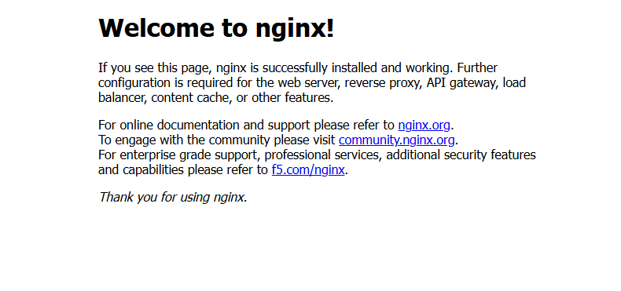
The page is served by containers the internet can’t reach
Not secure cobble-dev-alb-229548621.ap-southeast-2.elb.amazonaws.com
Load balancer
The only thing on the public internet
Containers
Private subnets, no public IP
nginx
Stands in until the Cobble app exists
Notes:
terraform output app_url. nginx stands in for the Cobble app. What matters is the path: through the load balancer, from containers in private subnets.

Slide 14
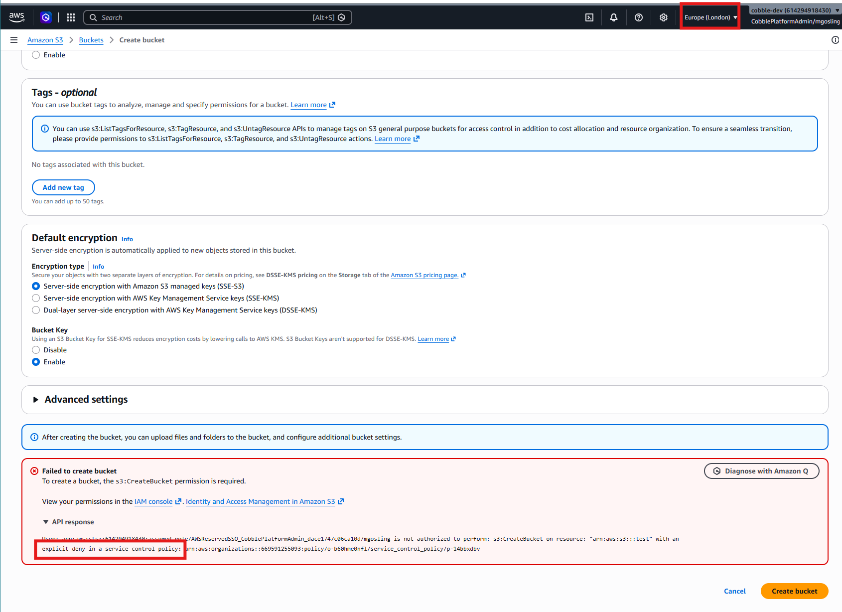
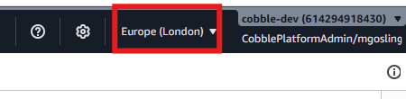
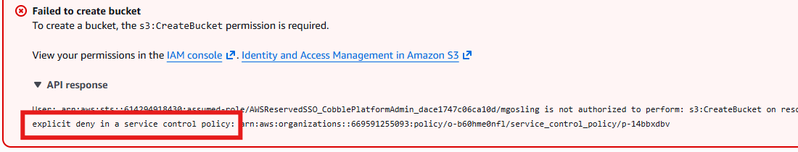
Even an administrator is refused outside Australia
Signed in as CobblePlatformAdmin, region set to Europe (London)
Refused: explicit deny in a service control policy
Notes:
Signed in with full admin rights in cobble-dev, creating a bucket in London is refused with an explicit deny from a service control policy.

Slide 15
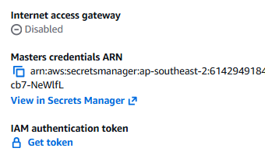
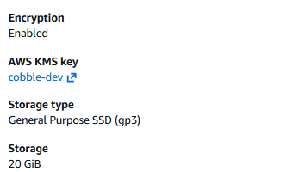
The database is private, and its storage is encrypted
No internet access gateway
Encryption enabled
Password kept by AWS in Secrets Manager
With the account’s own cobble-dev key
Notes:
No internet access gateway on the database. AWS generated the password and keeps it in Secrets Manager. Storage is encrypted with the account’s own key.

Slide 16
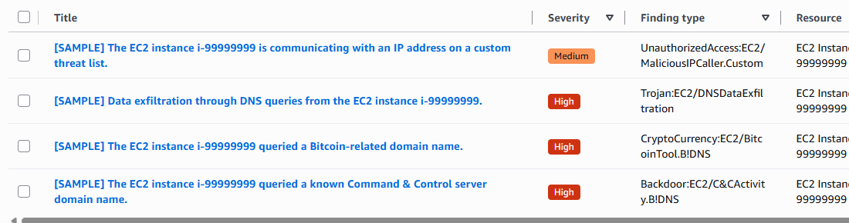
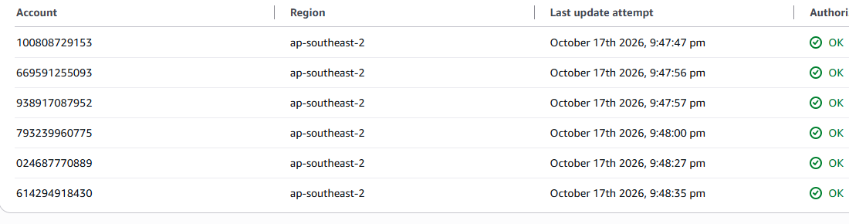
A threat in any account surfaces in the Security account
GuardDuty
A sample threat finding, raised and seen centrally
Config
All six accounts reporting OK
Notes:
A sample GuardDuty finding appears in the Security account. The Config aggregator lists all six accounts reporting OK.

Slide 17
Everything that costs money came down with one command
75
68
10
A$0
dev resources
security resources
minutes
an hour afterwards
$ .\lz-dev.ps1 down
Destroy complete! Resources: 68 destroyed
$ .\lz-dev.ps1 status
dev · staging · prod · security → GuardDuty, Security Hub, Config: False
Notes:
lz-dev.ps1 down removes dev, then the security services, in about 10 minutes. The accounts, sign-in and guardrails are free, so they stay, and the next lz-dev.ps1 up reuses them. The status table proves nothing is left running.

Slide 18
Where we stand
DONE
IN PROGRESS
PHASE 2
Built and proven
Evidence and fixes
Close the gaps
Both solutions deploy and tear down
Landing zone, guardrails, sign-in
Central logging and detection
CI checks and nightly drift
Evidence log and screenshots
GuardDuty and Security Hub membership
Security Hub standard scores
First backup restore test
Backups outside the account
Application alarms, dashboards
Break-glass, narrower admin roles
Automatic deploys with approvals
Notes:
Where we stand: both solutions deploy and tear down from code. Some evidence is still to capture, and four Phase 2 items close the biggest gaps.

Slide 19
About A$790 a month to run everything
A$790 / month, all environments
A$475 / month, dev and staging off when idle
Central
dev
staging
prod
A$70–145
≈ A$160
≈ A$175
≈ A$375
Solution B costs about A$0 between demos · a Solution A demo is about A$5 a day
Notes:
Estimates for Sydney at A$1.44 per US dollar. Turning dev and staging off when idle brings Solution A to about A$475.

Slide 20
How the team operated
Parallel work streams
Tracked in GitHub
Every deliverable is an issue: 17 issues, 18 pull requests, 76 commits
Design and documents
Architecture, landing zone, controls, operations, threat model, compliance
Technical build
Every change reviewed
Terraform modules, both solutions, CI checks, runbooks and evidence
Branch → pull request → automatic checks → one approving review → merge
Notes:
Design and build ran in parallel. Every deliverable is a GitHub issue; every change is a pull request that is checked and reviewed before it merges.

Slide 21
Every change is checked before it reaches AWS
Pull request
format, validate, test, scan
Review
one approval
Merge
into main
dev
auto deploy
staging
1 approval
prod
2nd approver
Nightly drift check flags anything changed outside the code
Built today
Phase 2: until then, an admin deploys by runbook
Notes:
Every pull request is formatted, validated, tested and security-scanned. Automatic deploys are Phase 2; until then an admin deploys by runbook. A nightly drift check flags anything changed outside the code.

Slide 22
Key decisions and the reasoning behind them
AVOIDS DRIFT
COST
Two solutions, one codebase
One Security account
Copies of the same code would drift apart, so B is built from A’s modules
Half the fixed cost of AWS’s two-account split, with the same separation
FROM THE GUIDE
COST + PROOF
ECS Fargate, not Kubernetes
Everything can be torn down
The Guide recommends EKS only when the team can run Kubernetes day to day
Rebuilding from code proves it’s repeatable, and keeps the bill near zero
Notes:
The decisions that shaped the design, and what would make us revisit each one.

Slide 23
Three risks to fix before real tenant data arrives
HIGH · T1
HIGH · T2
HIGH · T9
Tenant isolation
Admin access
Backups
Tenants are kept apart only by the application
One stolen admin session can change anything
No copy outside the account they protect
Fix: a database user and role per module
Fix: narrower roles and a break-glass role
Fix: AWS Backup to another account and region
13 threats rated with STRIDE: the other ten are Medium or Low, acceptable for a proof of concept
Notes:
Thirteen threats rated with STRIDE; three are High. Each has a clear next step, and all three must be fixed before real tenant data arrives.

Slide 24
Mapped to four frameworks: support, not certification
Framework | Where the design helps | Not covered
NIST CSF 2.0 | Strong on Protect and Detect | Policy, training, supplier risk
Essential Eight | Maturity Level 1 within reach | Staff devices, owned by client IT
ISO/IEC 27001:2022 | Technical controls covered | People, physical, supplier controls
SOCI Act | Locked trail supports 12/72-hour reporting | No written reporting procedure yet
The gaps are mostly organisational, or depend on the Cobble application
Notes:
Support, not certification. Essential Eight Maturity Level 1 is realistic once Solution A is deployed and a restore is tested.

Slide 25
Reflection and what’s next
Honest reflection
Ready to hand over
Evidence was captured late. Screenshots taken after the demo showed setup gaps we hadn’t checked: GuardDuty and Security Hub membership.
The landing zone needed retries to deploy in order. A scripted, tested run-through earlier would have caught both.
Next time: capture evidence as each step runs.
✓
Both solutions deploy and tear down from code
✓
Every change checked and reviewed
✓
Eight deliverables drafted
✓
Phase 2 gaps named and sequenced
Decisions needed: recovery region, SQL Server edition, recovery targets
Notes:
Be honest about what we would do differently, then show what is ready to hand over.

Slide 26
Questions?
Everything shown is in the repository
Terraform, runbooks, the eight deliverables and the demo evidence
github.com/G-0Z/IFB398---Cobble-AWS---T235
Thank you
Notes:
Questions. Likely: deploy time (about 15 minutes for Solution A), what keeps tenants apart today (the application), why one Security account (half the fixed cost).

