Slide 1

Secure foundation. Rebuilt from code.
Team T235
Industry partner: Cyber Security Centre
JH
Jacob Hardcastle
TH
Tim Hartmann
Definition
Design
MG
Max Gosling
KD
Khai Do
A multi-account AWS landing zone and proof of concept for the Cyber Security Centre
Demo and plans
Operations

Slide 2
What is Cobble?
A proof-of-concept Software-as-a-Service platform from the Cyber Security Centre: many customer organisations (tenants) share one platform, built from modules that each deploy on their own.
/apl
/adm
/aum
Application Plane
Administrative Plane
Application User Modules
What users sign in to
Runs the platform itself
What tenants actually use
• React application shell
• Login and identity context
• Loads each module’s screen
• Tenancies
• Module management: install, version, disable
• Logging and audit (LOG)
• Member management (MMS) first
• More modules over time
• e.g. 20 modules = 20 services
Every module owns
its screen, its API, its data and its release
Tenants kept apart by
row-level security in SQL Server
One faulty module
can be disabled or rolled back alone
We don’t build the modules: we build the secure AWS foundation they run on

Slide 3
Cobble needs a foundation before it needs features
8
10
5
deliverables in the brief
control areas to design
risk themes to answer
Many tenants share one platform, so a weak base exposes all of them at once
The Implementation Guide sets the target: 17 sections, from landing zone to runbooks
It has to be repeatable: deployed, torn down and rebuilt the same way every time

Slide 4
Two solutions. One set of building blocks.
B
Minimum viable product
A
Full landing zone
Working today
What the Cyber Security Centre would run
≈ A$0
≈ A$790 / month
One account, 48 resources
Encryption, audit trail, threat detection, budget alert
Torn down between demos
Six accounts with guardrails and single sign-on
Locked central logs and security monitoring
dev, staging and prod from one workload folder
Same modules: B is a working slice of A, not a throwaway prototype

Slide 5
Six accounts, each with one job
Management
runs the organisation, sign-in and billing
Security OU
Infrastructure OU
Workloads OU
NonProduction
Production
security
locked logs, detection
shared
image registry
dev
try changes
staging
dress rehearsal
prod
what tenants use

Slide 6
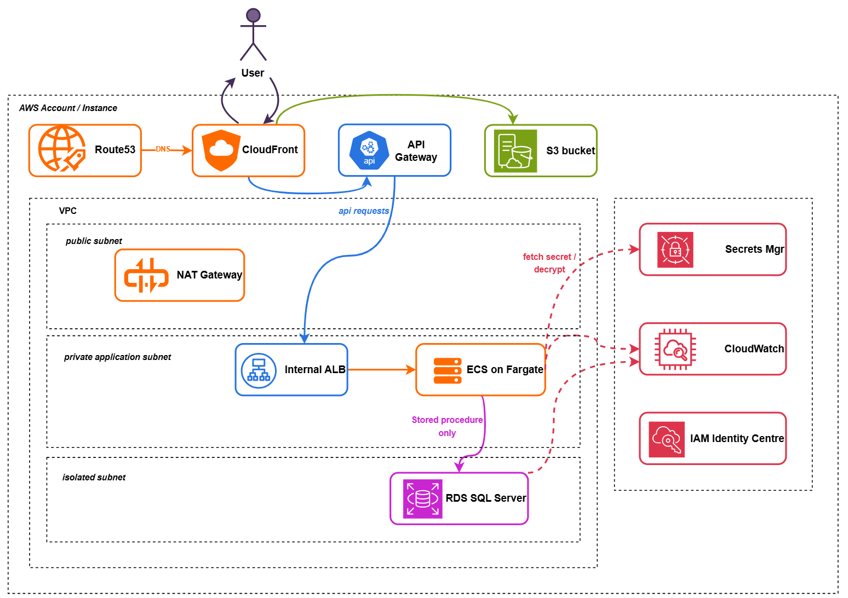
One request, from the internet to the database
1
Edge
Route 53 and CloudFront with a web firewall. Static pages from a private bucket
2
API
API Gateway to an internal load balancer, never public
3
Containers
ECS on Fargate in private subnets; secrets fetched at start-up
4
Database
SQL Server in an isolated subnet, stored procedures only, no route out
Target from the Implementation Guide §2. Built today: load balancer, private containers, private encrypted database. Edge and API Gateway follow once there is a domain (Phase 2).

Slide 7
Four guardrails hold, even for administrators
1
2
Stay in Australia
No root user
Sydney only, plus us-east-1 for global services
Member accounts’ root users are blocked
3
4
Security stays on
No leaving
CloudTrail, GuardDuty, Config, Security Hub and Access Analyzer can’t be turned off
No account can remove itself from the organisation
Service control policies at the organisation root: no admin in a member account can override them

Slide 8
All ten control areas are built in code
Access
Enforced
Encryption
Configured
Logging
Enforced
Network separation
Configured
Monitoring
Enforced
Vulnerability management
Configured
MFA
Configured
Incident response
Configured
Secrets
Configured
Backup and recovery
Configured
Enforced: a guardrail stops anyone turning it off. Configured: built by the code; an admin could still change it.
Biggest gap: backups have no copy outside the account they protect

Slide 9
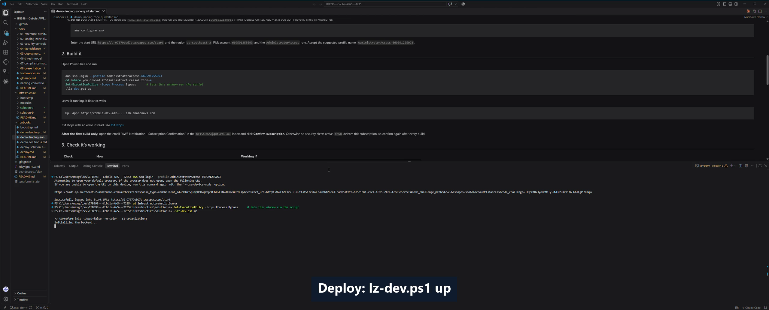
Built, checked and torn down from code
Recorded run, 18 October 2026. The build and teardown are sped up; the video plays automatically.

Slide 10
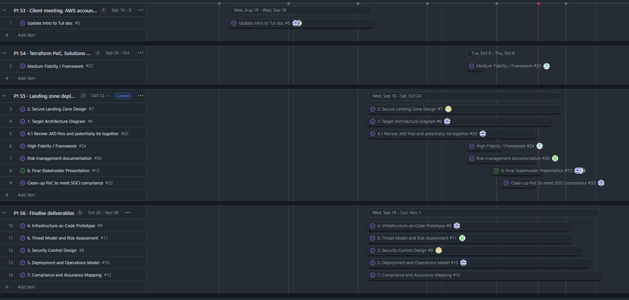
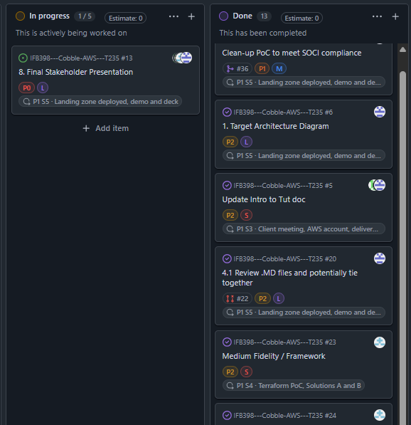
How we planned Phase 1
S1 · 17 Aug
Repo and workflow
S2 · 31 Aug
Research, pricing
S3 · 14 Sep
Client meeting, scope
S4 · 28 Sep
Terraform PoC, A and B
S5 · 12 Oct
Landing zone, demo, deck
S6 · 26 Oct
Finalise deliverables
SPRINT PLAN · GITHUB ROADMAP
ISSUES REGISTER
6
two-week sprints
13 / 14
deliverable issues done
19
pull requests merged
Sprint plan: each deliverable an issue with owner, priority, size and dates, in its sprint. Issues register: 13 done, the final presentation in progress.
Sprint plan and issues register in GitHub · every change a pull request, checked and reviewed

Slide 11
Where we stand
DONE
IN PROGRESS
PHASE 2
Built and proven
Evidence and fixes
Close the gaps
Both deploy and tear down, one command each
Landing zone, guardrails, sign-in
Central logging and detection
CI checks and nightly drift
Evidence log and screenshots
Shared services account (AWS account limit)
Security Hub standard scores
First backup restore test
Backups outside the account
Application alarms, dashboards
Break-glass, narrower admin roles
Automatic deploys with approvals

Slide 12
Phase 2 is the Centre’s decision to make
Phase 1 gives them three ways to configure Cobble’s platform. They choose and sign off; then we build.
OPTION 1
OPTION 2
OPTION 3
NOT YET APPROVED
Full landing zone
Start small, grow
Review DigitalOcean first
≈ A$790 / month
≈ A$0 between demos
Evidence before building
• Solution A in the Centre’s own AWS organisation
• Six accounts, guardrails, single sign-on
• A$475 with dev and staging off when idle
• Solution B in one Centre account
• Grows into Solution A when tenants arrive
• Same modules, so nothing is thrown away
• Map today’s platform against the ten control areas
• Then choose Option 1 or 2 with the evidence
• Migration or hardening plan
Needs: their AWS organisation, budget and identity provider
Needs: one AWS account
Needs: development approval to review DigitalOcean
First: re-confirm scope with the Centre · Then: they choose an option and sign off the plan and business case

Slide 13
Going forward in IFB399
TBC: depends on the Centre and the unit
1 Team re-forms for IFB399 in Welcome Week
3 Approval to review the DigitalOcean platform
5 Revise the sprint plan
7 Goal date: platform ready to hand over
Wk 0
15 Feb
Sem 1
TBC
Sem 1
TBC
Sem 1
TBC
Sem 1
TBC
Sem 1
TBC
Wk 13
28 May
2 Re-alignment meeting with the Centre
4 Meet the unit coordinator to confirm deliverables
6 Centre decides the option and signs off the business case
QUT Semester 1 2027: Welcome Week 15 Feb · teaching ends 28 May · exams 5–19 June

Slide 14
Why this plan is feasible
RISKS TO THE PLAN, RATED BY IMPORTANCE
01
It’s already running
Both solutions deploy and tear down from code. Phase 2 extends a working platform.
DigitalOcean review access not approved
VERY IMPORTANT
Ask in writing at re-alignment; if no answer, keep building
The Centre’s decision takes time
VERY IMPORTANT
The work is named and ordered
The same modules serve every option
02
13 threats rated; each of the 3 High ones has a named fix.
No Centre accounts in time
IMPORTANT
Handover includes a step-by-step deploy guide
Account limits and cost
IMPORTANT
03
The decision can’t stall the build
Keep accounts; tear down only what costs money
The same modules serve whichever option the Centre picks; only the target accounts change.
Exams squeeze the end
IMPORTANT
Goal date is the end of teaching, 28 May
Phase 2 isn’t a restart: it builds on the platform you’ve just watched deploy

Slide 15
Three risks to fix before real tenant data arrives
HIGH · T1
HIGH · T2
HIGH · T9
Tenant isolation
Admin access
Backups
Tenants are kept apart only by the application
One stolen admin session can change anything
No copy outside the account they protect
Fix: a database user and role per module
Fix: narrower roles and a break-glass role
Fix: AWS Backup to another account and region
13 threats rated with STRIDE: the other ten are Medium or Low, acceptable for a proof of concept

Slide 16
Team members
JH
TH
MG
KD
Jacob Hardcastle
Tim Hartmann
Max Gosling
Khai Do
IFB398
IFB398
IFB398
IFB398
Definition lead
Design lead
Project manager, build lead
Operations lead
Brief, requirements, scope, client meetings
Landing zone, security controls, risk register
Terraform, demo, sprint plan and issues register
Deployment, monitoring, backup, support model
IFB399 · PROPOSED
IFB399 · PROPOSED
IFB399 · PROPOSED
IFB399 · PROPOSED
Client liaison
Security lead
Project manager, platform build
Operations lead
Re-alignment, option and business case sign-off
Admin roles, break-glass, guardrails, threat re-rating
Sprint plan, deploy pipeline, DigitalOcean review
Monitoring, backups and restore test, handover
Each of us leads one part now, and owns one part of Phase 2

Slide 17
How the team operated
Parallel work streams
Tracked in GitHub
Every deliverable is an issue: 17 issues, 18 pull requests, 76 commits
Design and documents
Architecture, landing zone, controls, operations, threat model, compliance
Technical build
Every change reviewed
Terraform modules, both solutions, CI checks, runbooks and evidence
Branch → pull request → automatic checks → one approving review → merge

Slide 18
Reflection and what’s next
Honest reflection
Ready to hand over
Evidence was captured late. Screenshots taken after the demo showed setup gaps we hadn’t checked: GuardDuty and Security Hub membership.
The landing zone needed retries to deploy in order. A scripted, tested run-through earlier would have caught both.
Next time: capture evidence as each step runs.
✓
Both solutions deploy and tear down from code
✓
Every change checked and reviewed
✓
Eight deliverables drafted
✓
Phase 2 gaps named and sequenced

Slide 19
Questions?
Everything shown is in the repository
Terraform, runbooks, the eight deliverables and the demo evidence
github.com/G-0Z/IFB398---Cobble-AWS---T235
Thank you

