Slide 1
DATA_211_PROJECT
COFFE CONSUMPTION
STUDY
BY GUSTAVO OROZCO NUNEZ
By Gustavo Orozco Nunez

Slide 2
QUESTION: AM I DRINKING TOO MUCH COFFEE?
According to the FDA, up to “400 milligrams a day-that’s about four or five cups of coffee-…” is not too much in general, for people in good health.
https://www.fda.gov/consumers/consumer-updates/spilling-beans-how-much-caffeine-too-much

Slide 3
Data collected.
Number of Days | Day of the Week | Cups of coffee | Amount of coffee in milligrams
1 | Monday | 6 | 1418440
2 | Tuesday | 4 | 945626.5
3 | Wednesday | 3 | 709219.9
4 | Thursday | 8 | 1891253
5 | Friday | 5 | 1182033
6 | Saturday | 6 | 1418440
7 | Sunday | 4 | 945626.5
8 | Monday | 9 | 2127660
9 | Tuesday | 7 | 1654846
10 | Wednesday | 5 | 1182033
11 | Thursday | 6 | 1418440
12 | Friday | 8 | 1891253
13 | Saturday | 5 | 1182033
14 | Sunday | 7 | 1654846
14 days-Sample size
Day of the week-Independent variable
Amount of coffee in cups
Amount of coffee consumed in milligrams-Dependent variable

Slide 4
Claim: The mean amount of coffee that I drink is greater than 400 milligrams.
I will use a 0.05 significance level to test this claim.

Slide 5
Hypothesis Testing
Null Hypothesis:
H₀:µ = 400mg
Alternative Hypothesis:
H_{a}:µ > 400mg
Choose One-Tailed Test.

Slide 6
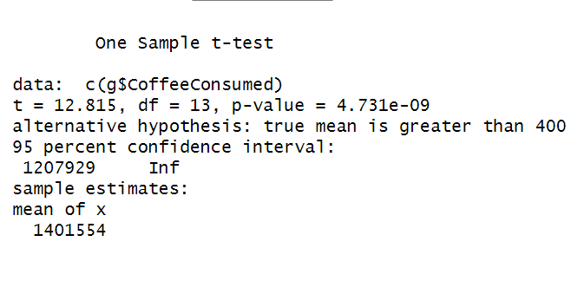
Hypothesis Testing
p-value = 4.731e-09 which is less than the significance level 0.05.
Reject the H₀:µ = 400mg.

Slide 7
Conclusion:
Base on the rejection of the null hypothesis I conclude that there is sufficient evidence to support the claim that the mean amount of coffee that I drink is more than 400 mg.

Slide 8
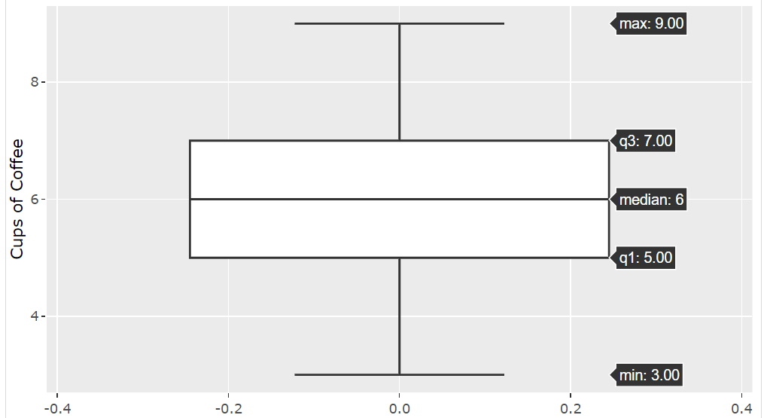
Five number summary graph.

