Slide 1
Data Acquisition
Input, verification, storage, and output

Slide 2
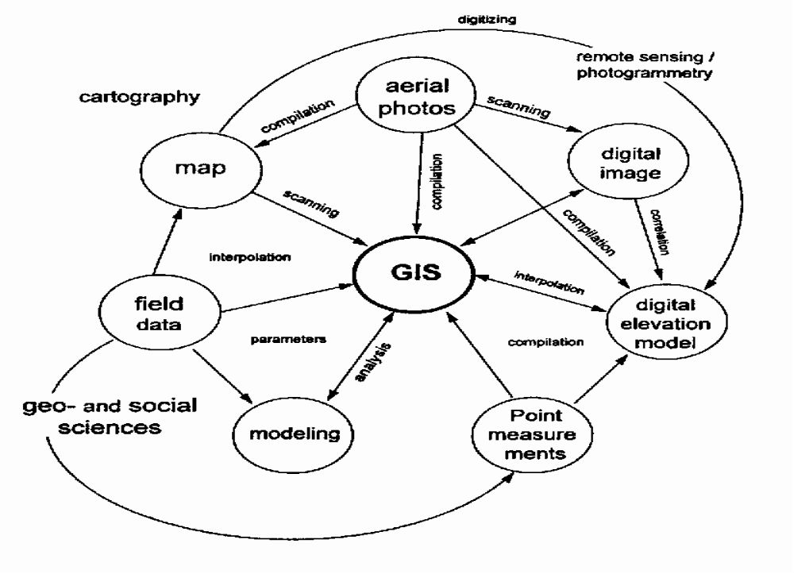
GIS, Data SOURCES & CONVERSIONS
Different data sources and conversation strategies

Slide 3
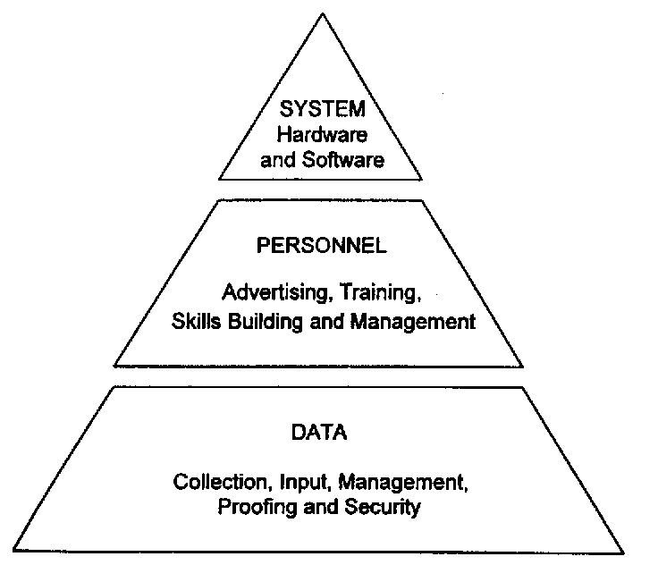

Cost relation in a GIS

Slide 4

Modeling
A Geoinformation system ➔ represent the real world, or at least a part of the real world we are interested in.
  We are putting up a model of this part of the real world (the Universe of Discourse (UoD)).
  Data are the simplified and computer-enabled results of such abstractions, e.g.
    coordinates as a model of location,
    a polygon as a model of a land parcel,
    the name of the owner as a model of a person.

Slide 5
Vector versus Raster: which is “better”?
Both are valid and necessary approaches for GIS spatial data representation (geometry). Each is suited for particular GIS applications.
Raster advantages
  Faster data acquisition especially for dense data eg contours
  Easier integration of map data with remote sensing data
  Easier data compaction → reduction of data volumes by not storing blank spaces between data items. Achieved by use of run length encoding
  Suitable for GIS operations of map overlay and area computation
  Easier data simulation – each spatial data unit is the same size and shape
  Some feature relationships e.g. neighborhood are implicit and do not need to be encoded

Slide 6
Raster disadvantages
  Raster data obtained by scanning. All data captured at same sampling precision → large data volumes. Attempt to reduce data volumes by increasing pixel size results in information loss.
  Unsuitable for representing point features (point covers whole pixel)
  Distance between points are difficult to establish – unsuited for network analysis
  Resolution need to be high for fine line output else output graphics are coarse.

Slide 7
Vector advantages
  Enables precise point location – suited for representation of point data, boundaries and networks
  Very fine output graphics
  Suited for network analysis, buffer generation, distance and perimeter computation
Disadvantages
  Data compaction is difficult – data reduction is achieved by generalization.
  Data simulation is difficult as each spatial unit is of different size.
  Map overlay is difficult – need to intersect layers
  Can only allow integration with RS data through superimposition.

Slide 8
Modeling processes
The process of setting up a computer representation of the UoD involves several steps:
  a view of reality (i.e. fixing the UoD)
  a formalization of the UoD without any conventions or restrictions on implementation (i.e. setting up the conceptual data model)
  a representation of the conceptual model that reflects how the data are recorded in the computer (i.e. setting up the logical data model)
  a file structure, which is the particular representation of the data structure in the computer memory (i.e. setting up the physical data model)
  accepted rules for handling the data (i.e. setting up the data manipulation model, sometimes called the functional model)
  accepted rules and procedures for displaying and presenting spatial data (i.e. setting up the graphical model)

Slide 9
GIS data
Geographical phenomena require two descriptors to represent the real world:
  what is present (in terms of well defined objects or entities and their attributes),
  where it is (in terms of its spatial location and extent → geometry).
The partition of GIS data into spatial and descriptive data is due to:
  different presentation: maps / tables
  different retrieving requirements: topological / logical

Slide 10
GIS data
geographic (spatial) data
  location (map coordinates)
  topology (neighborhood relationships)
  graphical representation (map layout)
descriptive (attributive data)
  well structured (tables)
  multi-media
  other documents
older GIS ➔ spatial data stored using file-based structure, adapted to the special requirements of topological retrieving with attributive data stored in a database system.
Using two different systems to store the data has disadvantages: ➔very difficult to maintain the consistency of the two kinds of data.
Storing the enterprise data in a file based-structure has some disadvantages too, thus the actual trend is to store both kinds of data in a common general-purpose database system.

Slide 11
Sources of GIS data
Creating a GIS database is a daunting task
  Involves data capture, verification, and structuring
Raw geographical data is available in many different analogue and digital forms such as maps, aerial photographs, satellite images, or tables
Creation of a spatial database may involve the following, not mutually exclusive ways
    Acquire digital database from a supplier
    Digitize existing analogue data
    Carry out one’s survey
    Interpolate from point observations to continuous surfaces.

Slide 12
Sources of GIS data
Most common source of GIS data are
  the paper or digital topographic or thematic map
  Images: derived from optical and digital remote sensing systems mounted on aircraft and satellite platforms
    Stereo aerial photographs are overlapping analogue images that have many applications.
    They are a major source of data for human interpretation and mapping of geology, soil, vegetation, or land cover.
    They are also valuable background documents for placing other spatial data in a geographical contest
    Digital orthophotos and photogrammetry provide data on terrain elevation and land cover directly in digital form.
    Wide range of scanners on satellites provide digital data directly

Slide 13
Three major technologies for remote sensing
Aerial photography: a technique of taking photographs from the air by means of an aircraft and digital photogrammetric equipment
Satellite images: Images are collected by sensors on board a satellite and relayed to Earth as a series of electronic signals, which are then processed by a computer to produce an image.

Slide 14
Remote sensing technologies
Light detection and ranging: A remote sensing system that uses aircraft-mounted lasers to collect topographic data. Measurements are spatially referenced using high-precision GPS.

Slide 15
Sources of GIS data
  From traditional survey methods of ground or field surveys
    Sample values at known locations are recorded, ranging from questionnaires , soil augers, to automatic chemical probes.
    Recording is in terms of series of point locations and attribute values in tables
    Digital data loggers have improved the art of data collection, which may be read directly or through an exchange format into a computer database.
It is important that all spatial data in a GIS is located with respect to a common frame. Placing these in a common system in GIS is attained through georeferencing
This frame is provided in one of a number of geodetic coordinate systems
  Plane Orthogonal Cartesian coordinates oriented conventionally north-south and east-west and derived from geographical coordinates
  Geographical (spherical) coordinates on ellipsoids for mapping the true curved surface of the earth

Slide 16
Geographic data collectors and providers
Systematic data collectors
  Government agencies: national and regional mapping agencies
    Have the mandate to define and maintain the map spheroids, projections, grid origins, orientation and spacing, reference sea levels, data measurements and collection standards
    Carry out cadastral surveys and registration of utilities in a systematic manner
    Systematic collection of remote sensing data in some countries, e.g in Canada, USA, Russia, India, France and Japan
Adhoc Data Collectors
  Data collected by private surveyors, commercial organizations, market researchers, political organizations, or academic institutions
    Data are for specific purposes
    Access to these data is often restricted because of commercial interests
Data providers
  Offer and sell geographical data in a variety of detail, format, scales and structures.
  Sell data that they have processed but may not have acquired e.g. Regional Centre for Services in Surveying and Mapping in Kenya.
  Some data is provided free e.g elevations, roads, towns, rivers...

Slide 17
Acquiring digital datasets
Consider the following to ensure they are compatible with the application
  Currency of the data
  Length of the record
  Scale of the data
  Georeferencing system used
  Data collection technique and sampling strategy
  The quality of data collected
  Data classification and interpolation methods
  Size and shape of the individual mapping units

Slide 18
Creating digital datasets by manual input
Main input of data into a GIS involves four (4) main stages
  Entering the spatial data
  Entering the attribute data
  Spatial data and attribute verification and editing, and
  Linking the spatial to the attribute data (where necessary)

Slide 19
Creating digital datasets by manual input (2)
Entering the spatial data
Geographical data in entity model are in terms of points, lines, or areas/pixels defined by a series of coordinates
Simplest way is to type the coordinates into a file or input program of a GIS
This has been reduced by use of digitizers, scanners, or stereoplotters to encode the X and Y coordinates of desired points

Slide 20
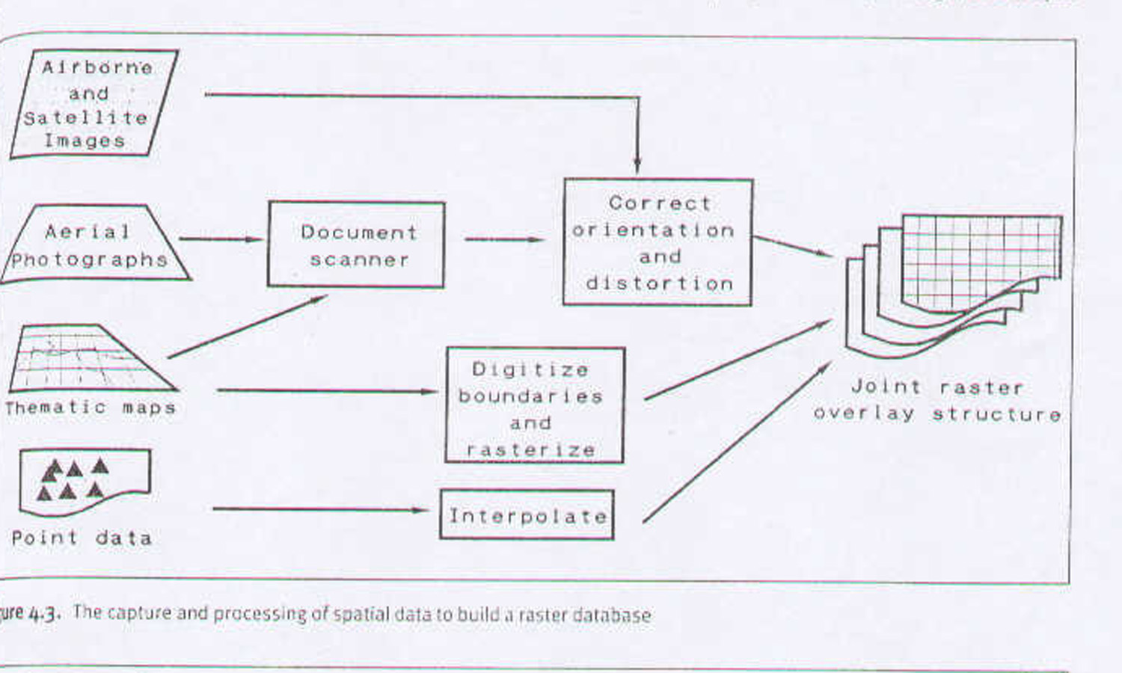
Rasterization: Vector to raster conversion
The capture and processing of spatial data to build a raster database
Notes:
Rasterization: is the process of converting vector data into a grid of pixel values. It involves basically placing a grid over the map and then coding the pixels according to the occurrence or not of the phenomena

Slide 21
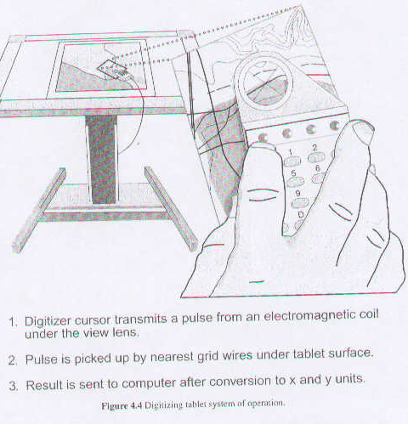
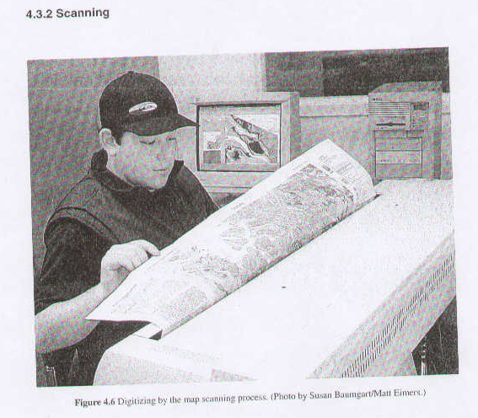
DIGITIZING
SCANNING
Notes:
Digitizer: is an electronic or electromagnetic tablet upon which a map or document is placed.
Digitizing: may be in two ways:
Stream digitizing
Point digitizing

Slide 22

Creating digital datasets by manual input (3)
Entering the attribute data
  Attribute data are non-spatial characteristics of the spatial entity that need to be handled by GIS
  Few attributes may be added at input of the spatial entity
  Others come from different sources such as paper records, existing databases, spread sheets
    They may be input manually, or imported into the GIS using a standard transfer,
    If in a relational database, an identifier is included in the attribute record to link the spatial and attribute data

Slide 23
Creating digital datasets by manual input (3)
Data verification and editing
It is important to check for errors:- inaccuracies, omissions, etc. prior to linking the spatial and attribute data
  Best way is to produce a paper plot or print and visually compare with original
  Certain GIS show topological or identifier errors
  Attributes may be visually checked by printing out files or by eye; computer programs can be used to scan for gross errors
Spatial data errors that may arise:
  Data are incomplete or double
  Spatial data in the wrong place
  Spatial data defined using too many coordinates
  Spatial data at the wrong scale
  Spatial data are distorted

Slide 24
Creating digital datasets by manual input (3)
Data verification and editing(2)
Typical errors arising in digitizing data are
  Dangling chain (undershoot or overshoot)
  Unlabelled polygon: due to duplicate digitizing of a single chain
  Conflicting labels for a polygon: in case of multiple seed points for a given polygon, e.g a group of islands belonging to a single polygon
  Line segments with the same left and right labels, due to mislabelling of adjacent polygons
  (Chrisman 1987)

Slide 25
Creating digital datasets by manual input (3)
Linking spatial data and attribute data
Available in GIS with relational database structures
Attained by use of identifiers which are common both in the spatial record and the attribute record
Identifiers are either automatically generated or added manually during digitizing or scanning/ vectorization process
Polygon identifiers are usually added after generation of topology
After the data capture process, we have geometrically correct raster data, or topologically and geometrically correct vector data.
  Most GIS accept both kinds of data
Structuring of the database as a whole is essential to optimize on storage requirement and performance of the GIS though sensible ordering and data compression techniques

Slide 26
Data Presentation and Storage
Most GIS include software which support the production of a range of data output options
Digital or computer-compatible outputs
  Files on an optical disk or other storage device that can be read or reused in another system, or transmitted via the Internet
Analogue or people-compatible kinds of outputs
  Maps, graphs and tables: These can be displayed on electronic screens or produced as permanent images on stable material such as paper.
High quality outputs are facilitated by
  Visual display units: main tool for displaying the results of GIS analysis
  Plotters: automated draughtsmen for making copies of geographical data on paper or film
  Printers: for making smaller-sized formats print-outs of GIS analysis results

Slide 27
Data Presentation and Storage
Main data storage devices are
  Removable storage
    Magnetic media: floppy disks, digital audio tapes
    Optical media: Compact Disk ROMs, Rewritable Optical Discs, DVDs,
    External hard drives: mass storage system
  Non-removable storage and Networks
    Due to falling prices, large data can now be stored on single computers
    To minimize duplication, use of networks within organizations and also globally.
      LANs and WANs
      Configuration of computers
        Peer-to-peer: not very useful for GIS
        Client-server:one or more powerful servers used to store data and software. The clients have their processing power , but access data and softwre from the server
        Central processing systems: main-frame and mini-networks with terminals. All processing is on the main-frame.

