Slide 1

INSURANCE CLAIMS
• Richa and Mainaki •
CDSAML

Slide 2
Predict the incurred amount based on historical data followed by the prediction of premium pricing for an insurance company
PROBLEM STATEMENT:

Slide 3
Overview
Feature Selection
Clustering of data
Data Cleaning
Data Preprocessing
Classification of data based on clusters

Slide 4
Feature Selection

Slide 5
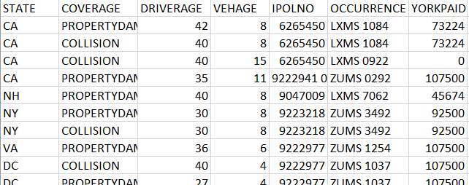
Features Selected

Slide 6
Data Clustering

Slide 7
Clustering: K-Means
0s
A
A
A
B
A
B
B
C
B
A
C
C
Third Clustering
Fifth Clustering
B
D
First Clustering
D
C
Fourth Clustering
A
Second Clustering
Cumalative range of last cluster of 1st,2nd,3rd,4th clustering
Entire Dataset
Dropped 0s
B
C

Slide 8
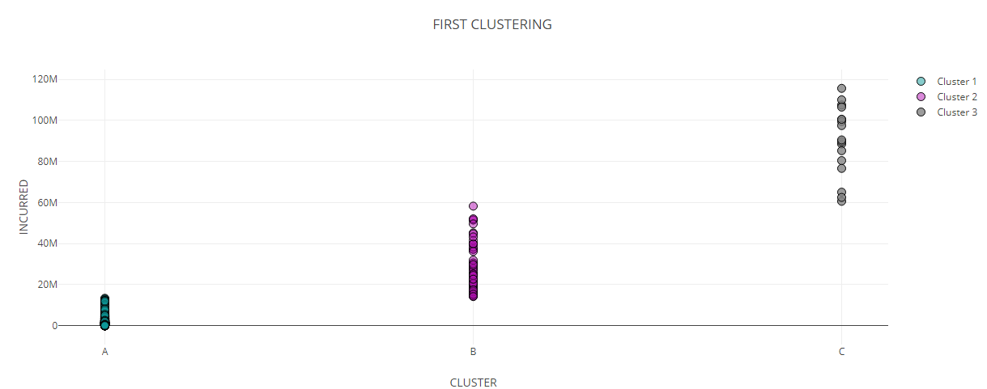
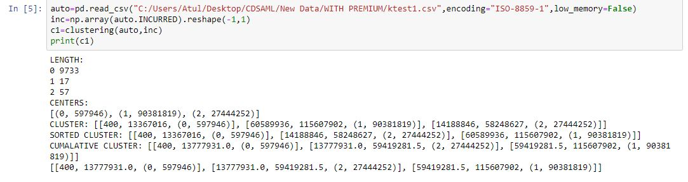

Slide 9
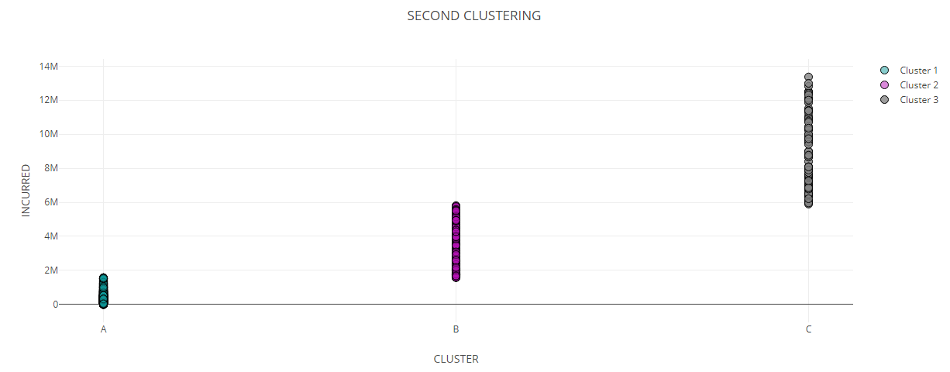
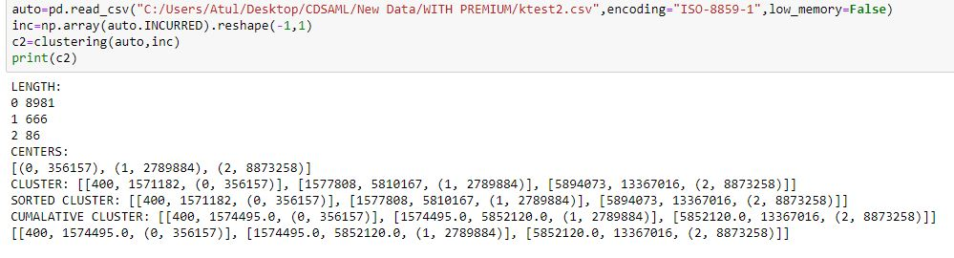

Slide 10
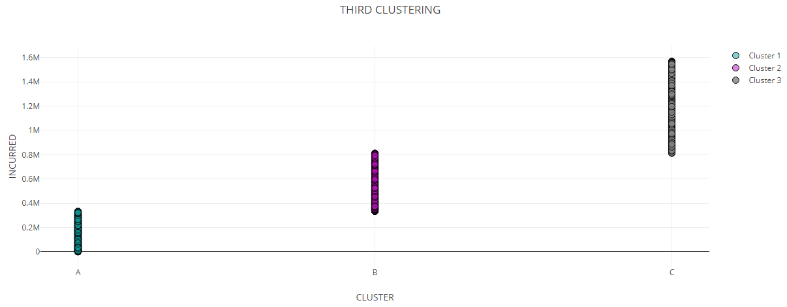
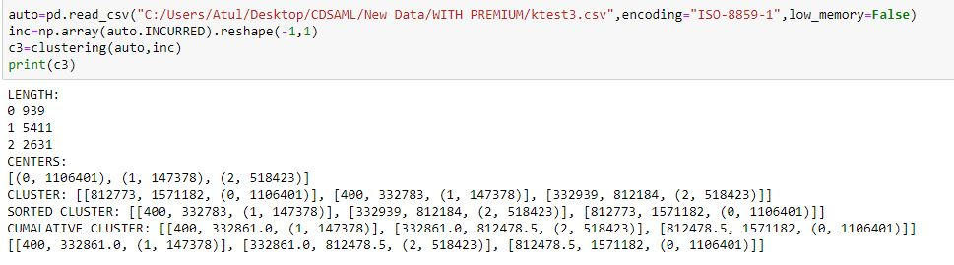

Slide 11
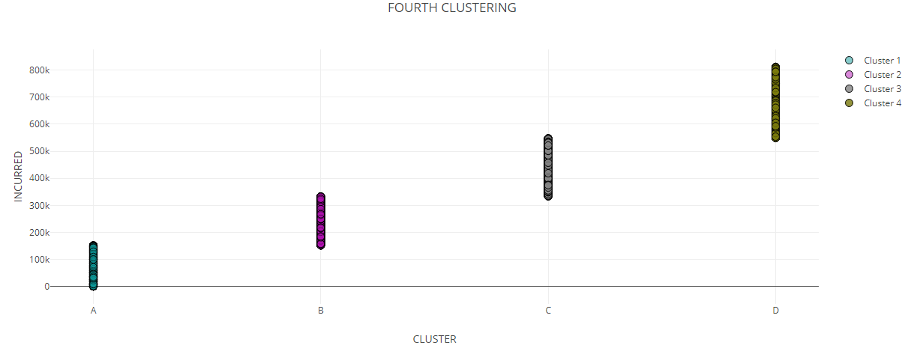
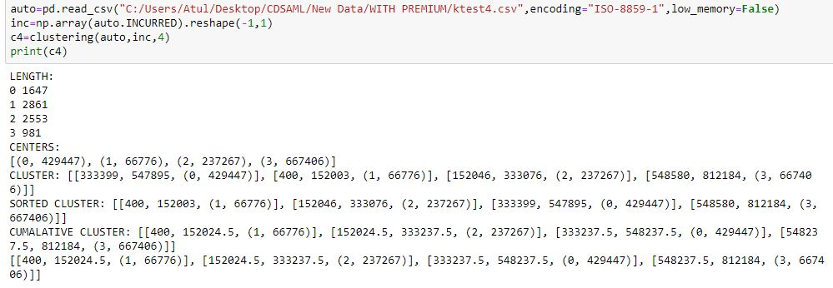

Slide 12
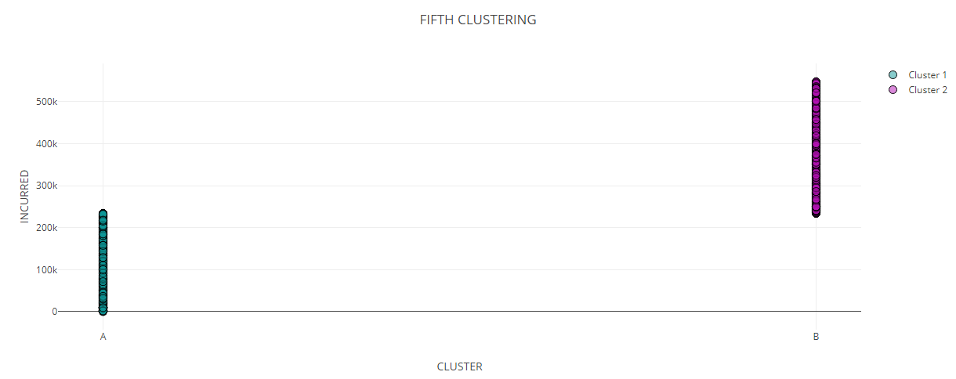
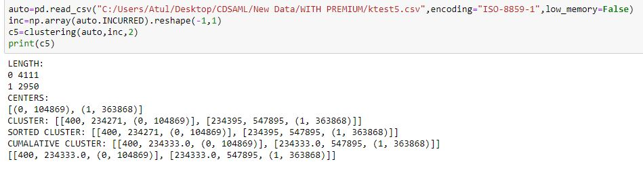

Slide 13
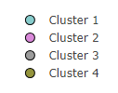
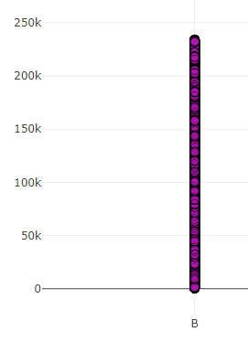
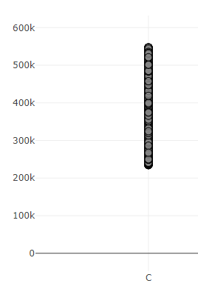
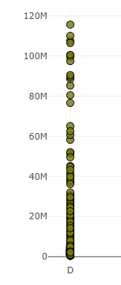
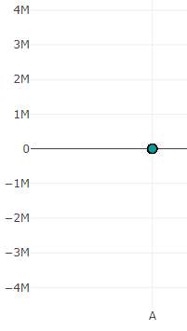

Slide 14
Data Cleaning

Slide 15
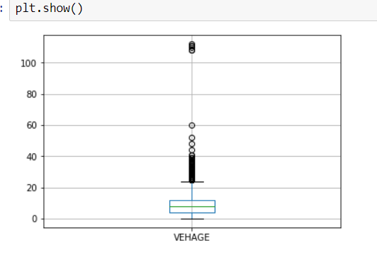
Finding Outliers
Driverage
Using standard deviation
Range: 20-70 years
Vehage
Using boxplot
Range: 0-24 years

Slide 16
Features: DRIVERAGE,VEHAGE
Fill Missing Values
Replace outliers

Slide 17



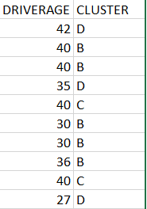


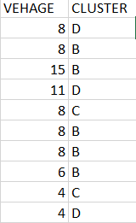
Cluster Local Means
DRIVERAGE:
VEHAGE:

Slide 18
Data Preprocessing

Slide 19
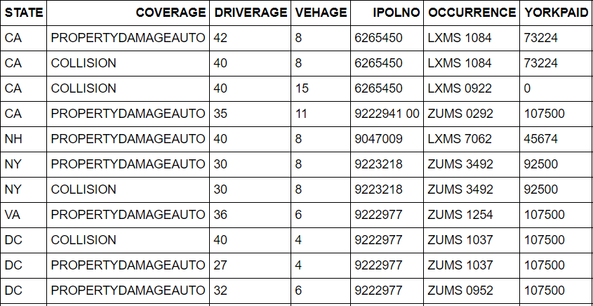
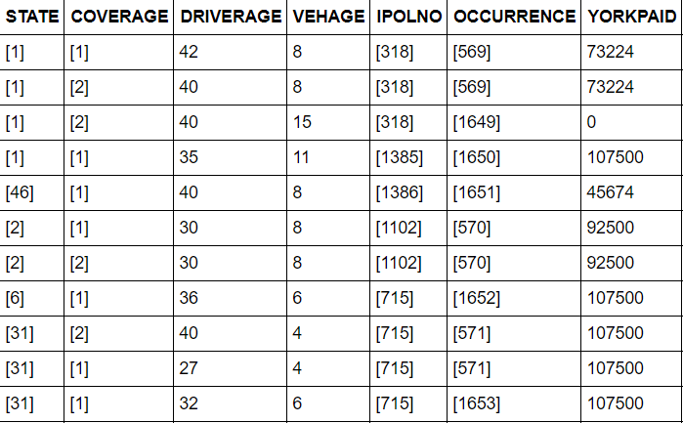
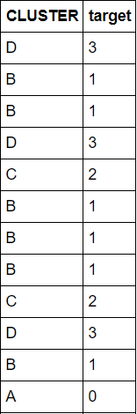
Data Encoding
1.Categorical Features:
Header file: from keras.preprocessing.text
Function: Tokenizer()
Split: ‘\n’
Convert to Binary: text_to_sequences() with padding
2.Target Cluster Name:
Header File: Pandas
Numeric Encoding of Labels

Slide 20
Classification -Neural Network-Keras

Slide 21
Architecture:
Dropout layer(0.05)
Converted to embedding
Categorical input-4
4 probabilities
A
B
C
Separate input layers
D
OUTPUT
Continuous input -3
hidden-5
Merged input layer
hidden-7
hidden-10
hidden-25
hidden-20
hidden-15

Slide 22
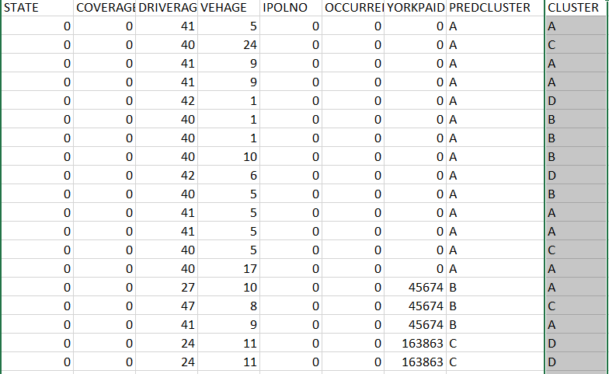
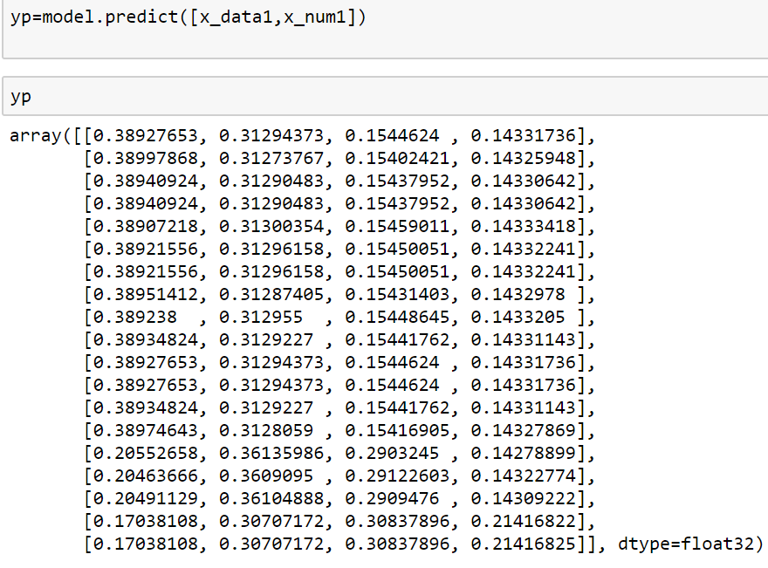
OUTPUT: after 1st train
ACCURACY=32.23%

Slide 23
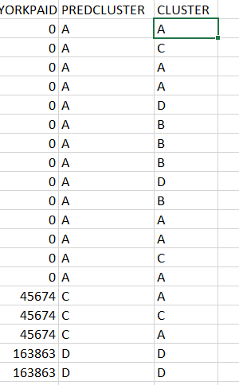
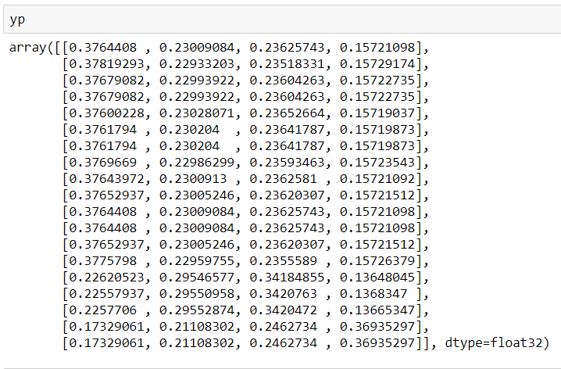
OUTPUT: After 2nd train:
ACCURACY=51.28%

Slide 24
THANK YOU

