Slide 1
The study of user responses to the iOS10 based on Twitter
Group 14
Shi He, Meng Wang, You Zhou, Zili Ma, Xiao-Qun Wang

Slide 2
Contents
Collecting & Cleaning Twitter Data
Sampling Twitter Data about a certain topic
Analyzing Tweets and Tweet Entities with Frequency Analysis
What do we learn from the tweets data we have collected
Another popular user in Twitter

Slide 3
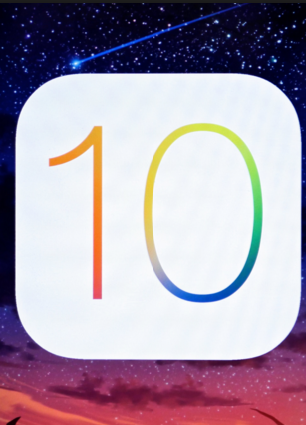
Collecting & Cleaning the Twitter Data
Topic of interest: “iOS10”
Reason: Interesting and meaningful in business
Total number of tweets collected: 730,000
After cleaning and removing the duplicated tweets, We use 180,000 original tweets.

Slide 4
Sampling Tweets about a certain topic
We divided the data into several groups and took sample from them:
Time zone
Time (sent time)
Source devices
We further filtered data into groups with different topic:
Music (New music app)
Unlock (New way to unlock screen)
Emoji (Redesign of the emoji)
UI (changes in UI)

Slide 5
Analyzing Tweets and Tweet Entities with Frequency Analysis
Word count
Most popular tweets
Top 10 hashtags & user mentions

Slide 6
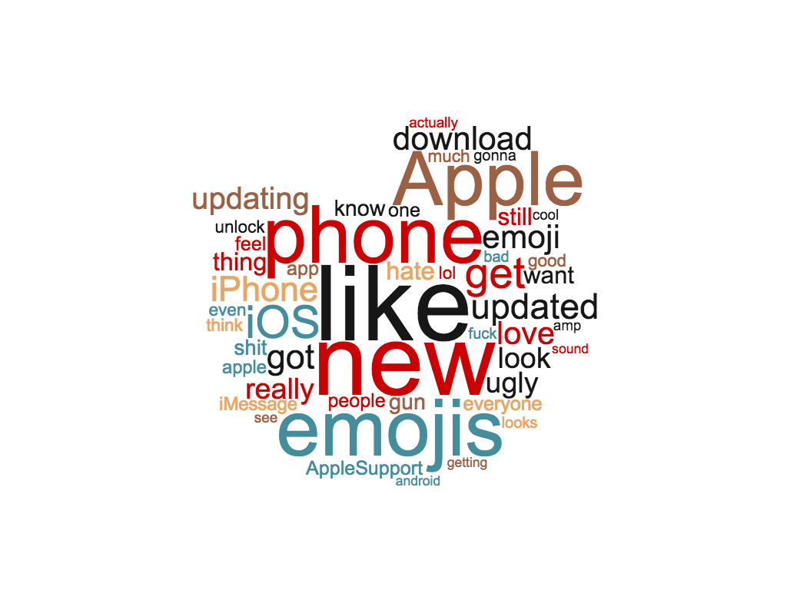
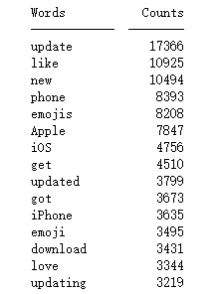
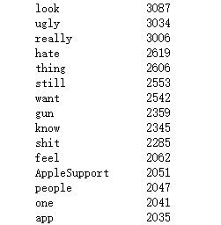
Word count
We eliminated some common words like a, the, and I, which cannot be representative.

Slide 7
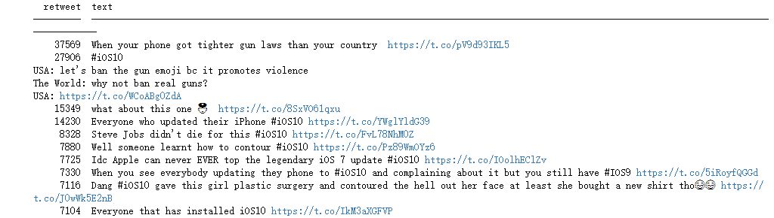
Most popular tweets

Slide 8
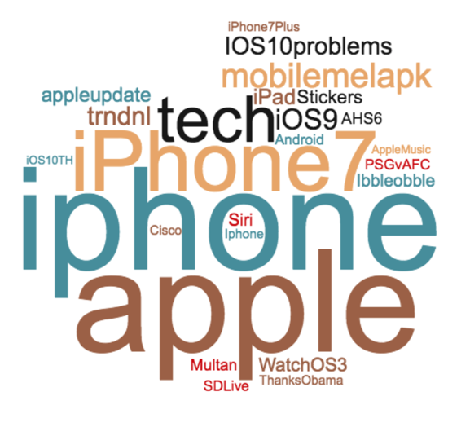
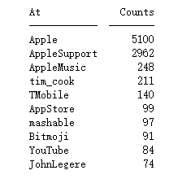
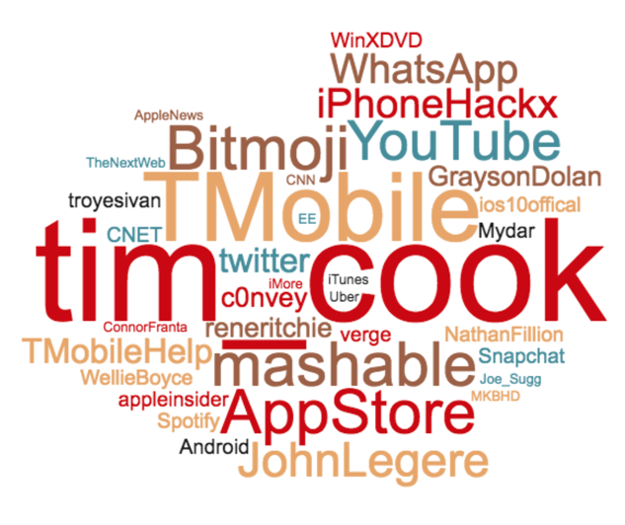
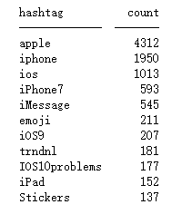
Top 10 hashtags & user mentions
Hashtag User mention
We combined the similar hashtags such as iphone and iPhone.

Slide 9


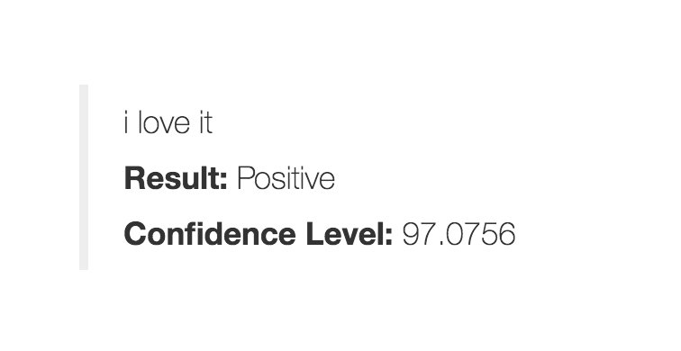
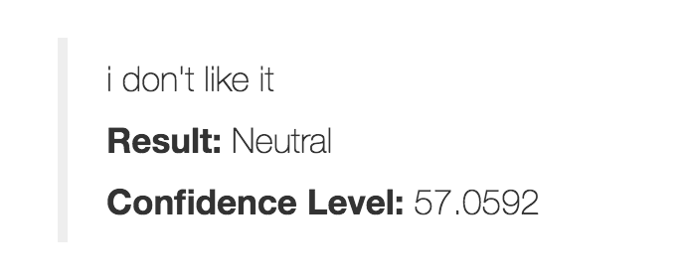
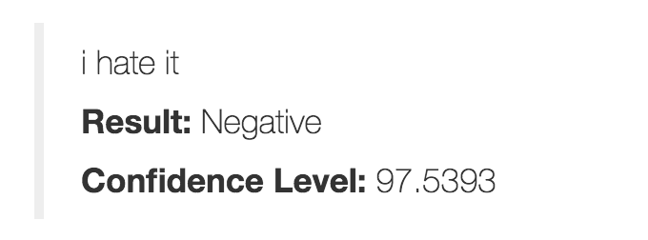
What do we know from the tweets data we have collected?
What results do we get?
What do we find from the analysis of the raw tweets data

Slide 10
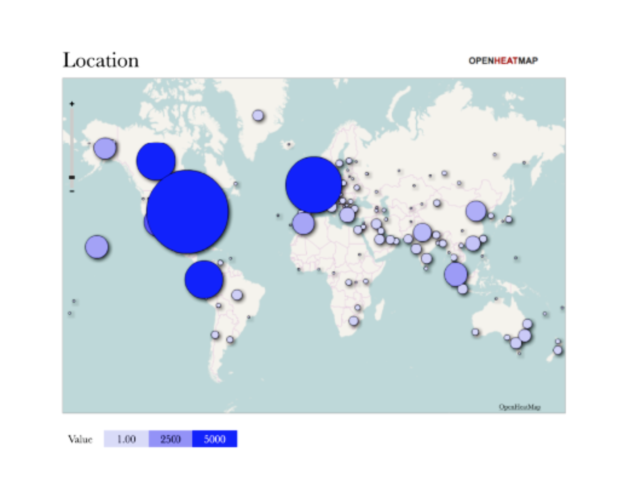
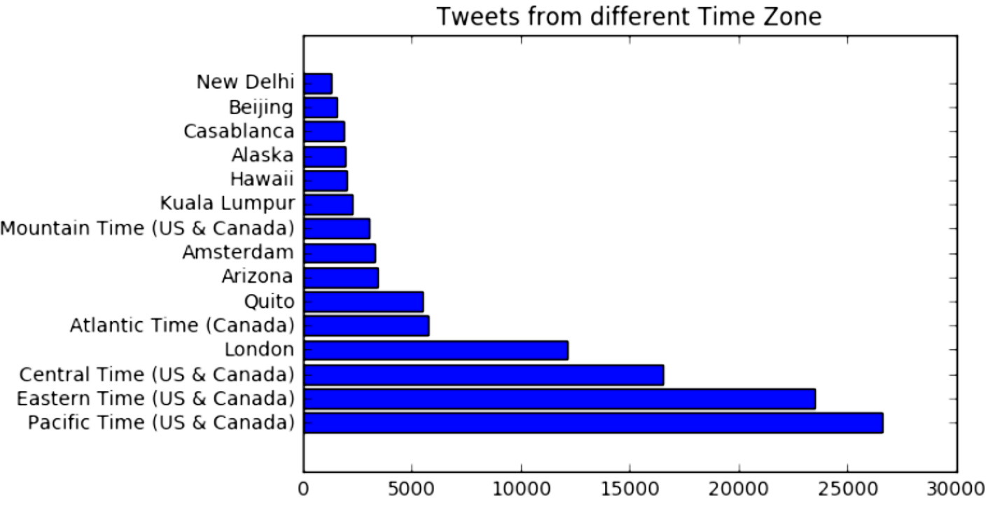
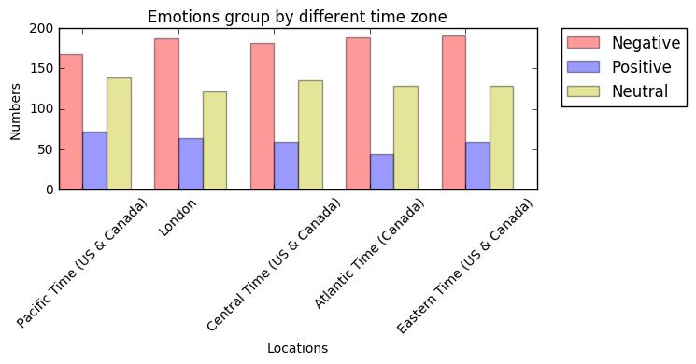
The number of tweets v.s. locations (Time zones)

Slide 11
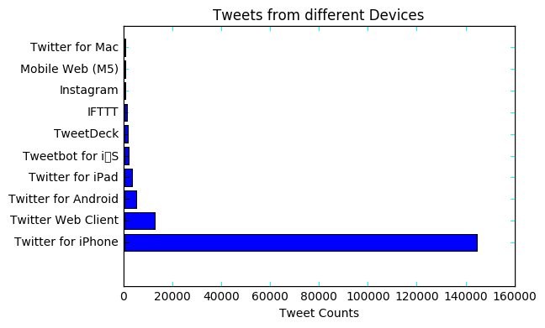
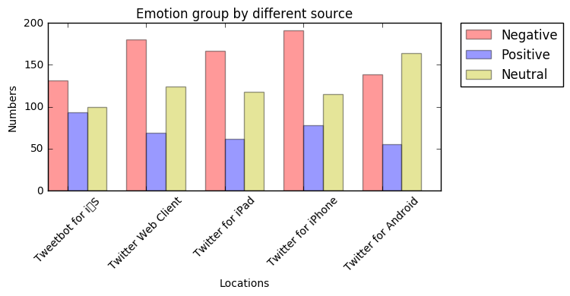
The number of tweets v.s. types of devices

Slide 12
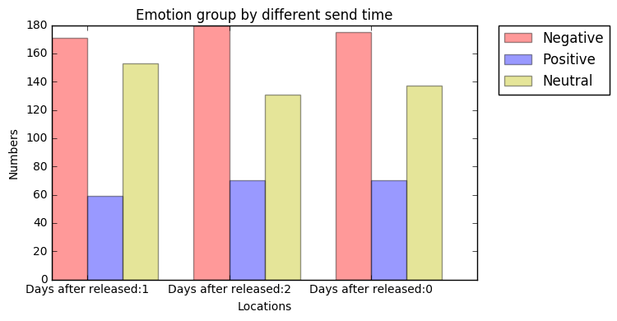
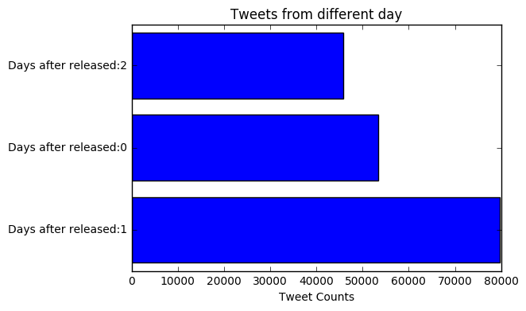
The number of tweets v.s. time
He loved soccer, but feared he had no way to talk to a coach or teammates.

Slide 13
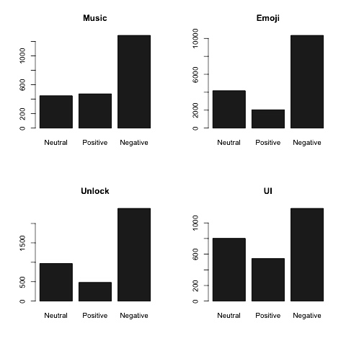
Sentimental analysis for iOS10’s new features.

Slide 14
Conclusions
Word count results display:
North America is the most active region to talk about iOS.
More popular in west coast than in east coast in US.
Developing countries in Asia are more keen on the new iOS than developed regions.
iPhone users are concerned more on this event.
Sentimental analysis results display:
iPhone users complain less( compare to other, but still alot).
Android users’ attitude is more neutral to iOS10.
Majority people love to make comments on Emoji.
Not too much people care about UI because there is nothing changed too much.
People on twitter prefer to complain instead of to praise.

Slide 15
Another popular user in twitter

Slide 16
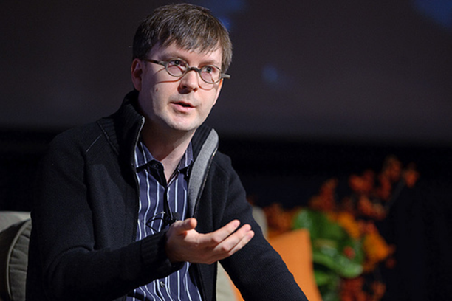
Kevin Lynch (@kevinlynch)
Vice president of technology at Apple Inc.
Former chief technology officer of Adobe System.

Slide 17
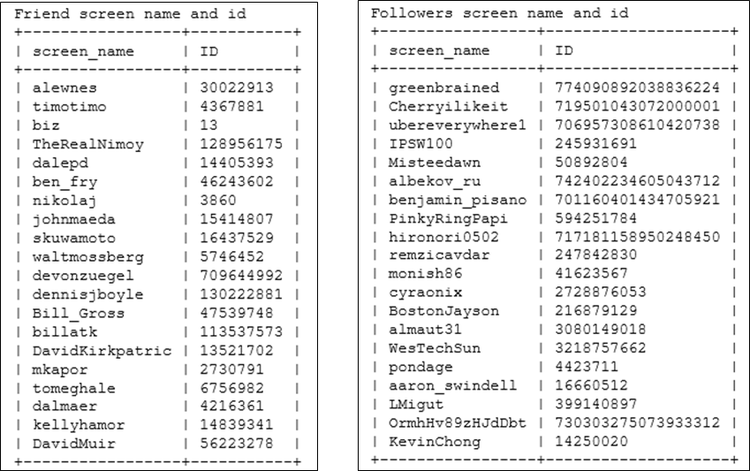
Plot 20 out of the all followers and all friends

Slide 18
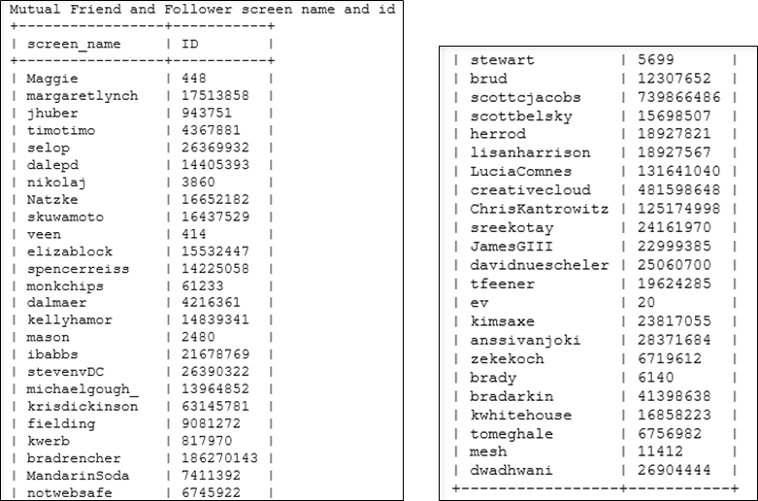
Find mutual friends

Slide 19
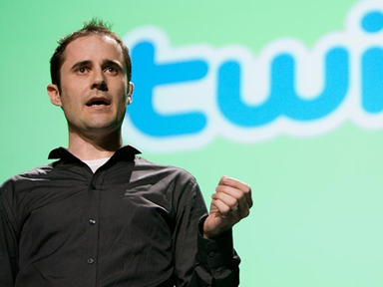
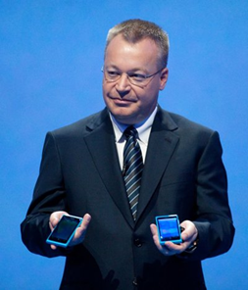

Who are they?
There are totally 48 mutual friends
At least 35 of them are CEO, entrepreneur, senior developer in IT industry.
Notes:
Ev Williams, CEO of twitter
Stephen Elop (former CEO at Nokia)
Jeff Huber, CEO of GRAIL (Cancer blood screening test company)

Slide 20
Thank you !

