Slide 1
Privacy-preserving Distributed Learning of Imaging Mass Spectrometry Data
Genghua Dong

Slide 2
Content
Introduction
SPDZ 2
Analysis Method
Results
Conclusion

Slide 3
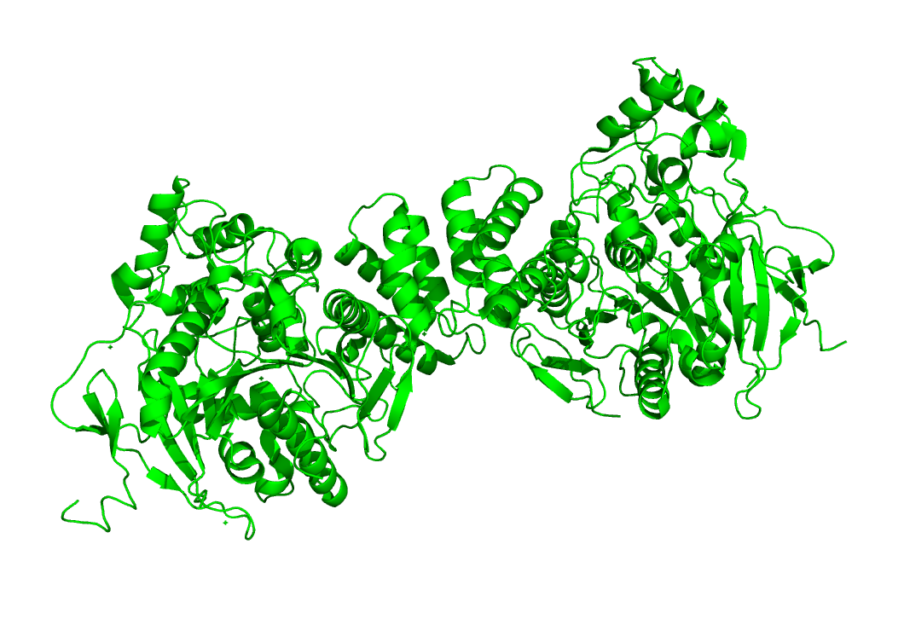
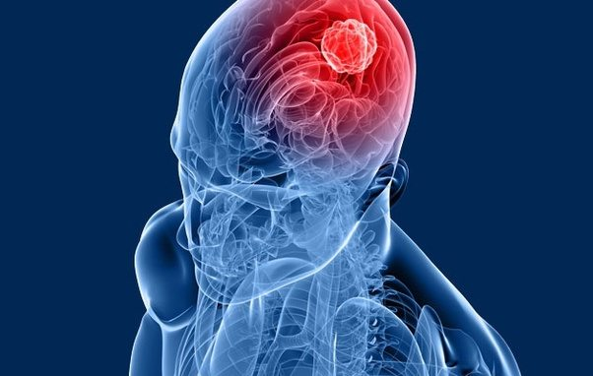
Introduction
Intelligent Medical Service: Build up models between tissues and tumor.
Linear
Classifier
Tissues
Tumor
Linear
Classifier
Tissues
Tumor

Slide 4
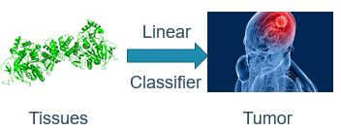
Introduction
Current situation and challenges
Single tissue
Privacy sensitive
Our solution and advantages
Gradient Descent
Secure Multiple Communication Protocol (MPC)
Small data amount & No model
Distributed Learning

Slide 5
Introduction
Imaging Mass Spectrometry
Data Acquisition
SPDZ 2
Communication
Gradient Descent & T-test
Analysis

Slide 6
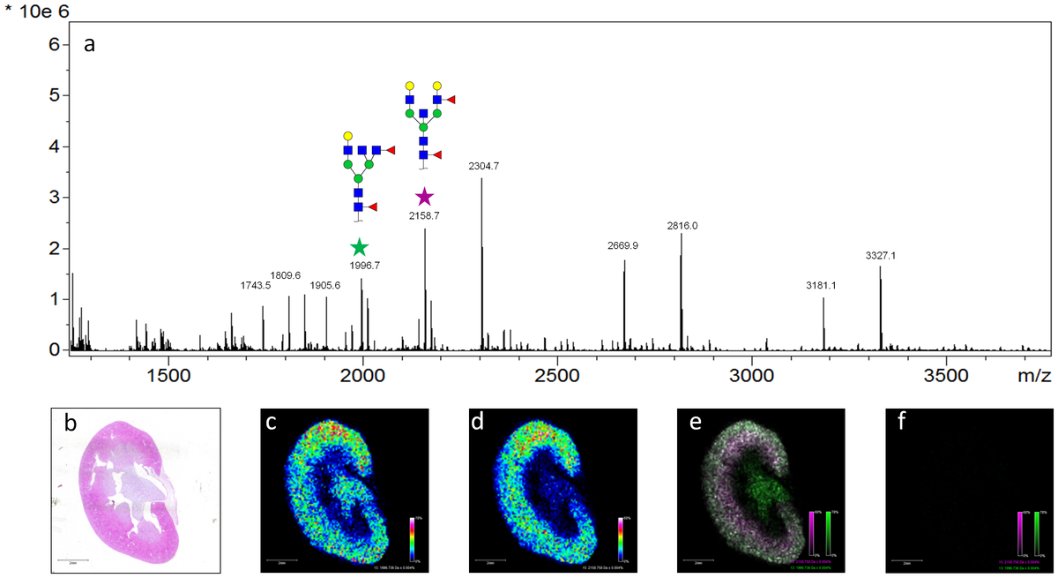
Imaging Mass Spectrometry (IMS)
Concentration of different molecules in the single pixel.
One Molecule
One Slide
Specific M/Z
Intensity
Molecule Concentration
Slides
Distribution of the molecule with 2500 M/Z

Slide 7
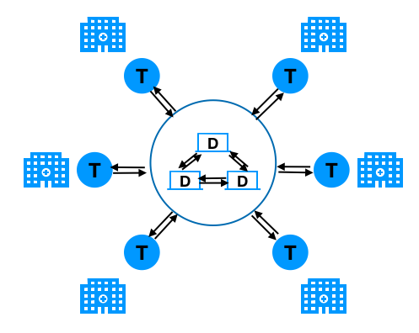
Communication Topology
Communication encrypted
Distributed

Slide 8

SPDZ 2
A Secure Multiple Party Communication protocol

Slide 9
SPDZ 2

Slide 10
SPDZ 2

Slide 11
SPDZ 2

Slide 12
Analysis Method
Gradient Descent
Stochastic Gradient Descent
T-test

Slide 13
Gradient Descent (GD)

Slide 14
Stochastic Gradient Descent (SGD)

Slide 15
T-test

Slide 16
Results Analysis
Cost simulation of Online and Offline phase

Slide 17
Results

Slide 18
Results

Slide 19
Results

Slide 20
Results

Slide 21
Conclusion & Future work
Linear behavior is qualified for big data analysis

Slide 22
Conclusion

Slide 23
Future work

