Slide 1

Holographic Reduced Representations for Working Memory Concept Encoding
by Grayson McKenzie Dubois

Slide 2

Cognitive Models that “Think Humanly”
Four corners of AI*
Acting Rationally | Acting Humanly
Thinking Rationally | Thinking Humanly
Our Research deals with Thinking Humanly
Computational Models based on Human Brain
Helps to learn how the brain works
Helps to solve engineering problems
* Introduction to Artificial Intelligence: A Modern Approach, Russel and Norvig, 1995.

Slide 3


The Working Memory Toolkit
A Neural Network to mimic human working memory
Stores info from percepts that “looks promising”
Classifies “useful” information
Discards info when no longer in use
“Working Memory, Reading, and Dyslexia”, Baddeley, 1986.
“A Biologically Inspired Working Memory Framework for Robots”, Phillips and Noelle, 2005.
“Primary Memory”, Norman and Waugh, 1965.
“Prefrontal Cortex and Dynamic Categorization of Tasks…”, O’rielly et al., 2002.

Slide 4
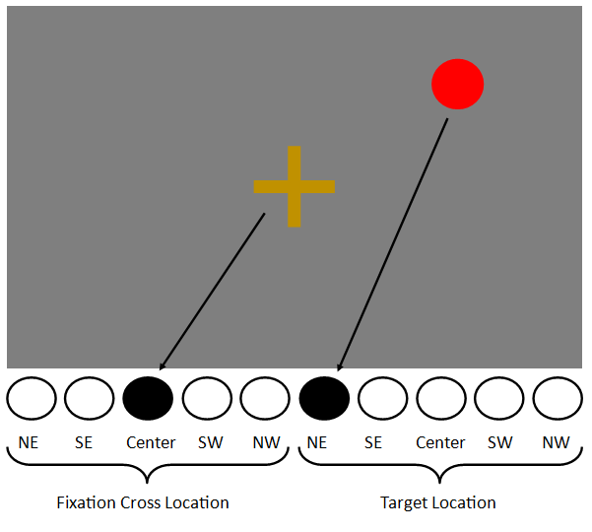
Representing ConCepts Digitally
Humans consciously think of concepts symbolically
Computers have no concept of… concepts
[ 0, 0, 1, 0, 0, 1, 0, 0, 0, 0 ]
Problem: representations have to be hand written by the researcher for every task

Slide 5


Holographic Reduced Representations
A vector of Gaussian numbers typically between -1.0 and 1.0
Holographic
Reduced
Representation
Combination of two concepts: “red” and “ball”
Extraction of constituent concept “ball” from complex concept “red ball”
Goal: replace manual DE/SE conversion interface in toolkit with HRRs
“Holographic Reduced Representations”, Plate, 1995.

Slide 6
Building an HRR Engine and adding it to the toolkit
Architecture of Holographic Working Memory toolkit.
Architecture of Original Working Memory toolkit*
* “A Biologically Inspired Working Memory Framework for Robots”, Phillips and Noelle, 2005.

Slide 7
Testing the Toolkit
What color am I thinking of?
Wisconsin Card Sort Task*
100% success rate within 8000 trials.
3.5-4.2 K trials to learn a new rule
* ”Prefrontal Cortex and Flexible Cognitive Control…” Rougier et al., 2005.

Slide 8
Achievements
Ease of Use
Hassle-free introduction of new concepts
More possibilities
Chunking
Learning external actions
Hierarchical tasks
Proof that HRRs can be used with TD learning in Neural Networks
Some studies suggest this is impossible*
* "Generalization in Reinforcement Learning: Safely Approximating the Value Function.“, Boyan and Moore, 1995.
"Generalization in Reinforcement Learning: Successful Examples Using Sparse Coarse Coding.“, Sutton, 1996.

