Slide 1

Holographic Reduced Representations for Working Memory Concept Encoding
by Grayson McKenzie Dubois

Slide 2
Overview
Cognitive Models that “Think Humanly”
The Working Memory Toolkit
Representing Concepts Digitally
Holographic Reduced Representations
Building an HRR Engine and Adding It To the Toolkit
Testing the Toolkit
Future Impact

Slide 3
Cognitive Models that “Think Humanly”
Acting Rationally | Acting Humanly
Thinking Rationally | Thinking Humanly
Our Research deals with Thinking Humanly
Computational Models based on Human Brain
Helps to learn how the brain works
Helps to solve engineering problems…

Slide 4
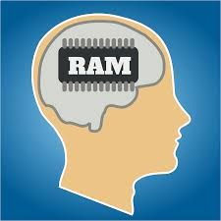
The Working Memory Toolkit
Working Memory is a small temporary storage mechanism
Retains some task-relevant info, then discards it
Toolkit design to mimic human and animal Working Memory
Stores small amount of info from percepts that “looks promising”
Remembers types of info that leads to actions yielding reward
Discards all useless info after a short time
Example Working Memory tasks:
Delayed Saccade
Wisconsin Card Sort

Slide 5
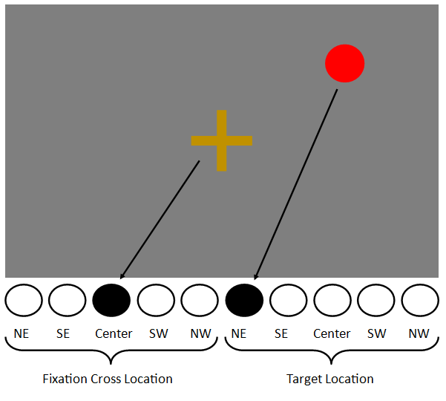
Representing ConCepts Digitally
Humans think of concepts symbolically
Computers have no concept of… concepts
Must represent symbolic concepts in a distributed formalism
[ 0, 0, 1, 0, 0, 1, 0, 0, 0, 0 ]
Problem: representations have to be hand written by the researcher for every task
Tedious
Requires knowledge of Neural Nets
challenging

Slide 6
Holographic Reduced Representations
Proposed by Tony Plate in 1995
A vector of Gaussian numbers typically between -1.0 and 1.0
Holographic: Can store data from several HRRs in a single vector
Reduced: Can combine HRRs into a new HRR of the same length
Representation: Can be assigned as a distributed representation of a symbolic value
Goal: replace manual DE/SE conversion interface in toolkit with HRRs

Slide 7
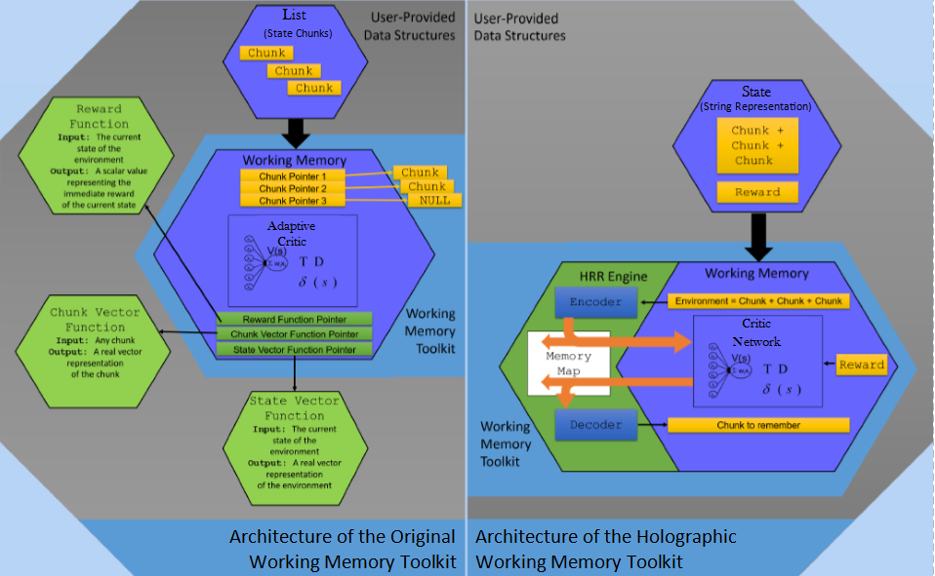
Building an HRR Engine and adding it to the toolkit

