Slide 1


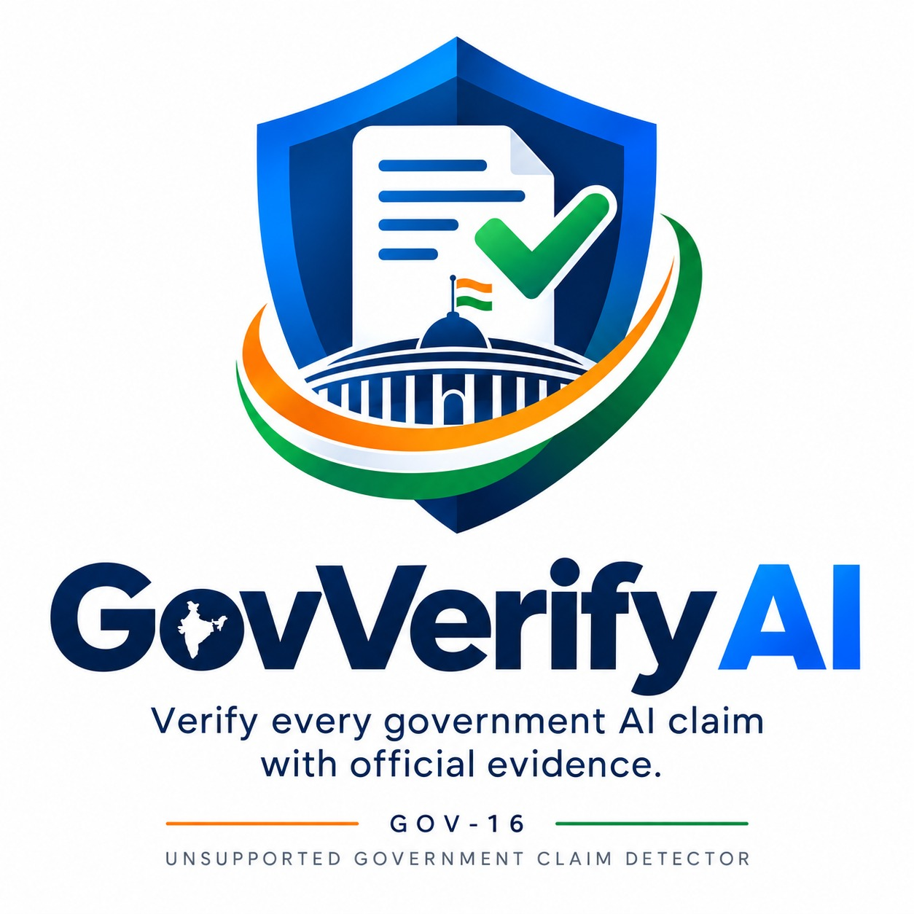
GovVerify AI
Unsupported Government Claim Detector
• PS ID : GOV-16
• PS Domain : Government & Public Services
• Problem Statement Title : Unsupported Government Claim Detector
• Team Name : VisionX
• Team Members: 1.Pavithra S(7376242AD244)
2.Manoranjith S(7376242AD214)
3.Sanjay S(7376242AD289)
4.Jayaseelan G(7376242AD188)

Slide 2



Why Government AI Answers Need Verification
Generative AI can produce convincing but unsupported government information.
AI Generated Answer
Citizens may trust AI-generated answers without checking official sources.
Government information is distributed across lengthy PDFs, guidelines and official documents.
Can we trust it?
Manually verifying every statement is time-consuming.
Existing AI systems primarily focus on answer generation rather than claim-level verification.
Official Government
Evidence
How can we ensure that AI-generated government information is actually supported by official evidence?
GovVerify AI | GOV-16 · Unsupported Government Claim Detector
1

Slide 3






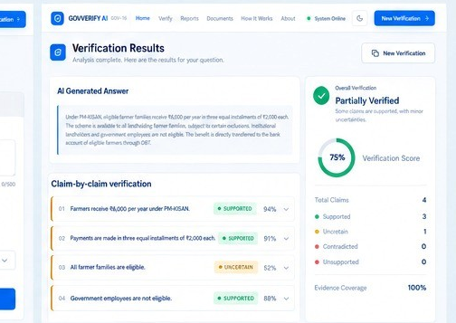
GovVerify AI — Verify Before You Trust
An evidence-grounded AI verification layer that checks every important government claim against official government documents.
User Query
AI Generated Answer
Claim Extraction
Official Gov. Documents
Semantic Evidence Retrieval
Classification
Supported
Uncertain
Unsupported
Verification Report
Evidence + Source + Page
Claim + Evidence Comparison
Every claim is traced back to evidence from official government documents.
Live Verification Interface
GovVerify AI | GOV-16 · Unsupported Government Claim Detector
2

Slide 4




What Makes GovVerify AI Different?
Conventional AI | GovVerify AI
✗ Answer generation | ✓ Answer + verification
✗ Whole-response focus | ✓ Claim-by-claim analysis
✗ May rely on model knowledge | ✓ Official government evidence
✗ Limited source traceability | ✓ Source + page citation
✗ Difficult to identify unsupported claims | ✓ Supported / Uncertain / Unsupported classification
Claim-Level
Verification
Evidence-Grounded
AI
Page-Level Source
Traceability
Explainable
Verification Results
GovVerify AI shifts government AI from ANSWER GENERATION to EVIDENCE-BACKED VERIFICATION.
GovVerify AI | GOV-16 · Unsupported Government Claim Detector
3

Slide 5














Feasibility — Built with Existing AI Technologies
Government PDFs
PyMuPDF
Text Chunking
BGE-M3 Embeddings
FAISS Vector Search
React Dashboard
Verification Result
DeBERTa NLI Verification
LLM + Claim Extraction
Relevant Evidence
Technology Stack
React + TypeScript
FastAPI + Python
LLM + BGE-M3 + DeBERTa
FAISS
PyMuPDF
PostgreSQL
Uses established and accessible open-source AI technologies.
Government documents are available in digital formats.
The system can start with a limited document collection and scale later.
GovVerify AI | GOV-16 · Unsupported Government Claim Detector
4

Slide 6

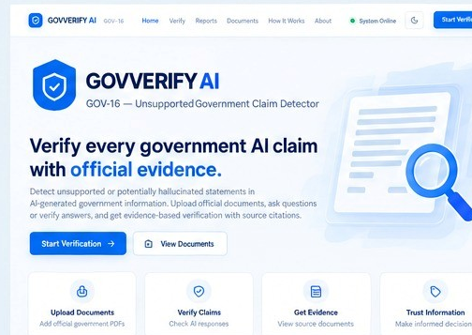



Impact — Building Trust in Government AI
Citizens
Government
AI Ecosystem
More trustworthy government information
More reliable AI-powered public services
Evidence-grounded AI
Faster verification
Reduced risk of misinformation
Hallucination detection
Direct access to original sources
Greater transparency
Reusable verification framework
TRUST
TRANSPARENCY
EFFICIENCY
ACCOUNTABILITY
GovVerify AI can act as a verification layer between generative AI and citizens.
GovVerify AI | GOV-16 · Unsupported Government Claim Detector
5

Slide 7




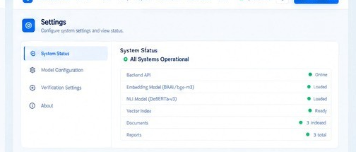
Implementation Roadmap & Future Vision
PHASE 1
PHASE 2
PHASE 3
PHASE 4
PHASE 5
PHASE 6
Official Document
Collection
Document Processing
& Indexing
RAG Evidence
Retrieval
Claim Extraction
& Verification
Dashboard
& Reports
Deployment
& Scaling
Future Scope
Live government website integration
Tamil and multilingual verification
Voice-based queries
Real-time document updates
Cross-document contradiction detection
Government chatbot integration
Advanced explainable AI
Making government AI information more trustworthy, transparent and verifiable.
Live System Status — All Systems Operational
GovVerify AI | GOV-16 · Unsupported Government Claim Detector
6

