Slide 1


MACHINE LEARNING PROJECT
HOUSE PRICE PREDICTION

Slide 2


INTRODUCTION
In this project, we have built a machine-learning model to predict house prices.
This project will be helpful in the real estate market among sellers and buyers.

Slide 3
PROBLEM STATEMENT
This is the data of a Real Estate company where they are trying to find Property Price evaluations as per the location and needs to develop a predictive machine learning model.

Slide 4
PROJECT SPECIFICATION
The goal of this project is to predict the house prices in Bangalore city based on some features such as location, size/area, number of bedrooms and No. of bathrooms.
All 9 features of the data are area_type, availability, location, size,total_sqft, bath, society, balcony, and price.
We are using machine learning algorithms to create a predictive model.

Slide 5
DATA CLEANING
The main aim of this process is to identify and remove the errors and duplicate data to create a proper dataset.
No_of rows: 13320 and No_of cols: 9
num_cols = df.select_dtypes(include=['int','float']).columns = 2
obj_cols = df.select_dtypes(include='O').columns = 7
df.isnull().sum() (check for the null values)
area_type 0 availability 0
location 1 size 16
society 5502 total_sqft 0
bath 73 balcony 609
price 0

Slide 6
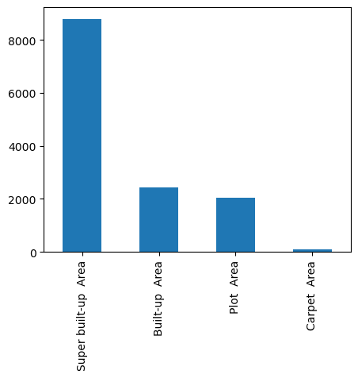
DROP THE UNWANTED FEATURES
AREA_TYPE, AVAILABILITY, SOCIETY, BALCONY
df2 = df. drop(['area_type’, 'availability’, 'society’, 'balcony’], axis =1)
By general observation we can conclude that area_type does not affect the price since the total_sqft is given.
Also society does not matter since location is given.
The rows having null values are dropped from our dataset.

Slide 7
CLEANING THE SIZE FEATURE
(['2 BHK', '4 Bedroom', '3 BHK', '4 BHK', '6 Bedroom', '3 Bedroom', '1 BHK', '1 RK', '1 Bedroom', '8 Bedroom', '2 Bedroom', '7 Bedroom', '5 BHK', '7 BHK', '6 BHK', '5 Bedroom', '11 BHK', '9 BHK', '9 Bedroom', '27 BHK', '10 Bedroom', '11 Bedroom', '10 BHK', '19 BHK', '16 BHK', '43 Bedroom', '14 BHK', '8 BHK', '12 Bedroom', '13 BHK', '18 Bedroom'], dtype=object)
Using the split to separate the characters from numbers in the string. And apply this in the lambda to this column.
df2['bhk']=df2['size'].apply(lambda x: int(x.split(' ')[0]))
The ‘bhk’ feature has been created from ‘size’ feature and converted to int dtype.

Slide 8
Total_sqft Feature:
df2['total_sqft'].unique()
['1056', '2600', '1440', ..., '1133 - 1384', '774', '4689'], dtype=object
Converting the values to float, and taking the avg values for the range values.
def is_float(x):
try:
float(x)
except:
return False
return True
import re
def sqft_to_num(x):
sqft=x.split('-')
if len(sqft)==2:
return (float(sqft[0])+float(sqft[1]))/2
try:
return float(x)
except:
return None

Slide 9
Converting the ‘total_sqft’ feature by applying the function.
df3['total_sqft']=df3['total_sqft'].apply(sqft_to_num)
CONVERTING THE ‘PRICE’ FEATURE
array([' $39.07 ', ' $120.00 ', ' $62.00 ', ..., '40.14', '231', '488'], dtype=object)
df3['price']=df3['price'].apply(clean_price)
import re
def clean_price(price):
price= re.sub(r'[^\d.]','',price)
if '-' in price:
range_value = price.split('-')
price = (float(range_value[0])+ float(range_value[1]))/2
return float(price)

Slide 10
ADDING NEW FEATURE
df3['price_per_sqft']=df3['price']*100000/df3['total_sqft’]
PRICE_PER_SQFT=PRICE*100000/TOTAL_SQFT

Slide 11
CLEANING THE LOCATION FEATURE
df3['location']=df3['location'].apply(lambda x: x.strip()) [Removing the unwanted white spaces]
df3['location']=df3['location'].apply(lambda x: x.strip())
location, Length: 1287, dtype: int64
In this location column it has high unique values which makes it difficult to know every value and use it for prediction. Thus we check with the location has maximum repetition in our data. Any location with repetition less than 10 can be replaced as 'others’
df3['location']=df3['location'].apply(lambda x: 'others' if x in location_lessthan10 else x)
len(df3.location.unique()) = 241

Slide 12
REMOVING THE OUTLIERS
considering the 1bhk minimum sqft required is 300sqft.by this will remove the data points considering less than 300sqft/bhk
df3[df3.total_sqft/df3.bhk<300].head()
df3.shape [(13200,7)]
AFTER REMOVING THE OUTLIER IN THE DATA
df3=df3[~(df3.total_sqft/df3.bhk<300)]
df3.shape [(12456,7)]

Slide 13
REMOVING OUTLIERS
Considering the ‘price_per_sqft’ feature
MIN:267.829813
25%: 4267.701345
50%: 5438.331478
75%: 7317.073171
MAX:12000000.0
The price_per_sqft feature shows the values that the min and max values which is not considerable. To remove the outliers we consider the one standard deviation values and removing the others.

Slide 14
df4= remove_pps_outliers(df3)
df4.shape [(10475,7)]
def remove_pps_outliers(df):
df_out = pd.DataFrame()
for key, subdf in df.groupby('location'):
m = np.mean(subdf.price_per_sqft)
st = np.std(subdf.price_per_sqft)
reduced_df = subdf[(subdf.price_per_sqft>(m-st))&(subdf.price_per_sqft<=(m+st))]
df_out=pd.concat([df_out,reduced_df],ignore_index=True)
return df_out

Slide 15
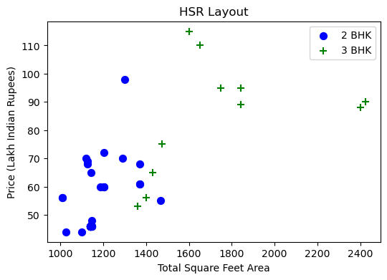
def remove_bhk_outliers(df):
exclude_indices = np.array([])
for location, location_df in df.groupby('location'):
bhk_stats = {}
for bhk, bhk_df in location_df.groupby('bhk'):
bhk_stats[bhk] = {
'mean': np.mean(bhk_df.price_per_sqft),
'std': np.std(bhk_df.price_per_sqft),
'count': bhk_df.shape[0]
}
for bhk, bhk_df in location_df.groupby('bhk'):
stats = bhk_stats.get(bhk-1)
if stats and stats['count']>5:
exclude_indices = np.append(exclude_indices, bhk_df[bhk_df.price_per_sqft<(stats['mean'])].index.values)
return df.drop(exclude_indices,axis='index')
OBSERVATION: From this graph, the 2BHK and 3BHK prices in the particular location are almost even and 3bhk total_sqft is greater than 2bhk but the price for the 2bhk is higher than the 3bhk ‘s total sqft area. Considering this as the outlier and where ever this kind of data points are they will be removed from the data.

Slide 16
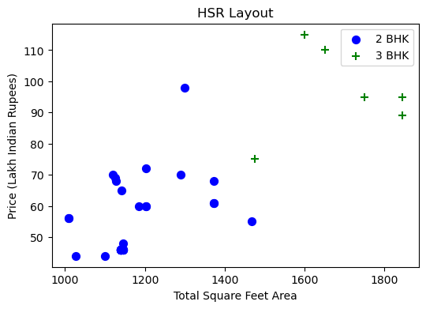
AFTER REMOVING THE BHK OUTLIER

Slide 17
REMOVING OUTLIERS IN BATH FEATURE
Considering the bath feature. The acceptable limit for the bath is BHK which has a max of 2 extra baths. i.e BHK + 2
df5[df5.bath>df5.bhk+2] (remove these data from the original data)

Slide 18
ENCODING THE LOCATION FEATURE
ohe = pd.get_dummies(df7.location)
1st Block Jayanagar | 1st Phase JP Nagar | 2nd Phase Judicial Layout | 2nd Stage Nagarbhavi | 5th Block Hbr Layout | 5th Phase JP Nagar | 6th Phase JP Nagar | 7th Phase JP Nagar | 8th Phase JP Nagar | 9th Phase JP Nagar | ... | Vishveshwarya Layout | Vishwapriya Layout | Vittasandra | Whitefield | Yelachenahalli | Yelahanka | Yelahanka New Town | Yelenahalli | Yeshwanthpur | others
0 | 1 | 0 | 0 | 0 | 0 | 0 | 0 | 0 | 0 | 0 | ... | 0 | 0 | 0 | 0 | 0 | 0 | 0 | 0 | 0 | 0
1 | 1 | 0 | 0 | 0 | 0 | 0 | 0 | 0 | 0 | 0 | ... | 0 | 0 | 0 | 0 | 0 | 0 | 0 | 0 | 0 | 0
2 | 1 | 0 | 0 | 0 | 0 | 0 | 0 | 0 | 0 | 0 | ... | 0 | 0 | 0 | 0 | 0 | 0 | 0 | 0 | 0 | 0
3 | 1 | 0 | 0 | 0 | 0 | 0 | 0 | 0 | 0 | 0 | ... | 0 | 0 | 0 | 0 | 0 | 0 | 0 | 0 | 0 | 0
4 | 1 | 0 | 0 | 0 | 0 | 0 | 0 | 0 | 0 | 0 | ... | 0 | 0 | 0 | 0 | 0 | 0 | 0 | 0 | 0 | 0

Slide 19
df8 = pd.concat([df7,ohe.drop('others',axis=1)],axis='columns’)
df8 = pd.concat([df7,ohe.drop('others',axis=1)],axis='columns’)
Drop the location feature from the table
total_sqft | bath | price | bhk | 1st Block Jayanagar | 1st Phase JP Nagar | 2nd Phase Judicial Layout | 2nd Stage Nagarbhavi | 5th Block Hbr Layout | 5th Phase JP Nagar | ... | Vijayanagar | Vishveshwarya Layout | Vishwapriya Layout | Vittasandra | Whitefield | Yelachenahalli | Yelahanka | Yelahanka New Town | Yelenahalli | Yeshwanthpur
0 | 2850.0 | 4.0 | 428.0 | 4 | 1 | 0 | 0 | 0 | 0 | 0 | ... | 0 | 0 | 0 | 0 | 0 | 0 | 0 | 0 | 0 | 0
1 | 1630.0 | 3.0 | 194.0 | 3 | 1 | 0 | 0 | 0 | 0 | 0 | ... | 0 | 0 | 0 | 0 | 0 | 0 | 0 | 0 | 0 | 0
2 | 1875.0 | 2.0 | 235.0 | 3 | 1 | 0 | 0 | 0 | 0 | 0 | ... | 0 | 0 | 0 | 0 | 0 | 0 | 0 | 0 | 0 | 0
3 | 1200.0 | 2.0 | 130.0 | 3 | 1 | 0 | 0 | 0 | 0 | 0 | ... | 0 | 0 | 0 | 0 | 0 | 0 | 0 | 0 | 0 | 0
4 | 1235.0 | 2.0 | 148.0 | 2 | 1 | 0 | 0 | 0 | 0 | 0 | ... | 0 | 0 | 0 | 0 | 0 | 0 | 0 | 0 | 0 | 0

Slide 20
MODEL BUILDING
x=df9.drop(['price'],axis=1)
x.shape (7305, 243)
y = df9.price
y.shape (7305,)
SPLITING THE DATA
from sklearn.model_selection import train_test_split
X_train,x_test,y_train,y_test= train_test_split(x,y,test_size=0.2,random_state=10)

Slide 21
LINEAR REGRESSION
from sklearn.linear_model import LinearRegression
from sklearn.metrics import r2_score, mean_squared_error
INSTANTIATING THE MODEL
lr = LinearRegression()
Fit the model
lr.fit(X_train,y_train)
lr_score = lr.score(x_test,y_test)
lr_rmse = rmse(y_test,lr.predict(x_test))
lr_score= 0.76214, lr_rmse= 55.25277

Slide 22
USING K FOLD CROSS VALIDATION
This is used to check the accuracy of linear regression for different splits of the data.The model will deal with the unknown data to predict the target values.
from sklearn.model_selection import ShuffleSplit
from sklearn.model_selection import cross_val_score
cv = ShuffleSplit(n_splits=5, test_size=0.2, random_state=0)
cross_val_score(LinearRegression(), x, y, cv=cv)
[0.74732887, 0.79720982, 0.75334384, 0.73739621, 0.76459975]

Slide 23
DECISION TREE REGRESSOR
from sklearn.tree import DecisionTreeRegressor
dt = DecisionTreeRegressor()
dt.fit(X_train,y_train)
dt_score = dt.score(x_test,y_test)
dt_rmse = rmse(y_test,dt.predict(x_test))
dt_score = 0.5951 dt_rmse = 72.0907

Slide 24
RANDOM FOREST REGRESSOR
from sklearn.ensemble import RandomForestRegressor
rf = RandomForestRegressor()
rf.fit(X_train,y_train)
rf_score = rf.score(x_test,y_test)
rf_rmse = rmse(y_test,rf.predict(x_test))
print(rf_score, rf_rmse)
Rf_score = 0.7190 rf_rmse= 60.05

Slide 25
USING GRID SEARCH CV
from sklearn.model_selection import GridSearchCV
from sklearn.linear_model import Lasso
from sklearn.tree import DecisionTreeRegressor
from sklearn.ensemble import RandomForestRegressor

Slide 26
def best_model_using_gridsearchcv(X,y):
algos = {
'linear_regression' : {
'model': LinearRegression(),
'params': {
'normalize': [True, False]
}
},
'random_forest': {
'model': RandomForestRegressor(),
'params': {
'n_estimators': [50,100,150],
'max_depth': [None,10,20,30]
}
},
'decision_tree': {
'model': DecisionTreeRegressor(),
'params': {
'criterion' : ['mse','friedman_mse'],
'splitter': ['best','random']
}
}
}
cv = ShuffleSplit(n_splits=5, test_size=0.2, random_state=0)
for algo_name, config in algos.items():
gs = GridSearchCV(config['model'], config['params'], cv=cv, return_train_score=False)
gs.fit(x,y)
scores.append({
'model': algo_name,
'best_score': gs.best_score_,
'best_params': gs.best_params_
})
return pd.DataFrame(scores,columns=['model','best_score','best_params'])

Slide 27
MODEL ACCURACY AND PARAMETERS
best_model_using_gridsearchcv(x,y)
model | best_score | best_params
0 | linear_regression | 0.759976 | {'normalize': False}
1 | random_forest | 0.691073 | {'max_depth': 20, 'n_estimators': 150}
2 | decision_tree | 0.535942 | {'criterion': 'friedman_mse', 'splitter': 'ran...

Slide 28
RESULT/OUTPUT
FUNCTION TO PREDICT THE PRICE
def predict_price(location,sqft,bath,bhk):
loc_index = np.where(x.columns==location)[0][0]
X = np.zeros(len(x.columns))
X[0] = sqft
X[1] = bath
X[2] = bhk
if loc_index >= 0:
X[loc_index] = 1
return lr.predict([X])[0]
predict_price('1st Phase JP Nagar',1000, 2, 2) = 72.305
predict_price('Uttarahalli',1400, 2, 3) = 65.83
predict_price('Gottigere',1100, 2, 2) = 38.77

Slide 29
THANK YOU

