Slide 1
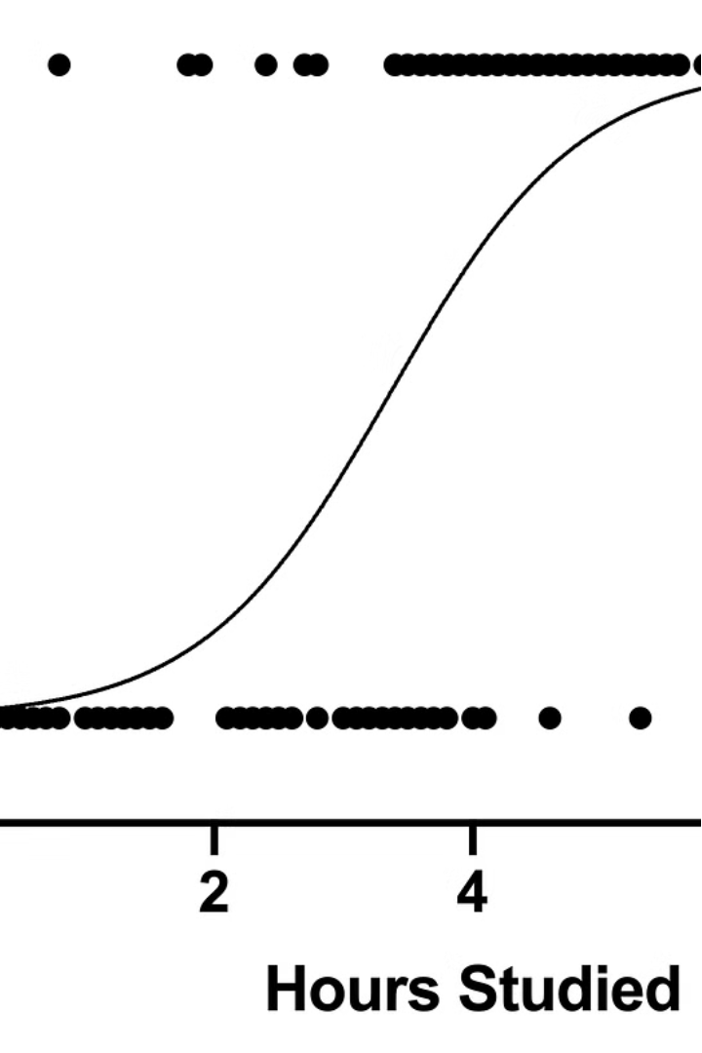



Introduction to Logistic Regression
Logistic regression is a powerful statistical technique used to model the relationship between a binary dependent variable and one or more independent variables. It is widely applied in various fields, including machine learning, medical research, and social sciences.
by Dr. Mahammad Shabana

Slide 2
Dependent and Independent Variables
Dependent Variable
Independent Variables
The dependent variable in logistic regression is a binary or categorical outcome, such as whether a patient has a certain disease (yes/no) or whether a customer will make a purchase (buy/not buy).
The independent variables are the factors that may influence the dependent variable, such as age, income, or medical history. These variables are used to predict the outcome of the dependent variable.

Slide 3
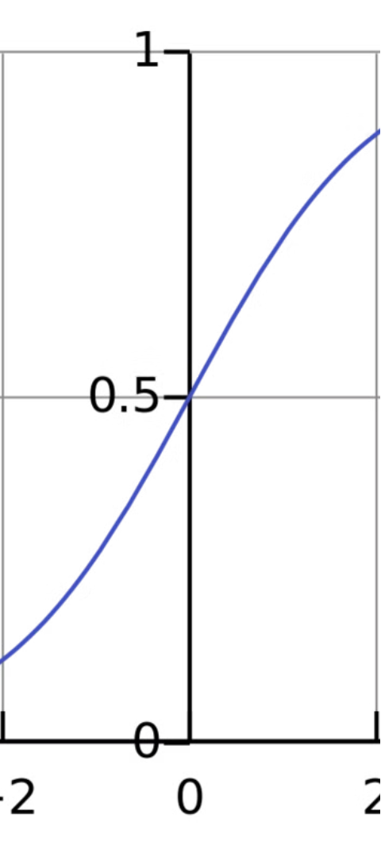
The Logistic Function
1
S-Shaped Curve
2
Range of Outputs
The logistic function maps the input values to a probability between 0 and 1, creating an S-shaped curve that represents the probability of the outcome occurring.
The logistic function ensures that the predicted probabilities are bounded between 0 and 1, making it suitable for modeling binary outcomes.
3
Nonlinearity
Logistic regression can capture nonlinear relationships between the independent variables and the dependent variable, making it more flexible than linear regression.

Slide 4
Odds Ratio and Probability
Odds Ratio
Probability
The odds ratio is a measure of the strength of the association between an independent variable and the dependent variable. It represents the change in the odds of the outcome occurring for a one-unit change in the independent variable.
The logistic regression model provides the probability of the outcome occurring, which can be used to make predictions and support decision-making.

Slide 5
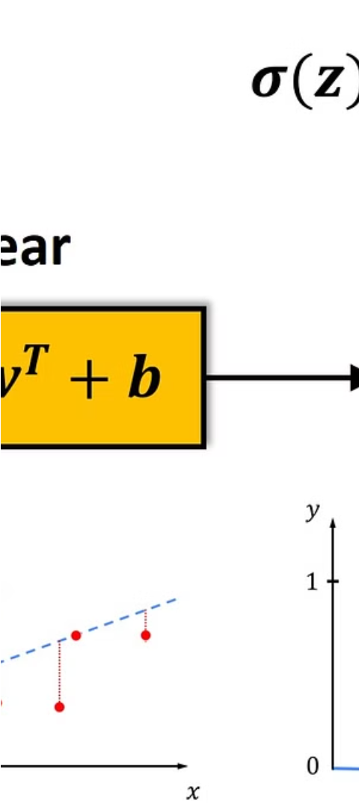
Model Training and Evaluation
1
Data Preparation
Ensure the dataset is clean, complete, and representative of the problem at hand.
2
Model Fitting
Use maximum likelihood estimation to determine the model parameters that best fit the data.
3
Model Evaluation
Assess the model's performance using metrics such as accuracy, precision, recall, and the area under the ROC curve.

Slide 6
Interpreting Logistic Regression Results
Coefficient Interpretation
Significance Testing
The sign and magnitude of the regression coefficients indicate the direction and strength of the relationship between the independent variables and the dependent variable.
Statistical tests, such as the Wald test or the likelihood ratio test, can be used to assess the significance of the model's predictors.
Model Fit Evaluation
Predicted Probabilities
Measures like the Hosmer-Lemeshow test and the R-squared equivalent can help determine how well the model fits the data.
The model's predicted probabilities can be used to make decisions, such as classifying observations or assigning risk scores.

Slide 7
Assumptions and Limitations
1
Linearity
2
Independence
The relationship between the independent variables and the log-odds of the dependent variable must be linear.
The observations must be independent of one another, with no autocorrelation or multicollinearity.
3
Large Sample Size
4
Assumption Violations
Logistic regression requires a large enough sample size to ensure reliable parameter estimates and statistical inferences.
Violations of these assumptions can lead to biased or unreliable results, requiring careful model diagnostics and possibly alternative approaches.

Slide 8




Applications and Use Cases
Medical Diagnosis
Marketing
Finance
Social Sciences
Predicting the likelihood of a patient having a certain disease or condition based on their symptoms and medical history.
Identifying potential customers who are likely to respond to a marketing campaign or make a purchase.
Assessing the risk of loan defaults or credit card fraud based on financial data and customer profiles.
Analyzing the factors that influence political outcomes, social behaviors, or educational attainment.

