Slide 1


Introduction to Naive Bayes Classifier
The Naive Bayes classifier is a popular supervised learning algorithm used for classification tasks. It's based on the Bayes' theorem, which provides a way to calculate the probability of a class given the input data.
by Dr. Mahammad Shabana

Slide 2
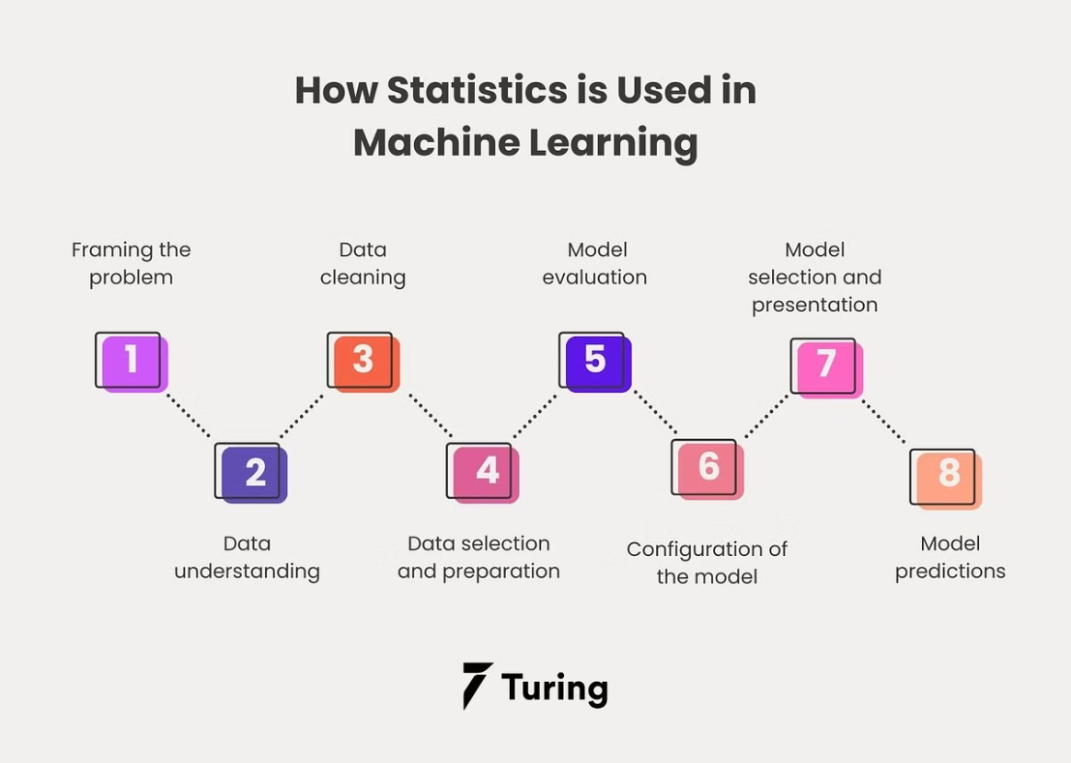

Slide 3
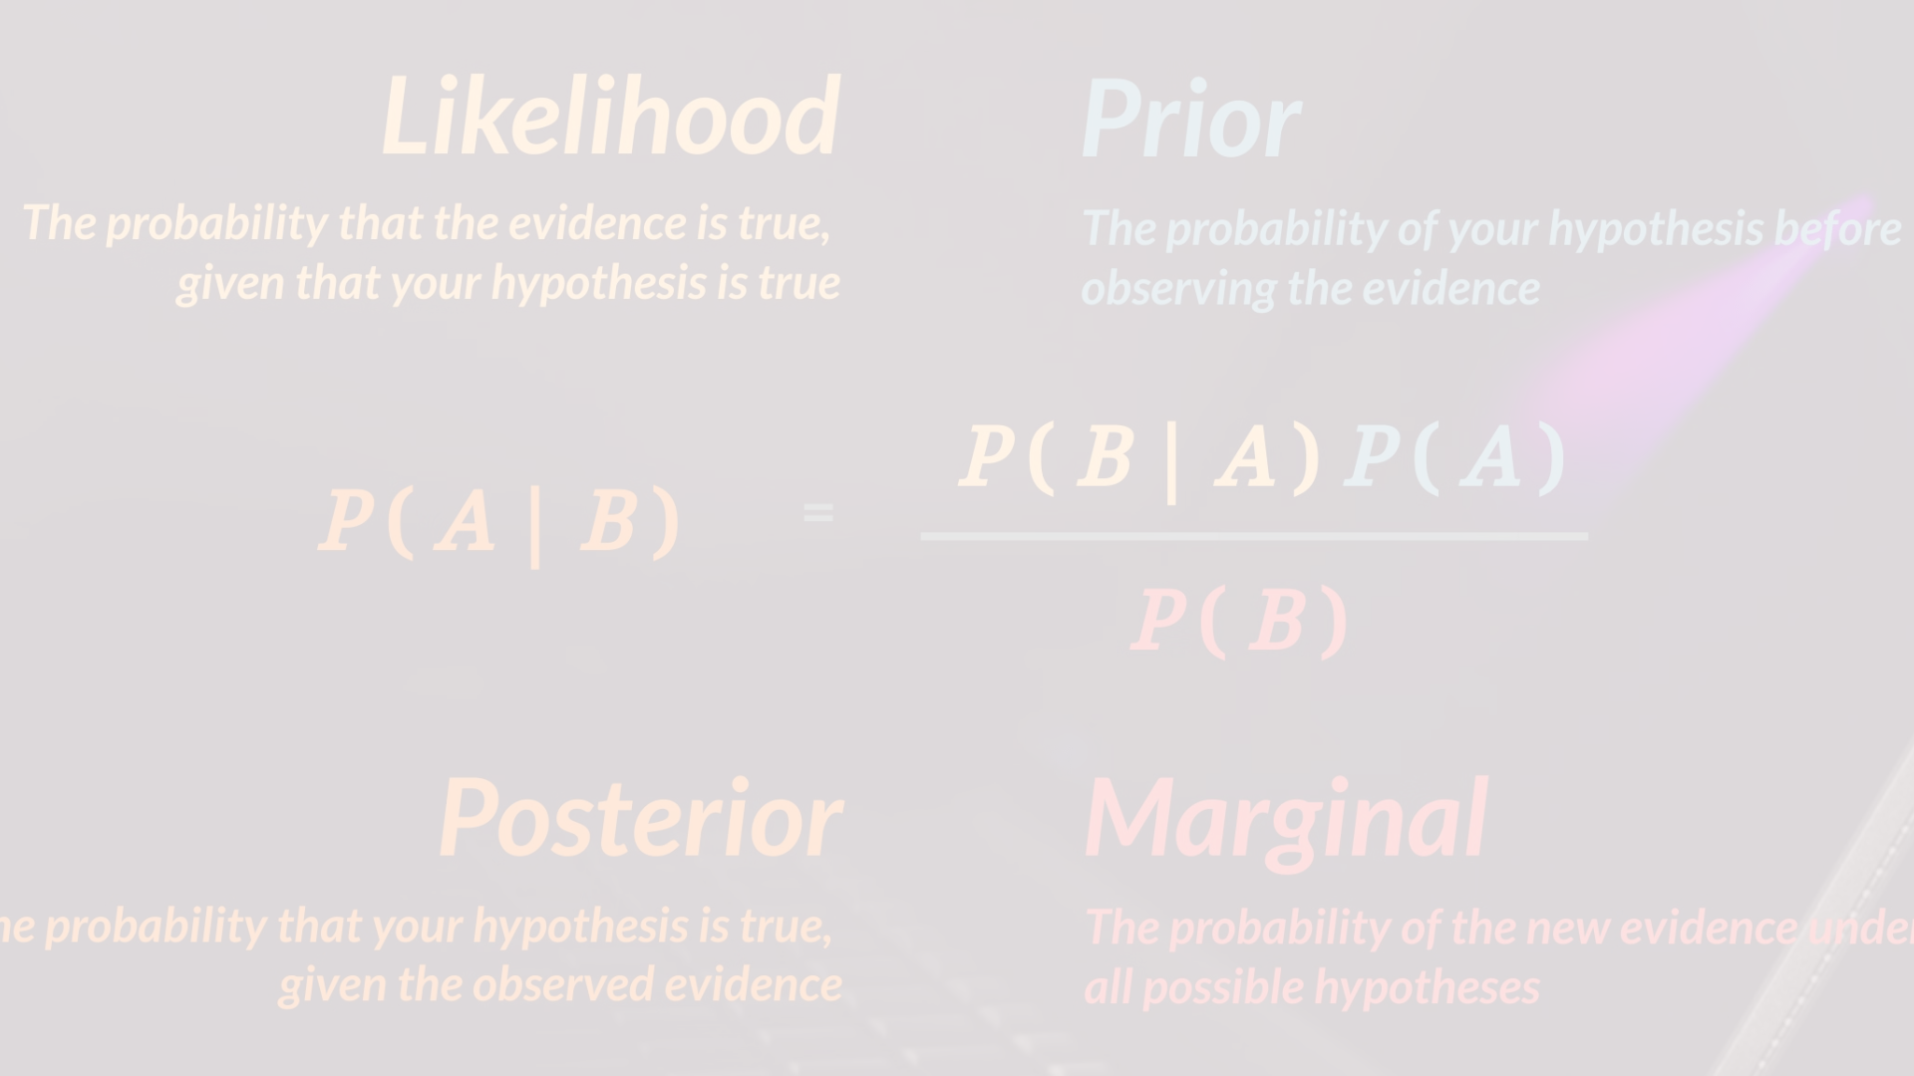
Probability and Bayes' Theorem
1
Conditional Probability
2
Bayes' Theorem
3
Independence Assumption
This theorem allows us to calculate the probability of a class given the input features.
The Naive Bayes algorithm relies on understanding the conditional probability of features given a class.
The Naive Bayes classifier assumes that the features are independent of each other.

Slide 4
Assumptions of Naive Bayes
Feature Independence
No Hidden Variables
Linearity
It assumes that there are no hidden variables or confounding factors that influence the prediction.
The algorithm makes linear decisions, making it suitable for problems with linearly separable classes.
Naive Bayes assumes that the features are independent of each other given the class.

Slide 5
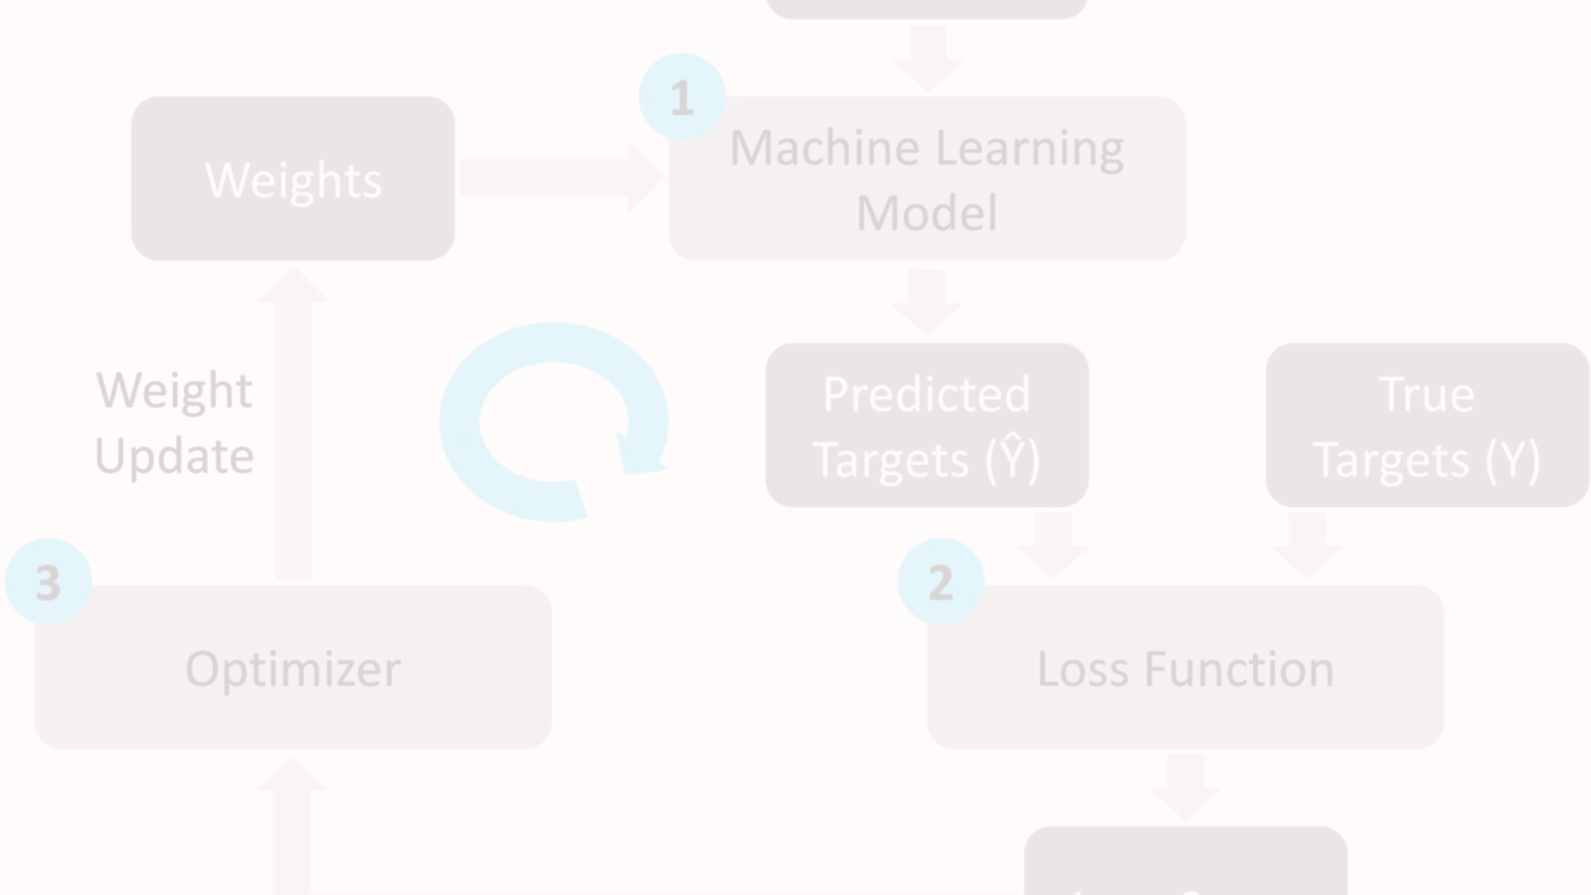
Training the Naive Bayes Classifier
Data Preparation
Collect and preprocess the training data, handling missing values and encoding categorical features.
Model Building
Combine the estimated probabilities to create the Naive Bayes classification model.
1
2
3
Parameter Estimation
Estimate the prior probabilities of classes and the conditional probabilities of features given classes.

Slide 6
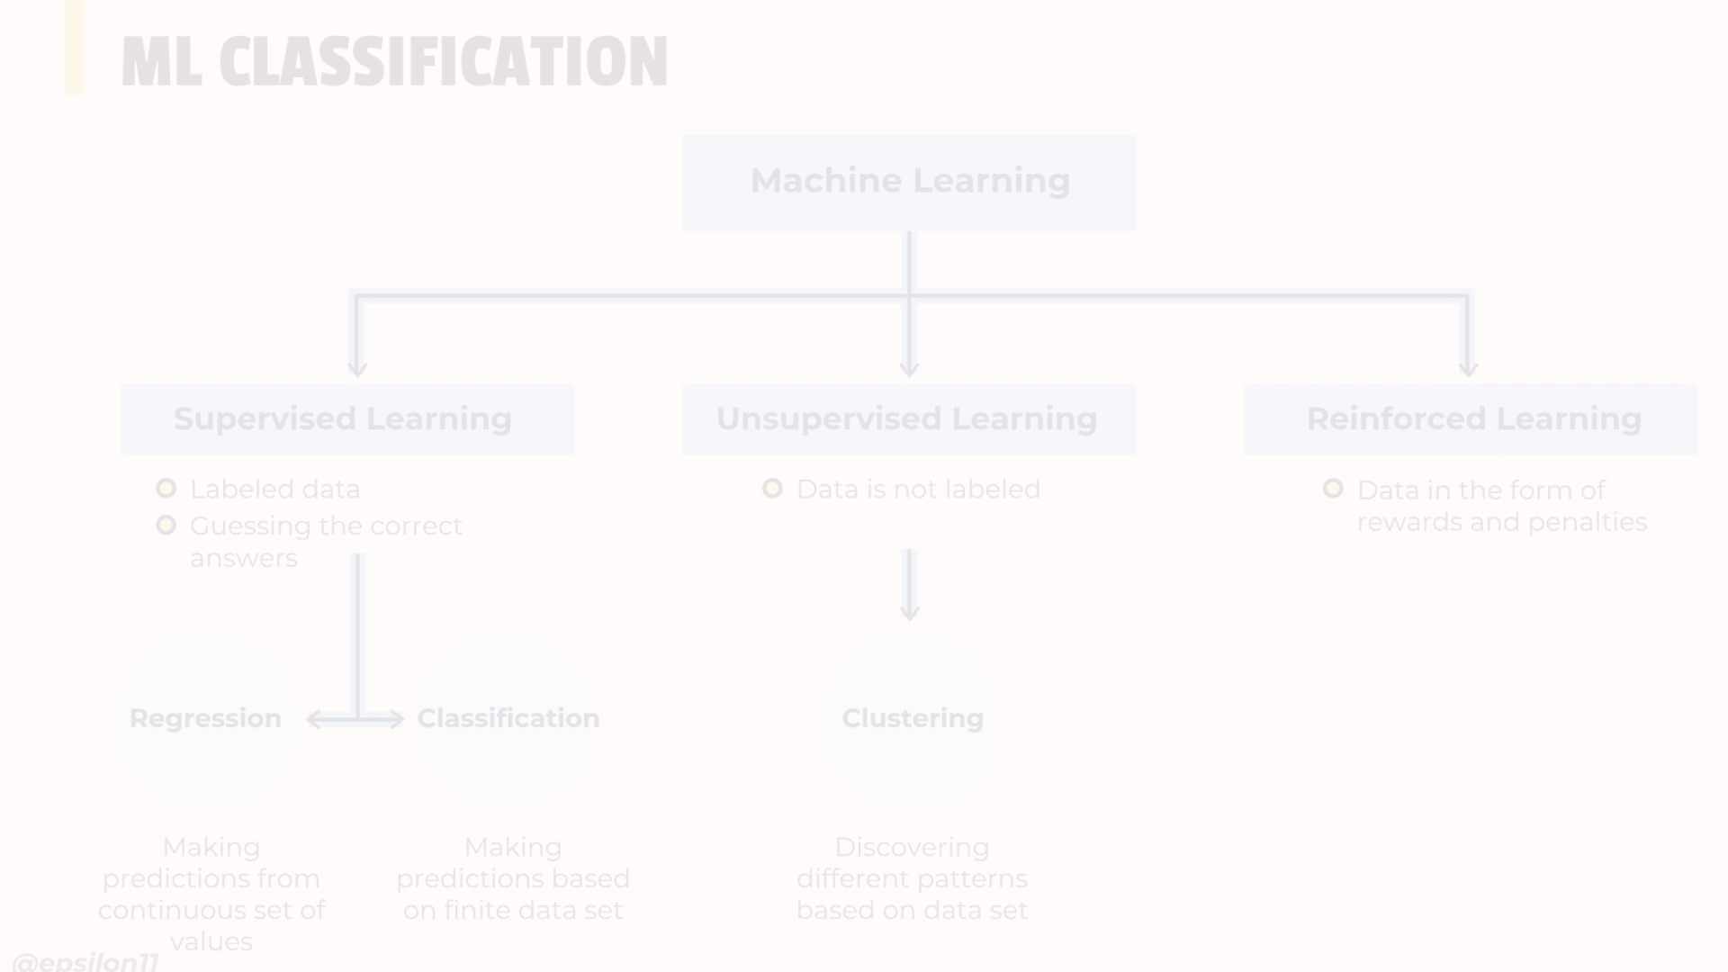



Applying the Classifier to New Data
Compute Probabilities
Classify
Evaluate
Assign the new data point to the class with the highest posterior probability.
Measure the performance of the classifier on the new data using metrics like accuracy, precision, and recall.
Use Bayes' theorem to compute the posterior probabilities of each class given the new input features.

Slide 7
Advantages of Naive Bayes
Simplicity
Scalability
Naive Bayes is a simple and easy-to-implement algorithm that requires minimal training data.
It can handle high-dimensional data and scales well with the number of features and samples.
Robustness
Interpretation
Naive Bayes is robust to irrelevant features and can perform well even with missing data.
The algorithm provides interpretable probabilities, making it easy to understand the predictions.

Slide 8




Limitations and Challenges
Feature Independence
Data Quality
Nonlinear Relationships
Class Imbalance
Naive Bayes is sensitive to the quality and representativeness of the training data.
Naive Bayes may perform poorly when dealing with highly imbalanced class distributions.
The assumption of feature independence may not hold in real-world datasets.
The algorithm struggles to capture complex, nonlinear relationships between features and classes.

Slide 9
Applications of Naive Bayes Classifier
Text Classification
Spam filtering, sentiment analysis, topic modeling
Medical Diagnosis
Predicting disease risk, identifying symptoms
Recommendation Systems
Product recommendations, content suggestions
Fraud Detection
Identifying fraudulent transactions, credit card fraud

