Slide 1


Introduction to k-Nearest Neighbors (k-NN)
The k-Nearest Neighbors (k-NN) algorithm is a simple, yet powerful, machine learning technique used for classification and regression tasks. It works by identifying the k nearest data points to a new, unknown data point and using the class or value of those neighbors to predict the class or value of the unknown point. This approach is intuitive and effective, making k-NN a popular choice for a wide range of applications. In this presentation, we'll explore the key concepts, advantages, and limitations of the k-NN algorithm, as well as its real-world applications.
by Dr. Mahammad Shabana

Slide 2
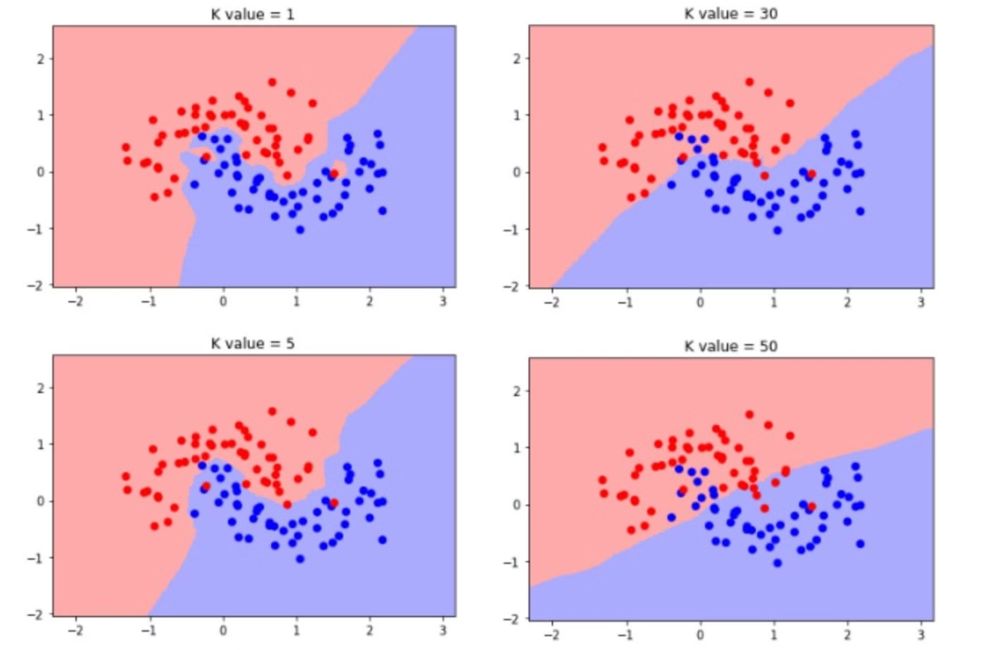

Slide 3
Understanding the k-NN Algorithm
1
Data Representation
2
Nearest Neighbor Identification
The k-NN algorithm works with data that can be represented as points in a multi-dimensional feature space. Each data point is described by a set of features, such as measurements or attributes, that define its location in the feature space.
To classify or predict a new data point, the algorithm identifies the k nearest data points in the feature space based on a chosen distance metric, such as Euclidean distance or cosine similarity.
3
Majority Voting (Classification)
4
Averaging (Regression)
For classification tasks, the algorithm assigns the new data point to the class that is most common among the k nearest neighbors. The class with the most votes becomes the predicted class for the new data point.
For regression tasks, the algorithm predicts the value of the new data point by averaging the values of the k nearest neighbors.

Slide 4
Choosing the Optimal Value of k
Balancing Bias and Variance
Cross-Validation
Visualization
To determine the optimal value of k, it's common to use cross-validation techniques, such as k-fold cross-validation. This involves splitting the data into multiple folds, training the algorithm on all but one fold, and evaluating its performance on the held-out fold. This process is repeated for different values of k, and the value that produces the best overall performance is selected as the optimal k.
The performance of the k-NN algorithm for different values of k can be visualized using techniques like learning curves or accuracy plots. These visualizations can provide valuable insights into the trade-offs and help in the selection of the optimal k.
The choice of k in the k-NN algorithm is a critical decision that involves balancing the trade-off between bias and variance. A small value of k can lead to high variance and sensitivity to noise, while a large value of k can result in high bias and less flexibility in capturing complex patterns in the data.

Slide 5
Distance Metrics in k-NN
1
Euclidean Distance
The Euclidean distance is the most common distance metric used in k-NN. It measures the straight-line distance between two points in the feature space and is suitable for data with continuous features.
2
Manhattan Distance
The Manhattan distance, also known as the city block distance, measures the distance between two points by summing the absolute differences between their corresponding coordinates. This metric is useful for data with categorical features or when features have different scales.
3
Cosine Similarity
Cosine similarity measures the cosine of the angle between two vectors in the feature space. This metric is particularly useful for high-dimensional data, such as text data, where the magnitude of the vectors is less important than the direction.

Slide 6
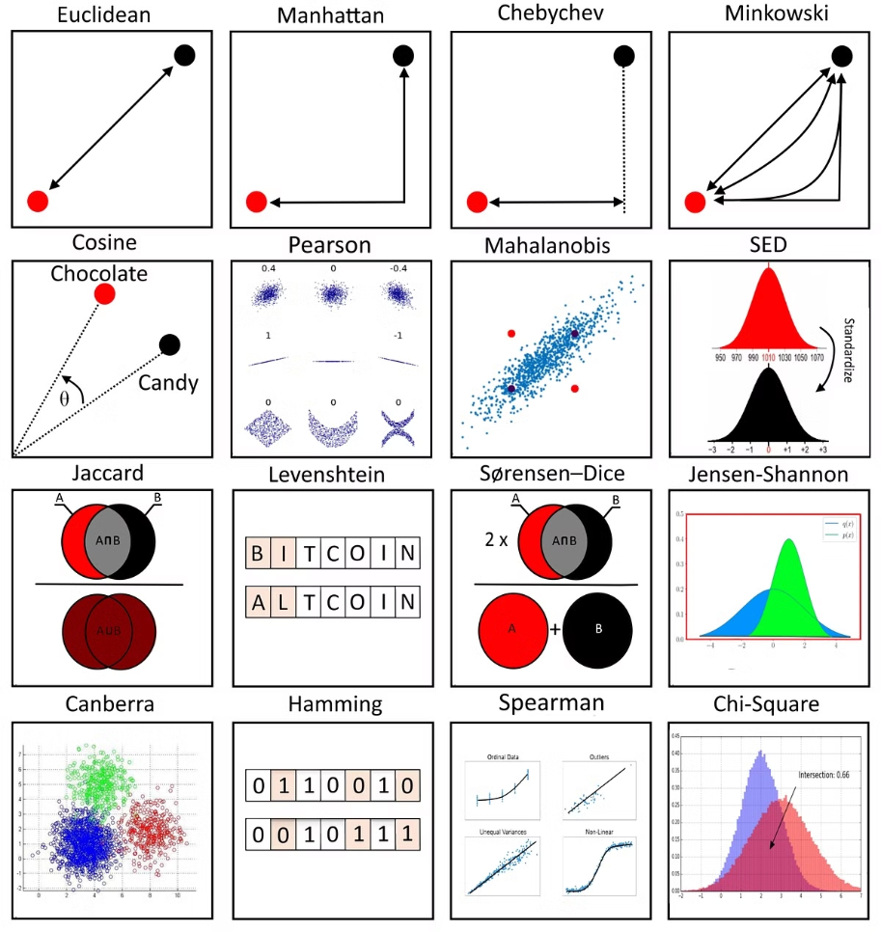

Slide 7
Advantages of k-NN
Simplicity
Versatility
The k-NN algorithm is straightforward to understand and implement, making it a popular choice for a wide range of applications.
k-NN can be used for both classification and regression tasks, and it can handle a variety of data types, including numerical, categorical, and even text data.
Lazy Learning
Interpretability
k-NN is a lazy learning algorithm, meaning it does not require a training phase. Instead, it simply stores the training data and performs the necessary computations at the time of prediction.
The predictions made by k-NN are easy to interpret, as they are based on the similarity between the new data point and its nearest neighbors.

Slide 8




Limitations of k-NN
Curse of Dimensionality
Sensitivity to Outliers
Computational Complexity
Limited Feature Selection
As the number of features increases, the k-NN algorithm becomes less effective due to the sparsity of the data in high-dimensional spaces.
The k-NN algorithm is sensitive to the presence of outliers in the training data, as they can significantly impact the identified nearest neighbors.
Calculating the distances between the new data point and all the training data points can be computationally expensive, especially for large datasets.
The k-NN algorithm does not perform any feature selection or dimensionality reduction, which can be a disadvantage when working with high-dimensional data.

Slide 9

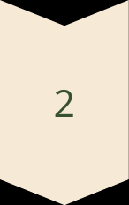
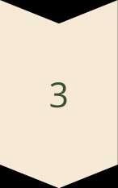
Applications of k-NN
Image Recognition
k-NN is widely used in image recognition tasks, such as handwritten digit recognition and object classification, by treating each image as a high-dimensional feature vector.
Recommendation Systems
k-NN can be used in recommendation systems to identify similar users or items based on their feature profiles, and provide personalized recommendations.
Bioinformatics
In bioinformatics, k-NN is used for tasks like gene expression analysis, protein structure prediction, and drug discovery by leveraging the similarities between biological data.

Slide 10
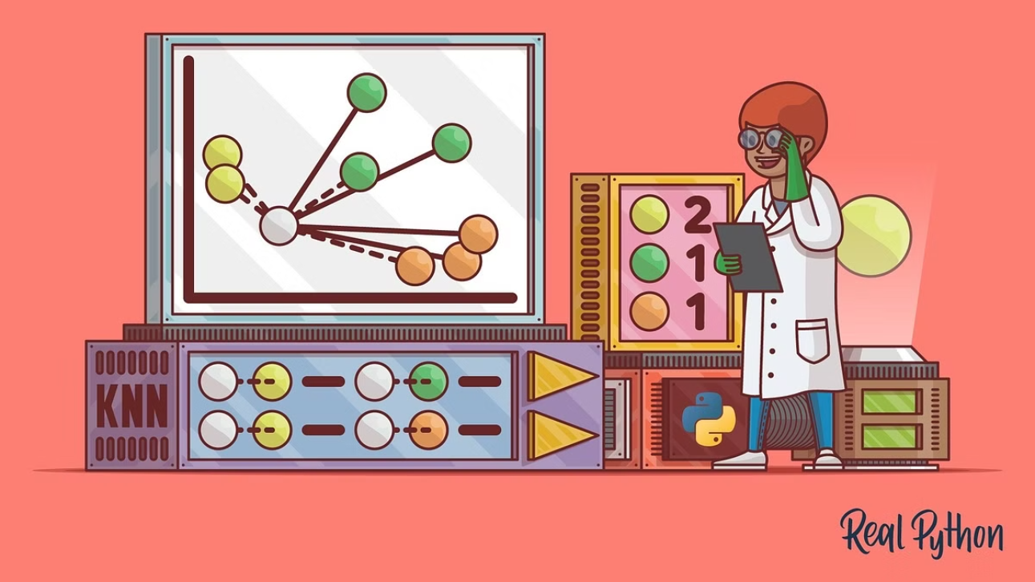

Slide 11
Conclusion and Summary
Simplicity
The k-NN algorithm is straightforward and easy to understand, making it a popular choice for many applications.
Versatility
k-NN can be used for both classification and regression tasks, and it can handle a variety of data types.
Interpretability
The predictions made by k-NN are easy to interpret, as they are based on the similarity between the new data point and its nearest neighbors.
Limitations
k-NN can be sensitive to outliers, computationally expensive for large datasets, and less effective in high-dimensional spaces.
Applications
k-NN is widely used in image recognition, recommendation systems, bioinformatics, and many other domains.

