Slide 1


Understanding Decision Trees
A decision tree is a powerful machine learning algorithm used for classification and regression tasks. It visually represents a series of decisions and their potential consequences, allowing for informed and data-driven decision-making.
by Dr. Mahammad Shabana

Slide 2
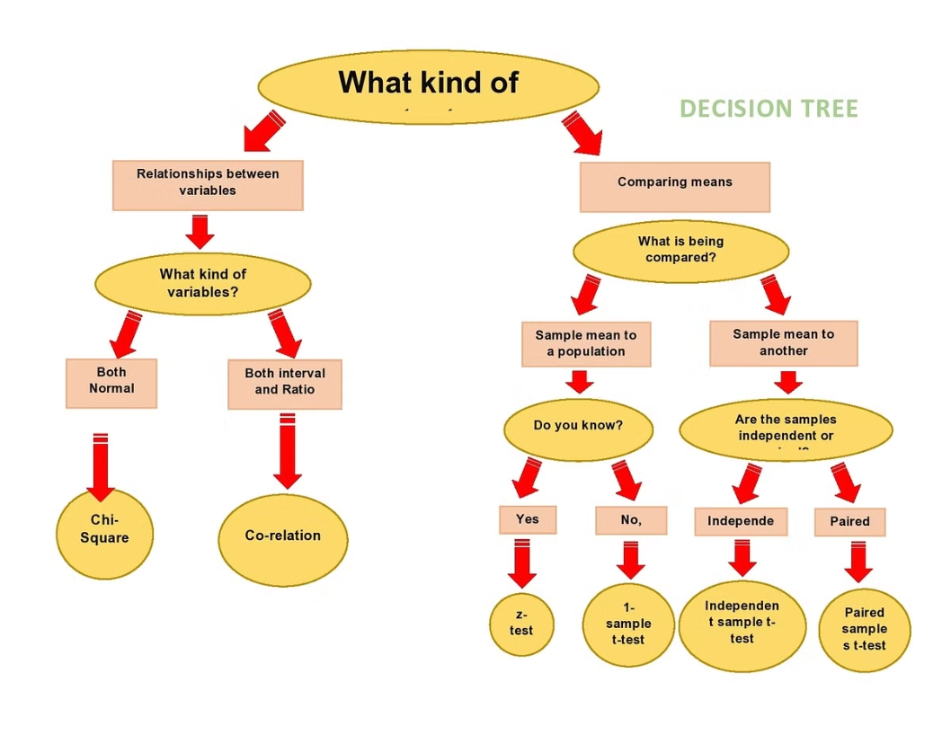

Slide 3
How Decision Trees Work
1
Data Collection
Gather relevant data points that will be used to train the decision tree model.
2
Feature Selection
Identify the most important variables or features that will be used to make decisions.
3
Tree Construction
The algorithm recursively splits the data based on the feature that provides the greatest information gain.

Slide 4
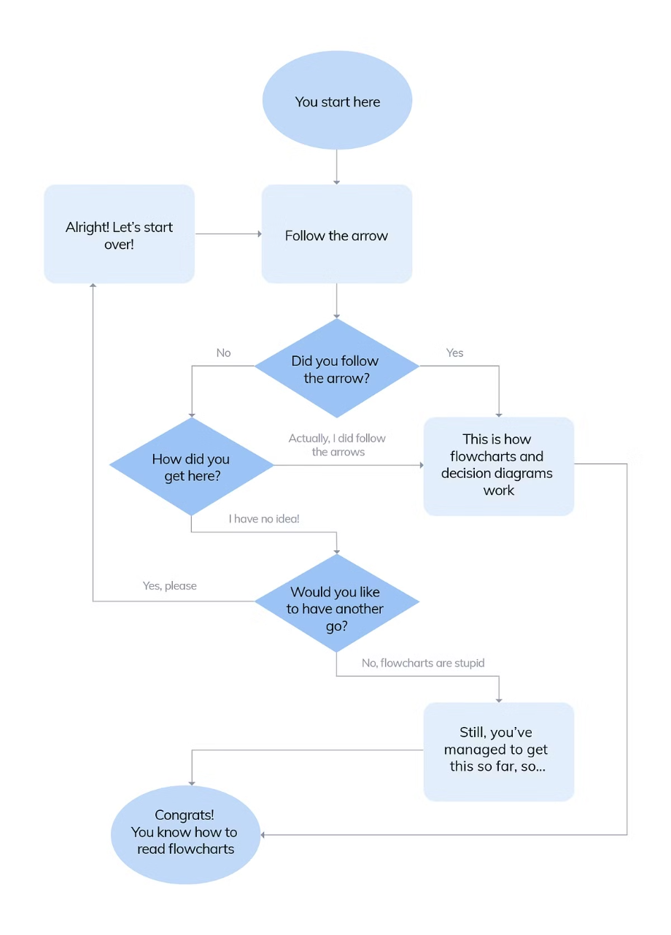

Slide 5
Key Components of a Decision Tree
Root Node
Internal Nodes
Leaf Nodes
The starting point of the decision tree, where the entire dataset is considered.
Represent the decisions or tests performed on the data based on the selected features.
The final outcome or prediction made by the decision tree based on the data.

Slide 6
Advantages of Decision Trees
1
Interpretability
2
Flexibility
Decision trees are easily interpretable, making them transparent and explainable.
They can handle both numerical and categorical data, and do not require feature scaling.
3
Non-parametric
4
Robustness
Decision trees can capture non-linear relationships without making assumptions about the data.
They are resistant to outliers and can handle missing data effectively.

Slide 7
Decision Tree Example: Loan Approval
Credit Score
Income Level
Evaluates the applicant's creditworthiness based on their credit history and financial information.
Considers the applicant's current income and ability to make loan repayments.
Employment Status
Loan Approval
Assesses the stability and longevity of the applicant's employment situation.
The final decision on whether to approve or deny the loan application.

Slide 8



Walkthrough of the Loan Approval Example
Credit Score
Income Level
Employment Status
The decision tree first evaluates the applicant's credit score.
If the credit score is sufficient, the decision tree then considers the applicant's income level.
Finally, the decision tree examines the applicant's employment status to make the final loan approval decision.

Slide 9



Interpreting Decision Tree Results
Approved
Denied
Uncertain
If the applicant meets the required criteria, the loan is approved.
If the applicant fails to meet one or more of the criteria, the loan is denied.
In some cases, the decision tree may not have enough information to make a definitive decision.

Slide 10
Limitations of Decision Trees
Overfitting
Bias in Data
Hierarchical Decisions
Decision trees can become too complex and overfit the training data, leading to poor generalization on new, unseen data.
The quality and representativeness of the input data can significantly impact the decision tree's performance and outputs.
Decision trees make decisions in a hierarchical manner, which may not always capture the complex, multidimensional nature of real-world problems.

