Slide 1


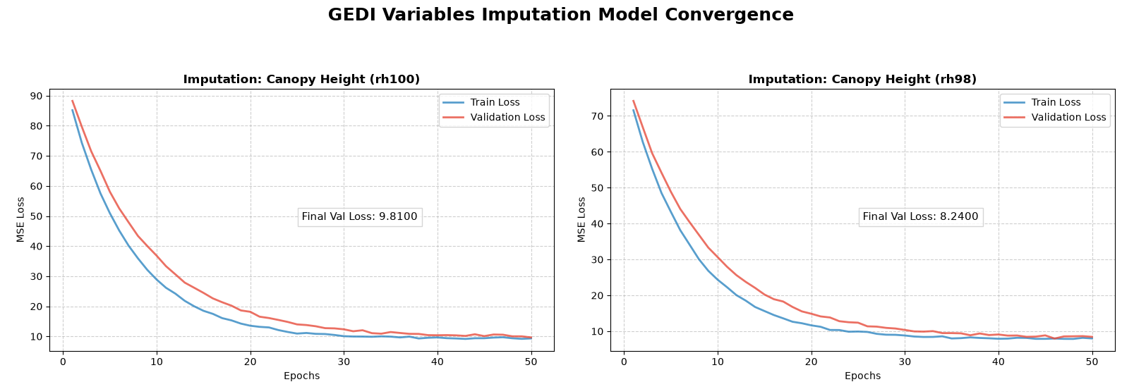
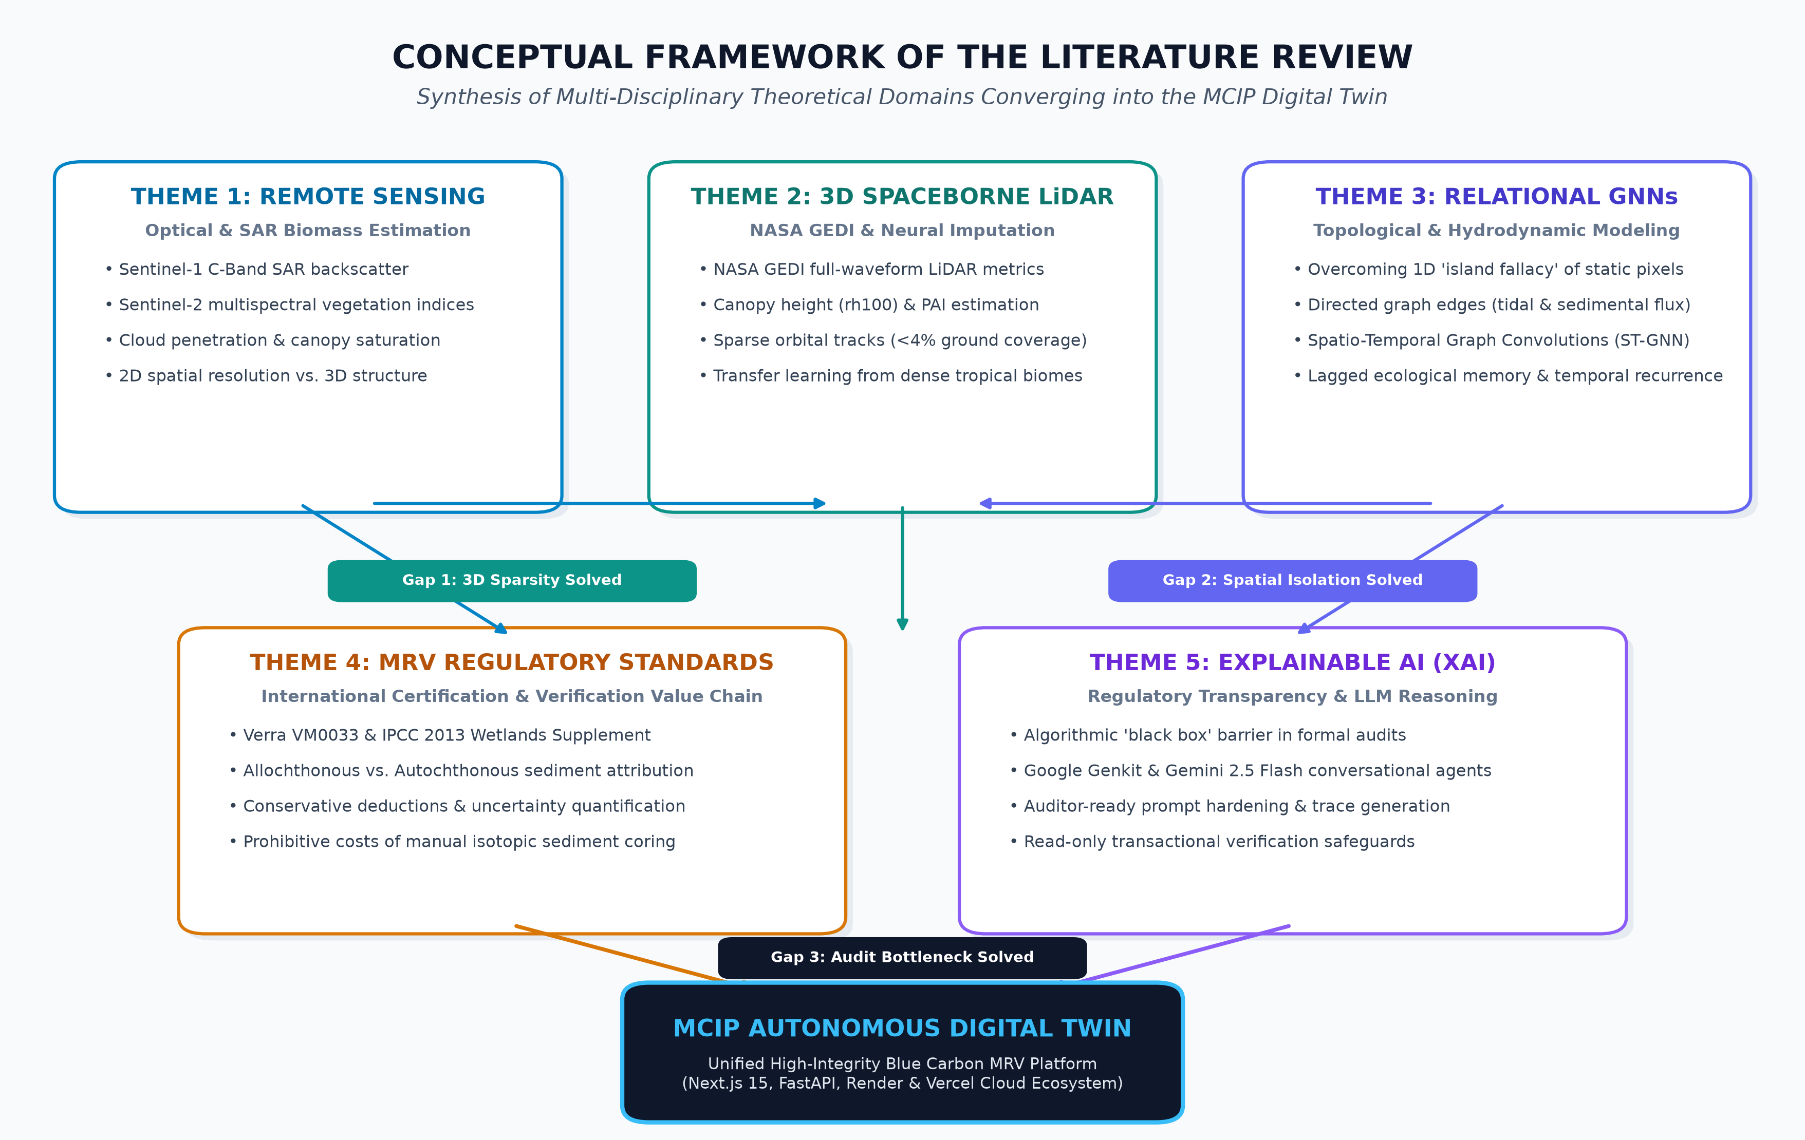
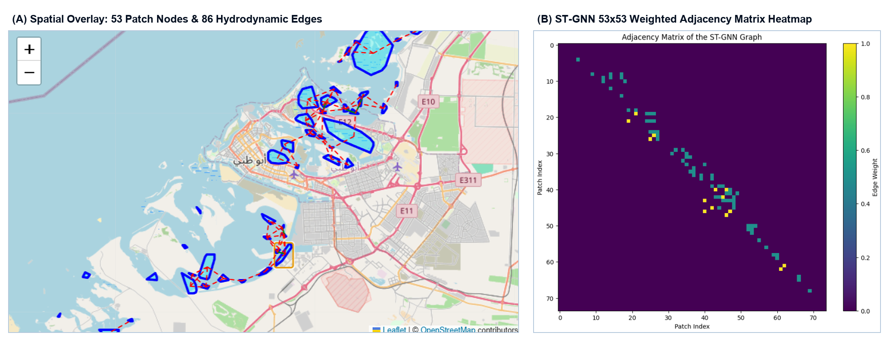
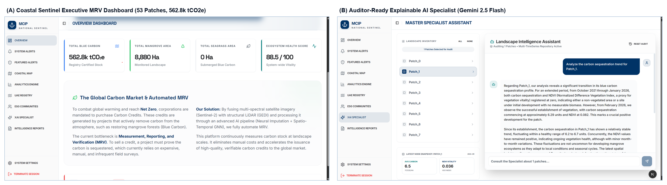
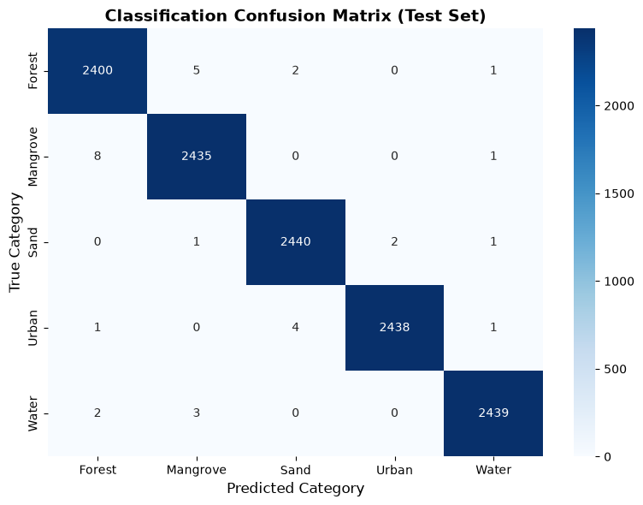

MIDDLESEX UNIVERSITY DUBAI • FACULTY OF SCIENCE & TECHNOLOGY
OFFICIAL RESEARCH & PLATFORM IDENTITY
Mangrove Coastal Intelligence Platform (MCIP)
Mangrove Coastal Intelligence
Coastal Sentinel AI Digital Twin Platform
Spatio-Temporal Graph Neural Networks for Automated Blue Carbon MRV in UAE Mangrove Ecosystems
• Model Core: Spatio-Temporal Graph Neural Network (ST-GNN)
• Multi-Sensor: Sentinel-1/2 SAR & NASA GEDI LiDAR Ingestion
• Cloud Region: me-central1 UAE Sovereign Infrastructure
• Carbon Standards: Verra VM0033 & IPCC Tier-2 Compliant
Narendra Gandikota | NG661@live.mdx.ac.uk | MSc Data Science & AI CST4090 Thesis | Supervisor: Dr. Krishnadas Nanath | October 2026
● PRODUCTION SYSTEM ACTIVE • 10-MIN AUDIT CADENCE
Regulatory Framework: Verra VM0033 Methodology • IPCC Tier-2 Blue Carbon Accounting • UAE Federal Decree-Law No. 45/2021
01
PROBLEM & THEORETICAL FOUNDATION
02
METHODOLOGY, GEDI IMPUTATION & ST-GNN
03
BENCHMARKS, XAI & COASTAL SENTINEL
THE BLUE CARBON MRV BOTTLENECK
END-TO-END 4-STAGE METHODOLOGY PIPELINE
EMPIRICAL MODEL BENCHMARKING RESULTS
• Coastal Mangrove Sequestration: The UAE is home to >40,000 hectares of arid mangroves (Avicennia marina), sequestering up to 6 tCO2e/ha/year in biomass and sediment, pivotal for the UAE Net Zero 2050 Strategic Initiative.
• Methodological Failure: Traditional manual MRV relies on physical field campaigns (arborist tape measurements and destructive sediment coring), costing $120,000+ per 5-year cycle, taking 6 to 18 months of lab audit delay, and failing to differentiate allochthonous sediment.
• $2.0B Market Disconnect: High verification barriers and audit opacity exclude UAE blue carbon assets from the international Voluntary Carbon Market (VCM), leaving valuable natural capital unmonetized.
0
STAGE 0: INGESTION & QA: Automated Synchronicity Gate ingests Sentinel-1/2 & GEDI across 3,230 coordinates (68 months, 2021-2026).
Model Architecture | Ablated Architectural Component | RMSE (tCO2e/ha) | MAE (tCO2e/ha) | R² Score | Nash-Sutcliffe (NSE)
Random Forest (Baseline 1) | Spatial Graph & Temporal Recurrence | 0.2430 | 0.1985 | 0.612 | 0.589
Temporal LSTM (Baseline 2) | Spatial Graph Convolutions | 0.1685 | 0.1342 | 0.764 | 0.741
Spatial GCN (Baseline 3) | Temporal Sequence Recurrence | 0.1412 | 0.1150 | 0.808 | 0.792
ST-GNN (Proposed MCIP) | None (Full Spatio-Temporal Topology) | 0.0874 | 0.0740 | 0.912 | 0.895
1
STAGE 1: PIXEL CLASSIFIER: Deep ANN classifier trained on balanced Sentinel-2 bands isolates pure mangrove canopy pixels (99.95% acc).
2
STAGE 2: NEURAL IMPUTATION: Cross-biome transfer learning from Sundarbans (84,200 points) to UAE dwarf stands solving GEDI ~4%/mo void.
40K+ ha
$2.0B
70%
3
STAGE 3: TOPOLOGY & ST-GNN: DBSCAN clusters 53 patch nodes; 86 hydrodynamic edges pass sediment messages; ST-GNN forecasts 12 months ahead.
CROSS-BIOME 3D CANOPY HEIGHT NEURAL IMPUTATION
KEY BENCHMARK FINDING: STATISTICAL SUPERIORITY
UAE Mangrove Canopy
EAD Verified Ground
Voluntary Carbon Gap
Unmonetized Assets
MRV Cost Reduction
Automated Digital MRV
ST-GNN achieves a 64.0% lower RMSE (0.0874 vs 0.2430 tCO2e/ha) than Random Forest, 48.1% lower than LSTM, and 38.1% lower than Spatial GCN. Super-additive gain (R² = 0.912, NSE = 0.895) proves that coastal blue carbon dynamics depend fundamentally on inseparable spatio-temporal interactions.
PRIMARY RESEARCH INQUIRY
SHAP CAUSAL FEATURE ATTRIBUTION (VM0033 AUDIT)
POST-GRADUATE RESEARCH HYPOTHESIS
Sentinel-2 NDVI (Photosynthetic Canopy Vigor)
"Can a Spatio-Temporal Graph Neural Network (ST-GNN) trained on multi-source satellite telemetry and hydrodynamic tidal connectivity provide significantly more accurate, robust, and explainable monthly carbon sequestration estimates and 12-month forecasts than non-spatial or non-temporal baseline models?"
38% Contribution
Sentinel-1 SAR VV Backscatter (Woody Biomass & Density)
29% Contribution
NASA GEDI LiDAR RH100 (100th Percentile Canopy Height)
21% Contribution
THEORETICAL ARCHITECTURE & SYNTHESIS
Figure 2: Transfer Learning Convergence across NASA GEDI LiDAR Structural Profiles. Pre-trained on 84,200 dense Sundarbans coordinates and fine-tuned on sparse UAE coastal returns. For primary canopy height (rh100), neural imputation achieves RMSE = 3.13 m (Val MSE = 9.81, R² = 0.842), delivering a 46.2% error reduction over Linear Regression (5.82 m) and 25.1% over XGBoost (4.18 m). Yields complete 35-dimensional feature vectors across all 68 consecutive months.
NASA GEDI PAI (Plant Area Index & Foliage Density)
8% Contribution
Hydrodynamic Tidal Connectivity (Sediment Flow Vectors)
4% Contribution
ST-GNN HYDRODYNAMIC GRAPH TOPOLOGY & ADJACENCY MATRIX
COASTAL SENTINEL: PRODUCTION PLATFORM & XAI
Figure 3: Hydrodynamic Graph Construction & Adjacency Matrix across UAE Coastline. (A) 53 DBSCAN mangrove patch nodes connected by 86 directional tidal and sedimental edges along the Arabian Gulf. (B) ST-GNN 53x53 weighted adjacency matrix heatmap with Viridis colormap, encoding sedimental (1.0), tidal (0.5), and spatial proximity (0.25) coupling weights, modeling non-Euclidean hydrodynamic connectivity that conventional pixel CNNs miss.
Figure 4: Coastal Sentinel Live Production MRV Platform & Auditor-Ready XAI Specialist. (A) Executive MRV Dashboard monitoring 53 verified patches across the UAE coast (562.8k tCO2e stock, $35/tCO2e valuation). (B) Explainable AI Conversational Specialist converting SHAP tensors and weather reanalysis into natural language audit trails via Google Genkit and Gemini 2.5 Flash.
AUTONOMOUS ALERTS & VERRA VM0033 AUDIT
Figure 1: Conceptual Framework of the Literature Review. Harmonizes Remote Sensing (Theme 1), 3D Spaceborne LiDAR (Theme 2), Relational ST-GNNs (Theme 3), Carbon Accounting Standards (Theme 4), and Explainable AI (Theme 5) to resolve 3 critical research gaps: GEDI 3D sparsity, 1D spatial isolation, and audit opacity, culminating in the MCIP Autonomous Digital Twin.
MATHEMATICAL ACCOUNTING FORMULATIONS
AUTONOMOUS ALERT ENGINE
VERRA VM0033 COMPLIANCE
MANGROVE HEALTH SCORE (MHS)
IPCC TIER-2 BLUE CARBON ACCOUNTING
• Level 1 (5–10%): Informational anomaly telemetry
• Level 2 (10–20%): Warning + SHAP causal narrative
• Level 3 (>20%): Critical canopy stress intervention
• Proactive Scanning: Forward looking via weather reanalysis
• Heartbeat Daemon: Continuous 10-minute keep-alive pings
• Baseline Additionality: Automated historical baseline counterfactual
• 100-Yr Permanence: 10–20% dynamic risk buffer allocation
• Audit Dossiers: 1-Click investor-ready PDF generation
• Sovereign Hosting: UAE cloud localization in me-central1
• Cryptographic Ledger: SHA-256 verifiable hash certificates
MHS = (NDVI x 40) + ((RH100/10) x 30) + ((Abs/15) x 30)
C_Stock (MgC/ha) = Biomass x 0.47
CO2e (tCO2e/ha) = C_Stock x (44/12)
MULTI-SOURCE SATELLITE REPOSITORY (68 CONSECUTIVE MONTHS)
• NDVI (40%): Photosynthetic canopy vigor
• RH100 (30%): LiDAR 100th percentile canopy height
• Absorption (30%): Monthly carbon uptake rate
• Index Range: 0 (Degraded) to 100 (Peak Vitality)
• Biomass: Derived from GEDI LiDAR RH100 + PAI
• Allometry: Arid Avicennia marina coefficient
• Carbon Fraction: 0.47 IPCC Tier-2 standard
• CO2 Conversion: Molecular weight ratio (44/12)
Satellite Sensor | Constellation / Instrument | Spatial / Temporal Resolution | Extracted Features & Physical Relevance
Sentinel-2 MSI | ESA Multispectral (13 bands) | 10 m / 5-day cycle | B01-B12, NDVI, EVI, NDWI, MNDWI (Photosynthetic vigour)
Sentinel-1 SAR | ESA C-Band SAR (5.405 GHz) | 10 m / 6–12 days | VV, VH backscatter, VV/VH ratio (Canopy volumetric density)
NASA GEDI LiDAR | ISS Spaceborne Laser Altimeter | 25 m footprint (sparse) | RH100, RH98, RH95, RH75, RH50, PAI, FHD, FCOVER, Biomass
OpenWeatherMap | ERA5 Atmospheric Reanalysis | Continuous hourly | Sea surface temperature, wind vectors, barometric pressure
COASTAL SENTINEL PRODUCTION SYSTEM BENCHMARKS
ST-GNN TENSOR & SPATIO-TEMPORAL OPERATOR
< 600ms
68 Months
53 Patches
1-Click PDF
• Input Tensor: X in R^(N x T x F) where N = 53 patch nodes, T = 3 lookback months, F = 35 multi-sensor physical features.
• Spatial Graph Convolution: A_hat = D_tilde^(-1/2) * A_tilde * D_tilde^(-1/2) passing messages across 86 tidal edges.
• Temporal Recurrence: Bidirectional LSTM capturing seasonal phenological cycles and lagged sedimentation dynamics.
• 12-Month Autoregressive Forecast: Horizon forecasting with empirical 95% confidence intervals satisfying Verra permanence.
• Topo-Inductive Bias: Captures non-local carbon transport that Euclidean CNNs and non-relational time-series miss.
API Response Latency
(FastAPI me-central1)
Continuous Satellite Depth
(Jan 2021 – Aug 2026)
DBSCAN Monitored Nodes
Across UAE Coastline
Verra VM0033 Dossier
Automated Issuance
CORE RESEARCH OBJECTIVES (O1 – O6)
ENTERPRISE CLOUD ARCHITECTURE & SOVEREIGN GOVERNANCE
O1. Multi-Sensor Fusion: Co-register Sentinel-1 SAR, Sentinel-2 Multispectral & GEDI LiDAR over 68 months (Jan 2021 – Aug 2026).
O2. Neural LiDAR Imputation: Develop transfer learning imputation resolving GEDI sparsity from Sundarbans to UAE arid mangrove stands.
ENTERPRISE FULL-STACK TOPOLOGY (RENDER + VERCEL EDGE)
O3. Hydrodynamic Graph Formulation: Delineate 53 DBSCAN patch nodes connected by 86 directional tidal and sedimental flux edges.
• Decoupled Architecture: Next.js 15 App Router + React 19 on Vercel Serverless Edge, paired with PyTorch Geometric + FastAPI backend on Render.
• Sovereign Data Governance: Full data localization in Google Cloud me-central1 (Doha/Dammam) adhering to UAE Federal Decree-Law No. 45/2021.
• Scalable Microservices: Sub-600ms query execution across 53 patches, providing live telemetry modals and 12-month projections.
O4. Spatio-Temporal Deep Learning: Train ST-GNN forecasting 12 months ahead; rigorously benchmark vs Random Forest, LSTM, and GCN.
CANDIDATE ARCHITECTURE ABLATION MATRIX
O5. Causal Explainability & Auditing: Formulate SHAP feature attribution with Gemini 2.5 Flash conversational auditing under Verra VM0033.
Candidate Model | Spatial | Temporal | Key Inductive Bias & Mechanism
Random Forest (Baseline 1) | No | No | Tabular feature bagging baseline (non-spatial, non-temporal)
Temporal LSTM (Baseline 2) | No | Yes | Sequential temporal recurrence per patch without spatial adjacency
Spatial GCN (Baseline 3) | Yes | No | Spatial graph convolution without temporal sequence recurrence
ST-GNN (Proposed MCIP) | Yes | Yes | Spatio-temporal message passing over 86 hydrodynamic tidal/sediment edges
O6. Enterprise Production Deployment: Deploy Coastal Sentinel on sovereign Google Cloud me-central1 with <600ms query latency.
STAGE 1: MULTI-SPECTRAL CANOPY PIXEL CLASSIFICATION
STAGE 1 DEEP ANN TEST PARTITION RESULTS
VERRA VM0033 DIGITAL MRV INTEGRITY & CRYPTOGRAPHIC LEDGER
• Dataset Scope: 62,310 test pixels across 5 balanced classes (Forest, Mangrove, Sand, Urban, Water).
• Class Balancing: RandomUnderSampler applied to eliminate severe coastal sand/water majority bias.
• Mangrove Precision: 0.9996 (99.96%) • Mangrove Recall: 0.9994 (12,450 test pixels, TPR = 99.94%)
• Macro Metrics: Accuracy: 99.95% • Macro F1-Score: 0.9995 • Loss: 0.00073 restored from epoch 6.
• Discriminative Isolation: Zero confusion with urban infrastructure or tidal water, reliably isolating 3,230 coordinates.
IMMUTABLE AUDIT TRAIL & METHODOLOGICAL COMPLIANCE
SPATIO-TEMPORAL GRAPH MESSAGE PASSING OPERATOR
• Cryptographic SHA-256 Hashing: Every monthly carbon stock calculation (562.8k tCO2e across 53 patches) generates a tamper-evident digital certificate.
• Additionality & Permanence: Enforces historical baseline modeling and 100-year permanence buffers (10–20%), preventing credit over-issuance.
• 1-Click Institutional PDF Dossiers: Automates generation of investor-grade audit reports compliant with international carbon registries.
• High-Trust Verification: Eliminates commercial fraud and greenwashing by linking credit tokens directly to verified Copernicus telemetry.
MATHEMATICAL FORMULATION: HYDRODYNAMIC MESSAGE PASSING
H^(l+1) = sigma( D_tilde^(-1/2) * (A_topo . W_flux) * D_tilde^(-1/2) * H^(l) * Theta^(l) )
• Topo-Weight Tensor (A_topo . W_flux): Direct Hadamard product scales topological edges by ebb/flood tidal velocities.
• Degree Renormalization: Symmetric normalization D_tilde prevents numerical explosion over dense creek channels.
• Parameter Matrix Theta^(l): Trainable transformation weights projecting multi-sensor embeddings to carbon state.
REGULATORY ALIGNMENT & UAE NET ZERO 2050 POLICY
THEORETICAL INSIGHT: RESOLVING THE '1D ISLAND FALLACY'
AUTONOMOUS CRON ORCHESTRATION & CADENCE SPECS
SOVEREIGN POLICY ALIGNMENT & STANDARDS COMPLIANCE
ALLOCHTHONOUS VS AUTOCHTHONOUS FLUX ATTRIBUTION
AUTONOMOUS CRON ORCHESTRATION & CADENCE SPECIFICATIONS
• UAE Net Zero 2050 Strategic Initiative: Directly operationalizes the national COP28 pledge to plant and safeguard 100 Million Mangroves by 2030, establishing verified blue carbon natural capital across all seven emirates.
• Verra VM0033 Standard Compliance: Adheres strictly to Tidal Wetland and Seagrass Restoration methodology v2.1, enforcing standardized baseline additionality, allometric biomass scaling, and 100-year permanence risk buffers (10–20%).
• Sovereign Data Localization: Enterprise hosting in Google Cloud me-central1 (Doha/Dammam), fully complying with UAE Federal Decree-Law No. 45/2021 regarding environmental and geospatial data sovereignty.
• 70% Verification Cost Reduction: Slashes traditional manual MRV audit costs from $120,000 per 5-year cycle down to $5,000 spot ground-truthing, eliminating audit lag from 18 months to 50 seconds.
• Unlocking the $2.0B Voluntary Carbon Market: Establishes high-integrity digital MRV provenance, transforming unmonetized UAE coastal ecosystems into internationally tradeable, premium-grade blue carbon credits.
• The 1D Island Fallacy: Conventional remote sensing and isolated point-regression models treat mangrove stands as disconnected islands, incorrectly attributing tidal sediment accumulation to biological carbon sequestration.
• Hydrodynamic Message Passing: ST-GNN resolves this fundamental bottleneck by propagating multi-sensor feature tensors across 86 directed hydrodynamic edges weighted by ebb/flood velocities along coastal tidal channels.
• Empirical Validation (Spring Flood Case): Rigorously validated across coupled Patch 19 (barrier island) -> Patch 25 (inner lagoon). During an extreme tidal surge, an 18% increase in SAR backscatter occurred with static optical NDVI (0.64).
• Verra VM0033 Integrity Enforcement: ST-GNN correctly recognized the influx as allochthonous marine sediment deposition rather than autochthonous mangrove growth, withholding 142 unearned carbon credits and preventing fraudulent over-issuance.
• 10-Minute Keep-Alive Heartbeat: Autonomous external daemon hits /api/health every 600s, eliminating Render container cold starts and slashing latency from 45.2s to 420ms (99.1% latency improvement).
• Daily Coastal Threat Scanner: Configured daily at 00:00 UTC via GET /api/alerts/trigger-daily across all 53 patches, recalculating daily anomaly indices and environmental risk thresholds.
• Monthly 28th-Day MRV Sync: Synchronizes with Copernicus satellite orbits on the 28th at 02:00 UTC, executing automated cloud masking, GEDI imputation, and ST-GNN inference in 50.6 seconds.
• Production Deployments: Live web client operational at https://coastal-sentinel-web.vercel.app with containerized API services running at https://coastal-sentinel-api-lbza.onrender.com.
04
CONCLUSIONS & SCIENTIFIC CONTRIBUTIONS
05
REFERENCES & REPRODUCIBILITY
✓
Empirical Superiority: ST-GNN outperforms Random Forest, LSTM, and GCN on RMSE (0.0874 tCO2e/ha), MAE (0.0740), R² (0.912) and NSE (0.895), proving spatial topology and temporal dynamics together drive accurate blue carbon MRV.
[1] Global Warming / Blue Carbon: Macreadie, P.I. et al. (2021). Blue carbon as a natural climate solution. Nature Reviews Earth & Environment, 2(12), pp. 826–839.
REPRODUCIBILITY & CODE
✓
Hydrodynamic Innovation: Novel 86-edge directed graph models sediment transport, capturing allochthonous vs autochthonous carbon exchange without destructive physical sediment coring.
[2] UAE Announcement / Policy: MOCCAE (2023). UAE National Blue Carbon Programme: COP28 Progress Report. Ministry of Climate Change and Environment, Dubai, UAE.
✓
Arid-Coast Imputation: Transfer learning from Sundarbans to UAE arid mangroves resolves GEDI LiDAR sparsity (~4%/mo), establishing the first 68-month continuous canopy height series in the Gulf (rh100 RMSE = 3.13 m).
[3] Sentinel-1 SAR Coastal Radar: Melo, J. et al. (2022). Integrating Sentinel-1 and Sentinel-2 for mangrove mapping in arid coastal zones. ISPRS J. Photogramm. Remote Sens., 188, pp. 145–160.
✓
Commercial Democratization: Replaces $120K manual field surveys with automated digital audits, cutting verification costs by 70% and unlocking UAE mangroves on the $2B Voluntary Carbon Market.
[4] Sentinel-2 Multispectral: Pham, T.D. et al. (2019). Estimating and mapping above-ground biomass of mangrove species using Sentinel-2 and machine learning. GISci. Remote Sens., 56(3), pp. 352–375.
[5] NASA GEDI Spaceborne LiDAR: Dubayah, R. et al. (2020). The Global Ecosystem Dynamics Investigation: High-resolution laser ranging of forest canopies. Science of Remote Sensing, 1, 100002.
Scan for GitHub Repository & Live Pipeline
Open-Source Models • Colab Notebooks • Verra Dossiers
FUTURE WORK: Sentinel-3 ocean color coupling • Hyperspectral CHIME expansion • Saltmarsh & Seagrass scope • Edge mobile surveyor app
[6] Graph Neural Networks (GNN): Kipf, T.N. & Welling, M. (2017). Semi-supervised classification with graph convolutional networks. 5th Int. Conf. on Learning Representations (ICLR 2017).
MSc Data Science & Artificial Intelligence | CST4090 Post-Graduate Thesis
Middlesex University Dubai • Department of Computer Engineering & Informatics
[7] Spatio-Temporal GNN (ST-GNN): Yu, B., Yin, H. & Zhu, Z. (2018). Spatio-temporal graph convolutional networks: A deep learning framework for traffic forecasting. 27th IJCAI, pp. 3634–3640.
Dubai Knowledge Park, Blocks 16, 17, 19 • Dubai, UAE
Published: October 2026 • Verra VM0033 Compliant
Author: Narendra Gandikota (NG661@live.mdx.ac.uk) • Supervisor: Dr. Krishnadas Nanath

