Slide 1
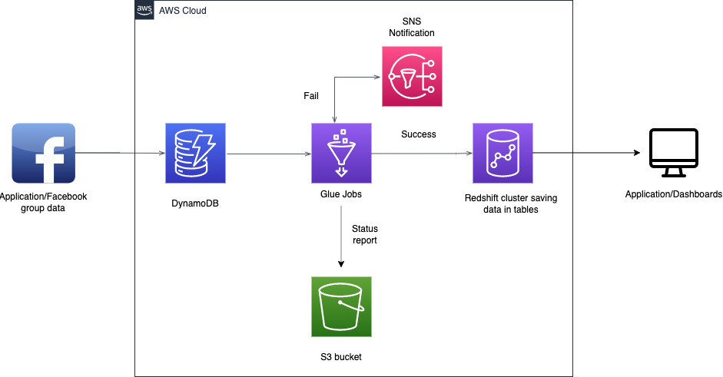
Case Study – AWS Redshift Data Warehouse(Convosight)
Client wanted to have a robust, more secure and easily accessible and developer friendly system as it was growing in business. So, it wanted to bring all its existing external 3rd Party Services like Panoply to be migrated to cloud platforms like AWS(Amazon Web Services).
Challenges
Supporting complex data types like list-of-strings (Creation of sub tables for these lists)
Supporting schema changes (Addition of new columns at DynamoDB side)
Migration of heavy tables(few tables are 30GB-40GB)
Solution
ETL solution is implemented where data is ingested from DynamoDB, transformed to suitable form(casting data types, breaking the complex data types) so that it can be written to Redshift.
This migration is a two-step process. The first step includes total migration of data up to date. The second step involves incremental data migration which runs multiple times a day.
Benefits
20%
Reduction in overheads and cost
30%
Reduction in Overall Processing time
Notes:
30% Reduction in Overall Processing time as compared to Panoply
20% Reduction in overheads and cost due to no fixed licensing cost as compared to Panoply Solution
Data remains in a same AWS region and hence more secure as compared to Panoply Solution

