Slide 1
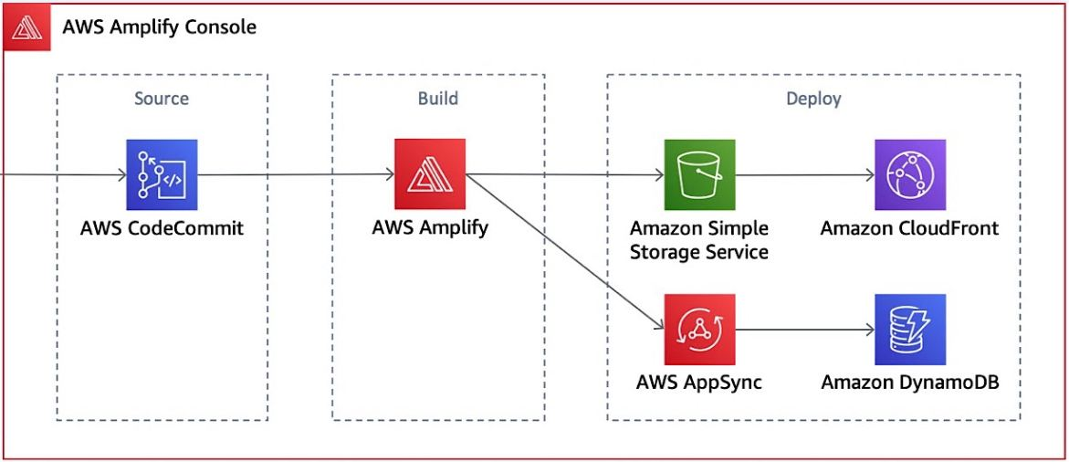

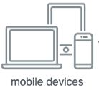
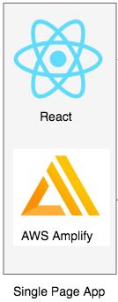




Fig. Covid chatbot architecture diagram

Slide 2
 | Amazon Lex | IBM Watson | Microsoft Bot
Ease of Use | Yes | Yes | Yes
Integrations | SMS, Slack, FB Messenger, Kik, Twilio | Voice Agent, Slack, FB Messenger, Wordpress, Custom APIs | FB Messenger, Slack, Skype, Kik, Telegram, Twilio
Web and Mobile Integrations | Basic chat widget UI for testing on website | Basic chat UI available for websites | Open source chat widget available
Languages | Spanish, Canadian French, British English, Australian English, German, French, US English | English, Spanish, Japanese, Chinese, Italian etc. | English, French, German, Spanish etc.
Pricing | $0.004/ voice request $0.00075/ text request | Free | $0.0005/message request
Fig. Comparison of major chatbot building frameworks

Slide 3
 | Google Vision | Microsoft Computer Vision | IBM Watson | AWS Rekognition
Face Detection | Yes | Yes | Yes | Yes
Face Recognition | No | Yes | No | Yes
Face Landmarks | Yes | Yes | No | Yes
Feature Detection | Yes | Yes | No | Yes
Similar Faces | No | Yes | No | Yes
Emotion | Yes | Yes | No | Yes
Label Detection | Yes | Yes | Yes | Yes
Landmarks | Yes | Yes | Yes | No
Celebrities | No | Yes | No | Yes
Logo Detection | Yes | No | No | Yes
NSFW | Yes | Yes | Yes | Yes
Image Analysis | Yes | Yes | Yes | Yes
Video Analysis | Yes | Yes | No | No
Custom Model Creation | No | Yes | Yes | Yes
Fig. Comparison among top computer vision APIs by public cloud providers.

